Slide 1
INTERNSHIP REPORT
AI WEB DEVELOPMENT
InAmigos Foundation (IAF)
Abdul Muspik
IILM University, Greater Noida
09 June 2026 – 23 June 2026

Slide 2
Internship at a Glance
Verified from the offer letter and completion certificate
• Organization: InAmigos Foundation (IAF)
• Role: AI Web Development Intern
• Duration: 09 June 2026 – 23 June 2026
• Work arrangement: generally remote
• Completion certificate issued: 07 July 2026
AI Web Development Internship | Abdul Muspik | 02

Slide 3
Responsibilities & Completion Status
AI Web Development / website work
COMPLETED
Website research / improvement analysis
COMPLETED
Digital / social presence research
COMPLETED
Donation / fundraising activity
NOT COMPLETED
AI Web Development Internship | Abdul Muspik | 03

Slide 4
What the Internship Focused On
• Practical web development and interface composition
• Website improvement and UX-oriented analysis
• Digital presence research across social platforms
• Structured NGO website content: impact, campaigns, donation, volunteer and testimonials
• Documentation of work through screenshots and supporting internship records
AI Web Development Internship | Abdul Muspik | 04

Slide 5
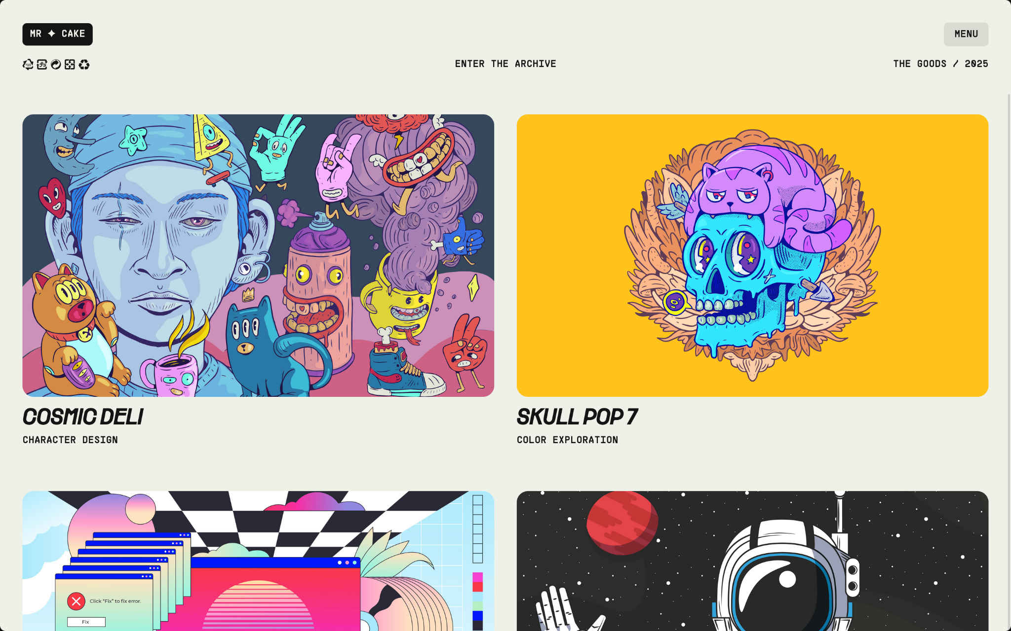
Project: HopeForward Website
Supplied project/prototype evidence
• Clear NGO-style hero and mission
• Impact statistics and progress
• Campaign cards with funding status
• Donation and volunteer conversion paths
• Testimonials and organization information
AI Web Development Internship | Abdul Muspik | 05

Slide 6
Website Information Architecture
01
Hero
Mission + primary CTA
02
Impact
Statistics + program progress
03
Campaigns
Initiatives + funding
04
Donation
Amount + donor form
05
Volunteer
Application + availability
06
Testimonials
Stories + social proof
07
Footer
Programs + support + contact
AI Web Development Internship | Abdul Muspik | 06

Slide 7
UX Findings & Improvement Direction
Based on the supplied InAmigos Foundation website analysis
• Homepage: stronger Donate Now / Volunteer CTAs and earlier impact figures
• Impact: animated counters, icons and growth context
• Causes: differentiated visuals, testimonials and success stories
• Volunteers & Events: richer profiles, registration, countdowns and galleries
• Contact: map, FAQs, WhatsApp option and response expectations
• Overall: sticky navigation, accessibility, mobile optimization, performance and donation visibility
AI Web Development Internship | Abdul Muspik | 07

Slide 8


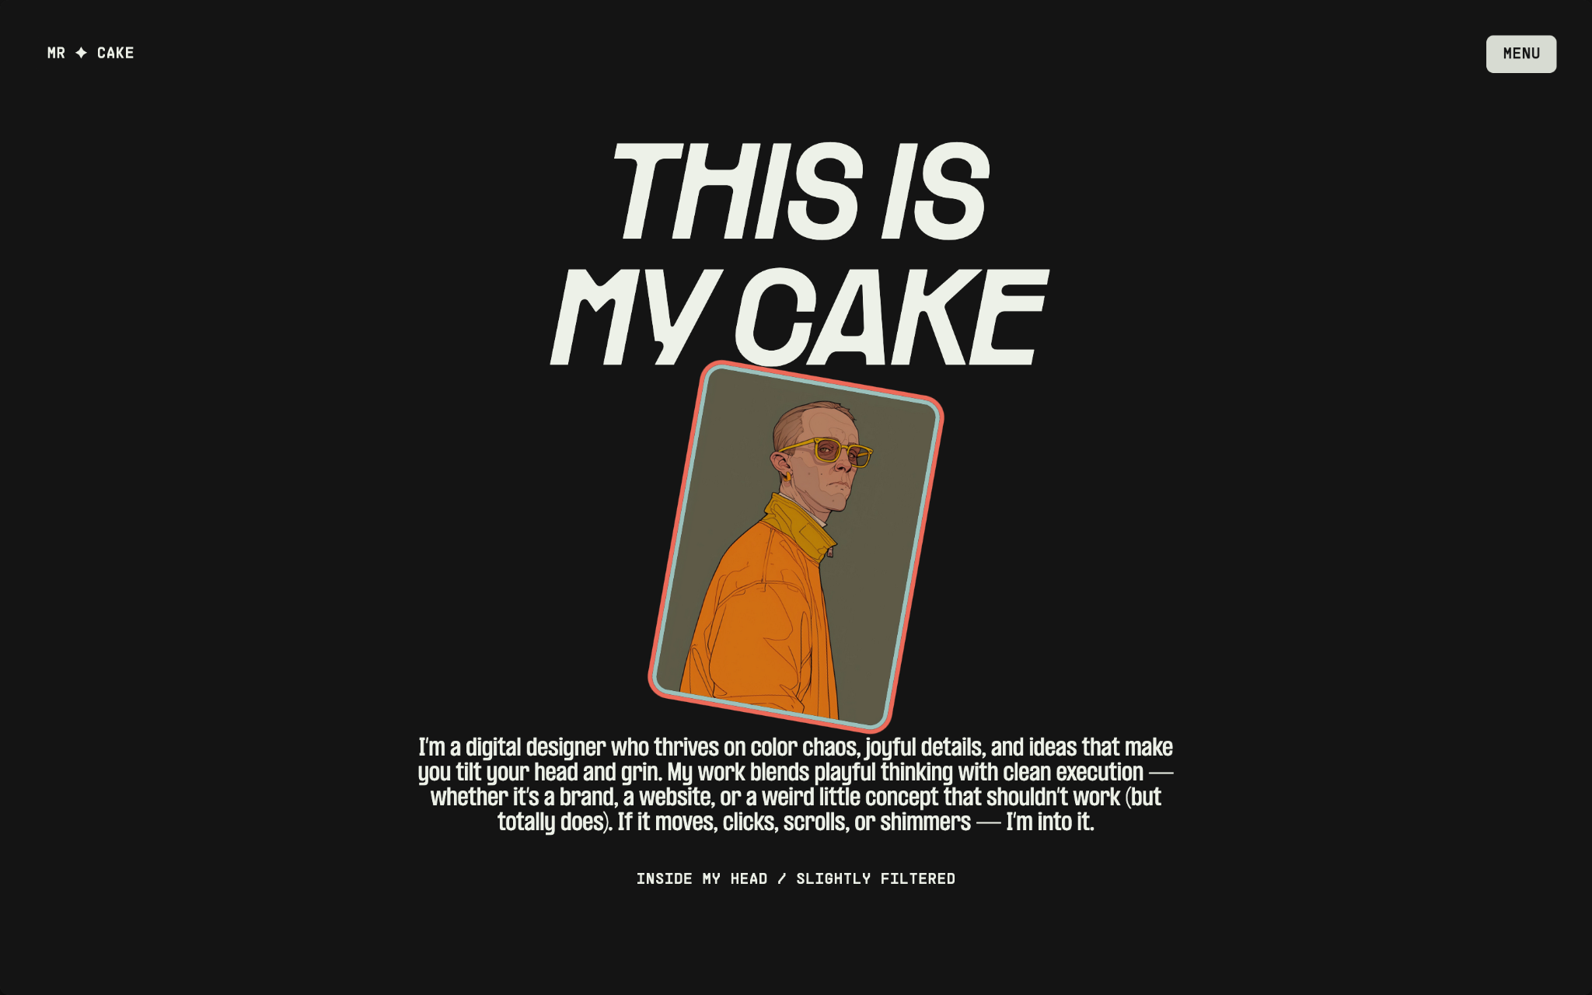
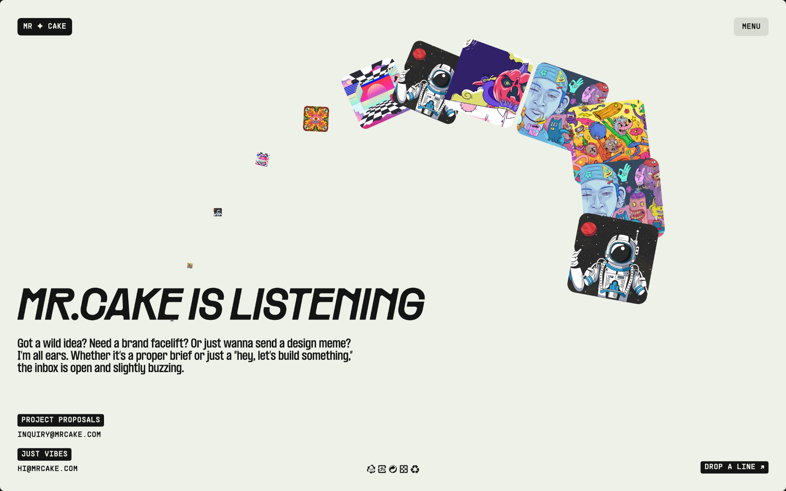
Design Evidence
Landing / visual identity
Visual DNA
About / profile
Contact
AI Web Development Internship | Abdul Muspik | 08

Slide 9
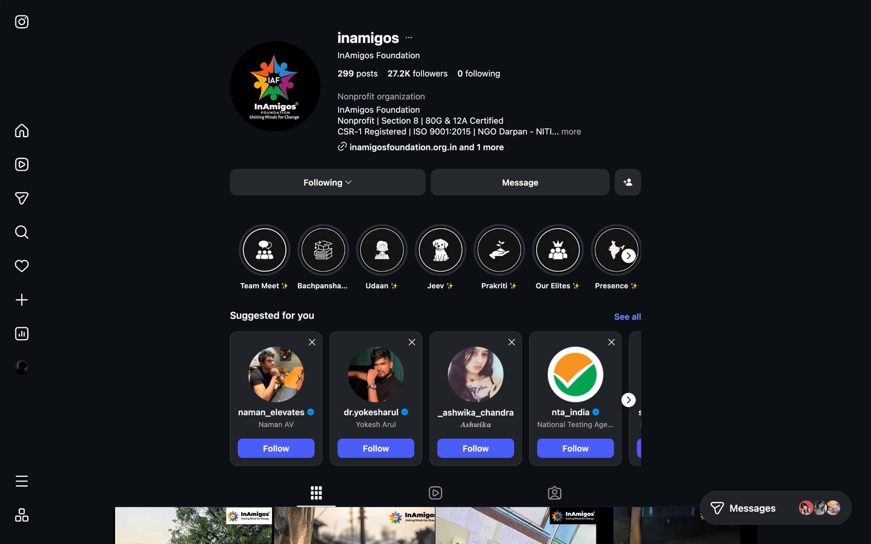
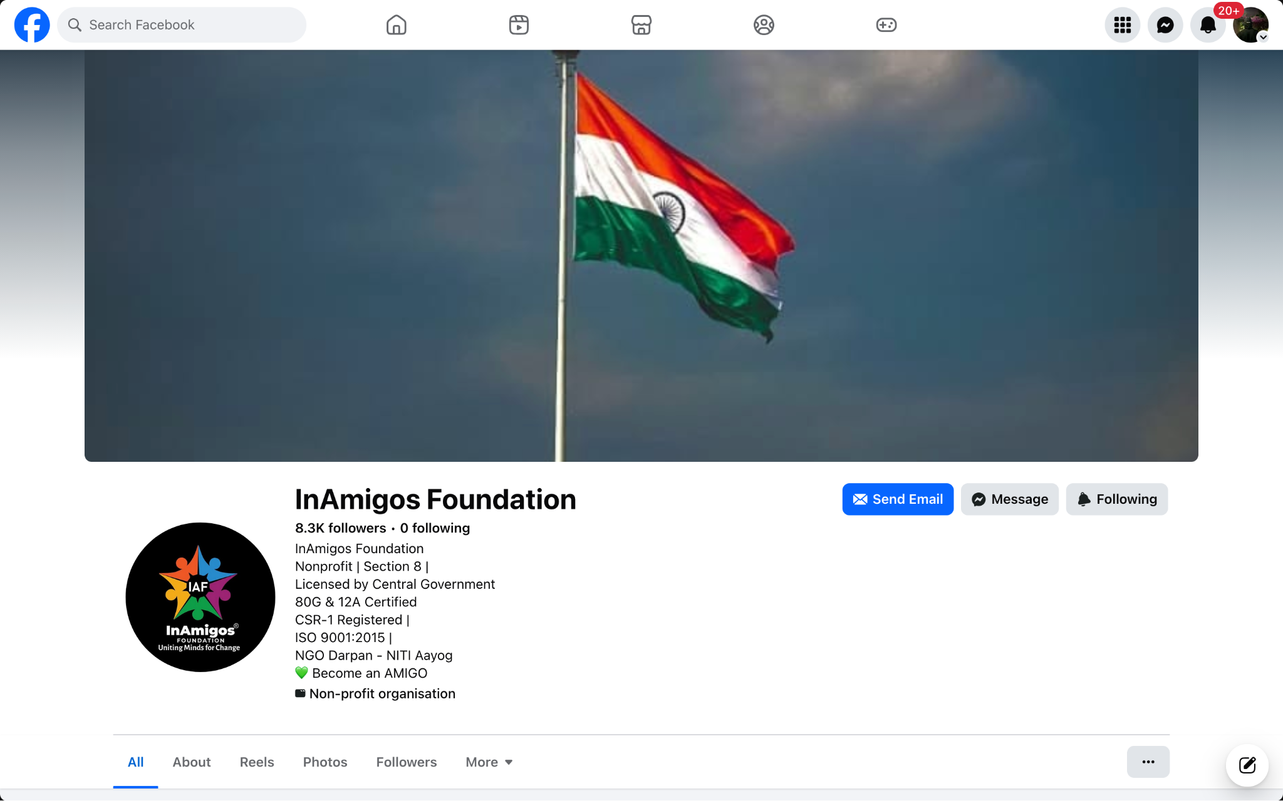
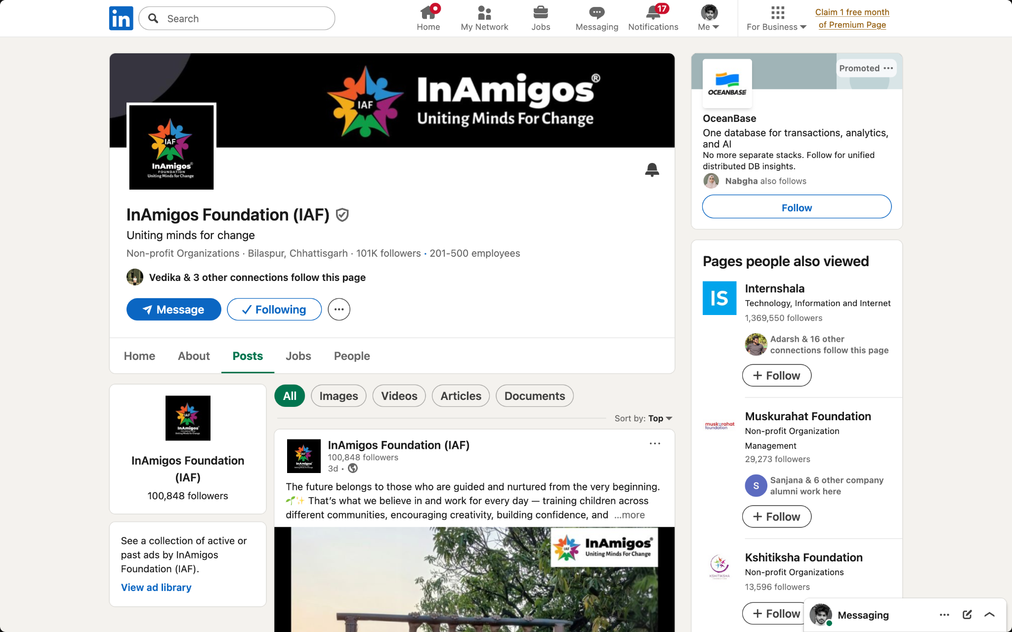
Digital Presence Evidence
Instagram
Facebook
LinkedIn
AI Web Development Internship | Abdul Muspik | 09

Slide 10
Key Learning Outcomes
• Translating organizational needs into page structure and UI
• Designing conversion paths around donation and volunteering
• Using visual hierarchy to make information scannable
• Building structured campaign, form, testimonial and statistics components
• Evaluating UX through accessibility, mobile, trust and performance lenses
• Documenting development work professionally
AI Web Development Internship | Abdul Muspik | 10

Slide 11
Challenges, Limitations & Accuracy
• Internship duration was short, so work required prioritization.
• Donation/fundraising activity was not completed and is not presented as completed.
• The report does not claim that the HopeForward prototype was deployed to InAmigos' production environment.
• Social-media numbers shown in screenshots are point-in-time evidence.
• All major claims in this presentation are grounded in the supplied internship documents and project evidence.
AI Web Development Internship | Abdul Muspik | 11

Slide 12
THANK YOU
AI Web Development Internship
InAmigos Foundation | Abdul Muspik
IILM University, Greater Noida

