Slide 1

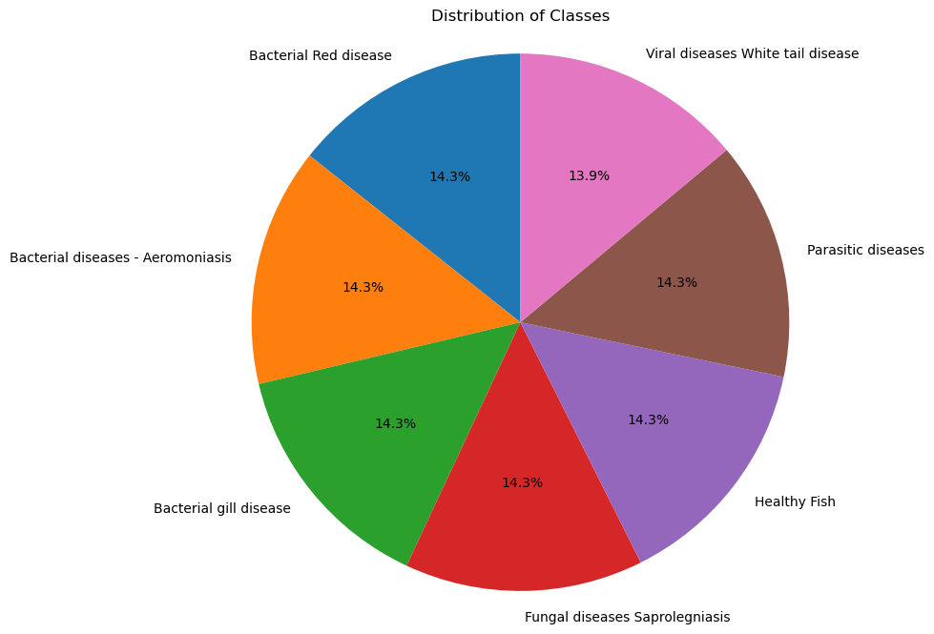
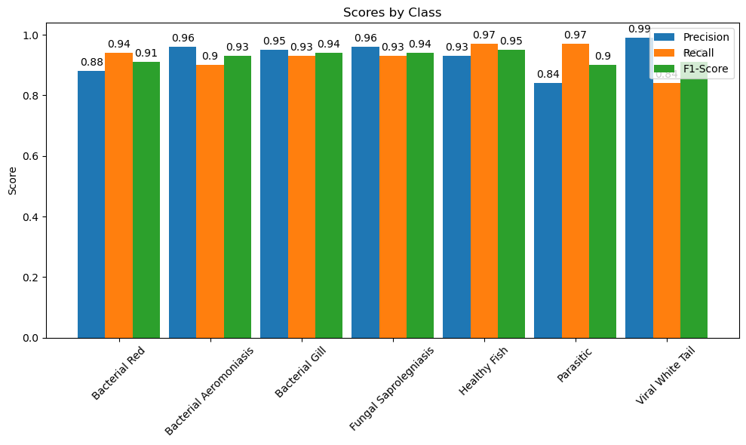
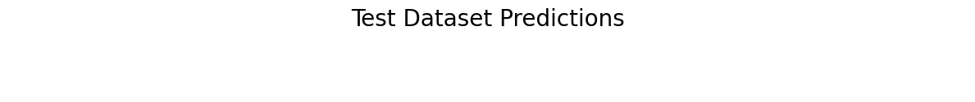
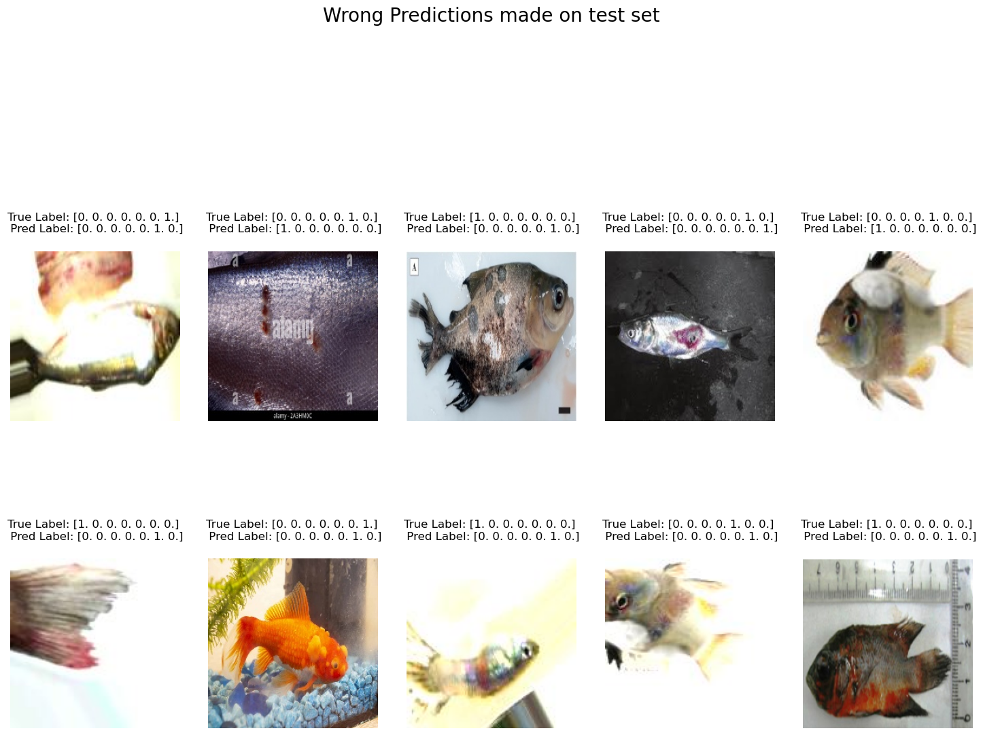
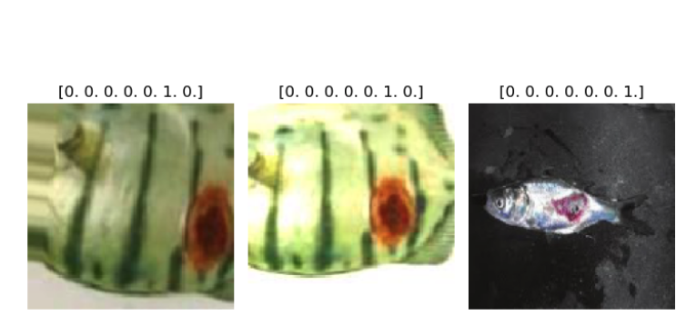
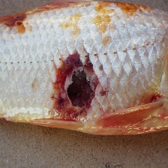
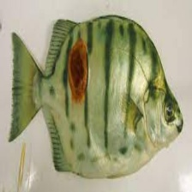
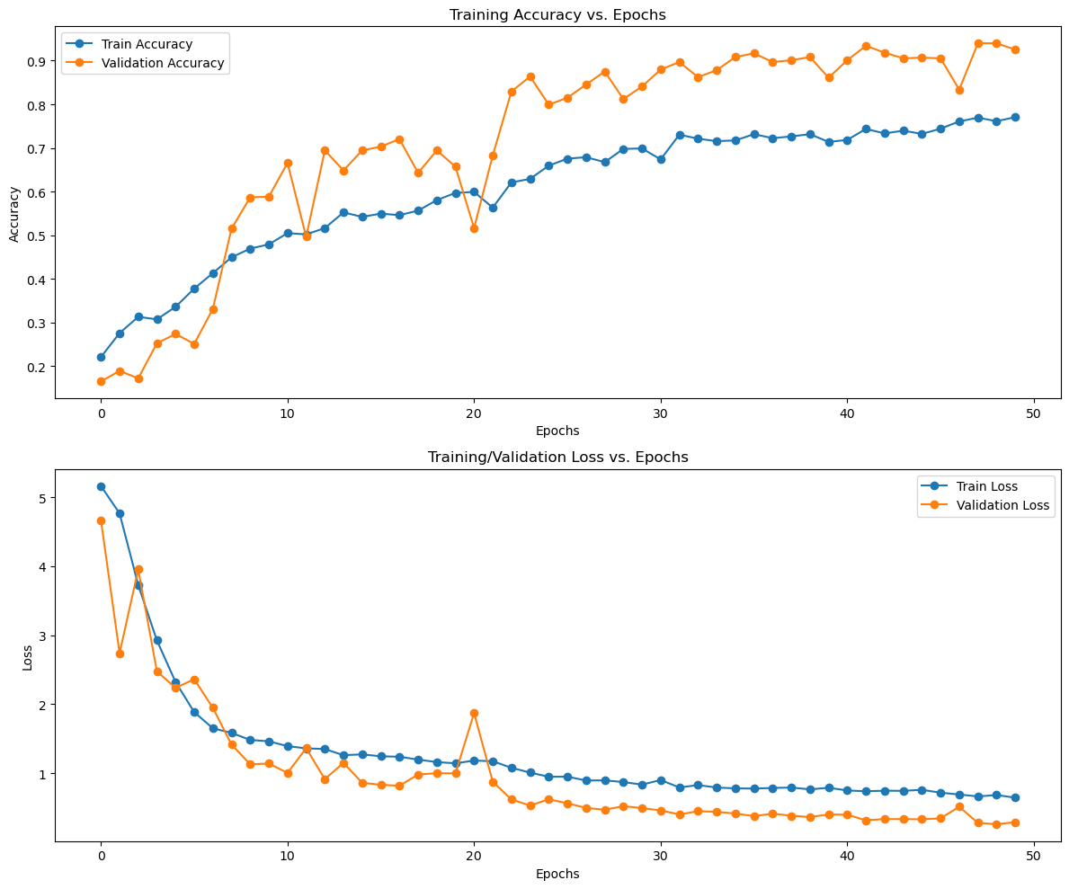
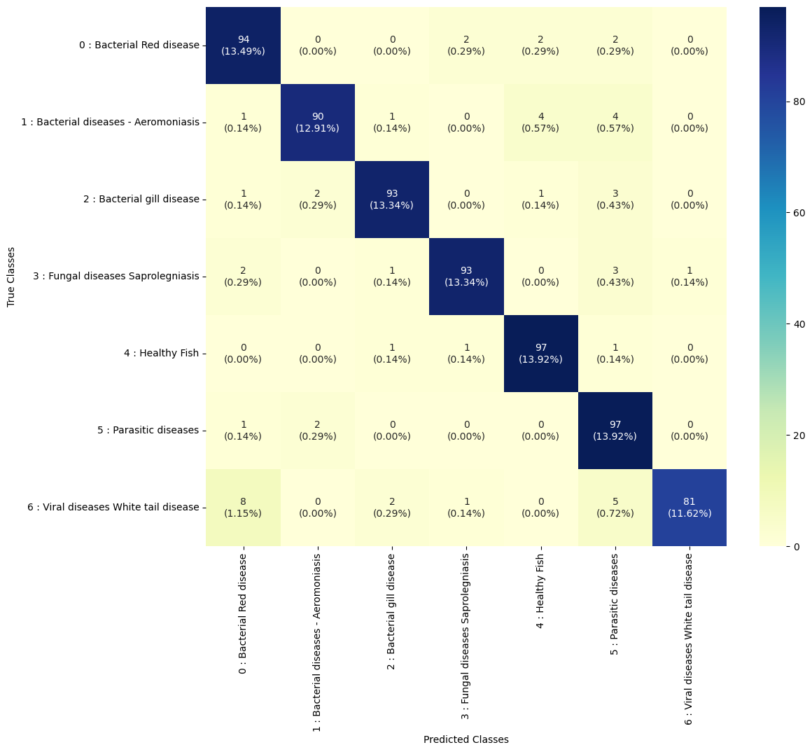
Enhancing Disease Detection in South Asian Freshwater Fish Aquaculture Through Convolutional Neural Networks
Hayin Tamut [htamut@atu.edu], Musfikur Rahaman [mrahaman@atu.edu], Dr. Robin Ghosh [rghosh@atu.edu]
Department of Engineering and Computing Sciences, Arkansas Tech University, Russellville, Arkansas 72801
Abstract
Methodology
Result
Aquaculture expansion necessitates innovative disease detection methods for sustainable production. This study investigates the efficacy of Convolutional Neural Networks (CNNs) in classifying diseases affecting South Asian freshwater fish species. The dataset comprises 1747 images representing 7 class, healthy specimens and various diseases: bacterial, fungal, parasitic, and viral. The CNN architecture includes convolutional layers for feature extraction, max-pooling layers for down sampling, dense layers for classification, and dropout layers for regularization. Training employs categorical cross-entropy loss and the Adam optimizer over 30 epochs, monitoring both training and validation performance. Results indicate promising accuracy levels, with the model achieving 92.14% and test loss 0.2918.Training history analysis reveals an initial accuracy increase, followed by a plateau and eventual overfitting. Future improvements may involve regularization techniques implementation or additional data acquisition through data augmentation for better generalization performance. CNNs offer automated disease detection, alleviating the burden on aquatic animal health experts and facilitating timely interventions to mitigate infection spread and economic losses. Integration of deep learning enables real-time surveillance and adaptive management strategies, enhancing disease monitoring capabilities. This research aligns with broader efforts to improve global food security and underscores the transformative potential of AI-driven solutions in aquaculture disease management.
Data Collection: Gather a diverse dataset comprising images of healthy freshwater fish and various disease manifestations from Kaggle.
Model Development: Design and implement a Convolutional Neural Network (CNN) architecture using TensorFlow and Keras.
Provide details on the layers of the model, including types (convolutional, pooling, fully connected), activation functions, and regularization techniques.
Training and Evaluation: Train the CNN model on the dataset using categorical cross-entropy loss and Adam optimizer, while monitoring performance on validation data.
Analysis: Assess the model's performance through metrics like accuracy, precision, recall, and F1-score, along with visualization of training history.
Comparative Study: Compare the CNN-based approach with traditional disease detection methods to highlight its advantages in accuracy and efficiency.
Fig. 4 Distribution of class
Analysis
Fig. 5 Scores by class
Discussion
The model's strong performance metrics validate its effectiveness in accurately classifying freshwater fish diseases, underscoring its suitability for real-world applications.
The developed convolutional neural network (CNN) achieved an impressive accuracy of approximately 92.5% on a test dataset containing images of south Asia freshwater fish diseases, showcasing its effectiveness in disease classification tasks. The model demonstrated high precision, recall, and F1-score across different disease categories, indicating robust performance in identifying various types of fish diseases.
Research Purpose
Result
Develop a CNN model tailored for accurate disease classification.
Evaluate model performance using diverse datasets and metrics.
Enhance disease monitoring and management in aquaculture.
Contribute to sustainability and productivity of South Asian aquaculture.
Investigate CNN effectiveness in detecting diseases in South Asian freshwater fish.
Conclusion
In conclusion, the implemented convolutional neural network (CNN) showed strong performance in classifying freshwater fish diseases, achieving an accuracy of approximately 92.5%. The model exhibited high precision, recall, and F1-score across different disease categories, indicating its effectiveness in disease identification. However, further refinement may be beneficial to address areas of incorrect predictions and enhance overall performance.
Acknowledgement
Department of Engineering and Computing Sciences, Arkansas Tech University, Russellville, Arkansas
FIG. 2. Training / Validation loss vs Epochs
Fig.3 confusion matrix (predicted class)

