Slide 1

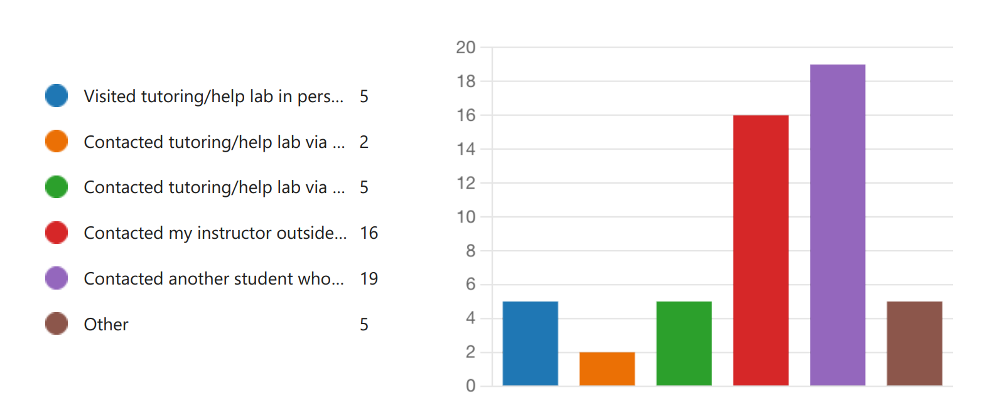
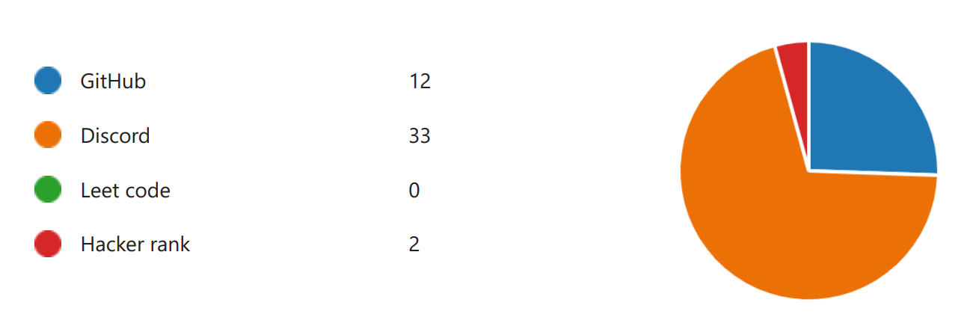
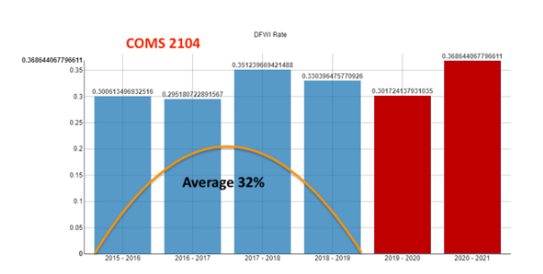
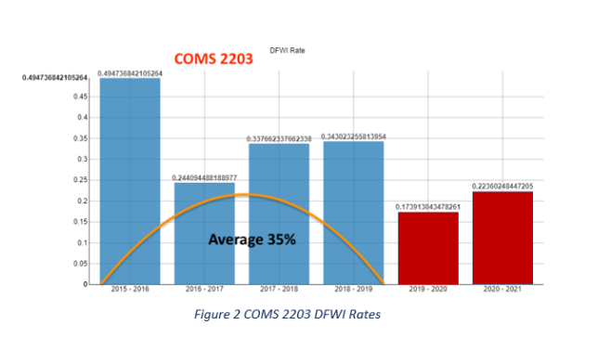
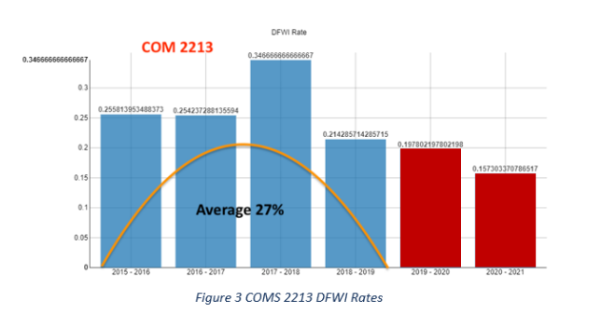
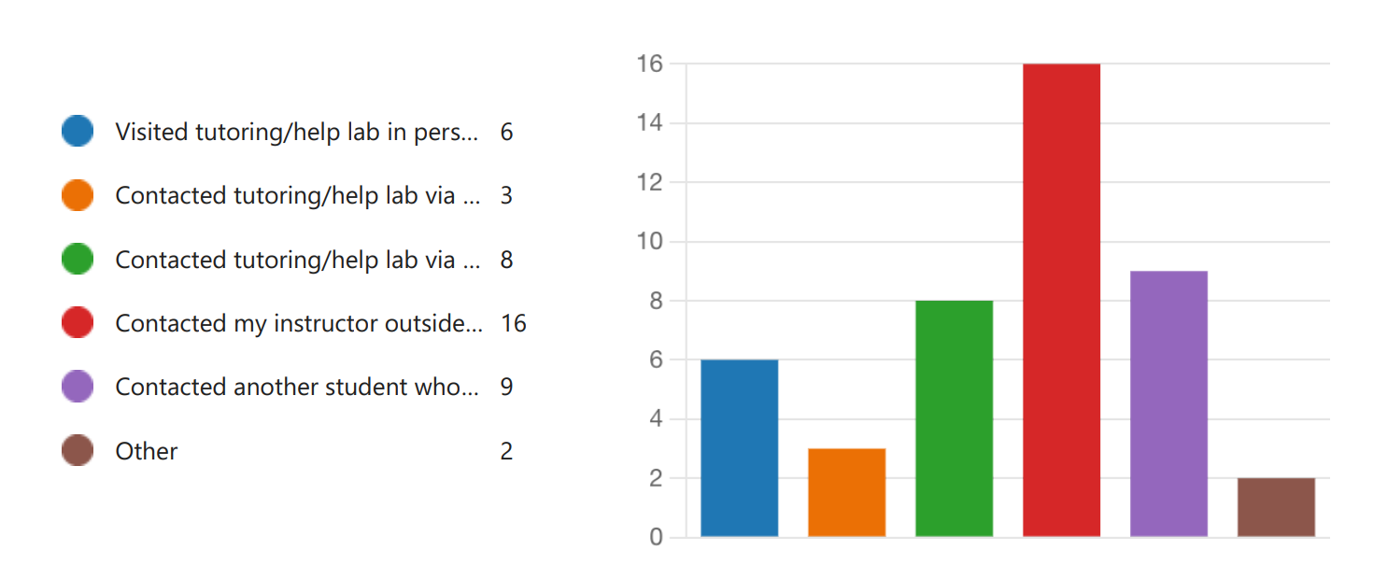
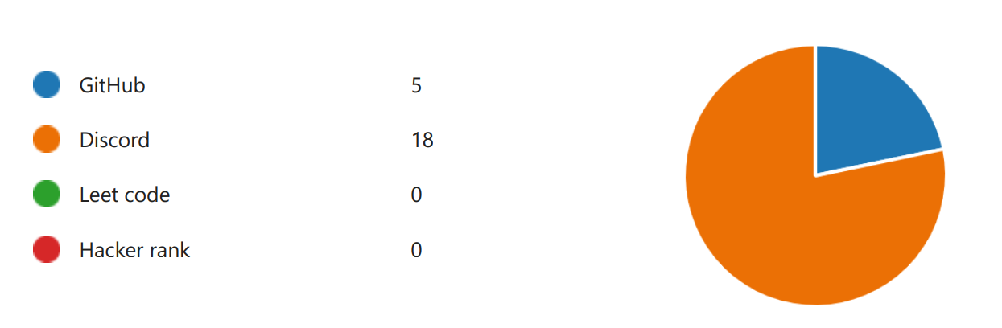
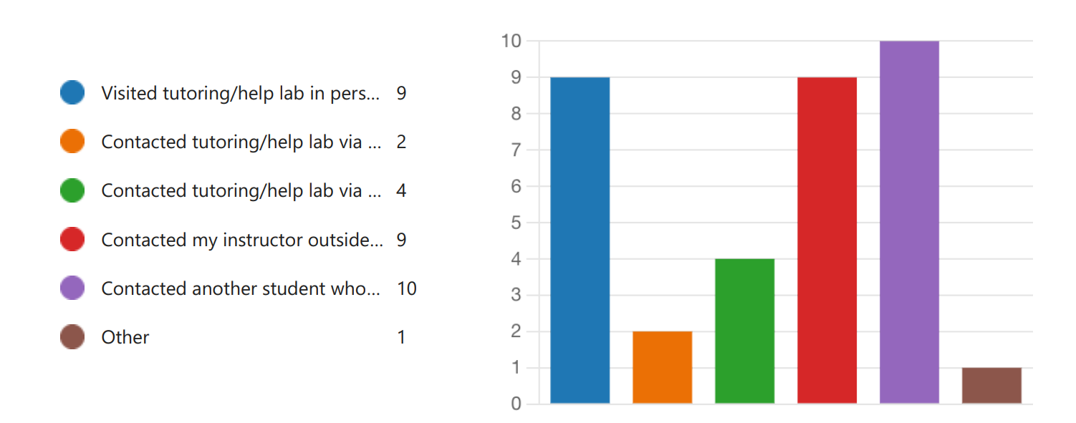
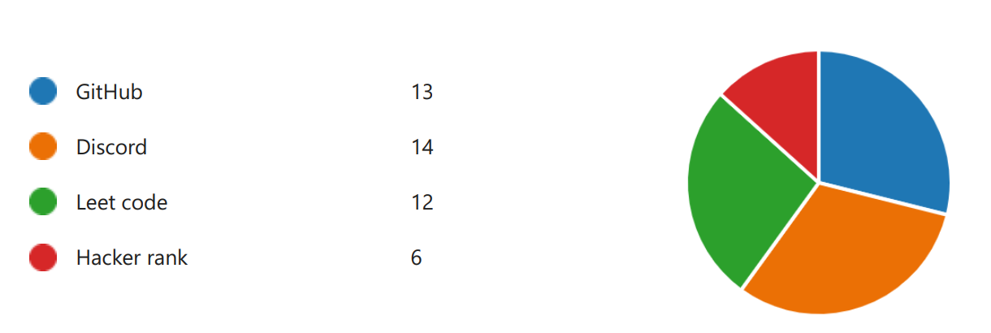
Programming Sequence Improvement Program (PSIP)
Musfikur Rahaman[mrahaman@atu.edu] , Dr. Robin Ghosh[rghosh@atu.edu], Mrs Becky Cunningham [rcunningham@atu.edu], Dr. Indira Dutta [idutta@atu.edu], Dr. Tolga Ensari [tensari@atu.edu] Department of Engineering and Computing Sciences, Arkansas Tech University, Russellville, Arkansas 72801
Abstract
Methodology
Students Survey Result
Every semester, students from various STEM (Science, Technology, Engineering, and Mathematics) majors at Arkansas Tech University take the programming sequence (PS) courses (over 650 students in the 2020–21 academic year). The Engineering and Computing Sciences Department has struggled to retain students in the PS courses. Minor efforts have been made to increase retention, but they have had little success. The Programming Sequence Improvement Program (PSIP) aims to increase retention and student success in three PS courses: Foundations of Computer Programming I (COMS 2104), Foundations of Computer Programming II (COMS 2203), and Data Structures (COMS 2213), reducing the rate of D, F, Withdraw, and Incomplete grades by 10% annually from the current average baseline of 32%, 35%, and 27%, respectively (2015-2019). The main goal of this PSIP project is to change the face of the PS program within the first two years of study by enhancing programming techniques for students. The project's interventions are likely to influence ATU students' academic performance and retention, leading to higher degree completion rates. This program used four different methods to reach its objective: creating a tutoring lab for students enrolled in a programming course, implementing communication and collaboration tools such as Discord and Webex for students, researching current pedagogies for teaching programming, and better aligning the curriculum with platforms like GitHub, Hackerrank & LeetCode.
Four main ways to do this:
Create a tutoring lab for students enrolled in a programming course.
Implement communication/collaboration tools for students.
Research current pedagogies for teaching programming.
Better align the curriculum.
Figure 1 A-B-C: DFWI Rates of COMS 2104, DFWI Rates of COMS 2203, DFWI Rates of COMS 2213
Resources used for COMS 2104
Platforms used for COMS 2104
Action Plan 1:Create comprehensive programming tutoring laboratories connected to the computer science (CS) curriculum within the Department of Computer and Information Science (CIS) to support dynamic collaborative learning and project-based coding activities.
Semester 1 (Spring 2022): Equipment acquisition and start deployment and utilize by at least 10~25 using them daily
Semester 2 (Fall 2022): Fully operational lab and utilized by all students enrolled in PS courses at ATU
Semester 3 (Spring 2023): Retention/completion in COMS 2104, COMS 2203, and COMS 2213 increased by 10%.
Semester 4 (Fall 2023): Retention/completion in COMS 2104, COMS 2203, and COMS 2213 increased by 10% from semester 1 & 2.
Action Plan 2:Develop a Social Media PS reaction system (SMPSRM): To measure students' understanding of programming/Data structure topics using social analytics tools in the classroom.
Semester 2 (Fall 2022): 20~25 participants enrolled in COMS 2104, COMS 2203, and COMS 2213.
Semester 3 (Spring 2023): 10% increase in participation from semester 2 in social media sites.
Semester 4 (Fall 2023): 10% increase in participation from semester 3 in social media sites.
Action Plan 3:Programming Sequence Curriculum Alignment.
Identify curriculum content for which an increased emphasis on critical thinking, analytical skills is appropriate within several different sections in the PS.
Examine the creation of team-taught PS courses within CIS faculty members using lab technologies.
Increase dialogue among faculty within the departments to increase awareness of relevance, usage, benefits of the changes within other disciplines, and the value of these approaches to STEM students' career paths.
Action Plan 4:Programming Sequence Curriculum Alignment Faculty Development in New programming Sequence Pedagogies.
Develop a training program for CIS faculty in PS pedagogies models for PS curriculum as listed in object 2
Develop a departmental wiki training series for faculty to train them to leverage digital tools such as leetCode & HackerRank.
Encourage faculty to participate in national conferences to receive training in the new curriculum efforts and student learning approaches.
Project Action Plan
Resources used for COMS 2203
Purpose
Platforms used for COMS 2203
The main goal of this project is to increase the first year and second-year student retention in Programming Sequence courses COMS 2104, COMS 2203, and COMS 2213 by decreasing DFWI ((D, F, Withdraw and Incomplete grades) rates 10% each year, from the current average baseline of 32%, 35% and 27% respectively (2015-2019).
Action Plan 1 Result
Resources used for COMS 2213
Unique Aspects of Proposed Project
This project is solely student-centric.
With the curriculum alignment implemented in these courses, the students will get similar standards regardless of the section or the faculty teaching that section.
The student feedback on the preset assignments will be a unique way of assessing their problems in these courses.
The help labs will also help us identify the problem areas in these courses.
Platforms used for COMS 2213
Figure 2 A-B-C: Comparison of the target DFWI rate and the actual rate through the fall of 2022
Acknowledgement
We were able to drop the proposed DFWI rate for COMS 2104 from 22% through Fall 2022 to 23%, which is 1% above the target.
Our target DFWI rate for COMS 2203 was 25%, and we accomplished a 15% DFWI rate up until Fall 2022.
We were able to successfully lower the DFWI rate for COMS 2213 to 0% till Fall 2022.
Arkansas Tech Innovation Grant, Department of Engineering and Computing Sciences, Arkansas Tech University, Russellville, Arkansas

