Slide 1


Enhancing the Programming Sequence for Undergraduate Computer Science Students: A Program for Improving Learning Outcomes
Paper ID - 199
Musfikur Rahaman
Graduate Teaching Assistant
Department of Engineering and Computing Sciences
Arkansas Tech University
Russellville, Arkansas 72801
Email: mrahaman@atu.edu

Slide 2
Content
Background
Purpose/Objective
Methodology
Results
Survey Results
Conclusion
Acknowledgment

Slide 3
Background
Every year students from STEM major take 3 PS courses :
1
Programming I(COMS 2104)
Programming II(COMS 2203)
Data Structures (COMS 2213)
Department of Engineering and Computing Science struggling to retain students.
2
DFWI rate for those PS course from 2015-2019 was 32%, 35% and 27%.
3

Slide 4
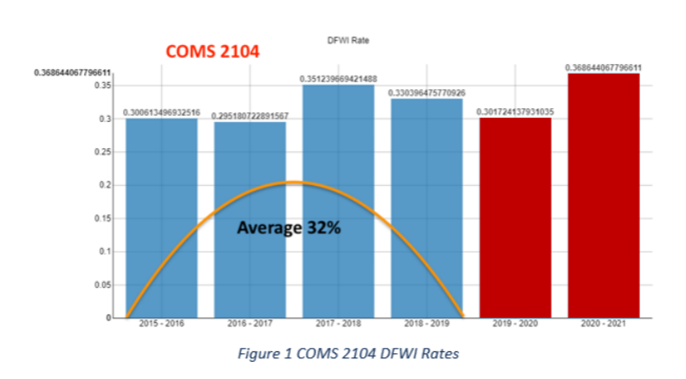

Slide 5
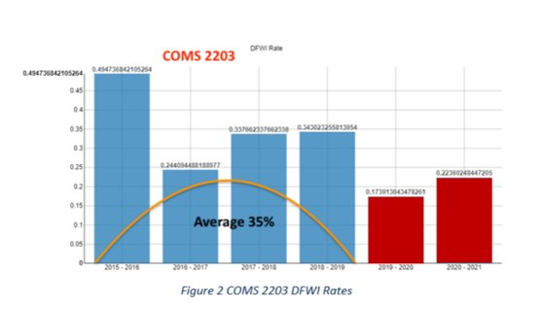

Slide 6
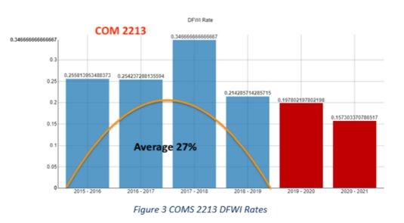

Slide 7
Purpose/Objective
Increase the first year and second-year student retention in Programming Sequence courses.
Decreasing DFWI rates 10% each year.

Slide 8
Methodology
Create a tutoring lab for students enrolled in a programming course.
Implement communication/collaboration tools for students.
Research current pedagogies for teaching programming.
Better align the curriculum.

Slide 9
Action Plans

Slide 10
Action Plan 1: Create Comprehensive Programming Tutoring Laboratories
Spring 2022
Semester 1 (Spring 2022): Equipment acquisition and start deployment and utilize by at least 10~25 using them daily
Fall 2022
Semester 2 (Fall 2022): Fully operational lab and utilized by all students enrolled in PS courses at ATU
Spring 2023
Semester 3 (Spring 2023): Retention/completion in COMS 2104, COMS 2203, and COMS 2213 increased by 10%.
Fall 2023
Semester 4 (Fall 2023): Retention/completion in COMS 2104, COMS 2203, and COMS 2213 increased by 10% from semester 1 & 2.

Slide 11
Action Plan 2: Develop a Social Media PS Reaction System (SMPSRM).
Fall 2022
Semester 2 (Fall 2022): 20~25 participants enrolled in COMS 2104, COMS 2203, and COMS 2213.
Spring 2023
Semester 3 (Spring 2023): 10% increase in participation from semester 2 in social media sites.
Fall 2023
Semester 4 (Fall 2023): 10% increase in participation from semester 3 in social media sites.

Slide 12
Action Plan 3: Programming Sequence Curriculum Alignment
1
Identify curriculum content for different sections in the PS.
2
Examine the creation of team-taught PS courses within CIS faculty.
3
Increase dialogue among faculty within the departments to increase awareness.

Slide 13
Action Plan 4: Programming Sequence Curriculum Alignment Faculty Development in New Programming Sequence Pedagogies
Develop a training program for CIS faculty.
1
Develop a departmental wiki training series for faculty.
2
Encourage faculty to participate in national conferences.
3

Slide 14
Results
Our target DFWI rate for COMS 2104 (Programming I) was from 32% to 22%, and we successfully reduced it to 23%.
Our target DFWI rate for COMS 2203 (Programming II) was from 35% to 25%, and we successfully reduced it to 15%.
Our target DFWI rate for COMS 2213 (Data Structure) was from 27% to 17%, and we successfully reduced it to 0%.

Slide 18

Survey Results Fall -2022

Slide 19
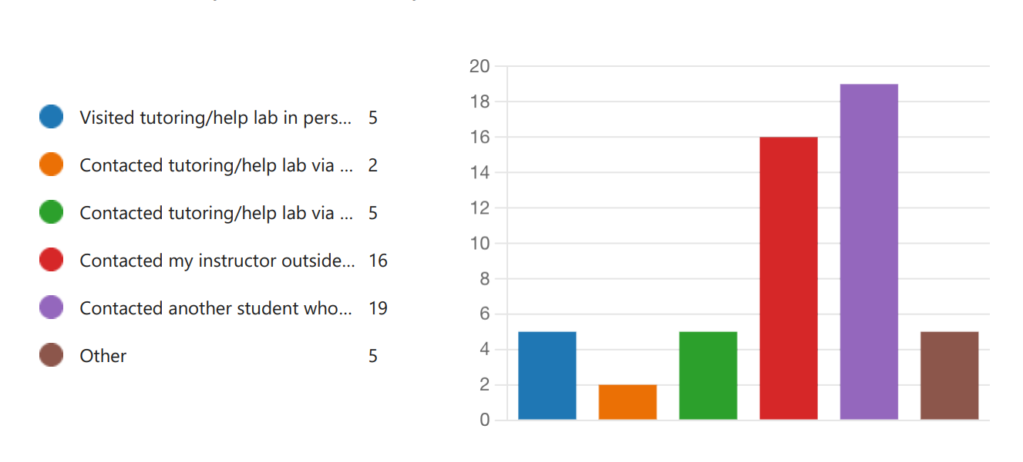
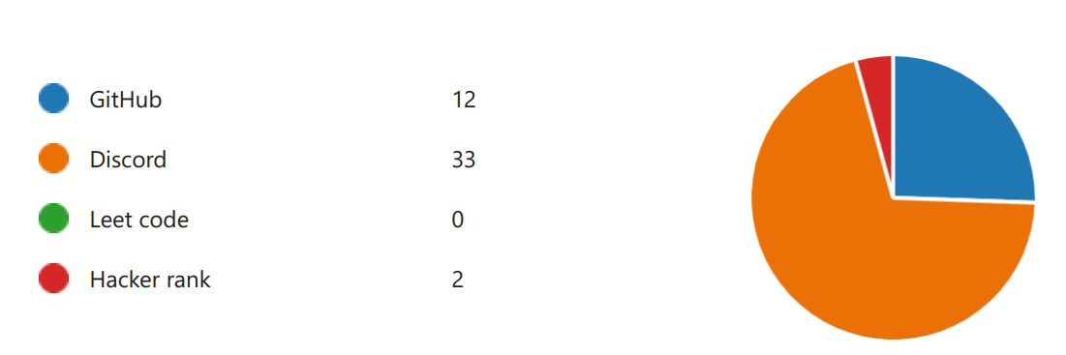
Programming I (COMS 2104)
40 Students

Slide 20
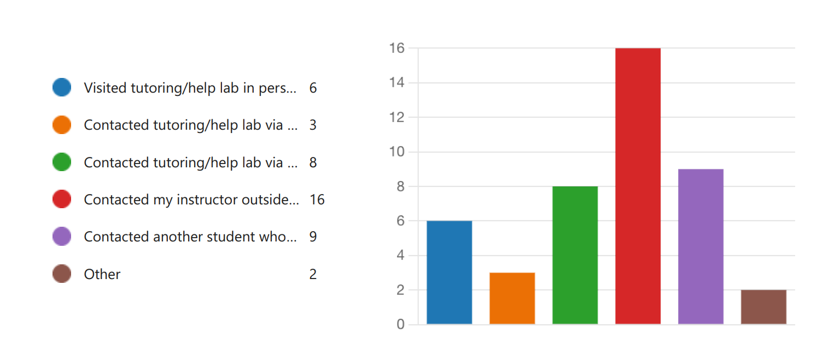
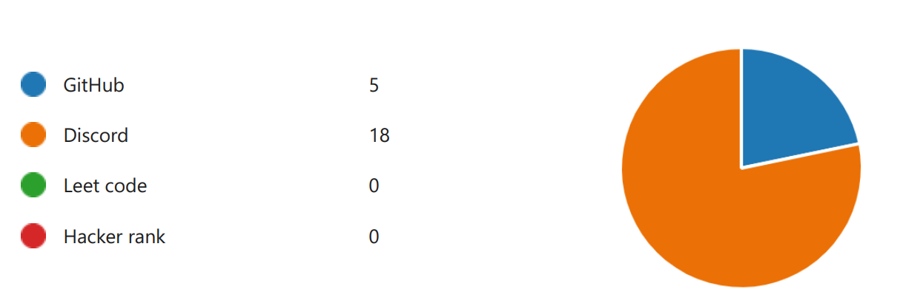
Programming II (COMS 2203)
22 Students

Slide 21
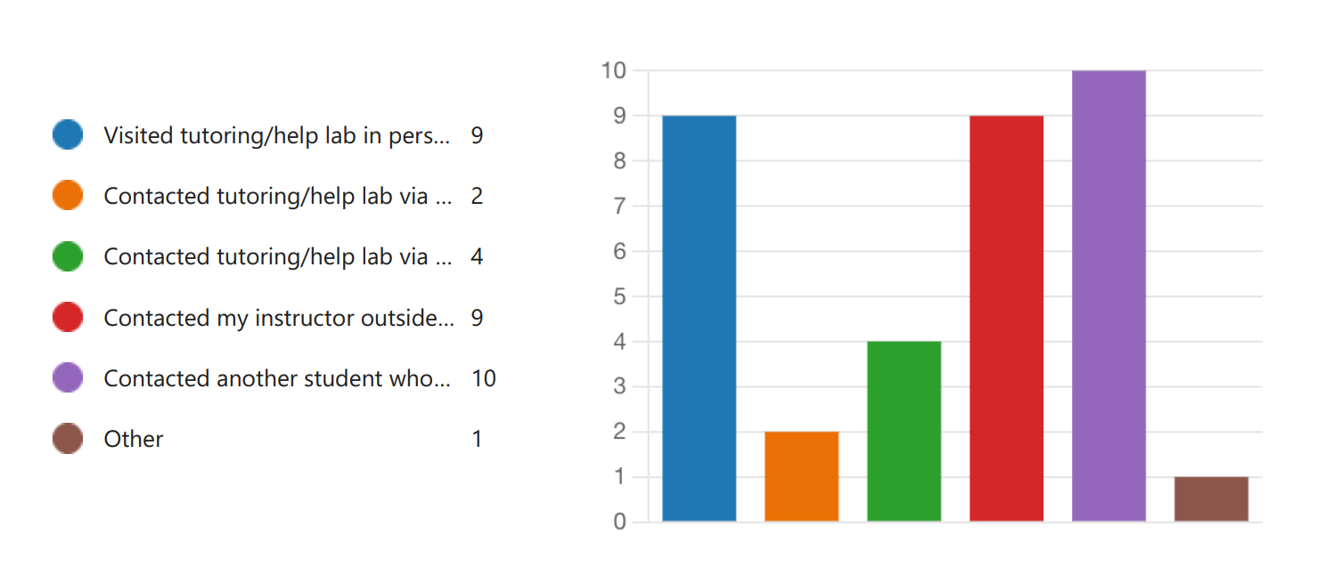
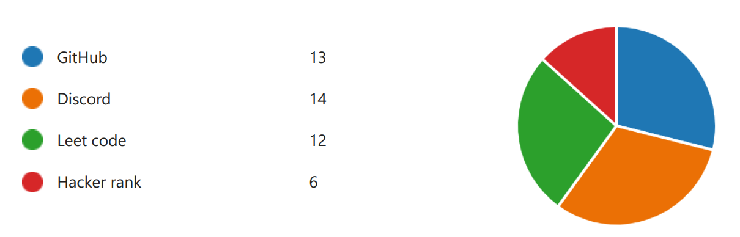
Data Structures (COMS 2213)
18 Students

Slide 22
Conclusion
This project is solely student-centric.
With the curriculum alignment implemented in PS courses, the students will get similar standards regardless of the section or the faculty teaching that section.
The tutoring labs will also help us identify the problem areas in PS courses.
We hope to achieve an average DFWI rate of 10% for all three PS courses by the end of this initiative in the fall of 2023.

Slide 23

Acknowledgment
Dr. Robin Ghosh [Mentor]
Dr. Indira Dutta
Dr. Tolga Ensari
Mrs. Becky Cunningham
Arkansas Tech Innovation Grant,
Department of Engineering and Computing Sciences,
Arkansas Tech University, Russellville, Arkansas

Slide 24

Any Questions?

Slide 25

Thank You

