Slide 1
Library management system of seminar library
S M Musfikur Rahman
Student ID: 190224
Computer Science & Engineering Discipline
Khulna University, Khulna
Masud Karim Omi
Student ID: 200220
Computer Science & Engineering Discipline
Khulna University, Khulna
Utsa Debnath
Student ID: 200242
Computer Science & Engineering Discipline
Khulna University, Khulna

Slide 2
Introduction
Online issue book
Generate
report
Find the availability of Book
Identify the lost books

Slide 3
Motivation
To reduce the work of the librarian.
To manage the books and other files easily.
To keep track of all books easily and properly.

Slide 4
EXISTING VS PROPOSED System
The existing system does not have any facility to generate student reports as well as book issue reports whereas the proposed system provides librarians with a tool to generate reports.
The existing system does not have any facility for book requests and suggestions whereas in the proposed system after logging in to their accounts student can request books as well as provide suggestions to improve the library.
The existing system does not have a facility for online reservation of books whereas the proposed system has a facility for online reservation of books.

Slide 5
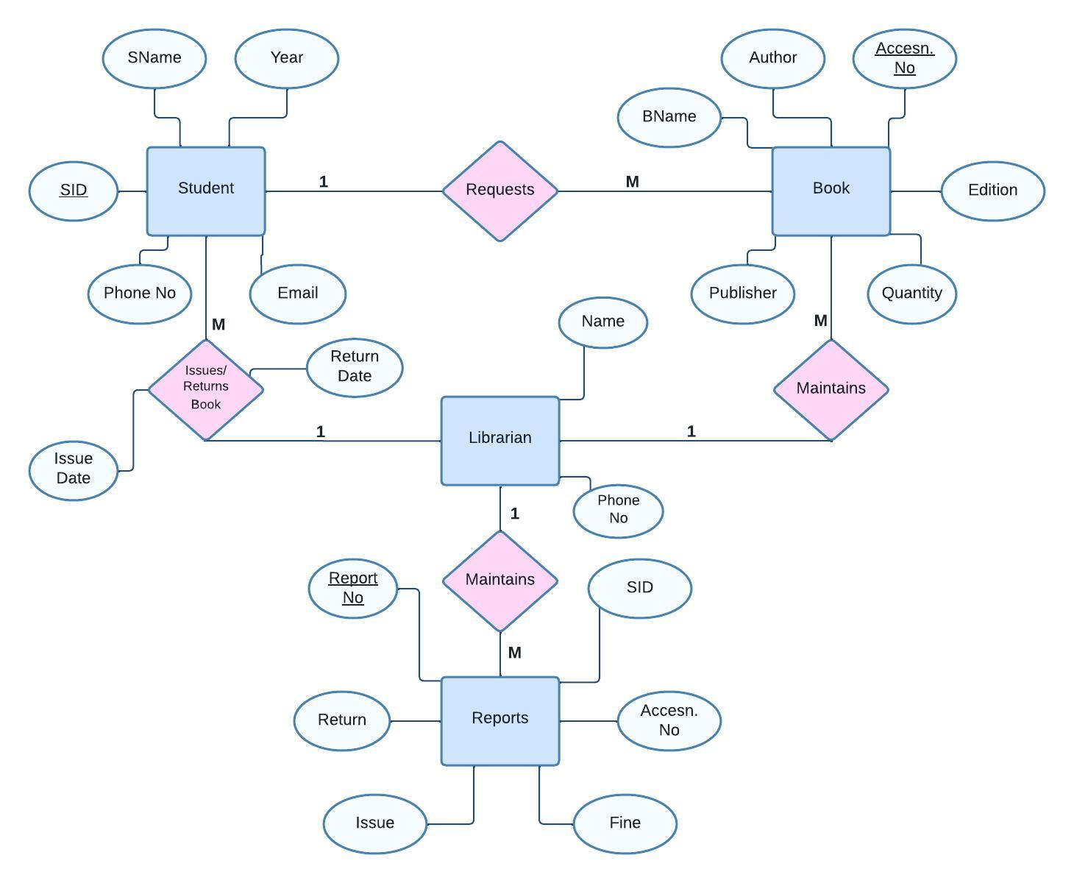
ER DIAGRAM
LIBRARY MANAGEMENT SYSTEM

Slide 6
LIBRARY MANAGEMENT SYSTEM
TOOLS & TECHNOLOGY
Software
Operating system: Windows 11 Home
Database: Microsoft SQL Server 2008
Development tools: Microsoft Visual Studio 2022
Programming language- HTML, CSS, JavaScript, PHP
Hardware
Processor: Intel(R) Core(TM) i5-9500K CPU @ 3.90GHz
Ram: 12 GB

Slide 7
Interesting Query
1.Retrieve all books from the database:
SELECT * FROM books;
2. Retrieve all books published after 2010:
SELECT * FROM books WHERE publication_year > 2010;
3.Retrieve all books with the title “Software Engineering":
SELECT * FROM books WHERE title = 'Software Engineering';
4.Add a new book to the database:
INSERT INTO books (book_id, author, publication_year, publisher, book_name, term, edition, category);
VALUES (5051, 'Roger Pressman', 1991, ‘Mc Graw Hil Education’, 'Software Engineering',’1st’,’10th’,’CSE’);
Updating Books:
5. UPDATE books SET publication_year = 1999 WHERE title = ‘Analog Communication';

Slide 8
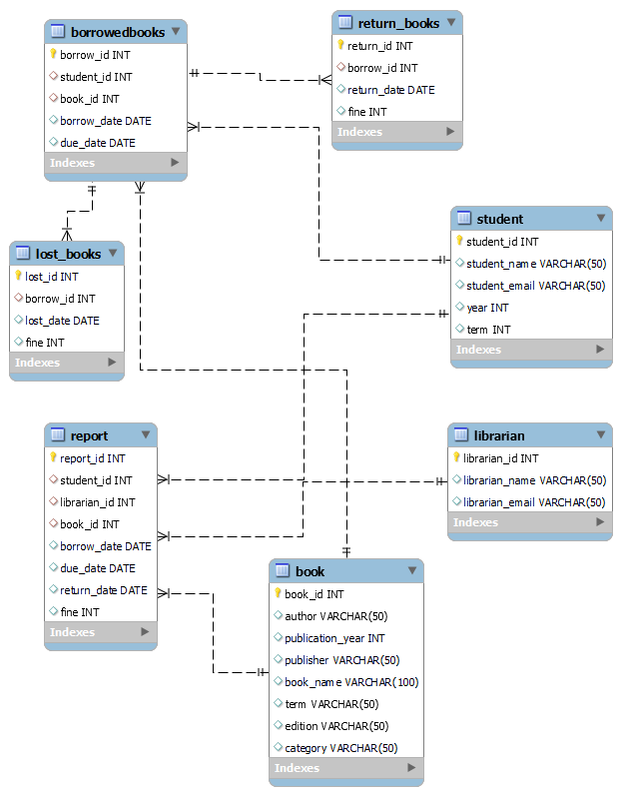
Schema Diagram

Slide 9
Schema of library management system
Student (student_id, student_name, student_email, year , term )
Librarian (librarian_id, librarian_name, librarian_email )
Book ( book_id, author, publication_year, publisher, book_name, term, edition, category )
BorrowedBooks (borrow_id, student_id , book_id, borrow_date,due_date ,student_id,book_id)

Slide 10
Schema of library management system
Lost_Books ( lost_id , borrow_id , lost_date ,fine , borrow_id)
Return_Books (return_id, borrow_id, return_date, fine, borrow_id)
Report (report_id,student_id,librarian_id,book_id,borrow_date,due_date,return_date,fine,student_id,librarian_id,book_id)

Slide 11
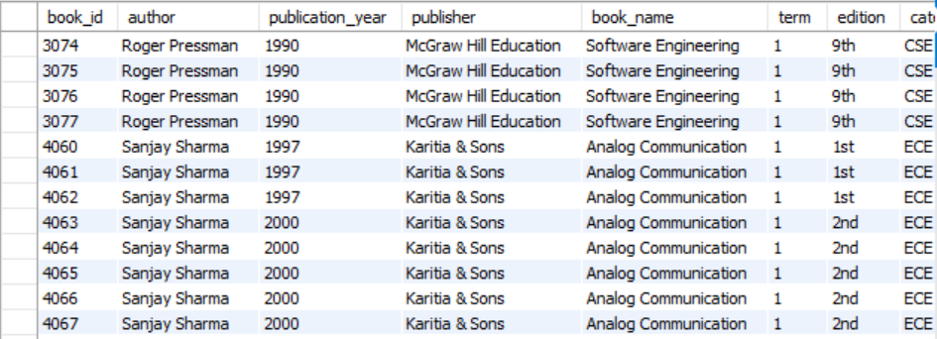
Book TABLE

Slide 12
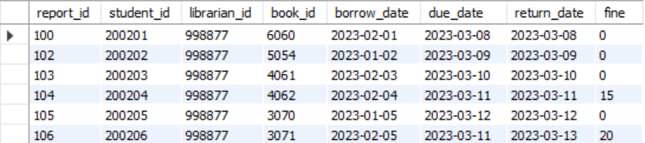
RePORT TABLE

Slide 13
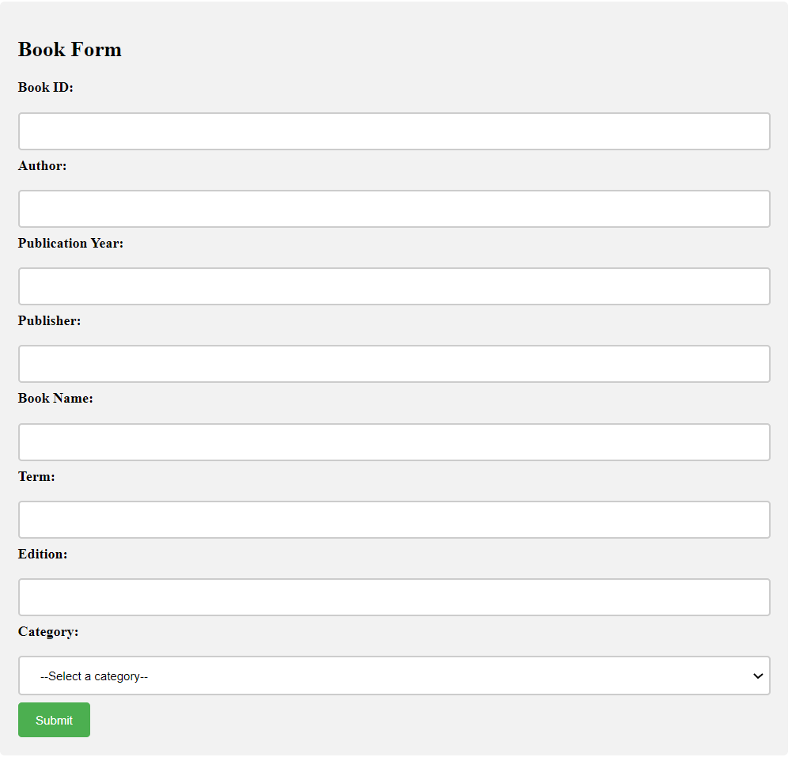
Book FORM

Slide 14
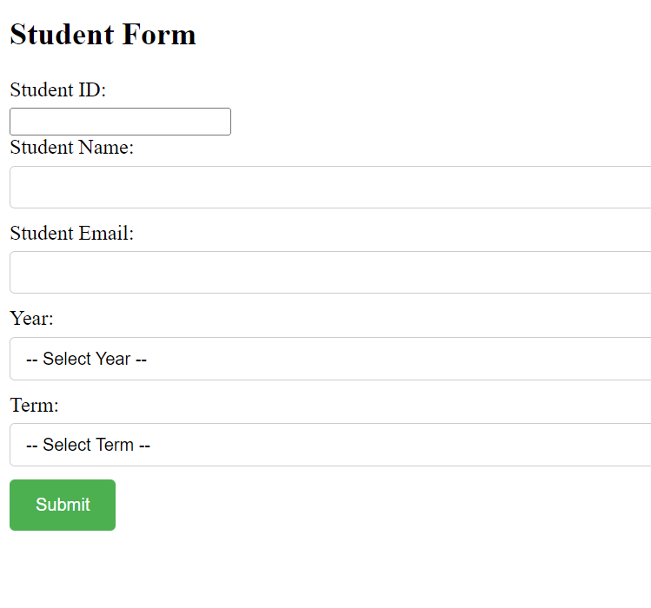
Student FORM

Slide 15
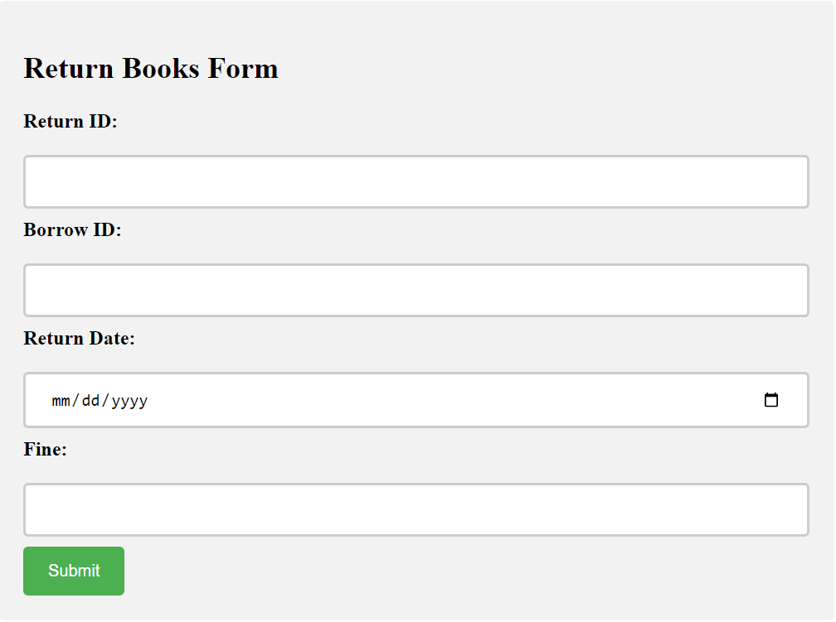
Return Book Form

Slide 16
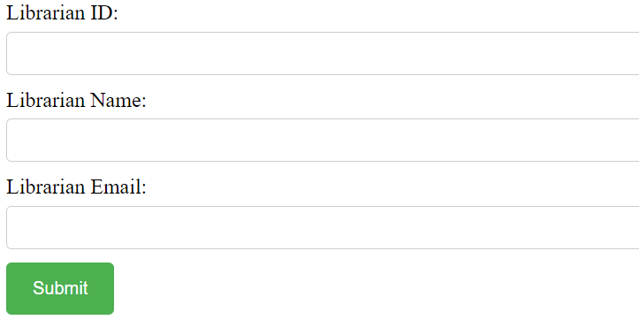
Librarian Form

Slide 17
Librarian Form

Slide 18
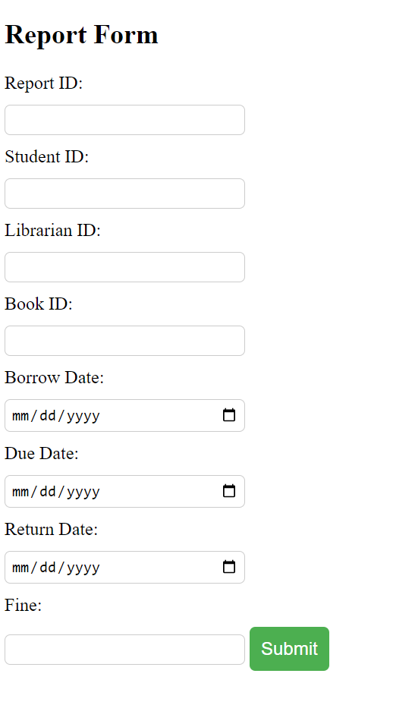
REport Form

Slide 19
THANK YOU

