Slide 1


SECURITY AWARENESS TRAINING
Don't Take the Bait
Recognizing and Defeating Phishing Attacks
A practical module on phishing emails, fake websites, and the social
engineering tactics attackers use to steal your credentials and data.
STUDENT INFORMATION
Student Name
Musfira Hassan
Student ID
CA/DF1/201508
Internship Domain
Cyber Security
Module length: ~25 minutes • Includes 3 knowledge checks

Slide 2




WHAT WE'LL COVER
Agenda
What phishing is
Anatomy of a phishing email
Why it's the #1 way attackers get in the door
The tell-tale signs hiding in plain sight
Spotting fake websites
Social engineering tactics
URLs, certificates, and login pages that lie
The psychology attackers exploit
Real-world cases
Best practices & quiz
Two breaches that started with one email
Habits that keep you safe, then test yourself
Phishing Awareness Training
2

Slide 3
THE BIG PICTURE
What Is Phishing?
Phishing is a scam where an attacker impersonates a trusted person or brand — a bank, a coworker, IT support, a delivery service — to trick you into handing over credentials, payment details, or access to a system.
60%
Arrives by email, text (smishing), phone call (vishing), or chat
Doesn't need to hack your software — it only needs you to click, reply, or approve
Is often the very first step in a much larger breach or ransomware attack
of confirmed data breaches involve
a human action — a click, a reply,
or a rushed approval
15%
of breaches started with a phishing
email as the initial point of entry
Source: Verizon 2025 Data Breach Investigations Report
Phishing Awareness Training
3

Slide 4

KNOW THE VARIANTS
Phishing Comes in Several Flavors
Email Phishing
Spear Phishing
Whaling
Mass emails impersonating a known brand, sent to thousands of people hoping a few take the bait.
A targeted email personalized with your name, role, or a real project to feel legitimate.
Spear phishing aimed at executives, often faking urgent requests from a CEO or CFO.
Vishing
Smishing
Clone Phishing
A phone call from someone posing as IT, a bank, or law enforcement to extract information.
A text message with a malicious link, often about a 'package' or 'account' issue.
A copy of a real, previously-sent email with the link or attachment swapped for a malicious one.
Phishing Awareness Training
4

Slide 5


READ BEFORE YOU CLICK
Anatomy of a Phishing Email
● ● ●
Look-alike domain
The domain swaps letters to mimic the real company domain (“cornpany” vs “company”).
From: IT Support <helpdesk@yourcornpany-it.com>
Subject: URGENT: Your mailbox will be suspended today
Manufactured urgency
A tight, scary deadline is designed to stop you from thinking it through.
Dear User, We detected unusual activity on your account. You must verify your identity within 2 hours or your mailbox will be permanently deleted. Click below to confirm your password and avoid disruption: ▸ Verify My Account Now
Thank you,
The IT Helpdesk Team
Generic greeting
“Dear User” instead of your name — legitimate IT teams know who you are.
Mismatched or hidden link
The button text and the actual destination URL rarely match; hover to check.
Phishing Awareness Training
5

Slide 6
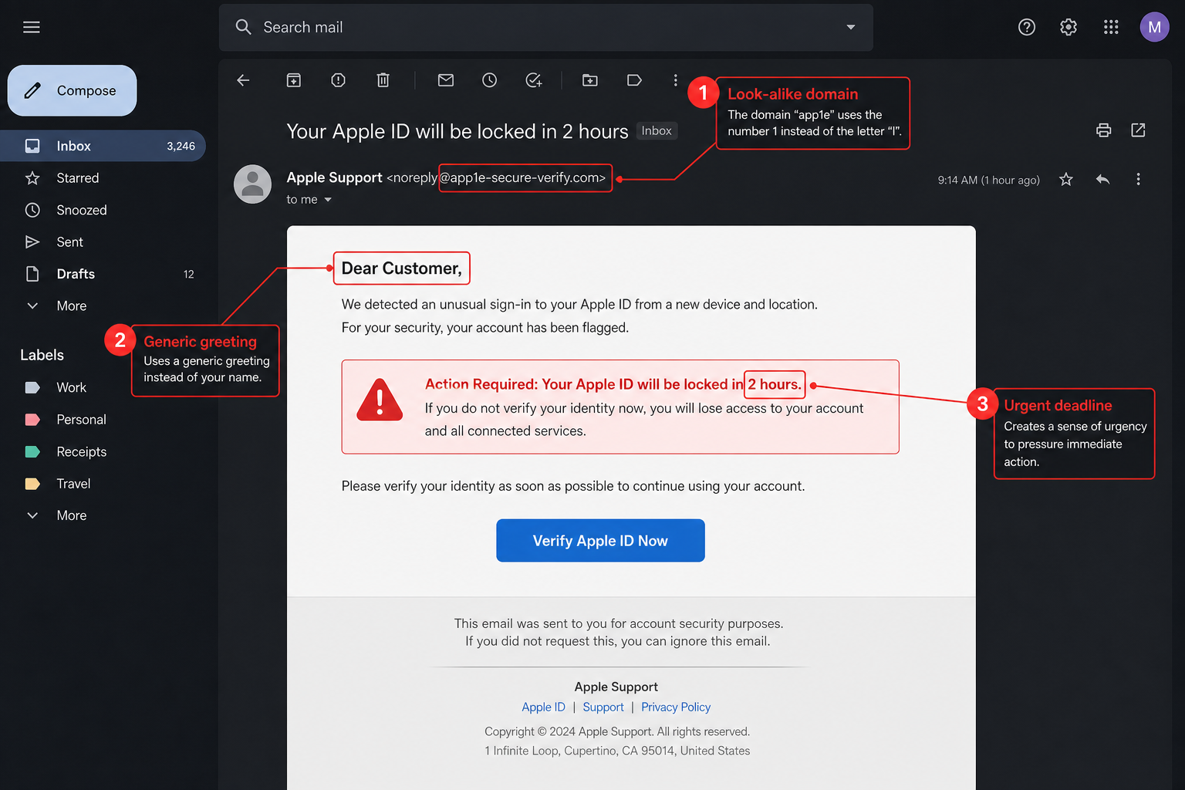
SEE IT IN THE WILD
Real Example: Fake Apple ID Alert
The same red flags from the last slide, annotated on a real-style phishing email.
Training mockup — not a real email.
Phishing Awareness Training
6

Slide 7
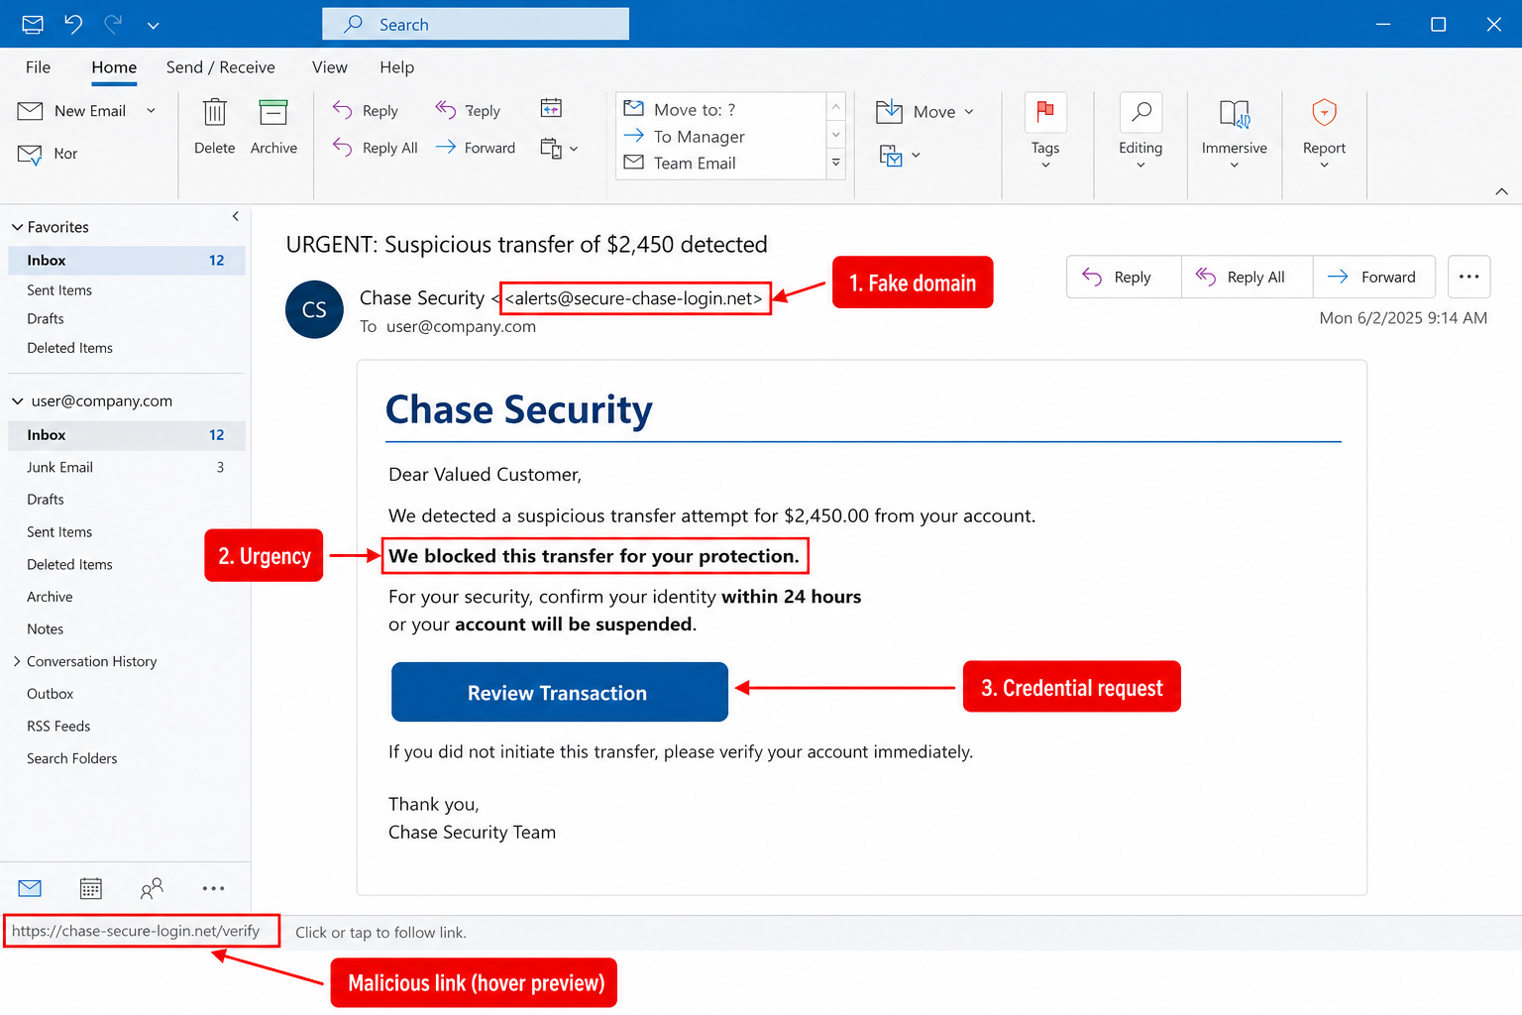
SEE IT IN THE WILD
Real Example: Fake Bank Transfer Alert
A convincing bank-branded email, with the fake domain and malicious link exposed.
Training mockup — not a real email.
Phishing Awareness Training
7

Slide 8
BEYOND THE INBOX
Spotting a Fake Website
A convincing email often leads to an even more convincing login page. Before you type a password anywhere, check these five things.
The domain, not just the padlock
Misspellings and extra words
A padlock only means the connection is encrypted — anyone can get one, including attackers. Read the full domain carefully.
Watch for swapped letters, extra hyphens, or added words like “secure” or “verify” bolted onto a familiar brand name.
Unusual top-level domains
Requests for everything at once
A bank or major retailer using an unfamiliar domain ending that doesn't match their real site is a red flag.
Real login pages ask for a username and password — not your PIN, security questions, and card number on one page.
Phishing Awareness Training
8

Slide 9

THE HUMAN ANGLE
Social Engineering Tactics
Phishing rarely relies on technical tricks alone — it relies on these psychological levers.
Urgency
Authority
Fear
“Act in 24 hours or lose access.” Pressure short-circuits careful thinking.
Impersonating a CEO, IT admin, or government agency so you comply without question.
Threats of fines, account suspension, or legal trouble to provoke a panicked click.
Curiosity
Familiarity
Reciprocity & reward
“See who viewed your profile” or an unexpected invoice attachment you feel compelled to open.
Spoofing a real coworker, vendor, or ongoing email thread to feel unremarkable.
A fake gift card, refund, or prize that trades a small click for a big payoff.
Phishing Awareness Training
9

Slide 10

What happened
An attacker set up a company with a name nearly identical to a real hardware supplier both companies already worked with, then sent convincing forged invoices, contracts, and letters requesting wire payments.
Because the paperwork mirrored real vendor correspondence and used a look-alike company name, finance staff at both organizations approved the transfers as routine business payments.
CASE STUDY 01
The $100M
Invoice Scam
Why it worked
Google & Facebook, 2013–2015
A look-alike company name exploited familiarity with a real vendor
Forged invoices and contracts matched the real business relationship
Large organizations' payment approval steps didn't independently verify the vendor
$100M
Lesson: verify any change to vendor payment details through a second channel — a phone call to a known number, not a reply to the email.
paid out to a fabricated vendor over two years
Source: U.S. Department of Justice / SDNY, U.S. v. Evaldas Rimasauskas (2013–2015); reported by Reuters, CNBC, and NPR (2019).
Phishing Awareness Training
10

Slide 11

What happened
Attackers called employees by phone posing as internal IT staff, convincingly referencing real internal tools and terminology to build trust before asking for login credentials.
With those credentials, they reached an internal support tool and took control of a large number of high-profile accounts, using them to promote a cryptocurrency scam.
CASE STUDY 02
The Voice-Phishing
Takeover
Why it worked
A major social platform, 2020
Phone-based pretexting feels more personal and harder to doubt than email
Attackers had done homework on internal terms, building instant credibility
One set of stolen credentials unlocked a powerful internal admin tool
130+
Lesson: a phone call claiming to be IT is not proof of identity. Hang up and call your helpdesk back on a known, published number.
high-profile accounts hijacked in a single afternoon
Source: Twitter's July 2020 security incident update (blog.x.com); covered by BBC and TechCrunch.
Phishing Awareness Training
11

Slide 12


BUILD THE HABIT
Best Practices to Stay Safe
Do
Don't
Hover over links to check the real destination before clicking
Verify unexpected requests through a separate, known channel (phone, in person)
Check the sender's full email address, not just the display name
Report suspicious emails using your organization's “phishing” button
Use multi-factor authentication everywhere it's offered
Slow down when a message pushes urgency or fear
Don't enter credentials after clicking a link from an email or text
Don't enable macros or run attachments you weren't expecting
Don't trust a request just because it looks like it's from your boss
Don't reuse the same password across work and personal accounts
Don't assume a padlock icon means a site is legitimate
Don't act on a single urgent message without a second opinion
Phishing Awareness Training
12

Slide 13
KNOWLEDGE CHECK
Test Yourself
Three quick questions. Read each one, choose your answer, then check the next slide.
Phishing Awareness Training
13

Slide 14
QUESTION 1 OF 3
Which detail is the biggest red flag in this email?
From: Payroll <payroll@yourcompany.hr-update.com> Subject: Update your direct deposit info Hi, Our payroll system was upgraded. Please confirm your bank details within 24 hours using the secure link below or your next paycheck may be delayed. ▸ Update My Banking Info
A. The email uses the word “secure”
B. The sender domain is not the real company domain
C. The email includes a greeting
D. The email mentions a paycheck
Phishing Awareness Training
14

Slide 15
ANSWER
B — the sender domain
“yourcompany.hr-update.com” is not your company's real domain — it's a look-alike subdomain designed to look plausible at a glance. The urgency (“24 hours”), the generic tone, and the direct request for banking details are supporting red flags, but the forged domain is the fundamental giveaway.
Takeaway: always check the full domain after the @ symbol — not just whether the email “looks” like it belongs to a real department.
Phishing Awareness Training
15

Slide 16
QUESTION 2 OF 3
A coworker calls, sounding rushed, and asks you to read out a one-time passcode you just received by text so they can “fix your account.” What should you do?
Read out the code quickly since they sound stressed and it's faster to just help.
A
Text the code to them instead of saying it out loud, since that's more secure.
B
Decline, hang up, and verify the request through a separate, known channel.
C
Ask them to prove who they are by telling you your employee ID.
D
Phishing Awareness Training
16

Slide 17
ANSWER
C — decline and verify separately
A one-time passcode exists specifically to prove it's really you logging in — reading it to someone else hands them the keys, whether by voice or by text. No legitimate coworker or IT staffer will ever need you to share that code with them.
Takeaway: treat urgency over the phone the same way you treat urgency in email — hang up and call back on a number you already know and trust, not one they gave you.
Phishing Awareness Training
17

Slide 18
QUESTION 3 OF 3
True or False: A green padlock icon in the browser address bar means a website is safe and legitimate.
TRUE
FALSE
The padlock guarantees this is the real, legitimate website.
The padlock only means the connection is encrypted — it says nothing about who owns the site.
Phishing Awareness Training
18

Slide 19
ANSWER
False
The padlock only confirms the connection between your browser and the site is encrypted — it says nothing about who owns or controls that site. Anyone, including an attacker, can get a certificate for a look-alike domain and show the exact same padlock.
Takeaway: always read the full domain name itself. The padlock is table stakes, not proof of trust.
Phishing Awareness Training
19

Slide 20
IF SOMETHING FEELS OFF
Report It — Don't Just Delete It
Don't click, reply, or forward
Report through official channels
Warn others if it's targeted
Don't interact with links, attachments, or the sender.
Use your organization's phishing-report button or IT security contact.
If coworkers may have received the same message, give your security team a heads-up.
Remember: no legitimate request will ever punish you for slowing down to double-check it.
Phishing Awareness Training
20

