Slide 1

Predicting Rate of Penetration (ROP) using drilling parameters. A Comparative Analysis: Statistical Linear Regression vs. Physics-Based Modelling
Statistical Models for Data Science
Mushahid Raza
11-December-2025

Slide 2

Problem Statement & Objective
The Business Problem:
Goal: To predict the Rate of Penetration (ROP) for an oil well to optimize drilling speed and reduce daily rig cost.
Why this matters:
Cost: Offshore rigs cost >$100k/day. Faster drilling = Direct savings.
Optimization: Accurate predictions allow engineers to select the optimal Weight on Bit (WOB) and Rotation Speed (RPM).
Methodology: We compared two modeling approaches to see which one is better for drilling.
Statistical Model (Log-Linear Regression): Learns purely from historical data patterns.
Physics-Based Model (Bingham Model): Uses engineering laws to constrain the predictions.

Slide 3
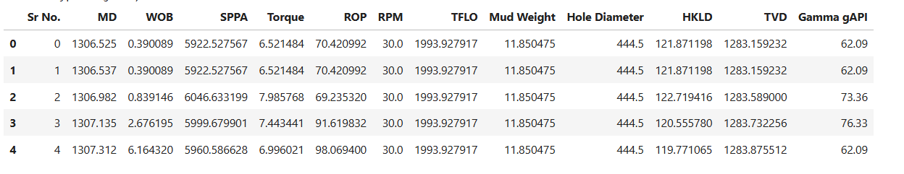
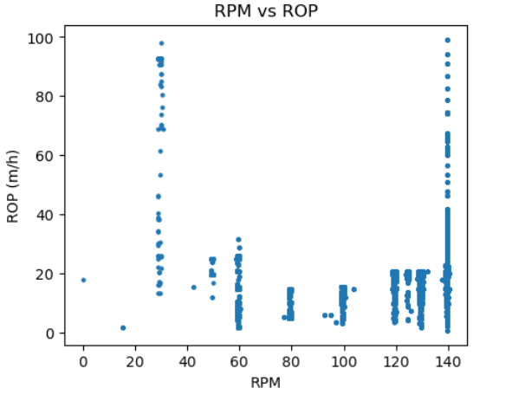
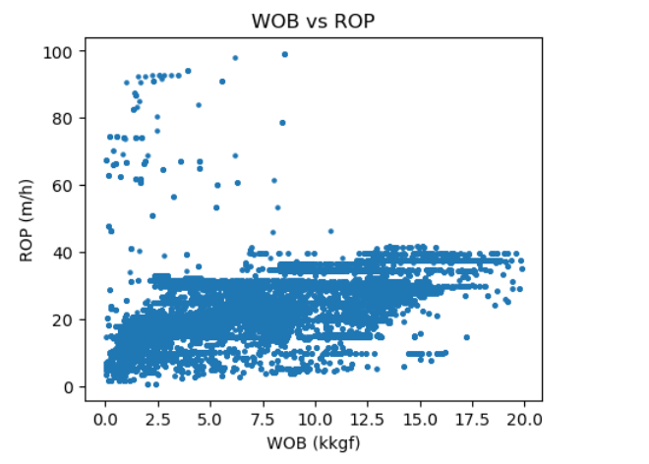
Dataset Overview & Exploratory Data Analysis
Source: USROP Public Dataset (GitHub)
Selected Well: USROP_A3
Total Observations: ~53,000
Drilling Variables: ROP, WOB, RPM, SPPA, TFLO, Torque, Depth
Key drivers: WOB & RPM
WOB shows strong positive trend with ROP
RPM shows weak nonlinear relation
Rest of the variables seemed non-relevant because they are highly corelated.

Slide 4

Methodology: The Two Approaches
Model 1 – "Log-Linear Regression" (The Data Approach)
This model looks at historical drilling data (53,000 rows) and finds correlations between the inputs (Weight, Speed) and the output (ROP).
Key Finding:
Weight on Bit (WOB): Positive coefficient. More weight ≅ Faster drilling.
RPM: Positive coefficient. Faster spinning ≅ Faster drilling.
Model Accuracy: RMSE: 7.895 m/h.
Why this is a potential problem: The model assumes that if you keep adding weight, the speed will keep increasing forever. It does not account for the physical "saturation point" where the rock cannot break any faster.

Slide 5

Methodology: The Two Approaches
Model 2 – "Bingham Model" (The Physics Approach)
Instead of relying only on patterns in the data, this model includes Engineering Domain Knowledge. It uses a specific formula that accounts for the mechanical efficiency of the drill bit.
Key Finding:
Coefficient 'a' < 1: The model estimated a parameter of 0.21, which mathematically proves diminishing returns.
Interpretation: This means that doubling the weight does not double the speed.
Model Accuracy: 7.821 m/h (Better than the Liner Regression Model).
Interpretation: This model aligns with physical reality: using the drill bit too hard eventually stops helping. : p

Slide 6
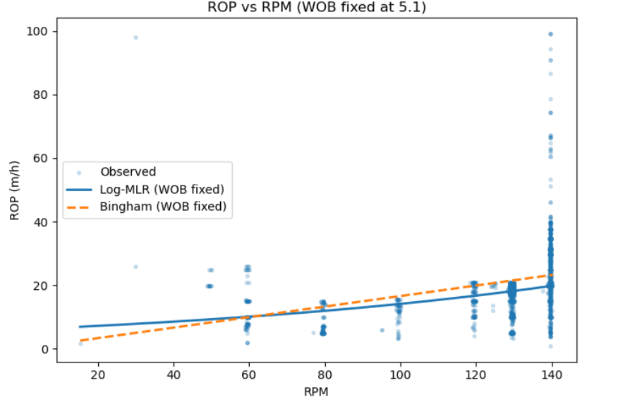
Comparison of Both Models
Similarities in the results: Both models identified Weight on Bit as the main driver of speed. Because the data had a strong signal, both models performed well (RMSE ~7.8).
Why the Physics Model is better:
The Statistical Model blindly followed the trend, risking over-prediction at high weights.
The Physics Model included a "structure" (the formula) that acted like a guardrail, preventing unrealistic predictions.
Which model should the engineers rely on?
The Physics-Based Bingham Model, because It is not just accurate; it is safe. It respects the physical limits of the machinery, whereas the statistical model might recommend dangerous settings just to chase a higher predicted speed.

Slide 7

Conclusion - The Final Takeaway
Data vs reality: Data is powerful, but it can be "naive." It doesn't know the physical limits of the machinery.
The Winner: Physics performed better because it understood the real-world constraints.
Future Recommendation: Do not replace the engineering physics. Instead, use data science to tune the physics equations for the best of both worlds.

Slide 8
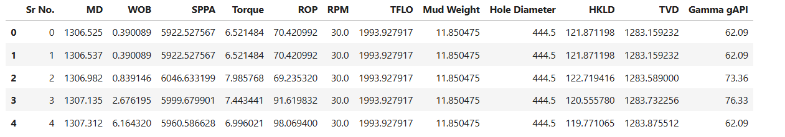
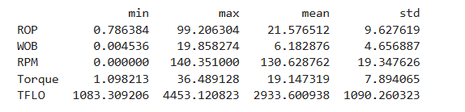
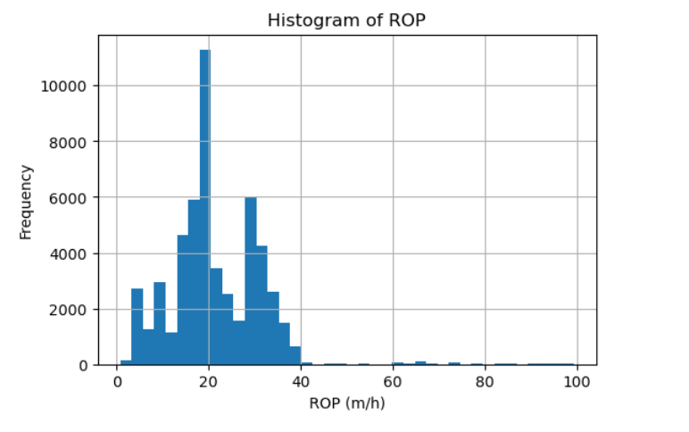
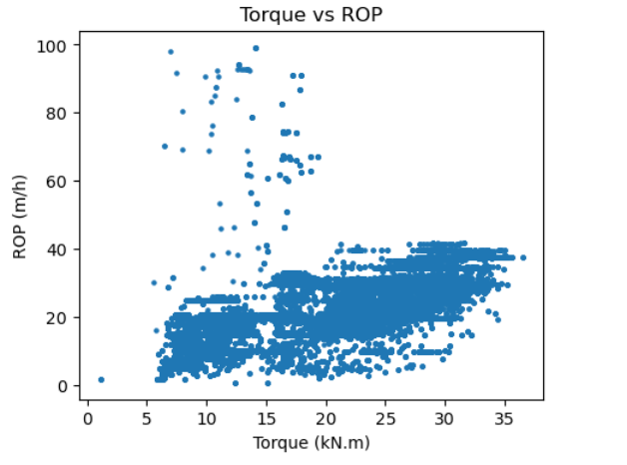
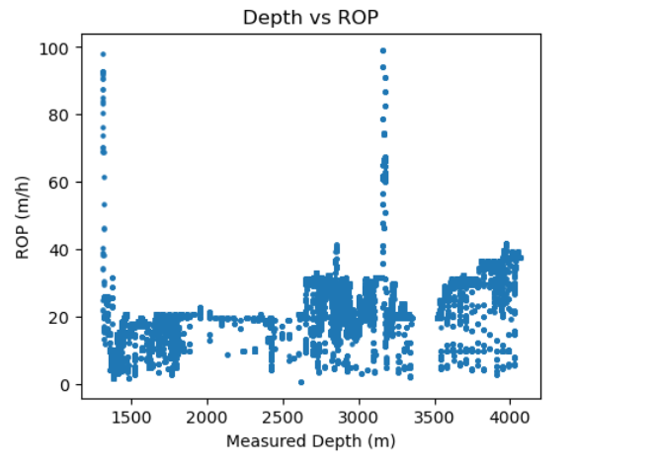
Appendix: EDA

Slide 9
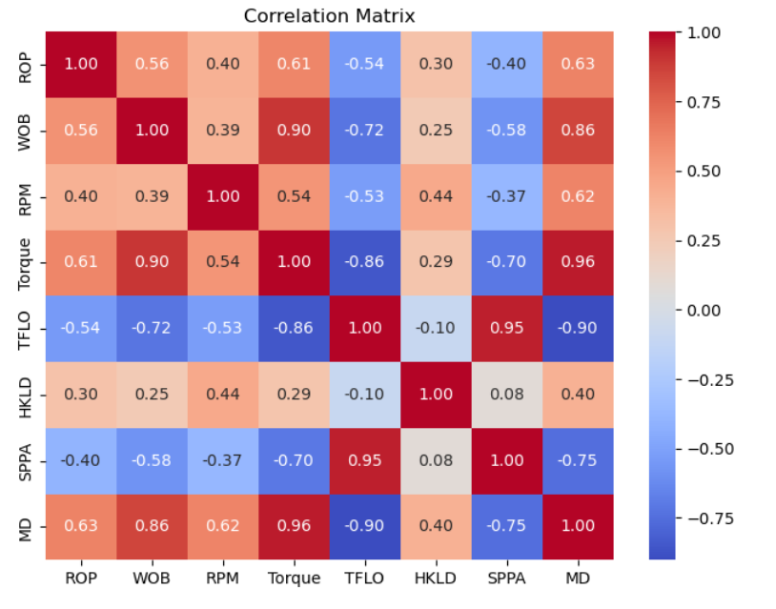
Appendix: Multicollinearity & Heteroskedasticity
Check Durbin–Watson
Or residual ACF plots
Many drilling variables are correlated:
This causes:
Inflated standard errors & table regression coefficients
We must use :
Correlation matrix OR Variance Inflation Factor (VIF)
Heteroskedasticity:
Variance of ROP changes with:
Depth, Formation changes, and Bit wear
We must run
Breusch–Pagan test or similar Possibly use:
Robust standard errors OR Weighted least squares
Autocorrelation (Serial Correlation)
Because data is:
Depth-ordered & Sequential
Residuals are not independent:
We have to use
Check Durbin–Watson Or residual ACF plots

Slide 10
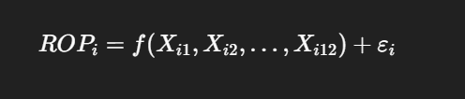
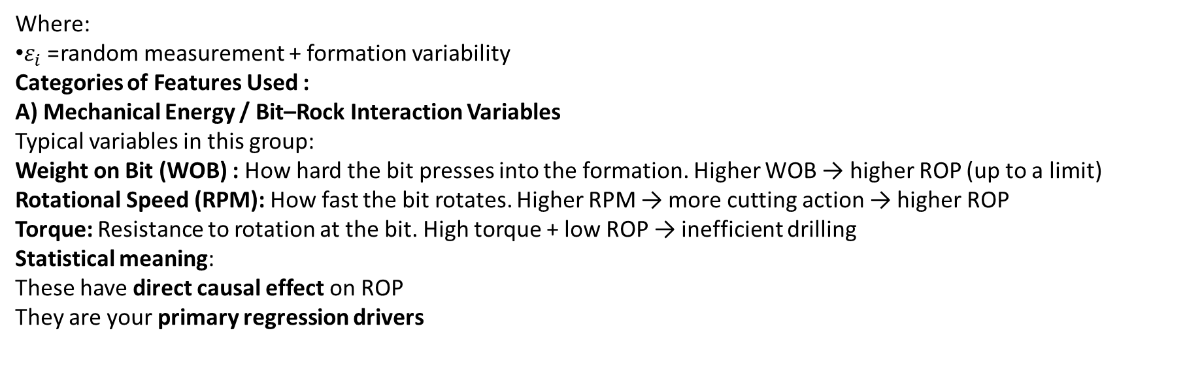
Appendix: Statistical Regression
Where:
$ε_{i}$= random measurement + formation variability
Categories of Features Used :
A) Mechanical Energy / Bit–Rock Interaction Variables
Typical variables in this group:
Weight on Bit (WOB) : How hard the bit presses into the formation. Higher WOB → higher ROP (up to a limit)
Rotational Speed (RPM): How fast the bit rotates. Higher RPM → more cutting action → higher ROP
Torque: Resistance to rotation at the bit. High torque + low ROP → inefficient drilling
Statistical meaning:
These have direct causal effect on ROP
They are your primary regression drivers

Slide 11
Appendix: Statistical Regression
B) Hydraulic / Circulation Variables:
These control cuttings removal and bottom-hole cleaning.
Typical variables:
Flow Rate
Standpipe Pressure
Mud Density
Proper hydraulics: Clean the bottom hole, Prevent regrinding cuttings, Stabilize ROP
Statistical meaning: These variables often show:
Nonlinear relationships
Interaction effects with WOB and RPM

Slide 12
Appendix: Statistical Regression
C) Well Geometry / Environment Variables
These describe the drilling environment, not direct energy.
Measured Depth / True Vertical Depth
Inclination
Hole Size
These affect:
Contact area of the bit
Friction
Cuttings transport efficiency
Statistical meaning: These variables often introduce:
Trend
Heteroskedasticity
Formation-dependent variance

Slide 13

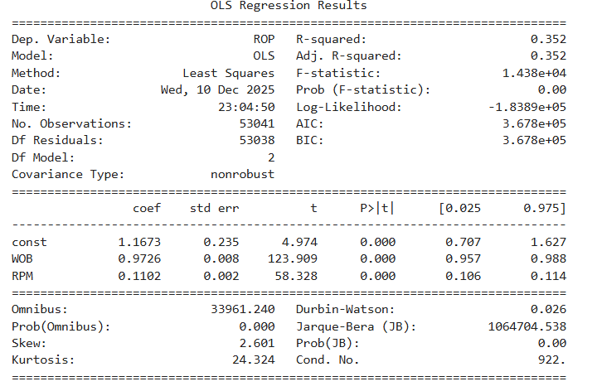
Appendix: Multiple Linear Regression
Initial MLR Model :
Final Model: (ROP) = 1.17 + 0.97 WOB + 0.11 RPM
R² = 0.352
ROP in this well is strongly controlled by WOB and moderately controlled by RPM. WOB is roughly 9× stronger than RPM per unit change. Together, they explain about 35% of the total ROP variability, with the remaining variation due to geology, hydraulics, bit wear, and transient conditions.
F-statistic p-value = 0.00
The model is globally statistically significant. At least one predictor contributes to explaining ROP

Slide 14
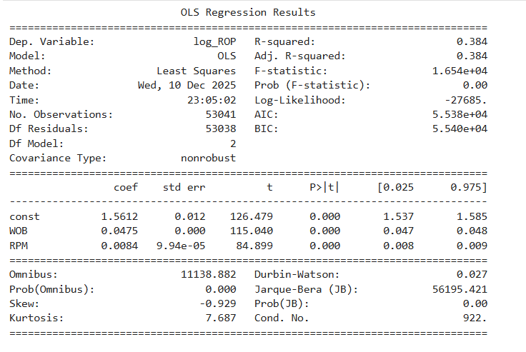
Appendix: Log Linear Regression
Initial MLR Model :
Final Model: (ROP) = 1.56+ 0.05 WOB + 0.01 RPM
R² = 0.384
A log-linear regression model using WOB and RPM explains 38.4% of the variation in ROP. Both predictors are statistically significant (p < 0.001). A 1 kkgf increase in WOB is associated with an average 4.9% increase in ROP, while a 1 rpm increase in RPM increases ROP by approximately 0.84%. The log transformation substantially reduces skewness and heavy-tailed behavior in the residuals, improving the validity of statistical inference. However, strong residual autocorrelation remains due to the time-series nature of drilling data.

Slide 15
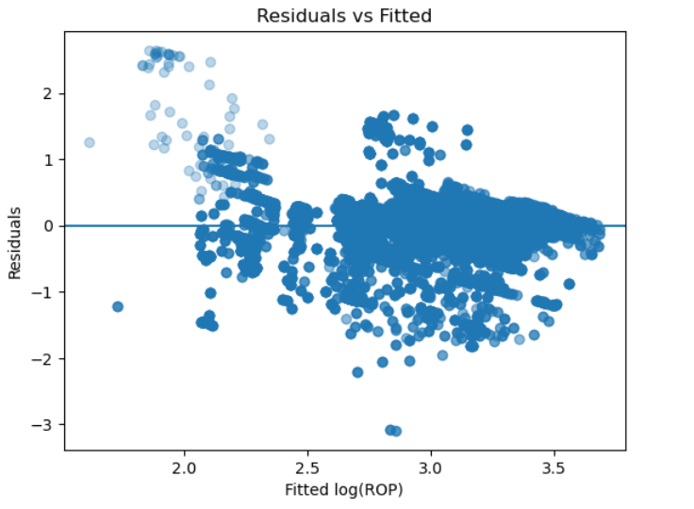
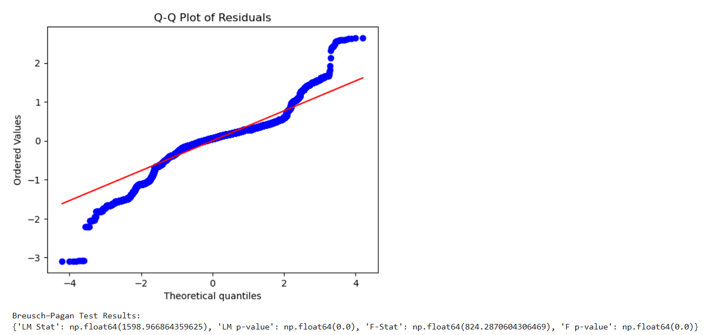
Appendix: Log Linear Regression
Model Diagnostics. Residual diagnostics were performed on the log-linear regression model to verify the key OLS assumptions.
residuals are centered around zero with no strong nonlinear pattern, indicating that the linearity assumption is reasonably satisfied. However, the spread of residuals varies with the fitted values, suggesting heteroskedasticity.
The Q–Q plot of residuals shows that the log-transformation substantially improves normality compared to the raw ROP model, although deviations remain in the tails, indicating heavy-tailed behavior.
The presence of heteroskedasticity is formally confirmed by the Breusch–Pagan test (p-value < 0.001), leading to rejection of the null hypothesis of constant variance. In addition, the Durbin–Watson statistic indicates strong positive autocorrelation, which is expected given the time-series nature of drilling data. While these assumption violations limit strict classical inference, the coefficient estimates remain unbiased, and the model is suitable for predictive and operational analysis with the stated limitations.

Slide 16
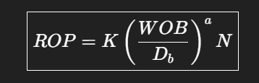
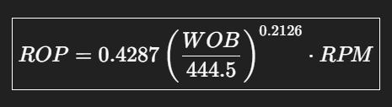
Appendix: Bingham Model – Nonlinear
Final Bingham Model:
Where:
ROP = Rate of Penetration (m/h)
WOB = Weight on Bit
Db = Bit diameter
N = Rotary speed (RPM)
K = constant related to formation strength = 0.43
a = bit weight exponent = 0.21
a < 1 → diminishing returns of WOB

Slide 17
Appendix: Model Comparison (Using RMSE)
RMSE (Bingham Model) = 7.821
RMSE (Log-MLR Model) = 7.895
Numerical Comparison:
Δ𝑅𝑀𝑆𝐸=7.895−7.821=0.074 ​
That means:
The Bingham model has a LOWER prediction error.
The improvement is:
Small in absolute terms, But consistent and real

