Slide 1



Weekly Python Practice Summary
Debugging, Python Basics, NumPy & Pandas, OOP, and Mini Project
By: Musharaf Habib

Slide 2
Debugging & Configuration
Wrote a small program with a logical bug.
Used debugger to inspect variables and step through code.
Learned to identify and fix logical issues efficiently.

Slide 3
Python Basics
Practiced variables, loops, functions, and lists.
Created simple calculator and grade tracker.
Strengthened understanding of Python syntax and control flow.

Slide 4
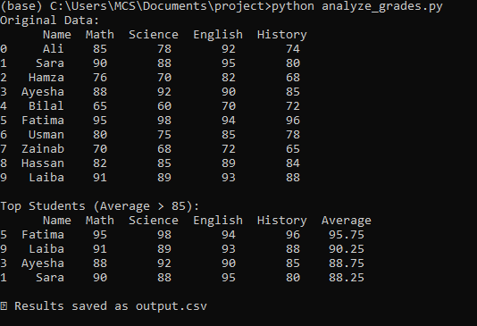
NumPy & Pandas
Loaded 'grades.csv' dataset using Pandas.
Calculated averages, sorted, and filtered data.
Learned structured data handling for real-world applications.

Slide 5
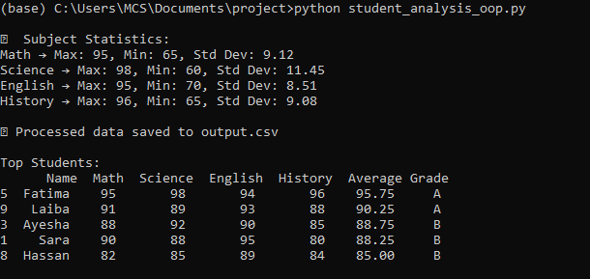
Practical OOP (Functions & Classes)
Refactored code into a Student class.
Implemented methods like calculate_average().
Gained experience in modular and reusable programming.

Slide 6
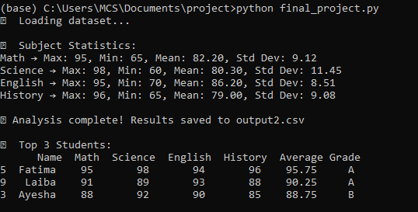
Mini Project Checkpoint
Combined all skills into a grade analysis project.
Processed CSV data and generated output.csv.
Completed first standalone Python project successfully.

Slide 7

Summary
Practiced debugging, Python basics, data handling, and OOP.
Created a working mini project integrating all concepts.
Built a solid foundation for advanced Python projects.

