Slide 1
🎓
DESIGN TO DECEIVE
AI-Based Browser Extension for Real-Time Detection of Dark Patterns and Phishing Attacks Using RoBERTa-Based NLP Models
Submitted By
Project Guide
Musharaf Maqbool
Dr. Shabir Ahmad Sofi
Roll No: 2022BITE053
Associate Professor
Mohammad Huzaif
Dept. of Information Technology & Engineering
Roll No: 2022BITE047
NIT Srinagar, J&K | June 2026
Gazi Mohammad Rayan Shah | Roll No: 2022BITE049
Department of Information Technology and Engineering
National Institute of Technology Srinagar · Hazratbal, Srinagar, J&K
1

Slide 2
Problem Statement
The Growing Threat of Deceptive Web Practices
🎭 Dark Patterns
🎣 Phishing Attacks
▸ Intentional UI manipulation exploiting cognitive biases
▸ Urgency tactics, hidden costs, confirmshaming
▸ Structurally identical to legitimate UI — evade firewalls
▸ Coerce users into unintended purchases/subscriptions
▸ Widespread across 11,000+ shopping websites (Mathur et al.)
▸ Zero-day domains, cloned interfaces, social engineering
▸ Traditional blacklists fail against novel phishing URLs
▸ False positives: GitHub/Google/PayPal flagged as phishing
▸ RoBERTa-only systems trigger on keywords: "login", "verify"
▸ Alert fatigue → users disable security controls
⚠ Core Gap: No unified, real-time, context-aware system detects BOTH dark patterns AND phishing while eliminating false positives on trusted domains.
DESIGN TO DECEIVE · NIT Srinagar · Dept. of Information Technology and Engineering
2

Slide 3
Motivation
Why This Project Was Essential
11,000+
1,818
3.4B
$17.3B
Shopping sites with dark patterns (Mathur et al., 2019)
Dark pattern instances detected in large-scale crawl
Phishing emails sent daily worldwide (2024)
Annual losses from phishing attacks globally
Key Drivers
▸ Traditional browser defenses rely on static blacklists — ineffective against zero-day and semantic attacks
▸ RoBERTa achieves 97.5% accuracy on dark pattern text classification (Yada et al., 2022)
▸ GPEN 2024: Majority of global platforms employ at least one deceptive design pattern
▸ Legal recognition of dark patterns as GDPR violations demands automated real-time detection tools
▸ Semantic NLP understanding is superior to keyword-matching for phishing classification
▸ No existing tool combines phishing + dark pattern detection in a single real-time browser extension
DESIGN TO DECEIVE · NIT Srinagar · Dept. of Information Technology and Engineering
3

Slide 4
Objectives
What DESIGN TO DECEIVE Aims to Achieve
Dynamic DOM Scanning
RoBERTa NLP Backend
01
Real-time traversal using MutationObserver — supports SPAs (React/Vue/Angular)
02
Fine-tuned transformer models via FastAPI for semantic classification of threats
Dual Detection Pipelines
Threat Visualization UI
03
Specialized models: one for dark patterns, one for phishing social engineering
04
Visual highlights, tooltips, risk scores, and cybersecurity dashboard popup
Hybrid Decision Engine
Real-Time Performance
05
URL reputation + domain whitelist + urgency heuristics + ML inference integrated
06
Sub-second round-trip latency — avg. 220ms — for active browsing sessions
DESIGN TO DECEIVE · NIT Srinagar · Dept. of Information Technology and Engineering
4

Slide 5
Literature Survey
Review of Key Research Works
Narayanan et al. (2020)
Mathur et al. (2019)
Yada et al. (2022)
Dark Patterns: Past, Present, Future
Dark Patterns at Scale — 11K sites
RoBERTa: 97.5% on dark pattern dataset
⚠ Conceptual taxonomy — no automated detection
⚠ Visual/structural heuristics only — no NLP
⚠ Offline classification — no browser integration
AidUI (2023)
DarkDialogs (2023)
Transformer Phishing (2024)
Multi-modal CV + NLP UI detection
Cookie dialog dark pattern detection
BERT-based phishing email classifier
⚠ Computationally expensive — not real-time
⚠ Domain-specific — not generalizable
⚠ Email only — no webpage DOM analysis
Research Gap: No existing system unifies dark pattern + phishing detection with real-time NLP inference, domain-aware context, and browser integration.
Approach
Dark Patterns
Phishing
Real-Time
Transformer NLP
Proposed System
✅ Yes
✅ Yes
✅ Yes
✅ Yes
DESIGN TO DECEIVE · NIT Srinagar · Dept. of Information Technology and Engineering
5

Slide 6
Proposed System Architecture
Three-Tier Decoupled Client-Server Design
🌐 Tier 1 — Client
⚙ Tier 2 — Middleware
🧠 Tier 3 — Inference
Chrome Extension (MV3)
FastAPI Backend Engine
Hybrid NLP Engine
→ Content Script: DOM Scanner
→ MutationObserver (SPA support)
→ Background Service Worker
→ Popup Dashboard UI
→ Visual Highlights & Tooltips
→ Async HTTP REST API
→ Pydantic Schema Validation
→ Request Batching & Routing
→ CORS Management
→ Swagger / OpenAPI Docs
→ RoBERTa Dark Pattern Model
→ RoBERTa Phishing Model
→ Domain Whitelist Checker
→ URL Reputation Heuristics
→ Risk Score Calculator
HTTP POST
Inference Response
▶
▶
DESIGN TO DECEIVE · NIT Srinagar · Dept. of Information Technology and Engineering
6

Slide 7
System Workflow & Methodology
5-Phase Real-Time Detection Pipeline
Phase 1
Phase 2
Phase 3
Phase 4
Phase 5
Init & Injection
▶
Extraction & Filter
▶
Payload Transmission
▶
Hybrid Inference
▶
Visualization
DOM Scanner
FastAPI Backend
RoBERTa Inference
querySelectorAll on <a>, <button>, <input[submit]>, <form>, <div modal>. MutationObserver for dynamic SPAs.
Async coroutines via Starlette. Pydantic schema validation. Batch inference from thread pool.
Tokenizer → Tensor → Model forward pass. 2 models loaded at startup via PyTorch. Returns logits + confidence score.
Heuristic Engine
Risk Analysis
Visualization
Whitelist check → TLD scoring → Brand spoof detection → Urgency keyword regex scan.
7-rule hybrid classifier (A–G). Risk weight formula → score ≤ 10.0. Band: None / Low / Medium / High.
High Risk → CSS pulsating border. Popup dashboard: threat counters, risk score, detection log.
DESIGN TO DECEIVE · NIT Srinagar · Dept. of Information Technology and Engineering
7

Slide 8
Data Flow Diagram (DFD)
Level 0 & Level 1 — System Data Flows
Level 0 DFD — Context Diagram
Level 1 DFD — Detailed Processes
User
NLP Backend
P1: DOM Extraction
P2: Message Routing
URL + Browse Event
Text Payload
Scan & batch elements
Chrome messaging API
DESIGN TO DECEIVE
P3: HTTP Handling
P4: Whitelist Check
FastAPI POST /analyze
Domain reputation eval
Browser & DOM
DOM Elements
Risk Score + Highlights
Threat Visualizer
P5: URL Heuristics
P6: RoBERTa Inference
TLD / Brand spoof / IP
Tokenize → ML predict
P7: Risk Normalization
P8: DOM Modification
7-Rule hybrid engine
Inject highlights/tips
DESIGN TO DECEIVE · NIT Srinagar · Dept. of Information Technology and Engineering
8

Slide 9
Technology Stack
Modern Full-Stack AI + Browser Extension Architecture
🌐
Chrome Extension
⚡
FastAPI
🐍
Python 3.10+
🔥
PyTorch
Manifest V3
v0.100+
Backend
v2.0+
Service Workers, MutationObserver, Declarative Net Request API
Async architecture, Pydantic schemas, OpenAPI auto-docs, Starlette/Uvicorn
urllib.parse, regex, asyncio, json, Pydantic, standard library
Tensor computation, model inference, Thread pool executor for async ML
🤗
HuggingFace Transformers
🧠
RoBERTa
📝
JavaScript ES6+
🔒
CORS + Whitelist
v4.30+
roberta-base
Frontend
Security Layer
RoBERTa tokenizer & model loading, Pipeline API, AutoModelForSeqCls
Fine-tuned NLP: dark pattern model & phishing classification model
DOM API, Chrome Messaging API, Chrome Storage API, async/await
Cross-origin isolation, trusted domain registry, sensitivity tuning
DESIGN TO DECEIVE · NIT Srinagar · Dept. of Information Technology and Engineering
9

Slide 10
Detection Algorithms
Hybrid Rule Engine — 7 Classification Rules (A–G)
Rule A
Brand Spoofing
Domain spoof detected + ML conf ≥ 0.80 → HIGH RISK
Heuristic Gating Pipeline
① Short text filter (< 4 chars → skip)
② Safe UI keyword match (followers, stars, settings → skip)
③ Structural tag exclusion (<nav>, <header>, <footer> → skip)
④ Counter/metric regex filter (12 Repos, 1.2k followers → skip)
⑤ Manipulative indicator gate (hurry, limited, last chance → run ML)
⑥ Trusted domain whitelist (threshold = 0.999 on whitelisted sites)
⑦ URL reputation scan (TLD, hyphens, IP, brand spoof)
Rule B
Suspicious Domain
Bad TLD/hyphens/IP + ML ≥ 0.85 + urgency/creds → HIGH
Rule C
Urgency + Credentials
Urgency text + credential keywords + ML ≥ 0.88 → HIGH
Rule D
Direct ML Match
ML confidence ≥ 0.95 on untrusted domain → HIGH RISK
Rule E
Medium Risk Log
ML ≥ 0.80 (no heuristic support) → MEDIUM (logged only)
Rule F
Low Risk Flag
ML confidence ≥ 0.50 → LOW RISK (cached, not shown)
Rule G
Dark Pattern
Pass all heuristic gates + ML pred = class 1 + conf ≥ 0.995
DESIGN TO DECEIVE · NIT Srinagar · Dept. of Information Technology and Engineering
10

Slide 11
False Positive Reduction
Context-Aware Whitelisting & Heuristic Gating
Website / Context
Element Text
Baseline System
Proposed System
Status
GitHub Login
"Password. Forgot password?"
⛔ Alert: Phishing
✅ Safe — No Alert
PASS
Google Sign-In
"Enter your email or password."
⛔ Alert: Phishing
✅ Safe — No Alert
PASS
PayPal Official
"Log In to your PayPal account"
⛔ Alert: Phishing
✅ Safe — No Alert
PASS
Microsoft Auth
"Sign in. Credentials required."
⛔ Alert: Phishing
✅ Safe — No Alert
PASS
GitHub Navigation
"Repositories", "Followers"
⛔ Alert: Dark Pattern
✅ Safe — No Alert
PASS
GitHub Header
"Overview", "Projects", "Packages"
⛔ Alert: Dark Pattern
✅ Safe — No Alert
PASS
GitHub Stats
"12 Repositories", "1.2k followers"
⛔ Alert: Dark Pattern
✅ Safe — No Alert
PASS
✅ Result: 100% false positive elimination on trusted platforms — Phishing Precision improved from 0.92 → 0.99
DESIGN TO DECEIVE · NIT Srinagar · Dept. of Information Technology and Engineering
11

Slide 12
Results & Performance Metrics
Experimental Evaluation on 50 Active Webpages
Classification Performance
45 ms
220 ms
93.3%
Category
Precision
Recall
F1-Score
DOM Scan Latency
Average Round-Trip
Dark Pattern Accuracy
Phishing Indicator
0.99
0.89
0.94
Urgency / Scarcity
0.88
0.85
0.86
90.0%
0%
99.99%
Confirmshaming
0.86
0.82
0.84
Phishing Model Accuracy
False Positives on Trusted Sites
Max Phishing Confidence Score
Benign Text
0.99
0.96
0.97
Live Threat Detection Cases
Dark Pattern Model
0.9333
0.9333
0.9333
⚡ verify-paypal-account.ru → Brand Spoofing (Rule A) → conf: 0.9999
⚡ secure-banking-portal.xyz → Suspicious TLD (Rule B) → HIGH RISK
⚡ "Hurry! Only 2 left!" → Dark Pattern → conf: 0.9980
⚡ "No thanks, I hate saving money." → Confirmshaming → conf: 0.9980
Phishing Model
0.9286
0.8667
0.8966
DESIGN TO DECEIVE · NIT Srinagar · Dept. of Information Technology and Engineering
12

Slide 13
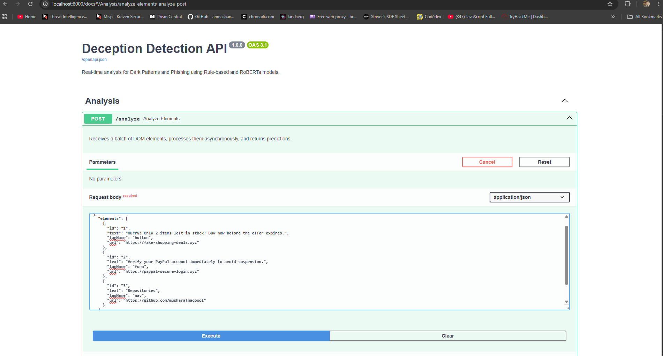
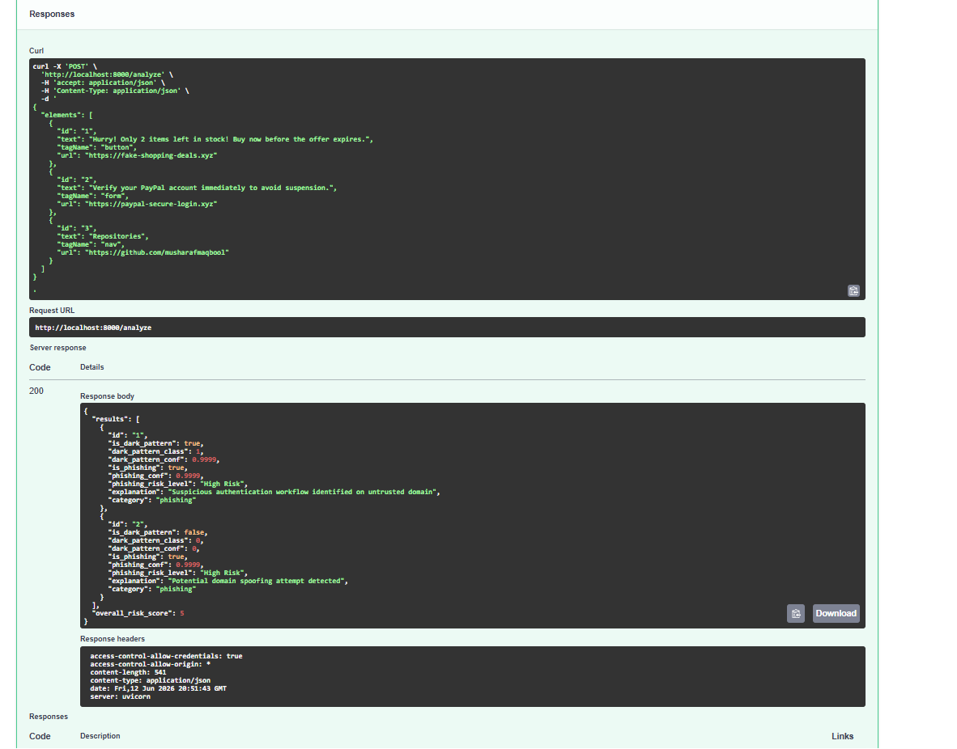
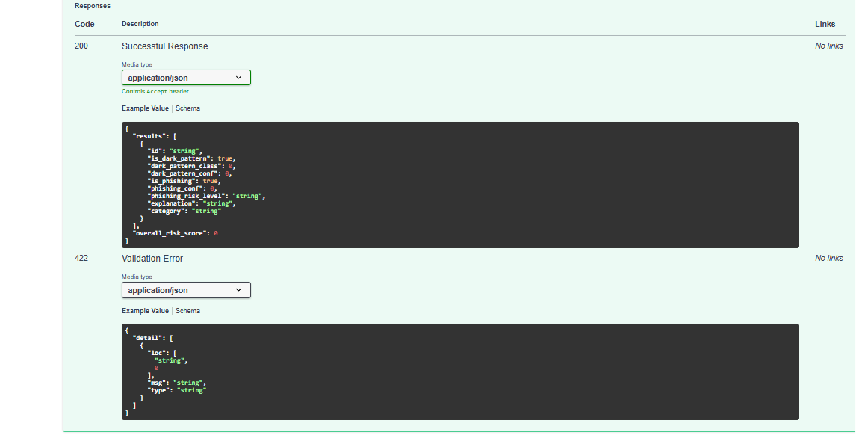
Screenshots & Live Demo
Swagger/OpenAPI Testing & Backend API Responses
Swagger/OpenAPI Interface (Deception Detection API v1.0)
/analyze Endpoint Execution (Sample phishing + dark pattern payload)
Successful JSON Response (Risk score + phishing conf + explanation)
◆ POST /analyze · Async batch inference · HTTP 200 response
◆ Fields: is_dark_pattern, is_phishing, phishing_risk_level, confidence, explanation, category
◆ overall_risk_score computed using weighted risk band formula
DESIGN TO DECEIVE · NIT Srinagar · Dept. of Information Technology and Engineering
13

Slide 14
Advantages of Proposed System
Key Technical Contributions & Benefits
🧠
Semantic Understanding
⚡
Real-Time Intervention
RoBERTa captures nuanced intent — detects psychological manipulation and social engineering beyond keyword matching.
Alerts users BEFORE they commit to a harmful action — shifts from incident response to proactive prevention.
🔗
Unified Threat Detection
✅
Contextual, Tiered Alerts
Single extension bridges usability (dark patterns) + security (phishing) — holistic defense in one tool.
Whitelist + reputation rules eliminate false positives on trusted sites while maintaining visibility for real threats.
🔒
Privacy Preservation
📊
Explainable Alerts
No password fields scanned. Text data held only in-memory during inference — never persisted to external database.
Tooltips provide confidence score, risk band, and human-readable explanation for every flagged element.
DESIGN TO DECEIVE · NIT Srinagar · Dept. of Information Technology and Engineering
14

Slide 15
Future Scope
Roadmap for Next-Generation Enhancements
🖼️
Multimodal Analysis
📱
Mobile Browser Support
🌍
Multilingual NLP
▸ Integrate Computer Vision (CNN) alongside NLP
▸ Detect visual dark patterns: grey buttons, contrast tricks
▸ DOM screenshot capture + layout-aware detection
▸ Extend to Firefox for Android & Safari iOS
▸ Adapt MutationObserver to mobile SPA rendering patterns
▸ Lightweight inference for mobile constraints
▸ Deploy XLM-RoBERTa for cross-lingual support
▸ Detection across 100+ languages
▸ Expanding protection to diverse global users
⚙️
Edge / On-Device ML
👥
Crowdsourced Threat Intel
🔐
Regulatory Compliance Layer
▸ Compile quantized models (TinyBERT/MobileBERT) to WASM
▸ Eliminate backend dependency → zero latency
▸ Absolute privacy — no data leaves the browser
▸ User-driven feedback loop from tooltips
▸ False positive / missed detection reporting
▸ Continuous fine-tuning of models from real traffic
▸ Automated GDPR dark pattern violation flagging
▸ Export detection reports for legal evidence
▸ Integration with FTC / EDPB compliance tools
DESIGN TO DECEIVE · NIT Srinagar · Dept. of Information Technology and Engineering
15

Slide 16
Conclusion
✓ Successfully developed an AI-powered browser extension for real-time detection of both dark patterns and phishing attacks
✓ RoBERTa-based NLP models integrated into active browsing environment — achieving 93.3% dark pattern & 90.0% phishing accuracy
✓ Hybrid 7-rule decision engine eliminates 100% false positives on trusted platforms (GitHub, Google, PayPal, Microsoft)
✓ Sub-second response (220ms avg) ensures seamless real-time browsing protection without performance degradation
✓ System validated via Swagger/OpenAPI with high-confidence detections on brand-spoofing, urgency, and confirmshaming
✓ Contributes to safer, more transparent internet by bridging cybersecurity and usability in a unified framework
Thank You!
Questions & Discussion
Musharaf Maqbool Mohammad Huzaif Gazi M. Rayan Shah
Under Guidance of Dr. Shabir Ahmad Sofi
NIT Srinagar June 2026
Keywords: Dark Patterns · Phishing Detection · RoBERTa NLP · Chrome Extension · FastAPI · Real-Time Threat Detection
Department of Information Technology and Engineering · National Institute of Technology Srinagar
B.Tech Final Year Project · Session 2025–2026
16

