Slide 1

Enhancing Operational Efficiency at C&H Sugars: Implementing a Cloud-Based ERP Solution for Streamlined Business Processes
Group Members
Aastha D. Kshatriya
Krishna Sahith Poruri
Musharraf M. Shaikh
Shloka Ramesh Daga
Srikanth Vooradi

Slide 2
Content
Introduction
SWOT Analysis
Cloud ERP
Management Problems
Technological Problems
Organizational Problems
Literature Review
KPI
Conclusion

Slide 3

Introduction
Welcome to the world of C&H Sugar, where sweetness meets a legacy of quality and commitment.
C&H Sugar, established in 1906, has been an integral part of kitchens across generations, adding joy to countless moments with its premium sugar products.
With over a century of experience, C&H Sugar has evolved into a household name known for its dedication to craftsmanship, innovation, and customer satisfaction.

Slide 4
SWOT Analysis
Strength:
Established brand reputation and market presence.
Diverse product portfolio catering to various consumer needs.
Strong supply chain and distribution network.
Weaknesses:
Potential reliance on traditional manufacturing and business processes.
Vulnerability to fluctuations in raw material prices.
Challenges in adapting to rapidly changing consumer preferences.

Slide 5
SWOT Analysis
Opportunities:
Expansion into new markets, especially in health-conscious segments.
Adoption of modern technologies (like cloud-based ERP) for improved efficiency.
Partnerships or collaborations for sustainable and ethical sourcing.
Threats:
Intense competition in the sugar industry.
Regulatory changes affecting production and distribution.
Economic downturns impacting consumer purchasing power.

Slide 6
Cloud ERP
Cloud-based ERP systems transform business processes via remote server hosting, improving accessibility and integration.
They offer cost savings, streamlined deployment, real-time data access, enhanced security, automatic updates, scalability, and seamless integration with third-party applications.
In the sugar industry, efficiency and quality control are pivotal.
Cloud-based ERP systems boost operational efficiency, providing enhanced data management, streamlined processes, and improved decision-making capabilities.

Slide 7
Management Problem
Environmental Compliance Problems: Allegations of discharging pollutants, indicating gaps in environmental management.
Supply Chain Management Issues: Inefficiencies and potential vulnerabilities in the supply chain, which can be improved with better data management.
Customer Relationship Management: Potential gaps in understanding and meeting customer needs and preferences, possibly due to insufficient market analysis and customer data utilization.
Deficient Strategic Planning: Difficulty in long-term planning and setting achievable goals, affecting the company's direction.
Resource Misallocation: Challenges in allocating resources effectively due to a lack of strategic direction.
Inadequate Pollution Control Measures: Suggesting outdated or poorly maintained equipment and lack of effective methods.

Slide 8
Solutions
ERP systems can also improve operational efficiency by cutting waste, simplifying manufacturing procedures, and making the most use of available resources.
ERP can offer a single platform for recording and managing environmental data, such as documentation of regulatory compliance, trash disposal records, and emissions monitoring.
ERP systems can be used to exchange information with stakeholders and regulatory bodies, as well as to enhance communication across various divisions within the business.
ERP systems can be utilized to detect and handle possible issues as well as to monitor and manage pollution control machinery.
ERP be used to report on the environmental performance of the business and monitor the advancement of environmental initiatives.

Slide 9
Technological Problems
Inefficiencies and bottlenecks in its supply chain and production processes
ACS has encountered the requirement to adjust to progressively rigorous food safety regulations.
The implementation of new food safety protocols has been compromised as the company's legacy systems failed to provide sufficient support, posing risks to both product quality and regulatory compliance.
The implementation of new food safety protocols has been compromised due to the company's legacy systems' inadequate support.
This inadequacy poses risks to both product quality and regulatory compliance.

Slide 10
Solutions
Cloud-based ERP systems offer the advantage of automatic updates, reducing the burden on IT departments and ensuring the organization always has the latest software version.
These systems can be deployed faster than traditional ERP systems, leading to a rapid return on investment.
Cloud ERP solutions require significantly lower upfront costs, as there's no need for expensive hardware or extensive computer networks.
loud ERP systems can seamlessly integrate with other business applications, reducing the need for expensive customizations​​.
Cloud ERP systems enable seamless inter-departmental collaboration and quick decision-making, thanks to their real-time data and analytics capabilities​​.

Slide 11
Organizational Problems
One of the central organizational challenges is the economic dependence of the town on a single company, C&H. In the past, the company was deeply involved in the community and provided employment for a significant portion of the population.
Organizational challenges related to supply chain management, ethical sourcing, and compliance with labor and environmental standards are significant in a globalized marketplace.
maintaining a balance between corporate interests and community needs and expectations, as well as building trust and transparency in this relationship.

Slide 12
Solutions
Streamlining Order Processing:
ERP systems automate and streamline order processing workflows, reducing manual intervention and minimizing the chances of errors.
Reducing Operational Costs:
By automating routine tasks, eliminating redundant processes, and optimizing resource allocation, ERP systems contribute to significant cost savings in operational activities.
Facilitating Communication and Collaboration:
ERP systems integrate various departments, fostering seamless communication and collaboration between sales, inventory management, shipping, and other relevant team.

Slide 13
Literature Review
Challenges Faced by American Crystal Sugar Company (ACS):
Management Challenges:
Slow adaptation to market changes.
Organizational Challenges:
Lack of diversity affecting talent acquisition.
Technological Challenges:
Aging infrastructure, especially outdated sugar factories.

Slide 14
Literature Review
Cloud ERP Adoption Challenges:
Data Security Concerns:
Mitigated with reputable providers (e.g., AWS).
Integration Complexity:
Addressed by solutions like IBM Cloud Integration.
Change Management:
Emphasized in resources from Salesforce, following Coca-Cola's successful model.
Data Migration:
Supported by tools and expertise of Oracle Cloud ERP (e.g., Nokia's transition).

Slide 15
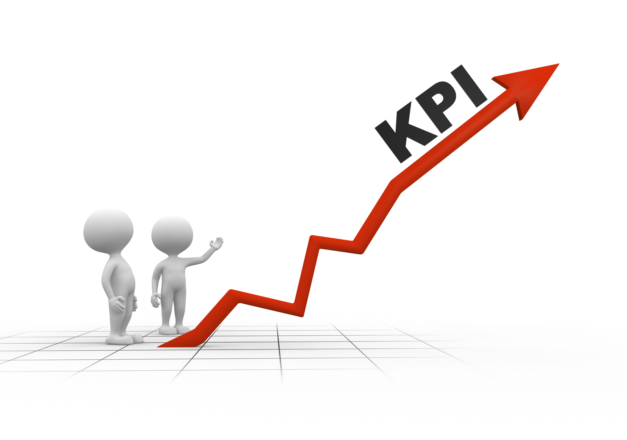
KPI
Cost Reductions
IT Infrastructure & Maintenance Cost Savings
Compare monthly/annual cost savings with previous ERP system
Return on Investment (ROI)
Calculate ROI over a designated time frame
Productivity and Efficiency
Order Processing Time
Track duration from initiation to fulfillment
Worker Productivity
Measure changes in tasks or transactions completed per employee

Slide 16
KPI
Information Administration
Data Accuracy
Monitor accuracy in data entry and reporting
Data Retrieval Speed
Measure time for accessing crucial decision-making information.
Integration and Compatibility
Integration Success Rate
Percentage of successful integrations with third-party apps
Compatibility Issue Resolution
Time required to fix compatibility problems during transition

Slide 17
Conclusion - Empowering C&H Sugars with Cloud-Based ERP
Strategic Insights:
Analysis through SWOT, Porter’s Five Forces, and Value Chain highlights the need for C&H Sugars to adopt technological advancements.
A cloud-based ERP system is identified as key to enhancing operational efficiency and competitiveness.
Impact of Cloud-Based ERP:
Offers scalability, improved data analytics, and seamless integration, addressing current operational challenges.
Aligns with the mission of C&H Sugars, enhancing decision-making and customer satisfaction.
Recommendations:
Transition to a proven cloud-based ERP solution, considering industry leaders like SAP and Oracle.
Monitor KPIs such as cost reduction, productivity, and customer feedback to measure success.

Slide 18
THANK YOU!!!!

