Slide 1

Global Economic Indicator Forecasting
Team:
Musharraf Shaikh
Aastha Kshatriya
Deepak Deokar
Ajay Tupe

Slide 2

Agenda:
Objective
CRISP-DM Process Overview
Data usage and limitation
Data Preparation
Implementation & Results
Model Evaluation & Comparison
Time Series
Future Work & Conclusion

Slide 3
Objective
Create a machine learning model to forecast key global economic indicators, aiding policymakers and investors in strategic decision-making and risk management.
Framework: Utilized CRISP-DM (Cross-Industry Standard Process for Data Mining)

Slide 4

CRISP-DM Process Overview
CRISP-DM Process Content:
1. Business Understanding
2. Data Understanding
3. Data Preparation
4. Modeling
5. Evaluation
6. Deployment

Slide 5

Data usage and limitation
Data Source: World Bank.
Key Variables: GDP,GDP growth rate, population, per capita GNI, sectoral contributions.
Collection Methodology: Compiled from national stats, international trade, and financial markets.
Granularity Level: Annual data from 1970 to 2021 for countries.
Worldwide coverage: Includes data for defunct and newly formed countries.
Limitations: Some incomplete country records; recent data may be provisional, null values in data, normalization of columns like GDP and GNI.
Preparation: Data has been cleaned, normalized, and validated.
Use Case: Historical trend analysis, economic performance comparison, future GDP growth forecasting.

Slide 6
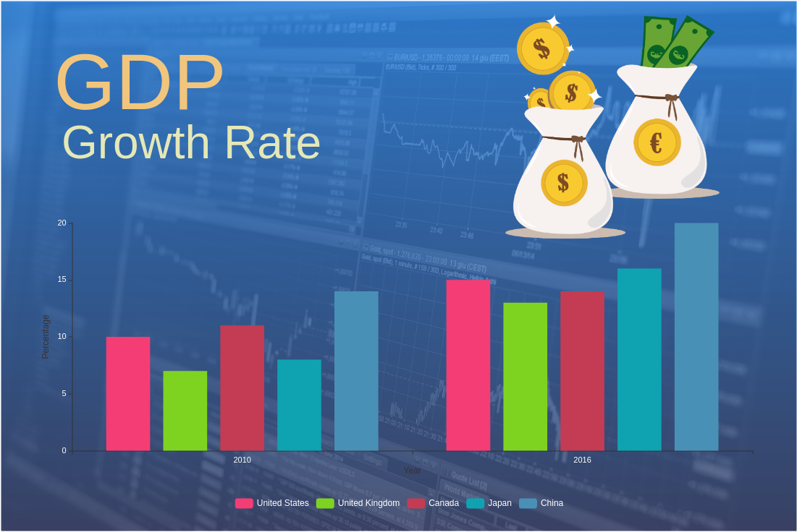
Target variable:
Annual GDP Growth Rate (%)
= (Most recent year's real GDP - Last year's real GDP)
Last year's real GDP.
Important Aspects:
1. Positive or Negative Rate
2. Value of all Goods and Services
3. Policy Decisions by Government
4. Economic Trends
5. Investment Decisions

Slide 7
Data Preparation
Steps Taken:
Interpolation
01
Normalization
02
Removal of ineffective, duplicate and irrelevant columns.
03
Removal of columns based on count of unavailable values.
04
Derived target variable
05
Data Conversion and Dummy Encoding
06
Notes:
Steps Taken:
Interpolation:- Averaging the missing values based on previous and next years' values.
Normalization:- According to data type, values are normalized.
Removal of ineffective, duplicate and irrelevant columns.
Removal of columns based on count of unavailable values.
Derived target variable:- Target variable is derived using a formula
Data Conversion and Dummy Encoding:- Converted categorical variables to numerical and dummy encoding

Slide 8
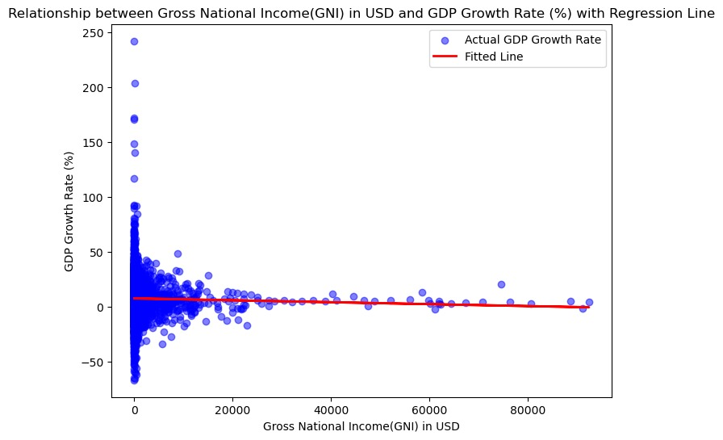
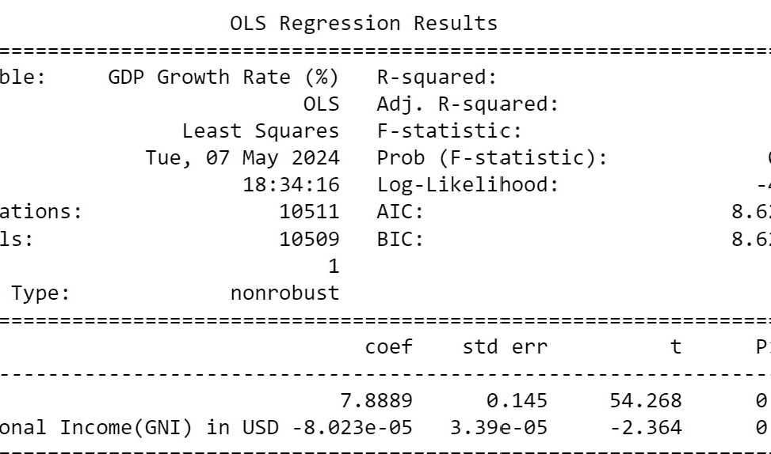
Model : Implementation and Results
Simple Linear Regression: Using GNI column as predictor

Slide 9
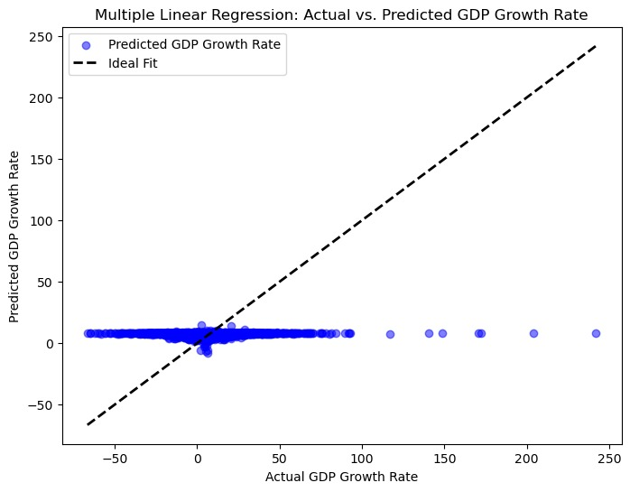
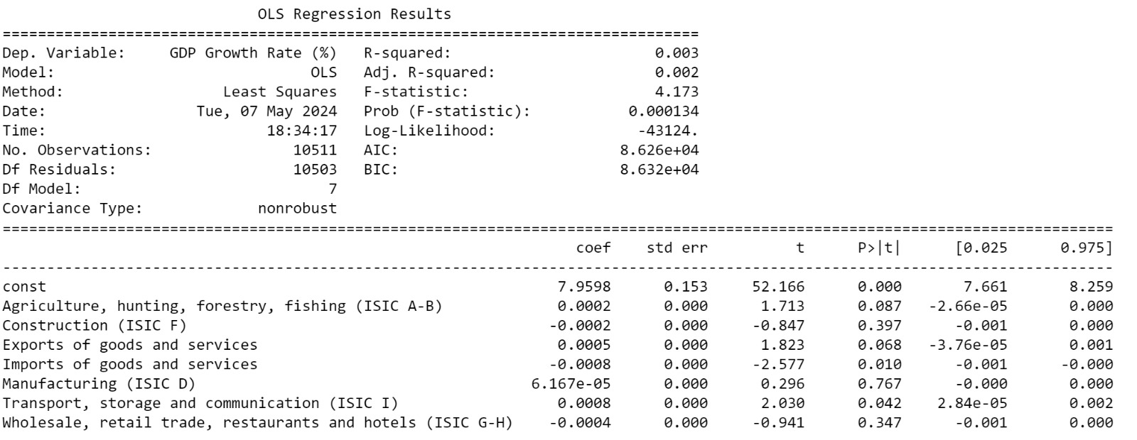
Model : Implementation and Results
Multiple Linear Regression: Using multiple columns for prediction

Slide 10
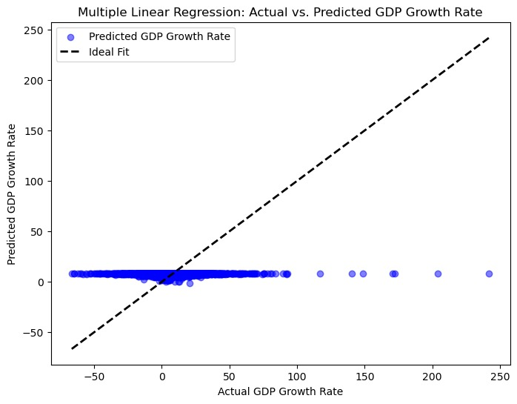
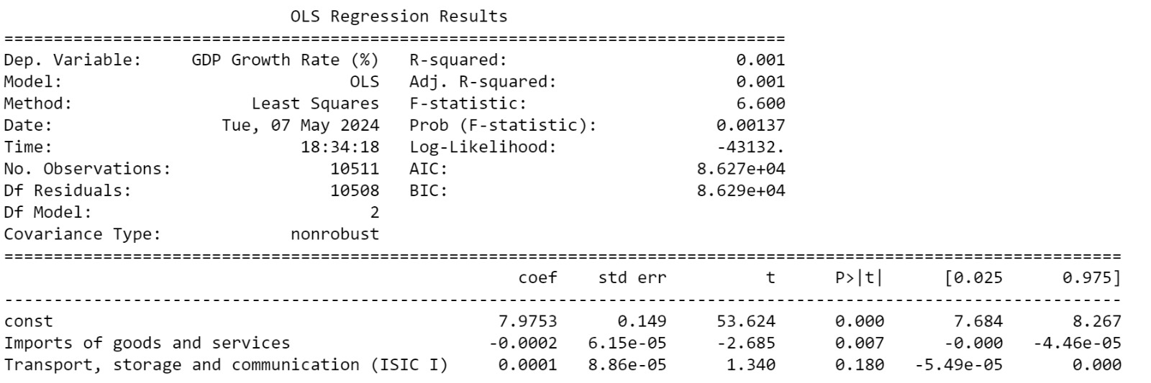
Model : Implementation and Results
Multiple Linear Regression: Using High Impacting Columns as Predictors

Slide 11
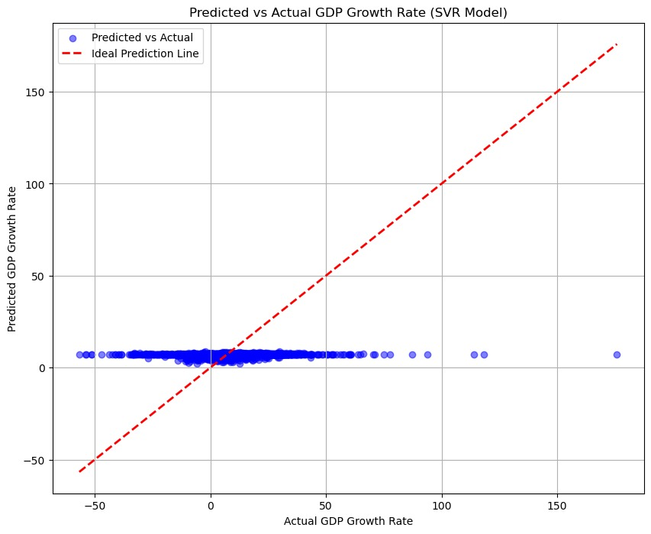
Model : Implementation and Results
Support Vector Regression (SVR)

Slide 12
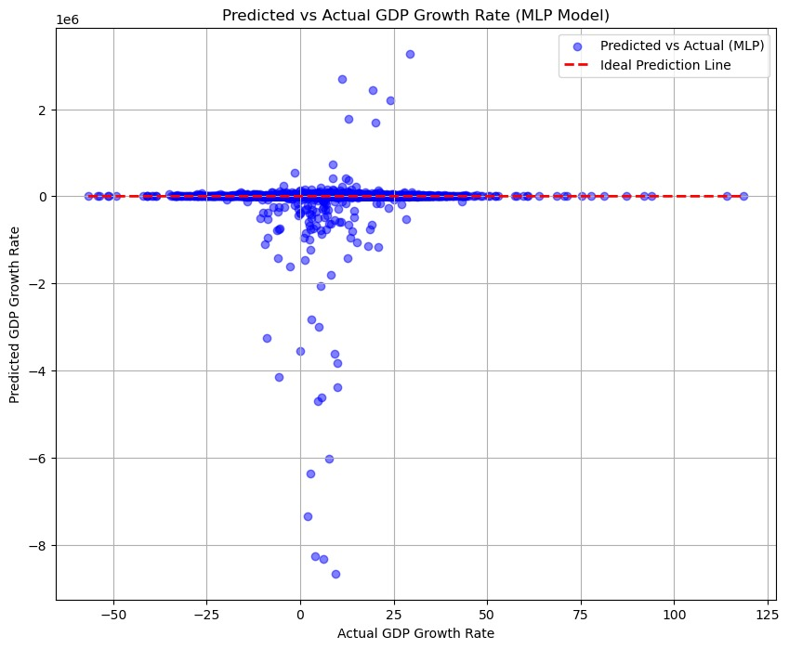
Model : Implementation and Results
MLP Model

Slide 13
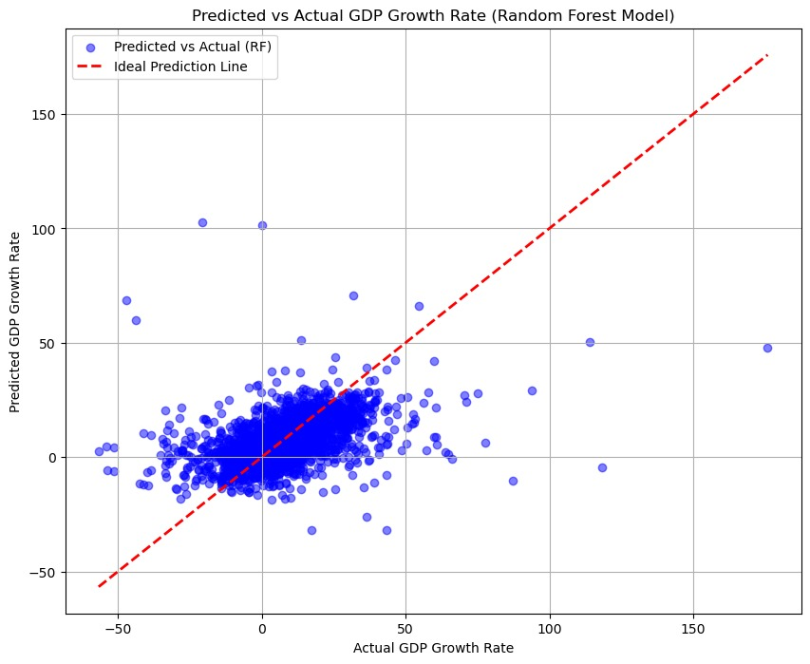
Model : Implementation and Results
Random Forest Model

Slide 14
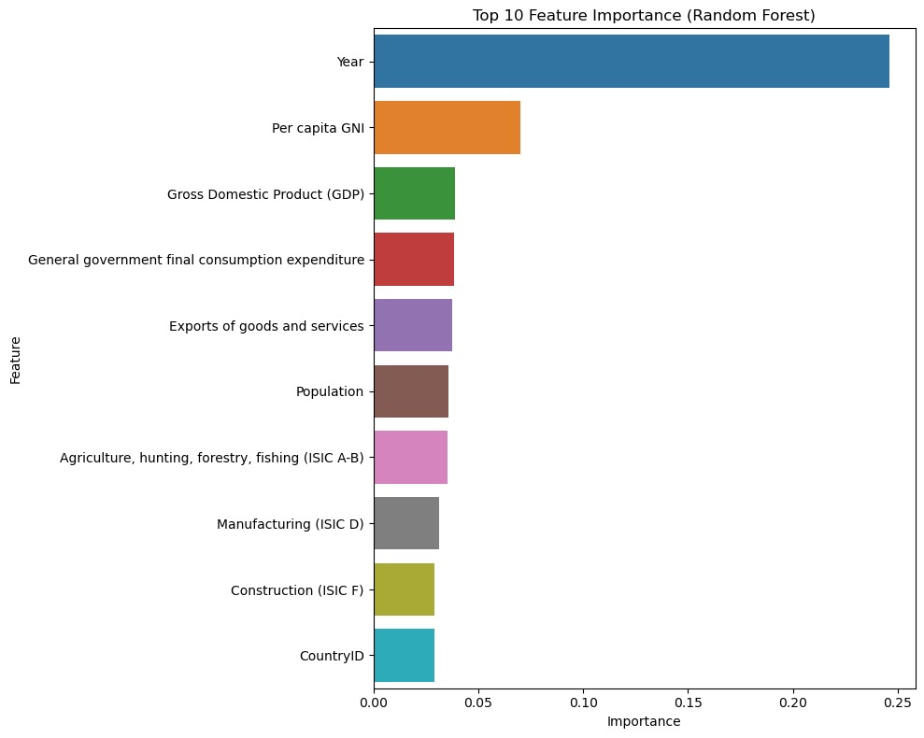
Model : Implementation and Results
Random Forest Model

Slide 15
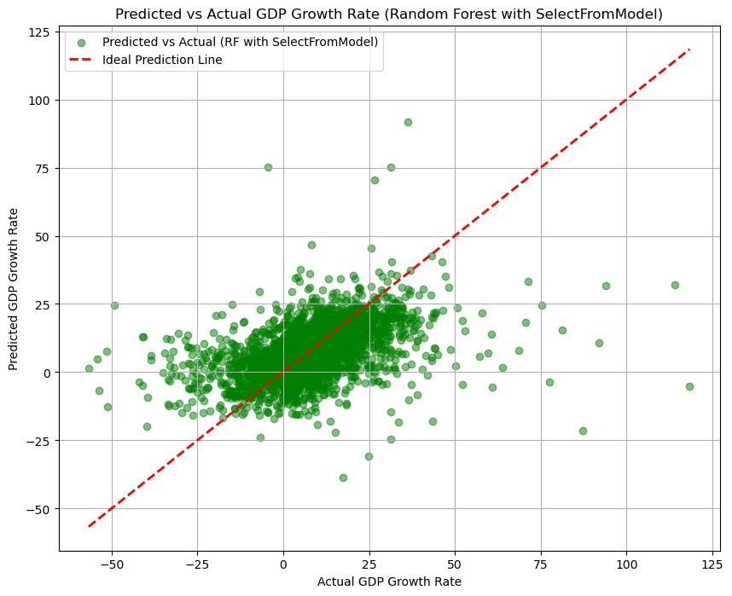
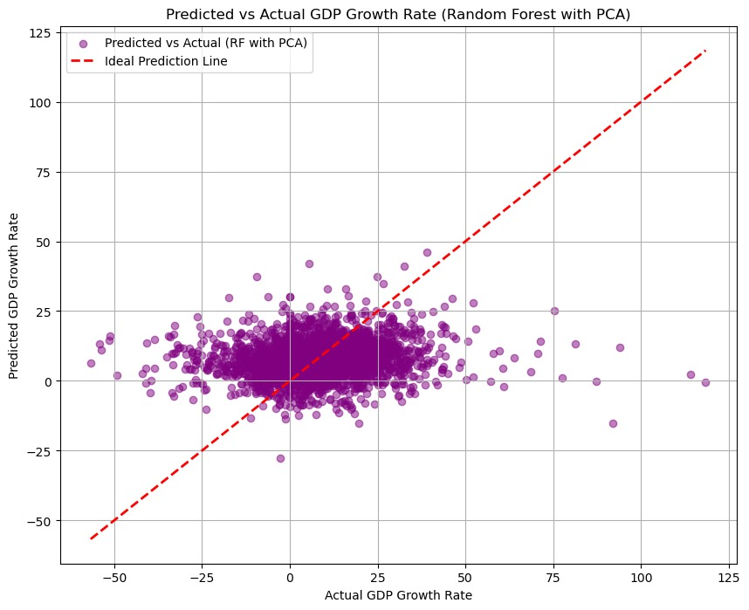
Model : Implementation and Results
Random Forest Model: Feature Engineering
Polynomial Features: Created interaction terms for better prediction
Select From Model: Selected top 20 features using Random Forest Regressor

Slide 16
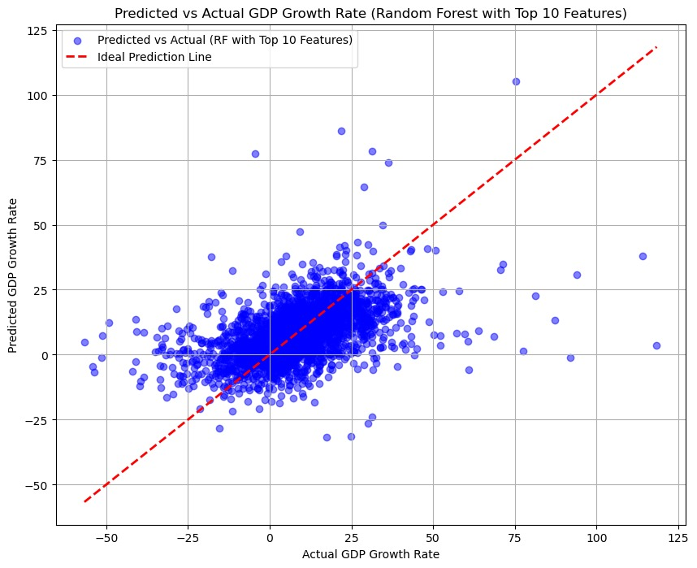
Model : Implementation and Results
Random Forest Model with Top 10 Features

Slide 17
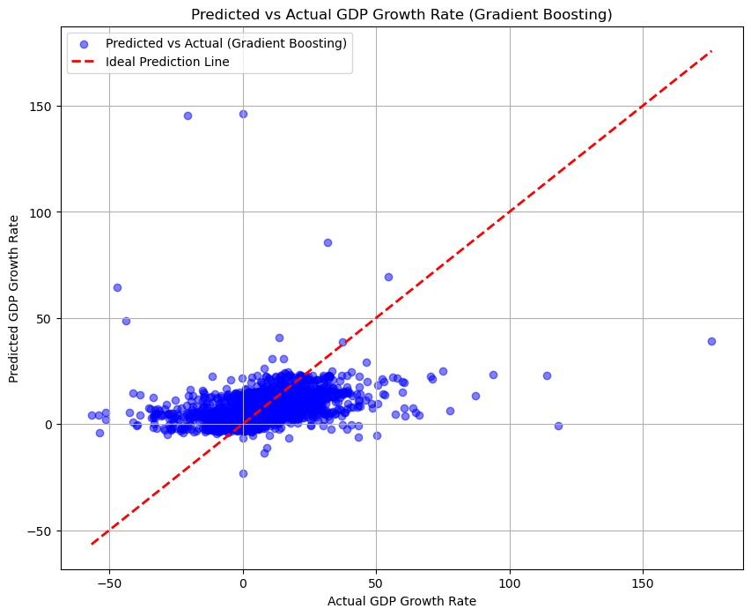
Model : Implementation and Results
Gradient Boosting Model

Slide 18
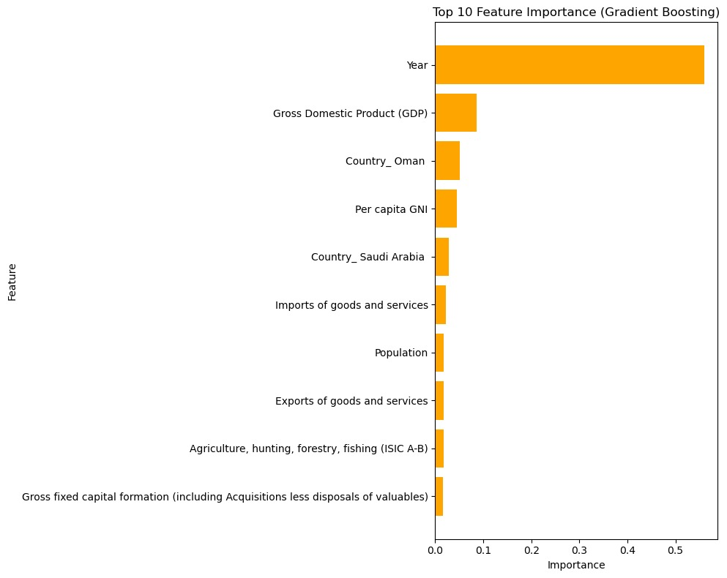
Model : Implementation and Results
Gradient Boosting Model For Top 10 Features

Slide 19
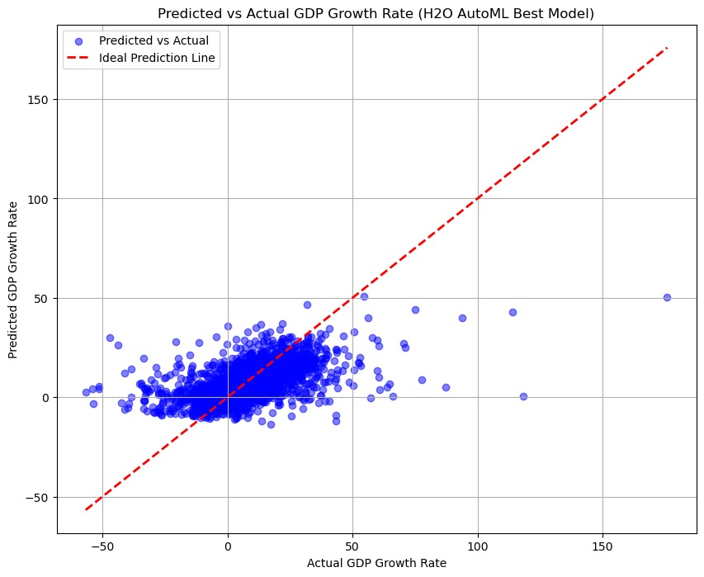
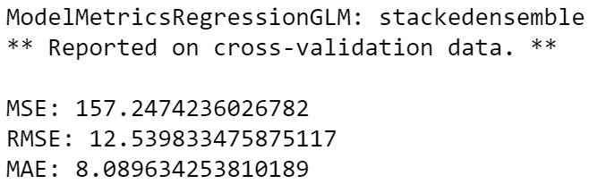
Model : Implementation and Results
H2O Model

Slide 20
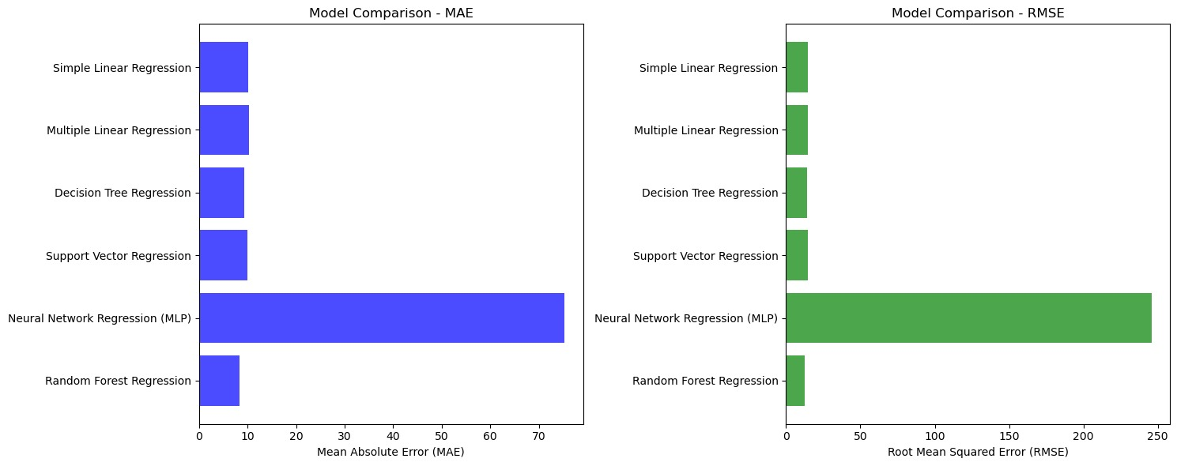
Evaluation : Comparison
Best Prediction Model:
H2O AutoML StackedEnsemble
Decision Tree Regressor
Random Forest

Slide 21
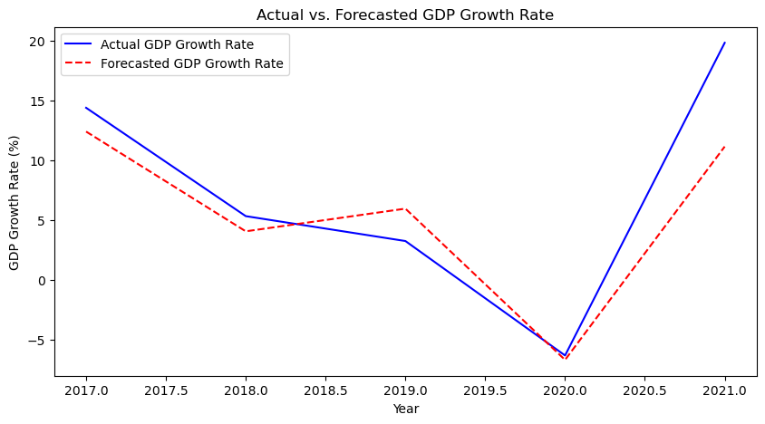
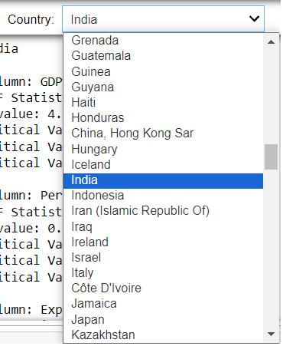
Time Series Analysis

Slide 22

Future Work & Conclusion
Future Work:
Incorporate more economic indicators to refine the model.
Expand the model for forecasting other economic parameters.
Create a web-based application for real-time prediction
Conclusion:
The project successfully demonstrated the application of machine learning models to predict GDP growth rates.
H2O AutoML provided an efficient and accurate solution for model selection.
Further feature engineering and model optimization can significantly enhance prediction accuracy.

Slide 23

Thank you

