Slide 1

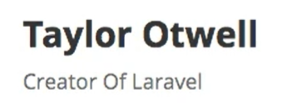
Medhat Elmasry
Notes:
https://app.pluralsight.com/course-player?clipId=526d2f7e-e537-4ea2-8b88-3561d9ba0c69

Slide 2

Laravel?
Great Documentation
https://laravel.com
Tons of Utilities & Helpers
Rich Ecosystem
Beautiful Code
PHP Framework
Syntactical Sugar
Secure, Lean & Fast
Awesome Community
Model-View-Controller (MVC)

Slide 3
Opinionated
app/Http/Controllers | Contains controller files
app/Models | Contains Models
resources/views | Views
routes | Routes
Laravel is said to be opinionated. This means that you must put your code in the proper directories for it to work properly.

Slide 4
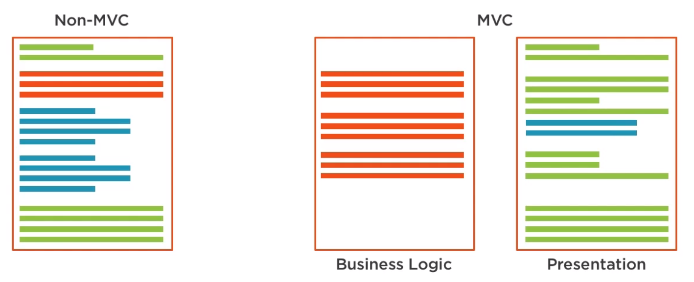
Non-MVC vs MVC
HTML
PHP
Data

Slide 5
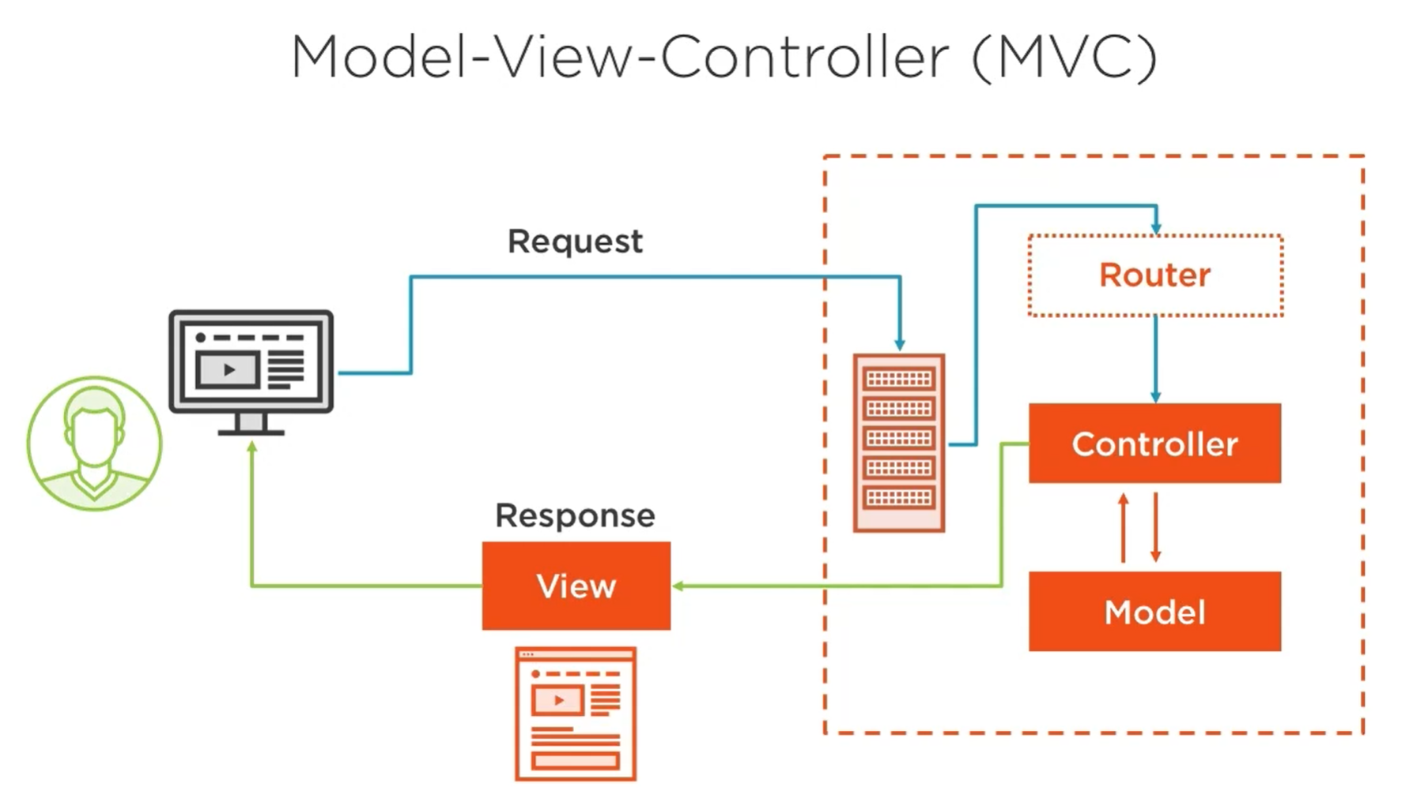
Model-View-Controller (MVC)

Slide 6
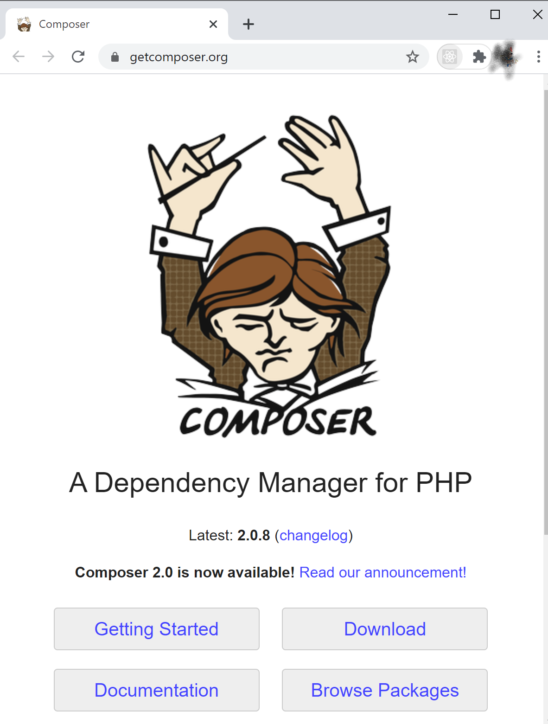
Installing Laravel
https://laravel.com
First, you need composer (PHP package manager) from https://getcomposer.org
Install Laravel
composer create-project laravel/laravel FOLDER

Slide 7
Getting started
Enable these extensions in php.ini
extension_dir="ext"
extension=openssl
extension=mbstring
extension=fileinfo
extension=zip
extension=pdo_mysql
composer create-project laravel/laravel laravel-rocks cd laravel-rocks
cd public
php -S localhost:8888
Alternatively, you can start the server in the app’s root folder is with the following command (recommended):
php artisan serve --port=8888

Slide 8
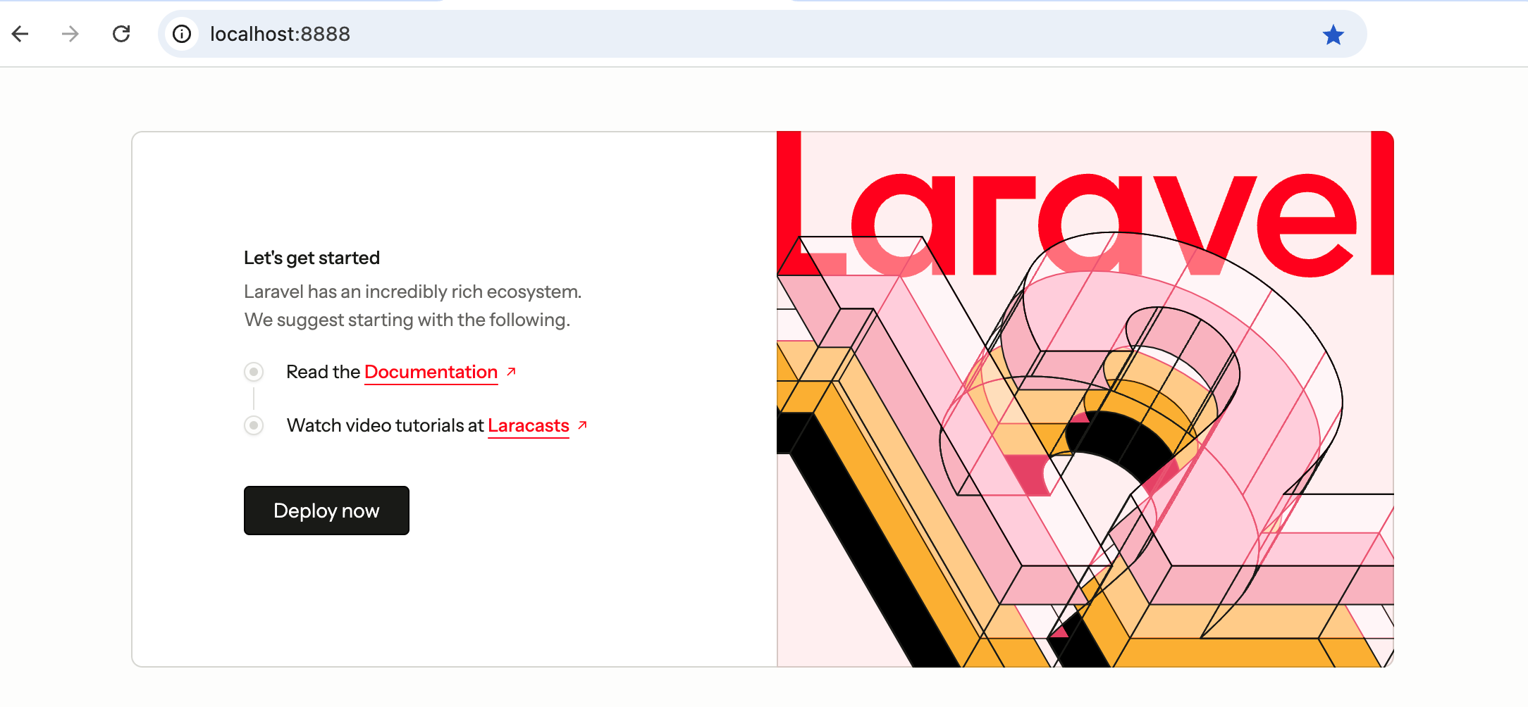
http://localhost:8888

Slide 9
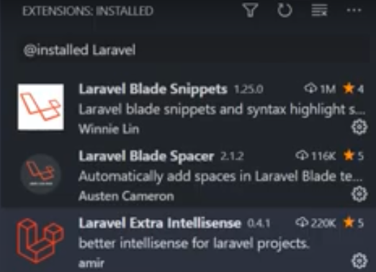

Useful VS Code extensions
Laravel Blade Snippets
Laravel Blade Spacer
Laravel Extra Intellisense
Laravel Blade formatter

Slide 10
The Artisan CLI
Allows you to quickly create (scaffold) application components - example
Create a controller
Generate unique key
Alternative to manual file creation
Utility commands
php artisan COMMAND

Slide 11
Views & Blade Templating Engine

Slide 12
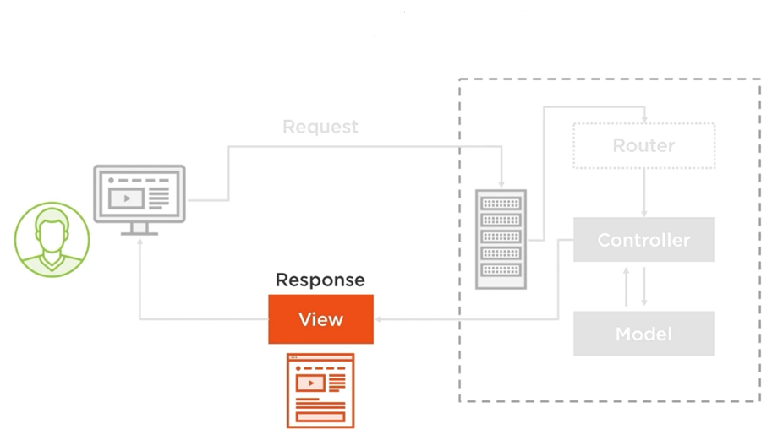
Where are we?

Slide 13
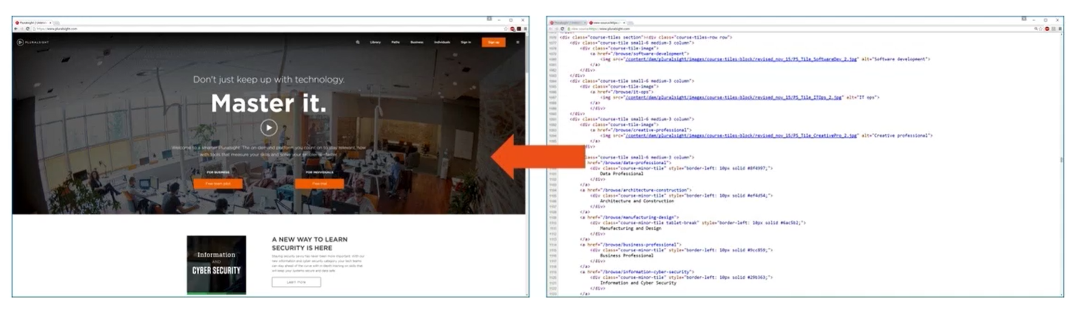
What is a view?
A view is what the user sees.

Slide 14
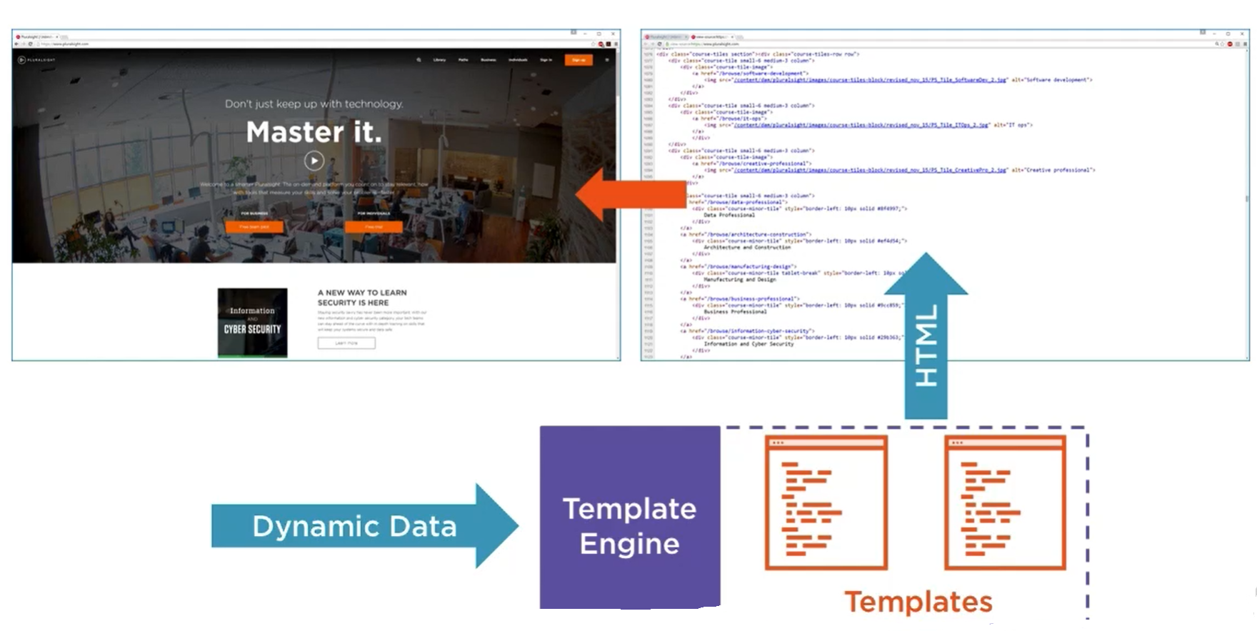
Views & templating engines

Slide 15
The blade templating engine
Allows you to dynamically create your views without mixing PHP & HTML.
<div>
<p>Hello {{ $name }}</p>
</div>
Display Data

Slide 16
The blade templating engine
Layouts, Inheritance & Modules
Layout
User
About
User & About pages share the same template (or layout)

Slide 17
intro_to_laravel_SCRIPT

Slide 18
The blade templating engine
Layouts, Inheritance & Modules
Any file with extension .blade.php will be handled by the Laravel internal templating engine.
<div>
@yield('content');
</div>
@extends('layout')
@section('content')
<div>
<p>Insert this!</p>
</div>
@endsection
inject

Slide 19
Important keywords
<!DOCTYPE html>
<html lang="{{ str_replace('_', '-', app()->getLocale()) }}">
<head>
<meta charset="utf-8">
<meta name="viewport" content="width=device-width, initial-scale=1">
<title>Laravel</title>
</head>
<body>
@yield('content')
</body>
</html>
@yield(' …… ')
@extends(' …… ')
@section(' …… ')
@extends('layouts.master')
@section('content')
<span style="color:white; background:tomato;font-size:xx-large;">
Helloooooo Laraveeeeel
</span>
@endsection
@endsection
Notice no <?php . . . . . . ?>

Slide 20
Partial views
<div>
@include('header')
</div>
<nav>
<a> href=''>Products</a>
<a> href=''>About us</a>
</nav>

Slide 21
Partials demo
Create folder resources/views/partials
Create file resources/views/partials/header.blade.php with content:
<nav class="navbar navbar-default">
<div class="container-fluid">
<div class="navbar-header">
<a href="#" class="navbar-brand">Laravel Guide</a>
<ul class="nav navbar-nav">
<li><a href="#">Products</a></li>
<li><a href="#">About us</a></li>
</ul>
</div>
</div>
</nav>

Slide 22
Control Structures (example)
<div>
@if($id == 5)
<p>Secret!</p>
@endif
<ul>
@foreach($posts as $item)
<li>{{ $item }}</li>
@endforeach
</ul>
</div>

Slide 23
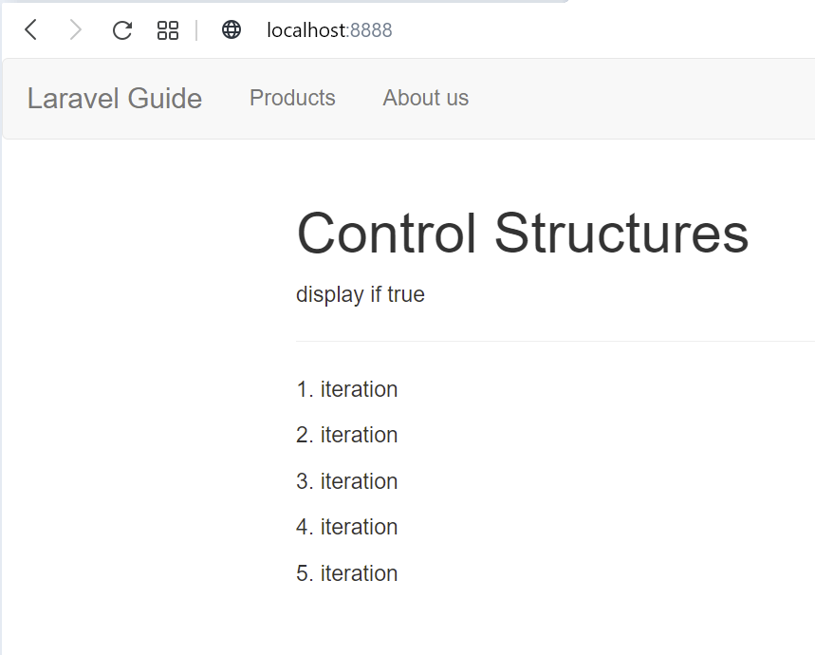
Control structures demo
Replace welcome.blade.php with the following:
@extends('layouts.master')
@section('content')
<div class='row'>
<div class="col-md-12">
<h1>Control Structures</h1>
@if(true)
<p>display if true</p>
@else
<p>display if false</p>
@endif
<hr />
@for($i=0; $i<5; $i++)
<p>{{ $i+1 }}. iteration<p>
@endfor
</div>
</div>
@endsection

Slide 24
Comments in blades (views)
<p>{{ $article['content']}}</p>
{{-- <p>{{ $article['content']}}</p> --}}
{{ var_dump($article) }}
{{-- var_dump($article) --}}

Slide 25
Cross site scripting attack protection
<div>
<p>{{ "<p>will not work</p>" }}</p>
<p>{!! "<p>will work</p>" !!}</p>
</div>
XSS protextion

Slide 26
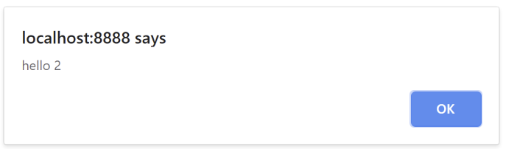
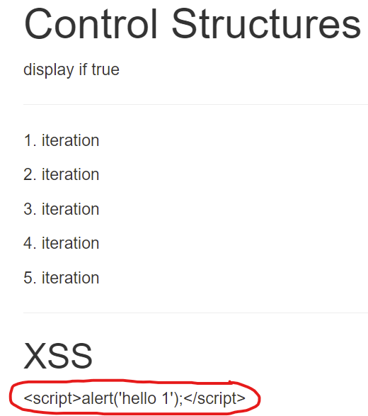
XSS protection demo
Add the following code to welcome.blade.php just before @endsection:
<hr />
<h2>XSS</h2>
<div>
<p>{{ "<script>alert('hello 1');</script>" }}</p>
<p>{!! "<script>alert('hello 2');</script>" !!}</p>
</div>

Slide 27
Facades
Service container
Session
Response
URL
Request
Route
……
<Code>

Slide 28
URL facade
In master.blade.php, replace the custom css link statement with the following:
<link rel="stylesheet" href="{{URL::to('css/styles.css')}}" />
This is better so that the asset is always found with absolute addressing

Slide 29
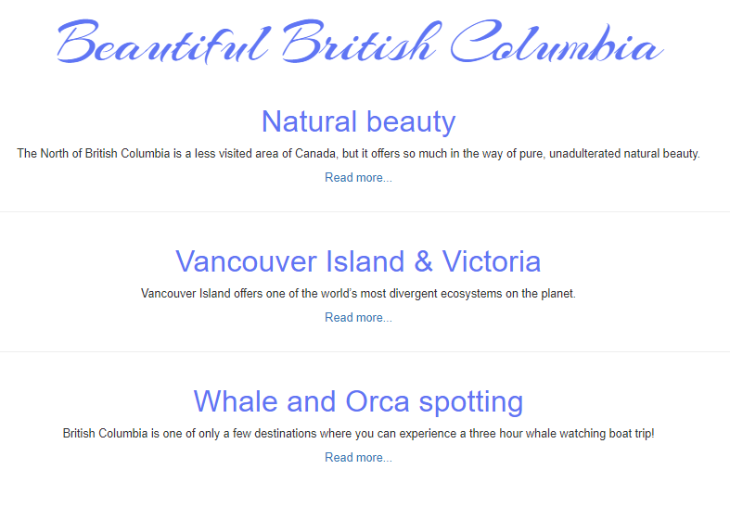
Google font
Add the following google font to master.blade.php:
<link href='http://fonts.googleapis.com/css?family=Arizonia' rel='stylesheet' type='text/css'>

