Slide 1
Intro to Azure Functions
Medhat Elmasry

Slide 2
Azure server-less compute
It’s now becoming easier than ever to create small, targeted micro-service architecture using a variety of services
Azure provides many services that can help you achieve a low-friction, high-throughput and low-cost solution

Slide 3
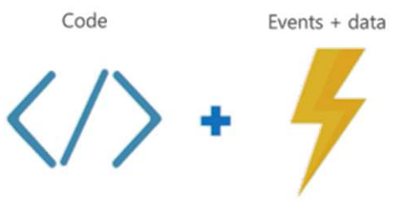
What is Azure Functions?
Azure Functions are a server-less, event driven experience that extends the existing Azure App Service platform
Azure Functions are “nano-services” that can scale based on demand (only paying for the resources you use)
Think of Azure Functions as…

Slide 4
What is Azure Functions (cont’d)
Server-less
Don’t worry about the infrastructure and provisioning of servers, especially when your functions scales up
Accelerate development
Write your code in the portal for immediate execution
Quickly and easily iterate with continuous deployment (Visual Studio Team Services, GitHub, BitBucket)
Bind into services
Easily add bindings to Azure services and external services (Box, DropBox, OneDrive, SendGrid, …) to get input into or output from your Azure Functions

Slide 5
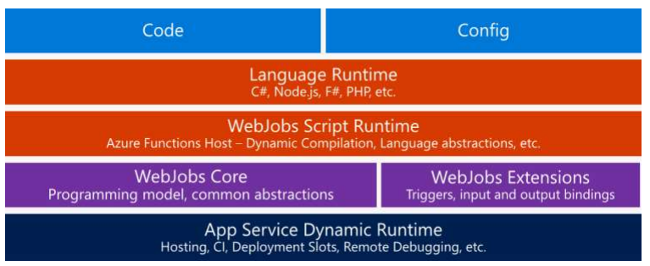
Azure Functions architecture
Azure Functions are built on top of Azure App Service and WebJobs SDK.

Slide 6
Features of Azure Functions
Choice of language
Pay-per-use pricing model
Bring your own dependencies (NuGet, NPM)
Integrated security
Simplified integration
Flexible development / deployment
Open-source
Very close to the metal, quickly caches and uncaches

Slide 7
Supported languages and tools
Azure Functions can be created in:
C#
Node/JavaScript
Python
F#
PHP
and scripting languages like PowerShell, Batch and Bash
Azure Functions can even run EXE’s or call into DLL’s

Slide 8
What can I do with Azure Functions?
Azure Functions are great for processing data, integrating systems, working with IoT, simple API’s and micro-services
Azure Functions provide templates for a number of key scenarios
Azure Functions supports
Triggers - a way to start execution
Bindings - a way to simplify code for input and output of data

Slide 9
Integrations
Azure Functions can be triggered by virtually any event in Azure, other 3rd party services or even from on-premise systems
These services can trigger your function (startup) or serve as input and output for your code
DocumentDB | Event Hubs
Mobile Apps (tables) | Notification Hubs
Service Bus (queues, topics) | Storage (blob, queues, tables)
GitHub (webhooks) | Twilio (SMS messages)
On-premises (using Service Bus)

Slide 10
Available trigger templates
BlogTrigger
EventHubTrigger
Generic webhook
GitHub webhook
HttpTrigger*
QueueTrigger
ServiceBusQueueTrigger
ServiceBusTopicTrigger
TimerTrigger
* Every function type with the exception of the HttpTrigger type will require a storage account.

Slide 11
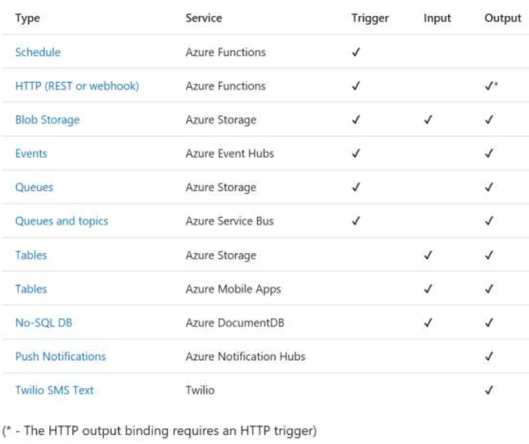
Triggers and bindings
A function can have any number of input and output bindings but can only have a single trigger binding.
The following is a list of different triggers and their available bindings:

Slide 12
Securing your Azure Functions
HttpTriggers can be protected by OAuth providers such as:
Azure Active Directory
Microsoft Account
Facebook
Google
Twitter

Slide 13
Visual Studio Tools for Azure Functions
Provides local development and tooling experience
Remote debugging is supported
Running locally is handled by the Azure Functions CLI
Provides publish to Azure

Slide 14
Approach to building functions
When building your Azure Functions consider this…
“A key to realizing the full value is to write only the smallest unit of logic to do a single scope of work and to keep the dependencies to a minimum.”
– Joseph Fultz and Darren Brust, MSDN Magazine

Slide 15
Best practices
Functions should “do one thing”
Functions should be idempotent
Functions should finish as quickly as possible

Slide 16
Common scenarios for Azure Functions

Slide 17
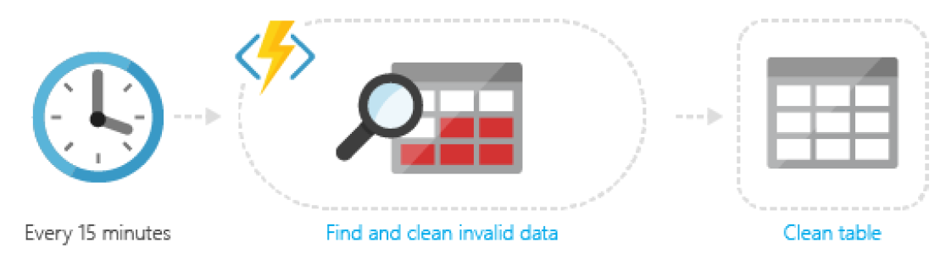
Timer-based processing
Azure Functions supports an event based on a timer using CRON job syntax.

Slide 18
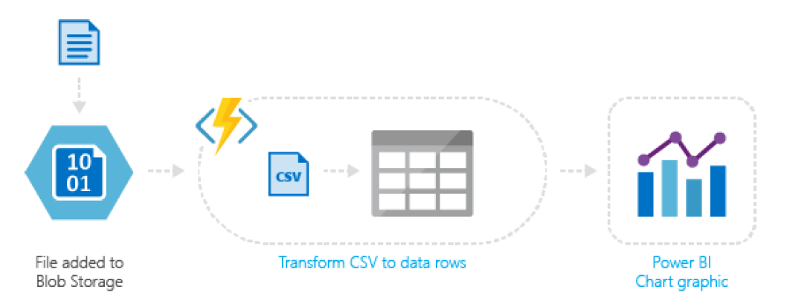
Azure service event processing
Azure Functions supports triggering an event based on an activity in an Azure service.

Slide 19
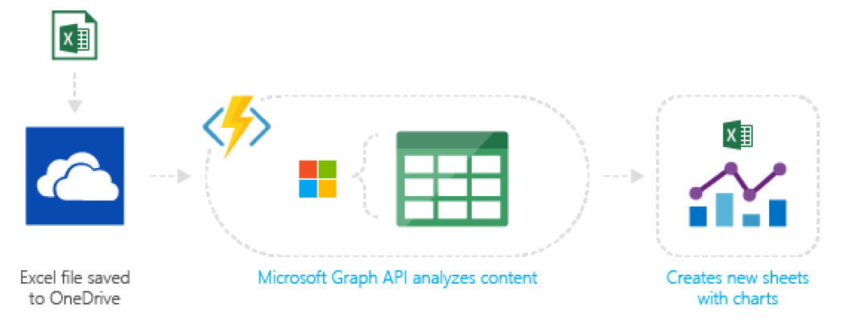
SaaS event processing
Azure Functions supports triggers based on activity in a SaaS service.

Slide 20
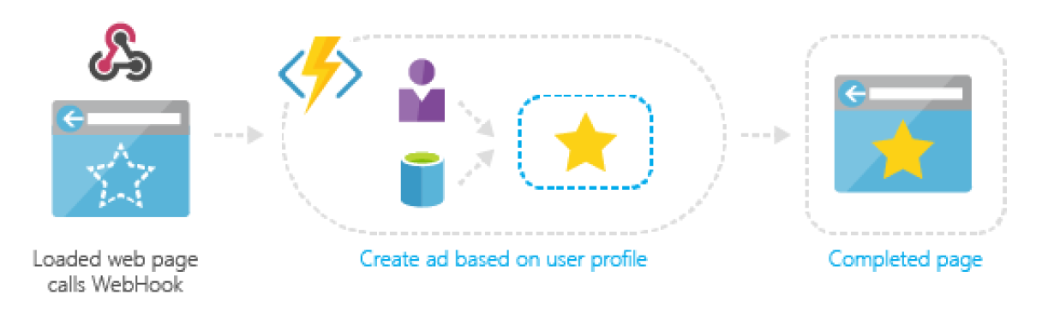
Server-less web application architectures
Azure Functions can power a single page app.

Slide 21
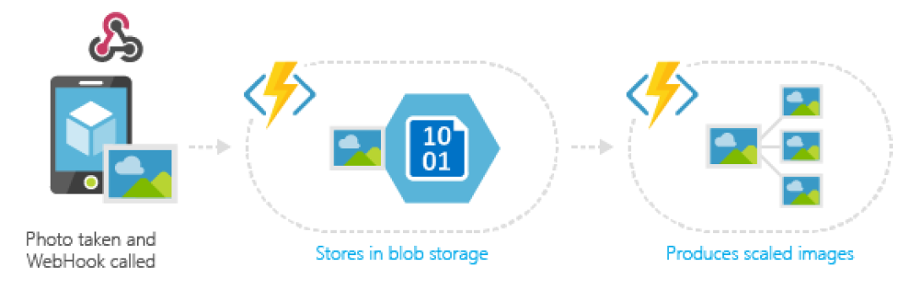
Serve-less mobile back-ends
A mobile backend can be just a set of HTTP APIs that are called from a mobile client using the WebHook URL.

Slide 22
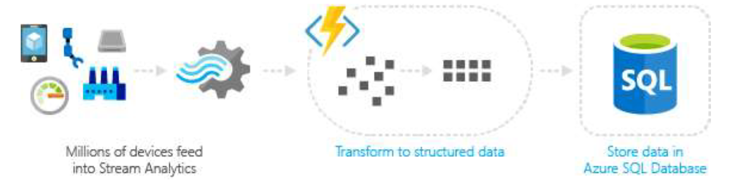
Real-time stream processing
Azure Functions can power an IoT Stream Analytics app.

Slide 23
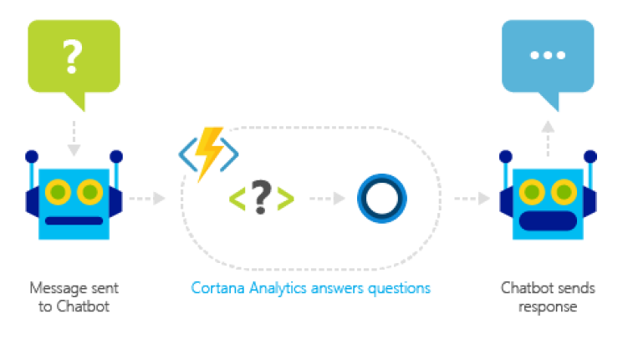
Real-time bot messaging
Azure Functions can be used to customize the behavior of a bot using a WebHook.

Slide 24
Pricing
No upfront cost
No termination fees
Pay only for what you use
Only pay for the time your code is running. You’ll be charged based on the number of resources your Azure Functions needs, and only for as long as it takes your code to execute.

Slide 25
Benefits
Focus ion code and not managing infrastructure.
Reduced time to market
Lower total cost of ownership
Pay per execution

