Slide 1

C# Meets AI
Medhat Elmasry

Slide 2
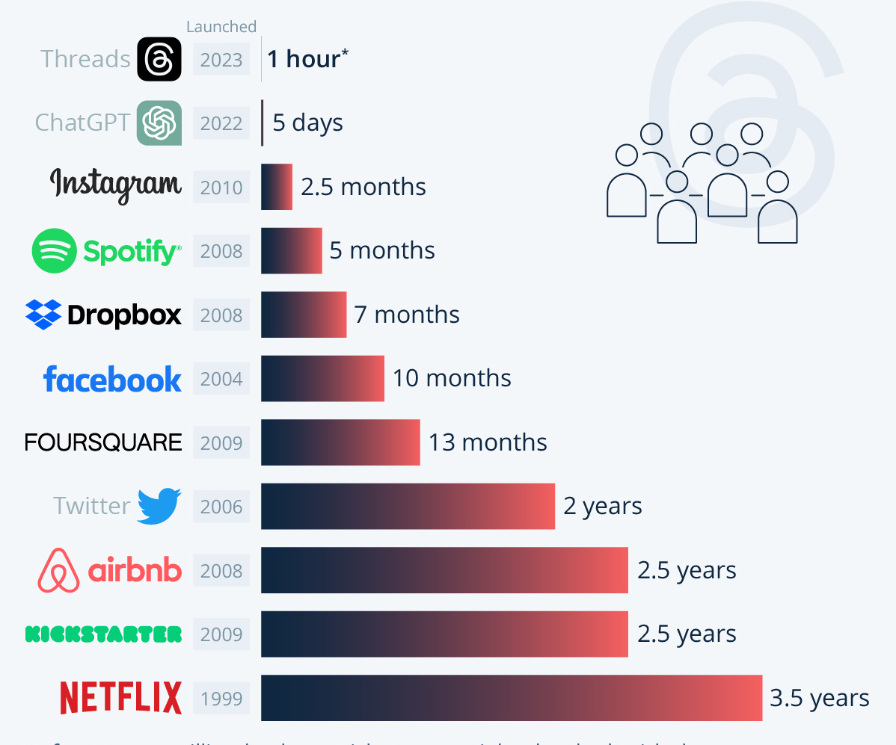
Time to reach one million users
Notes:
It took 2 years for Twitter to reach one million users.
It took 2.5 months for Instagram to reach one million users.
It took 5 days for ChatGPT to reach one million users.

Slide 3
All apps will be reinvented with AI
New apps will be built that were not possible before
Developers will do less coding and more editing

Slide 4
Large Language Models
(Generative AI)
prompt
completion
Prompt
Completion

Slide 5
What is Generative AI?
A type of AI that generates new content using LLMs (large language models), in response to a user prompt.

Slide 6
Large Language Models (LLMs)
OpenAI Models
GPT-4
GPT-4-32k
Text Embeddings Ada
Davinci / Babbage
Whisper
Dalle3
GPT-4 Turbo
AI models trained on massive datasets and specialized to work on natural language tasks.

Slide 7
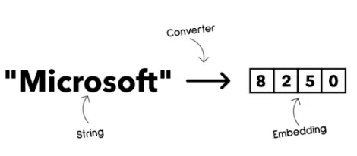
Embedding Models

Slide 8
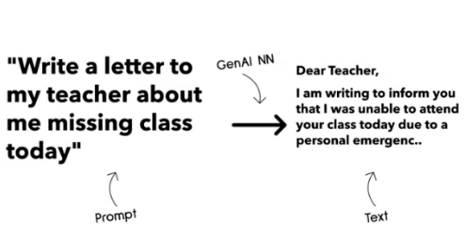
Text generation models

Slide 9
Chat Completion
Cleopatra VII Philopator was the last active ruler of the Ptolemic Kingdom of Egypt, succeeding her brother Ptolemy XIII in 51 BCE. Known for her intelligence and charisma, she presided over a period marked by cultural fluorescence. Fluent in multiple languages, she excelled in diplomacy, using her wit to maintain Egypt's autonomy against potential invaders.
Cleopatra's alliances with Roman leaders Julius Caesar and Mark Antony were strategic moves to safeguard Egypt's independence……..
Once upon a time there was a queen named Cleopatra

Slide 10
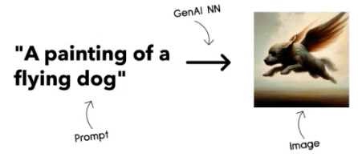
Image generation

Slide 11
Base LLMs will simply
predict the next token.

Slide 12
What are prompts?
Text input to LLM that instructs it on what to do.
It sets model parameters that influence response.

Slide 13
OpenAI GPT models
Completion API
Chat Completion API

Slide 14
Prompt Engineering

Slide 15
What is Prompt Engineering
Prompt Engineering is the process of designing and optimizing prompts to deliver consistent and quality completions for a given application objective and model.
This as a 2-step process:
design initial prompt for a given model and objective
iteratively refine the prompt to improve the quality of the response

Slide 16
Why is prompt engineering so important?
LLMs are stochastic in nature. This means that you can get different results every time you use it.
LLMs can hallucinate. They may produce output that does not make any sense, and which is not grounded in fact.
LLMs have diverse capabilities. There are different models from different providers, and different model generations trained on different data sets (examples: gpt-4, llama, claude …).

Slide 17
It does not always get it right
OrderDate,DaysToDeliver,DeliveryDate
2025/02/27,6,
2025/03/30,4,
2025/07/14,3,
2025/08/11,7,
2025/08/19,2,
2025/09/29,10,
2025/10/10,6,
Given the following csv data, fill out the last column: ----OrderDate,DaysToDeliver,DeliveryDate
2025/02/27,6,
2025/03/30,4,
2025/07/14,3,
2025/08/11,7,
2025/08/19,2,
2025/09/29,10,
2025/10/10,6,
----
PROMPT

Slide 18
Considerations
Business Days
Leap Year
Public Holidays
Length of months
Etc.

Slide 19
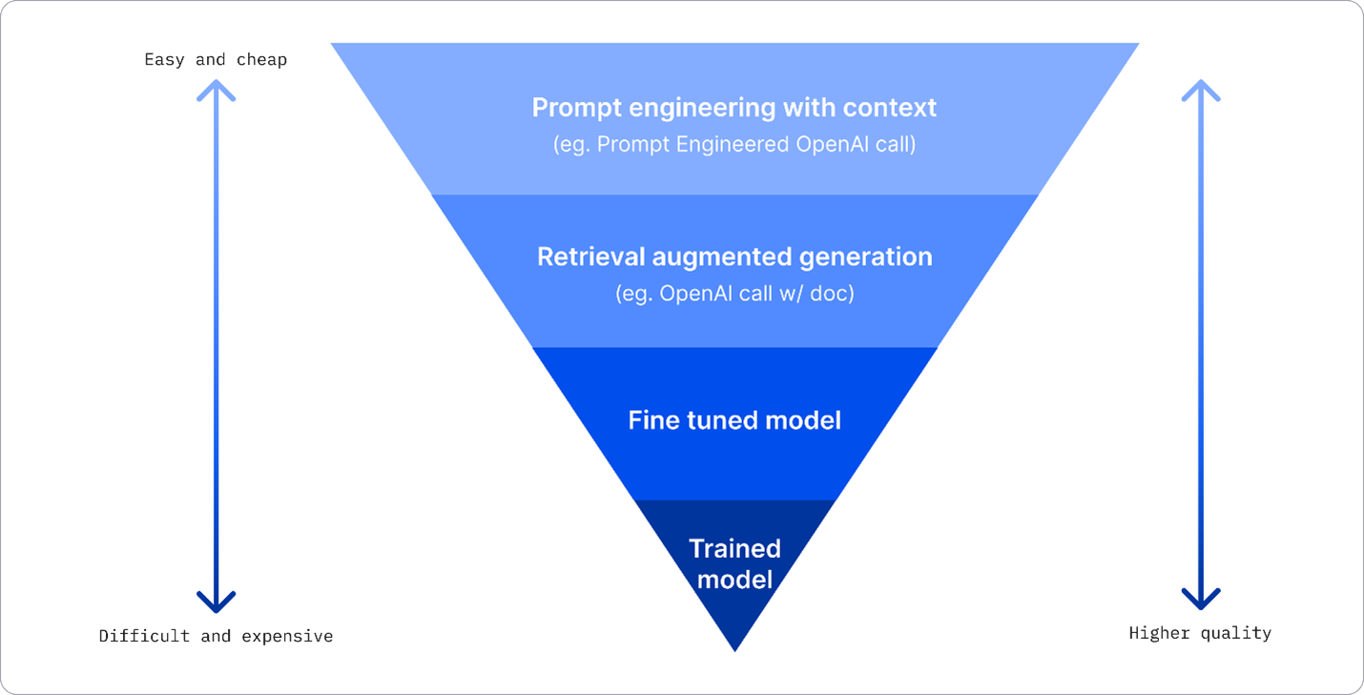
Improving results

Slide 20
Understanding Embeddings
Vector Store / Database
How does a LLM find things?
Some
Data
Embeddings
Model
Embedding
[1.76,3.29,…]
User
Query

Slide 21
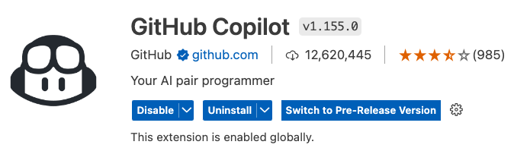
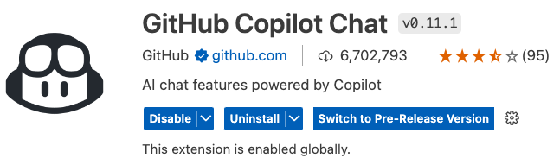
Essential VS Code GitHub Extensions

Slide 22
C# libraries
Low level libraries
dotnet add package OpenAI
dotnet add package Azure.AI.OpenAI
Higher level libraries
dotnet add package Microsoft.SemanticKernel
(C#, Python, Java)

Slide 23
What is Semantic Kernel?
Semantic Kernel is an open-source SDK that lets you easily build agents that can call your existing code. As a highly extensible SDK, you can use Semantic Kernel with models from OpenAI, Azure OpenAI, Hugging Face, and more!

Slide 24
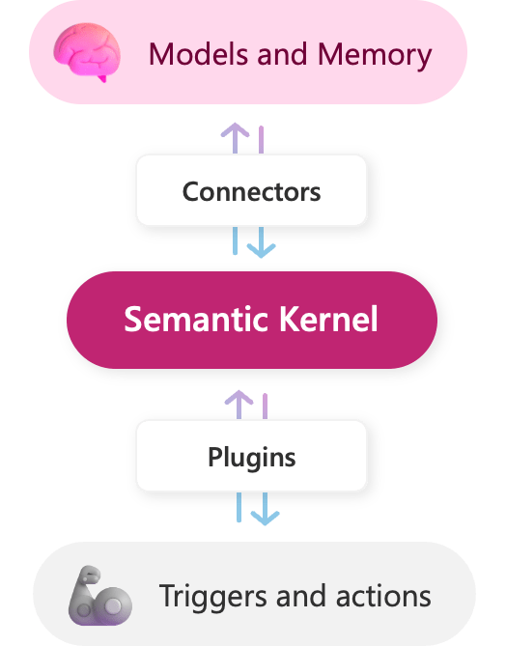
More on Semantic Kernel ….
Works with C#, Python, Java
Plugins (using prompts and native functions)
Context variables
Connectors (using memory and models)
Planners (AI orchestrator)
SOURCE: https://learn.microsoft.com/en-us/semantic-kernel/overview/

Slide 25
Demo #1
Tokenization
https://platform.openai.com/tokenizer
Notes:
The vast majority of Egypt’s many hundreds of queens, although famed throughout their own land, were more or less unknown in the outside world. As the dynastic age ended and the hieroglyphic script was lost, the queens’ stories were forgotten and their monuments buried under Egypt’s sands. But Cleopatra had lived in a highly literate age, and her actions had influenced the formation of the Roman Empire; her story could not be forgotten. Octavian (the future emperor Augustus) was determined that Roman history should be recorded in a way that confirmed his right to rule. To achieve this, he published his own autobiography and censored Rome’s official records. As Cleopatra had played a key role in his struggle to power, her story was preserved as an integral part of his. But it was diminished to just two episodes: her relationships with Julius Caesar and Mark Antony. Cleopatra, stripped of any political validity, was to be remembered as an immoral foreign woman who tempted upright Roman men. As such, she became a useful enemy for Octavian, who preferred to be remembered for fighting against foreigners rather than against his fellow Romans.

Slide 26
Demo #2
Simple C# completion app with Semantic Kernel Tool

Slide 27
Demo #3
Using our baking skill in C# console app

Slide 28
Demo #4
Using Sematic Kernel with AI models on GitHub

Slide 29
Demo #5
OpenAI Function Calling with Semantic Kernel, C#, & Entity Framework

Slide 30
Thanks

