Slide 1
SLM (Small Language Models)
Medhat Elmasry

Slide 2



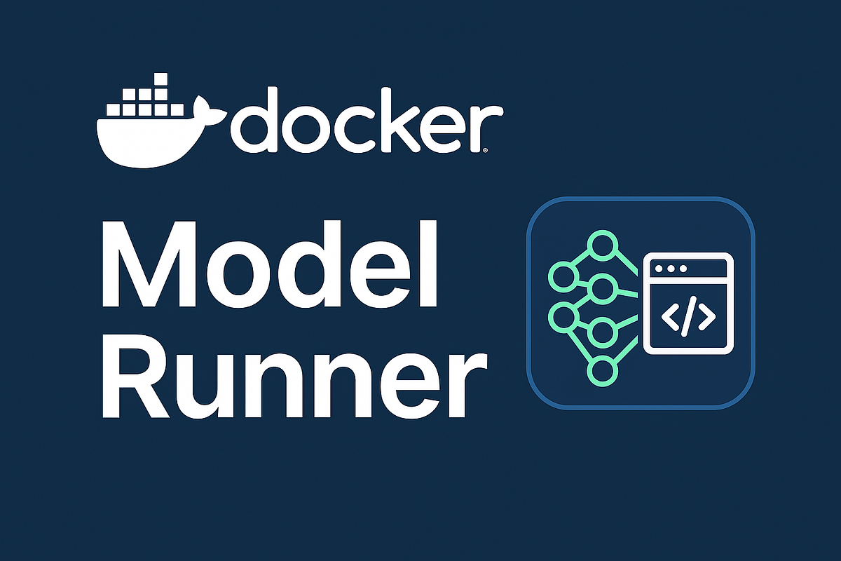

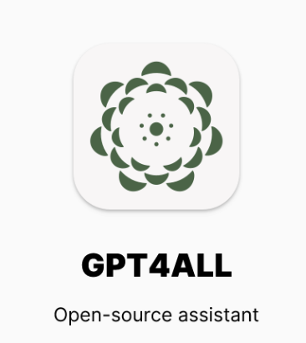


Slide 3
What Are Small Language Models?
Definition: SLMs are compact versions of large language models (LLMs), typically ranging from a few million to ~10 billion parameters. You can download these models onto your computer.
Purpose: Designed for efficiency, they perform natural language tasks like summarization, translation, and Q&A on resource-constrained devices.
Comparison: While LLMs like GPT-5 may have trillions of parameters, SLMs focus on doing fewer things well.

Slide 4
How Are SLMs Made Smaller?
Knowledge Distillation: A smaller “student” model learns from a larger “teacher” model.
Pruning: Removes redundant or less impactful parameters.
Quantization: Reduces numerical precision to save memory and compute.
Architecture Tweaks: Streamlined layers and tokenization strategies for faster inference.

Slide 5
Benefits & Use Cases
Efficiency: Lower latency, reduced energy use, and faster deployment.
Privacy: Ideal for on-device applications where data shouldn’t leave the device.
Use Cases:
Mobile assistants
Customer support bots
Real-time translation
Domain-specific tools (e.g., healthcare, finance)

Slide 6
Examples & Future Outlook
Popular SLMs:
Llama3.2-1B (Meta)
Qwen2.5-1.5B (Alibaba)
Phi-3.5-Mini-3.8B (Microsoft)
Trend: SLMs are gaining traction as sustainable, customizable alternatives to LLMs.
Outlook: Expect more open-source, task-tuned models optimized for edge and enterprise use.

Slide 7
Demo #1
C# client for Phi-3 SLM hosted by Ollama
(OllamaSharp SDK & Sematic Kernel SDK)

Slide 8
Demo #2
AI Toolkit Extension in VS Code
(OpenAI SDK & Sematic Kernel SDK)

Slide 9
Demo #3
Working with Docker AI Models from C#
(OpenAI SDK & Sematic Kernel SDK)

