Slide 1
SignalR
Medhat Elmasry

Slide 2
Any sufficiently advanced technology is indistinguishable from magic – Arthur C. Clarke

Slide 3
Introducing SignalR
Abstraction over transports
Events instead of task/async
Connection Management
Broadcast to all, target specific group, or target specific client

Slide 4
What is SignalR
SignalR is a series of abstractions around various methods of providing persistent HTTP connections distributed as open source code.
Translated into pure English ….
SignalR makes real-time HTTP so easy, it seems like magic

Slide 5
Hub
A more high-level pipeline that allows your client and server to call methods on each other directly

Slide 6
Polling
Client
Browser
HTTP GET – Got data?
Web
Server
HTTP GET – Got data?
HTTP GET – Got data?
Here’s some data!
HTTP GET – Got data?
HTTP GET – Got data?
HTTP GET – Got data?

Slide 7
Polling
Client
Browser
I do real time, do you?
Web
Server
Yep! I love real-time
Let’s boogie!
Awesome
Notes:
New Project >> Web >> Empty Web Application
Install-package SignalR.Sample
Install-Package Microsoft.AspNet.SignalR

Slide 8
Demo
SignalrChat (SignalR_Core_script.docx)

Slide 9
Where is the proxy?
Add /signalr/hubs to the URL. This is the proxy file.

Slide 10
What does SignalR do?
Client to Server persistent connection over HTTP
Easily build multi-user, real-time web applications
Auto-negotiates transport
Allows server-to-client RPC (remote procedure calls)
Built-in async to scale 1000’s of connections
Open Source on GitHub

Slide 11
Examples of SignalR apps
dashboards
monitoring applications
collaborative applications (such as simultaneous editing of documents)
job progress updates
real-time forms
Real-time gaming
. . . . .

Slide 12
SignalR Fallback
Long Polling
Forever Frames
Server Sent Events
Web Sockets

Slide 13
Monitoring Transports
You can determine what transport your application is using by enabling logging on your hub and opening the console window in your browser.
To enable logging for your hub's events in a browser, add the following command to your client application:
connection.hub.logging = true;

Slide 14
Specifying a transport
Negotiating a transport takes a certain amount of time and client/server resources.
If the client capabilities are known, then a transport can be specified when the client connection is started.
The following code demonstrates starting connection using Long Polling:
connection.start({ transport: 'longPolling' });

Slide 15
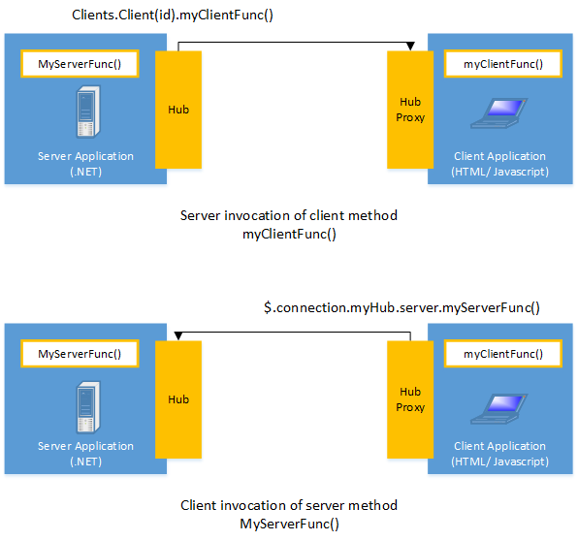
Connections
SignalR provides a simple API for creating server-to-client remote procedure calls (RPC) that call JavaScript functions in client browsers (and other client platforms) from server-side .NET code

Slide 16
Sending messages to all connected clients
Clients.All.doWork()
Scott
Jon
Hub
Brady

Slide 17
Sending messages to the calling client
Clients.Caller.doWork()
Scott
Jon
Hub
Brady

Slide 18
Sending messages to other connected clients
Clients.Others.doWork()
Scott
Jon
Hub
Brady

Slide 19
Sending messages to specific users
Clients.Users(“Brady”).doWork()
Scott
Jon
Hub
Brady

