Slide 1
Introduction to ASP.NET MVC
Medhat Elmasry

Slide 2
Overview
Motivation & Goals for ASP.NET MVC
Model View Controller
Routing
Controllers and controller actions
View and view helpers

Slide 3
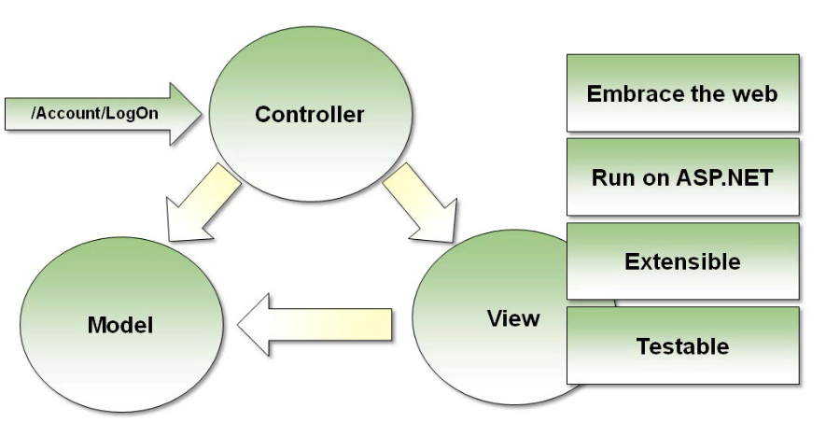
Design Goals

Slide 4
ASP.NET MVC Design Goals
Embrace the web
No illusions of state – no page lifecycle
Clean URLs & HTML
Extensible
Pluggable view engines
Controller factories
Frictionless Testability
Maintains a strict separation of concerns

Slide 5
What is MVC?
A design pattern
Acronym for Model ● View ● Controller
Separation of concerns
Analogy ➔ manual instead of automatic transmission
Search engine friendly URLs
http://stackoverflow.com
http://stackoverflow.com/questions/tagged/xml
http://stackoverflow.com/questions/tagged/wcf
Notes:
Fundamentally MVC is a design pattern for presentation. Its not new, in fact it originated from the SmallTalk community back in 1974.
In this pattern Models and Views are separated and managed independently through the use of controllers. Controllers manage the behavior of Views and Models through their accessor methods and thus the Models, Views, and Controllers themselves are all separated. This allows each to operate and behave independantly of the other and allows greater flexibility when design changes occur.

Slide 6
What is MVC?
Request
Controller
Step 1
Incoming request directed to Controller
Notes:
In practice what we see is that every interaction with the MVC application is done through inbound requests to a controller. Once in the appropriate controller, information (information can be anything coming from anywhere - following good architectural practices) is accessed to build the appropriate model.

Slide 7

What is MVC?
Controller
Model
Step 2
Controller processes request and forms a data Model
Notes:
The Controller will use the information it gathers and form a data model. The Controller may make decisions and access data from any number of sources in order to build this model.

Slide 8

What is MVC?
Controller
View
Step 3
Model is passed to View
Notes:
Once the Model is complete, it is passed to a View. An additional task for the Controller is to determine which View to show. That determination can be made from information coming from the model and/or gathered elsewhere.

Slide 9

What is MVC?
Controller
View
Step 4
View renders Model into appropriate output format
Notes:
A view takes a presentation model and will transform that data into some appropriate form of output..usually HTML but it could really be anything (JSON, XML, etc)

Slide 10
What is MVC?
Controller
View
Response
Step 5
Response is rendered
Notes:
Once complete, the View sends the appropriate response. The last job of the View is to render the output to the client.

Slide 11
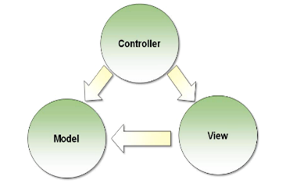
Separation of concerns
Each component has one responsibility
Most of the hard work is done inside the controller
Controller is responsible for building the model
Controller is responsible for selecting the view
View does not hold any state information
The model holds state information

Slide 12
Controller
public class HomeController : Controller {
public ActionResult Index() {
return View();
}
public ActionResult About() {
ViewBag.Message = "Your application description page.";
return View();
}
public ActionResult Contact() {
ViewBag.Message = "Your contact page.";
return View();
}
}
HomeController.cs

Slide 13
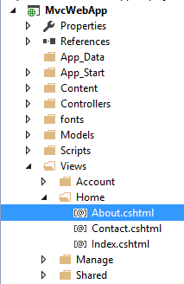
Views
@{
ViewBag.Title = "About";
}
<h2>@ViewBag.Title.</h2>
<h3>@ViewBag.Message</h3>
<p>Use this area to provide additional information.</p>
About.cshtml

Slide 14
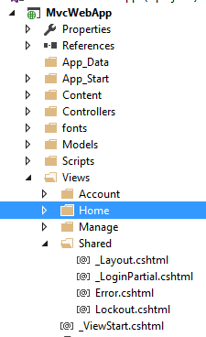
Shared
Master pages (_Layout.cshtml) and user controls (partial views) used by multiple controllers are placed in the shared folder

Slide 15
MVC Routing
Process of directing an HTTP request to a controller is known as routing
Directs incoming request to an MVC controller
Defines routes during application startup
Map URLs to controller action with parameters

Slide 16
Found in Program.cs
app.MapControllerRoute(
name: "default",
pattern: "{controller=Home}/{action=Index}/{id?}");
http://localhost:/Home/About
Controller
Action
id
Note: Controller names and action names are not case sensitive.

Slide 17
MVC Controllers
Public methods are “actions”
Method invoked by ASP.NET once it determines the proper route in the RouteConfig.cs file
Controller can build the model and place in ViewBag
Return value of ActionResult tells the framework where to go next
ViewData is like a dictionary
public ActionResult About()
{
// ViewData["Message"] = "Your application description page.";
ViewBag.Message = "Your application description page.";
return View();
}

Slide 18
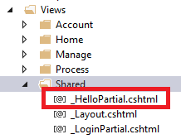
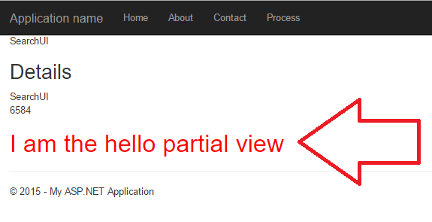
Adding Partial View
Under /Views/Shared add a _HelloPartial.cshtml view file with following contents
<h1 style="color: red;">I am the hello partial view</h1>
Add the following code to any .cshtml view page
@Html.Partial("_HelloPartial")
Run application as in previous slide.

