Slide 1
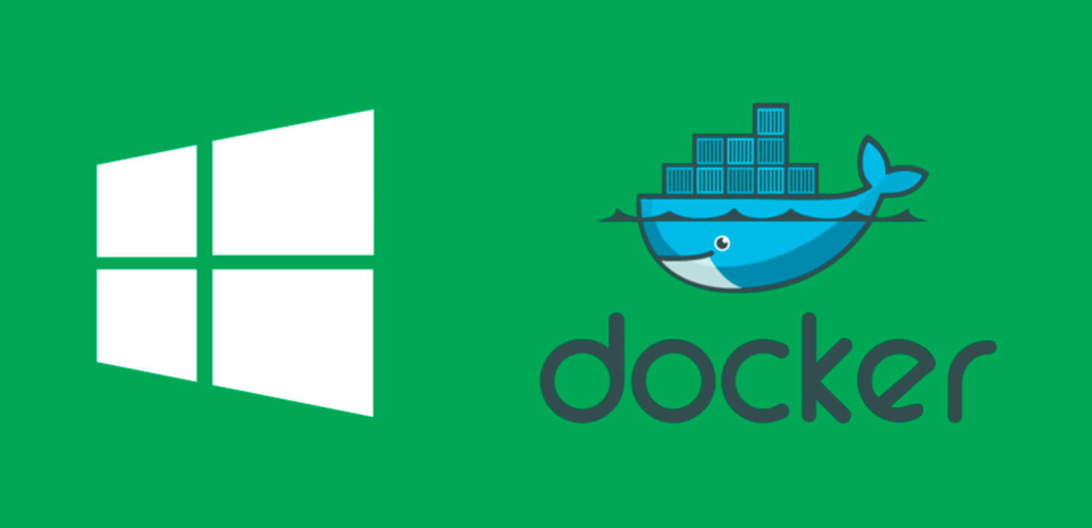
Native Docker Containers
Medhat Elmasry

Slide 2
What are containers?

Slide 3
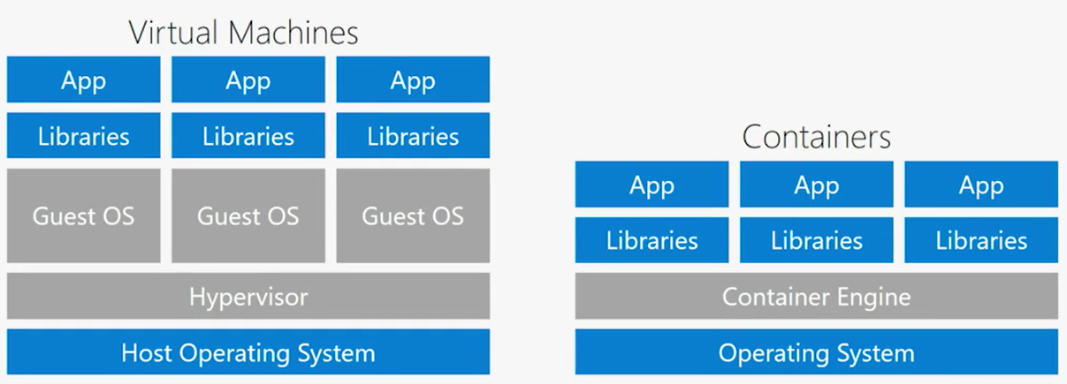
Containers
Containers are a lightweight alternative to VMs: smaller, less costly, faster to start, and self contained.

Slide 4
The Docker Platform
Docker provides the ability to package and run an application in an isolated environment called a container.
Containers are lightweight and contain everything needed to run the application, so you don't need to rely on what's installed on the host.

Slide 5
Docker tooling
Develop your app and its supporting components using containers.
The container becomes the unit for distributing and testing your app.
When you're ready, deploy your app into your production environment, as a container or an orchestrated service.

Slide 6
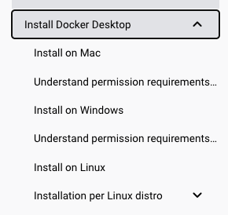
How to install Docker Desktop?
https://docs.docker.com/desktop/

Slide 7
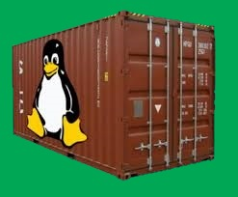
Demo:
Virtual network
Linux container
MySQL
Container name: db
Linux container
PHP
WordPress
Container name: wordpress
WordPress in 5 minutes

