Slide 1
Hands-On Microsoft Windows Server 2016 2nd Edition
Chapter 1
Introduction to Windows Server 2016

Slide 2
Objectives (1 of 2)
Identify the key features of each Windows Server 2016 edition
Understand the hardware requirements for Windows Server 2016
Identify client systems that can be used with Windows Server 2016
Understand important general features of Windows Server 2016
Plan a Windows Server 2016 networking model

Slide 3
Objectives (2 of 2)
Explore introductory concepts for the networking protocols, IPv4 and IPv6, used by Windows Server 2016
Configure and enable TCP/IP in Windows Server 2016

Slide 4
Windows Server 2016 Editions
Windows Server 2016 platforms:
Windows Server 2016 Essentials Edition
Windows Server 2016 Standard Edition
Windows Server 2016 Datacenter Edition
Additional Windows Server 2016 platforms targeted for specific-purpose niches:
Windows Server 2016 Multipoint Premium Server
Windows Storage Server 2016
Windows Hyper-V Server 2016

Slide 5
Windows Server 2016 Essentials Edition
Windows Server 2016 Essentials Edition supports a maximum of:
25 users
16.8 million connections for file sharing through Server Message Block (SMB) services
2 central processor sockets
50 Remote Desktop connections
50 Routing and Remote Access connections
In addition:
This edition cannot join a domain, other than to migrate files and data from one server to another
Provides most, but not all server roles
Does not provide a role for hosting virtual machines and cannot provide cloud services

Slide 6
Windows Server 2016 Standard Edition (1 of 5)
Standard Edition provides:
File and print services
Secure Internet connectivity
Centralized management of users
Centralized management of applications and network resources
New features in Windows Server 2016 Standard Edition:
Start button and Start menu are back on the desktop
Active Directory is easier to set up and has improved file security
A domain controller can be cloned to quickly create additional domain controllers
Generic Routing Encapsulation (GRE) tunneling to enable virtual private networks to go over external networks
Desired State Configuration is used to monitor specific server states and roles so that desired states don’t change as other elements are changed on one or many servers

Slide 7
Windows Server 2016 Standard Edition (2 of 5)
New features in Windows Server 2016 Standard Edition (cont’d):
Windows Defender is automatically included as an antivirus and antimalware program
Storage tiering allows selected blocks of data to be moved to different storage locations
Storage pinning works with storage tiering to enable you to move specific files to a desired type of storage
A new network controller role that provides information about the network structure
Parallel rebuild that enables a failed disk in RAID to be rebuilt significantly faster
Virtual desktops enables you to run different desktops side-by-side

Slide 8
Windows Server 2016 Standard Edition (3 of 5)
Included:
Hyper-V which enables servers to offer a virtualization environment
Hyper-V improvements:
Faster cloning
Migration of individual VMs
VM information is stored in a new file format that protects VM information from being directly edited
New to Windows Server 2016 is the option to use containers
Containers enable applications on one computer to run in an isolated fashion with the ability to execute multiple applications
Two types of containers:
Windows Server containers
Hyper-V containers

Slide 9
Windows Server 2016 Standard Edition (4 of 5)
All editions of Windows Server 2016 are compatible with the common language runtime used in:
Microsoft .NET Framework and Microsoft Visual Studio .NET
Another feature of Windows Server 2016 Standard Edition
Clustering – the ability to increase the access to server resources and provide fail-safe services by linking two or more computer systems so they appear to function as one

Slide 10
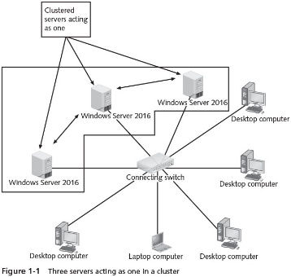
Windows Server 2016 Standard Edition (5 of 5)

Slide 11
Windows Server 2016 Datacenter Edition (1 of 2)
Designed for environments with:
Mission-critical applications
Very large databases
Very large virtualization requirements
Cloud computing needs
Information access requiring high availability
Offers support for clustering up to 64 computers
See Table 1-1 for maximums for Datacenter Edition

Slide 12
Windows Server 2016 Datacenter Edition (2 of 2)
Differences between Standard Edition and Datacenter Edition focus on Datacenter Edition’s industrial strength capabilities in the areas of:
Virtualization
Cloud computing
Database handling
Datacenter Edition does not come with database software
But it is designed to provide the OS resources to accommodate large database applications

Slide 13
Windows Server 2016 Multipoint Premium Server
Multipoint services
Enable many users to share the same physical computer through each person connecting a keyboard, monitor, and mouse to a USB hub that is connected to a server
Windows Server 2016 Multipoint Premium Server
Offered to educational customers as a way to provide volume licensing
The Multipoint Services role is included as a regular server role in Standard and Datacenter Editions

Slide 14
Windows Storage Server 2016
Original equipment manufacturers (OEMs) that focus on storage solutions for organizations
Can offer Windows Storage Server 2016 on the server-based products they sell
Windows Storage Server 2016
Turns a server into a central storage center for data
Takes advantage of storage utilities offered in Windows Server 2016

Slide 15
Microsoft Hyper-V Server 2016
Microsoft Hyper-V Server 2016
A free download of a basic server system that enables you to use Hyper-V
Use this if you want to learn more about how Hyper-V works or to set up a basic Hyper-V system

Slide 16
Using Windows Server 2016 with Client Systems
The client workstation operating system most compatible with Windows Server 2016:
Windows versions 7, 8, 8.1, and 10
Windows 10 being the most compatible in terms of client management
Client
A computer that accesses resources on another computer via a network
Workstation
A computer that has its own central processing unit (CPU) and can be used as a stand-alone or network computer

Slide 17
Using Windows Server 2016 with Client Systems (1 of 3)
The overall goal of Microsoft is to achieve a lower total cost of ownership (TCO)
TCO is the full cost of owning a network, including hardware, software, training, maintenance, and user support costs
Domain
A grouping of network objects, such as computers, servers, and user accounts, that provides for easier management
Computers and users in a domain can be managed to determine what resources they can access

Slide 18
Using Windows Server 2016 with Client Systems (2 of 3)
Advantages of using Windows Server 2016 and Windows versions 7 through 10 together include the following:
Enhanced capabilities to recover from many types of network communications problems
Computer code for more efficient network communications
More network diagnostic capabilities
Computer code for better use of the network communications protocols
Continuing upgrades for Windows PowerShell commands and scripts in both Windows Server 2016 and Windows 7 through 10

Slide 19
Using Windows Server 2016 with Client Systems (3 of 3)
Active Directory
Database of computers, users, groups of users, shared printers, shared folders, and other network resources
Windows Server 2016 supports Linux through Linus Integration Services (LIS)
Enables Linux clients to access a Linux VM in Hyper-V
New capabilities in LIS:
New software for enhanced desktop graphics performance on Linux clients
Improved backup support functions
Creation of kernel dumps for Linux VMs
Better control of available RAM in Linux VMs

Slide 20
Windows Server 2016 Features
Features include:
Server Manager
Security
Clustering
Enhanced Web services
Windows Server Core and Nano Server
Windows PowerShell
Virtualization
Reliability
Multitasking and multithreading
Physical and logical processors
Containers

Slide 21
Server Manager (1 of 2)
Server Manager
Enables the server administrator to manage critical configuration features from inside one tool
Server Manager is used to:
Configure a server from the beginning
View computer configuration information.
Change server roles and system properties
Configure networking
Configure Remote Desktop
Configure security, including the firewall
Add and remove features
Run diagnostics
Manage storage and backups
Manage multiple servers from one place

Slide 22
Server Manager (2 of 2)
New features of Server Manager include the following advantages:
Local Server option makes all of the local server properties available to manage
Multiple servers are easier to manage from one place
Servers can be grouped so that all servers in a specific group received one or more commands simultaneously
The Dashboard offers more quick-start guidance for setting up one or more servers and establishing groupings used to manage specific kinds of servers
The Server Manager GUI has a new look with added features, such as greater ability to add and manage remote servers

Slide 23
Security
When you install Windows Server 2016, add a feature, or install a Windows component
An essential level of security is automatically implemented
Other security features include:
File and folder permissions
Security policies
Encryption of data
Event auditing
Various authentication methods
Server management and monitoring tools

Slide 24
Clustering and Clustering Tools
Windows Server 2016 offers tools to:
Test a cluster to ensure it is set up to accomplish the tasks for which it is intended
Migrate configuration settings from one cluster to another
Quickly configure a cluster and troubleshoot problems
Set up storage used in a cluster
Create better cluster storage performance and reliability
Secure a cluster and enable it to use new network capabilities

Slide 25
Enhanced Web Services
Microsoft Internet Information Services (IIS)
Transforms Windows Server 2016 into a versatile Web server
IIS has been designed to:
Include over 40 modules
Intended to enable IIS to have a lower attack surface
Provide easier application of IIS patches
Make it easier for network programmers to write network applications and configure applications for the Web

Slide 26
Windows Server Core and Nano Server (1 of 2)
Windows Server Core
A minimum server configuration
Designed to function in a fashion similar to traditional UNIX and Linux servers
Does not provide the following:
A graphical interface, just a command line
Graphical tools to configure the server
Extra services that you do not need
A mouse pointer on the screen
Windows Mail, Microsoft Word, search windows, and other software
Windows Nano Server
A new installation option in Windows Server 2016
Smaller footprint than Server Core

Slide 27
Windows Server Core and Nano Server (2 of 2)
Windows Nano Server (cont’d)
Provides a basic foundation for server computing
Intended to be faster and need less maintenance
Microsoft views Nano Server as a platform on which to run a (an):
DNS or DHCP server
Applications server, such as from the cloud
Web server
Database or file server

Slide 28
Windows PowerShell (1 of 3)
Windows PowerShell
A command-line interface that offers a shell
A customized environment for executing commands and scripts
Scripts are files that contain commands to be run by a computer OS
Can perform the following tasks with PowerShell:
Work with files and folders
Manage disk storage
Manage network tasks
Set up local and network printing options
Install, list, and remove software applications

Slide 29
Windows PowerShell (2 of 3)
Can perform the following tasks with PowerShell (cont’d):
View information about the local computer, including user accounts
Manage services and processes
Lock a computer or log off
Manage IIS Web services
Windows PowerShell offers over 130 command-line tools, also called cmdlets

Slide 30
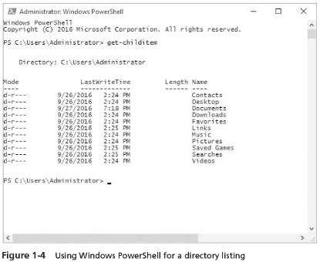
Windows PowerShell (3 of 3)

Slide 31
Virtualization
Hyper-V provides the ability to run two or more operating systems on a single computer
The Hyper-V capabilities include the following:
Compatible with clustering
Can be used with Windows and Linux operating systems
Compatible with different types of disk storage methods
Enables fast migration from one computer to another
Can house 64-bit and 32-bit operating systems

Slide 32
Reliability
The operating system kernel runs in privileged mode
Protects it from problems created by a malfunctioning program or process
The kernel consists of the core programs and the computer code of the operating system
Privileged mode gives the operating system kernel an extra level of security from intruders
Prevents system crashes due to poorly written applications
Process
A computer program or portion of a program that is currently running
Protected process
One for which outside influences are restricted

Slide 33
Multitasking and Multithreading
Multitasking
The ability to run two or more programs at the same time
Multithreading
The capability of programs written to run several program code blocks, or ‘‘threads,’’ at the same time
Preemptive multitasking
Each program runs in an area of memory separate from areas used by other programs
Reduces the risk of one program interfering with the smooth running of another program

Slide 34
Physical and Logical Processors
Physical processor
Is plugged into a processor socket on the motherboard of the computer
Windows Server 2016 can support up to 64 sockets for physical processors
Logical processor
A core than can run its own executable threads
One physical processor can house several logical processors
Virtual processor
A logical processor or one or more of its cores that function for the use of a specific VM
With Hyper-V in use
Windows Server 2016 supports up to 320 logical processors

Slide 35
Containers (1 of 2)
Using a container establishes a separate layer or engine for each application
Windows Server 2016 offers two types of containers:
Windows server containers – run through process and user-mode isolation
Hyper-V containers – involve a separate container for each VM running in Hyper-V
This approach eliminates the change that a rogue application in one container might attack other containers

Slide 36
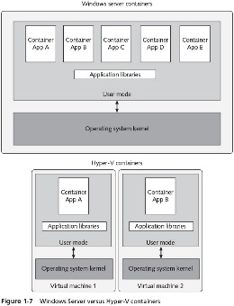
Containers (2 of 2)

Slide 37
Planning a Windows Server 2016 Networking Model (1 of 2)
Network
A communications system enabling computer users to share computer equipment, application software, and data, voice, and video transmissions
Contains computers joined by communications cabling or sometimes by wireless devices
Workstation or client network operating system
Enables individual computer to access a network, and in some cases to share resources
Peer-to-peer networking
Focuses on spreading network resource administration among server and nonserver members of a network
Server-based networking
Centralizes the network administration on one or more servers

Slide 38
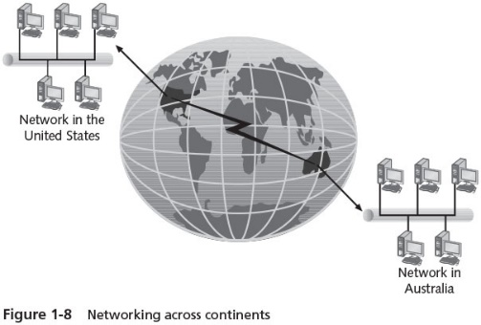
Planning a Windows Server 2016 Networking Model

Slide 39
Peer-to-Peer Networking (1 of 2)
Uses workstations to share resources such as files and printers and to connect to resources on other computers
No special computer is needed to enable workstations to communicate and share resources
Can be effective for very small networks
Disadvantages
Management of network resources is decentralized
As the network increases in size, administration becomes more difficult
Lack of security of resources

Slide 40
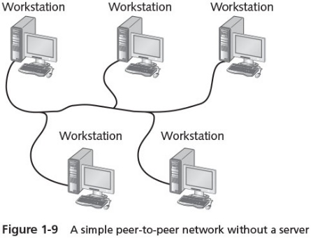
Peer-to-Peer Networking

Slide 41
Server-Based Networking (1 of 3)
Server
A single computer that provides extensive multiuser access to network resources
Can handle hundreds of users at once
Fast response when delivering the shared resource
Less network congestion when multiple workstations access that resource
Advantages
Users only need to log on once to gain access to network resources
Security is stronger
All members can share computer files
Printers and other resources can be shared
All members can have e-mail and send messages to other office members through an e-mail server

Slide 42
Server-Based Networking (1 of 2)
Advantages (cont’d)
Software applications can be stored and shared in a central location
Important databases can be managed and secured from one computer
All computers can be backed up more easily
Computer resource sharing can be arranged to reflect the work patterns of groups within an organization
The server administrator can save time when installing software upgrades

Slide 43
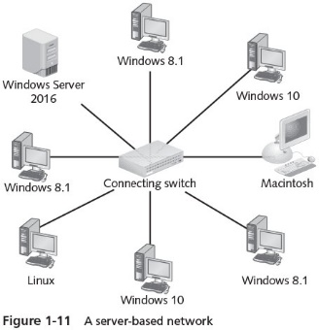
Server-Based Networking (2 of 2)

Slide 44
Protocols for the Windows Server 2016 Networking Model
A protocol consists of guidelines for the following:
How data is formatted into discrete units called packets and frames
How packets and frames are transmitted across one or more networks
How packets and frames are interpreted at the receiving end
Packets and frames
Units of data transmitted from a sending computer to a receiving computer
Windows Server 2016 and its clients primarily use the Transmission Control Protocol/Internet Protocol (TCP/IP)
A suite of protocols and utilities that support communication across LANs and the Internet
Local area network (LAN)
A network of computers in relatively close proximity

Slide 45
Transmission Control Protocol
Transmission Control Protocol (TCP)
Provides for reliable end-to-end delivery of data by controlling data flow
Computer agree on a “window” for data transmission that includes the number of bytes to be sent
Window is constantly adjusted to account for existing network traffic
TCP is also considered a connection-oriented communication
Ensures that packets are delivered, that they are delivered in the right sequence, and that their contents are accurate

Slide 46
Internet Protocol (1 of 11)
Internet Protocol (IP)
Provides network addressing to ensure data packets quickly reach the correct destination
Two versions: IPv4 and IPv6
IPv4 is used by default on most networks
IP also provides for routing data over different networks
Routing is accomplished through a device called a router
IP also handles fragmenting packets

Slide 47
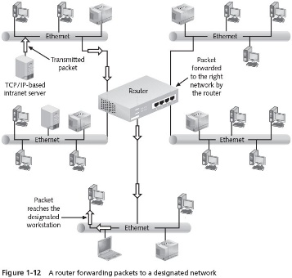
Internet Protocol (2 of 11)

Slide 48
Internet Protocol (3 of 11)
The IP address format is called the dotted decimal notation
32 bits long and contains four fields of decimal values representing eight-bit binary octets
Example: 192.51.100.0
Unicast
A transmission in which one packet is sent from a server to each client that requests a file or application
Multicast
Server is able to treat all clients as a group and send one packet per transmission that reaches all clients

Slide 49
Internet Protocol (4 of 11)
Broadcast
Sends a communication to all points on a specific network
Subnet mask
Shows the class of addressing used
Divides a network into subnetworks or subnets to control network traffic
Consists of a subnet ID within the network and a host ID

Slide 50
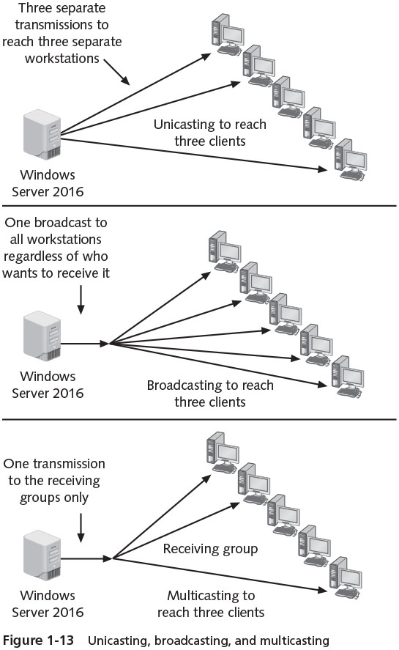
Internet Protocol (5 of 11)

Slide 51
Internet Protocol (6 of 11)
IP address considerations
The network number 127.0.0.0 cannot be assigned to any network
The address 127.0.0.1 is known as the loopback address
No one can use private IP addresses on the Internet
Designed for use on a private network behind a Network Address Translation (NAT) device
See Table 1-3
Cannot assign a network number to a computer or any other host on the network
Example: 198.51.100.0 is assigned as the network number and cannot be assigned to a host
Cannot assign the highest number on a network to a host
Example: 198.42.4.255 is reserved for broadcast messages

Slide 52
Internet Protocol (7 of 11)
Internet Protocol Version 6
Provides a logical growth path from IPv4
New features include:
A 128-bit address capability
A single address associated with multiple network interfaces
Address autoconfiguration
A 40-byte header instead of IPv4’s 20-byte header
New IP extension headers that can be implemented for special needs, including more routing and security options
Use of IP security (IPsec) to enhance network security
More compact and efficient routing capabilities

Slide 53
Internet Protocol (8 of 11)
IPv6 is designed so that addresses can be configured using a wide range of options
Enables better communications for routing and subnetting
Offers options to create distinctions within a single address for network size, network location, organization, organization type, workgroups within an organization, etc…
IPv6 addressing is autoconfiguring
Reduces the workload of the network administrator
IPv6 packet can be encrypted for security
Can increase the communication delays on a network

Slide 54
Internet Protocol (9 of 11)
Static and dynamic addressing
Static addressing
Involves assigning a dotted decimal address that becomes each workstation’s permanent, unique IP address
Dynamic addressing
Automatically assigns an IP address to a computer each time it is logged on
Uses the Dynamic Host Configuration Protocol (DHCP) to detect the presence of a new workstation and assign an IP address to that workstation
Default gateway
The IP address of the router that has a connection to other networks
Used when the host computer you are trying to contact exists on another network

Slide 55
Internet Protocol (10 of 11)
Name resolution
Domain Name System (DNS)
A TCP/IP application protocol that enables a DNS server to resolve (translate) domain and computer names to IP addresses, or IP addresses to domain and computer names
NetBIOS Names
The primary means of locating computers on a Windows-based network
Prior to Windows 2000 Server
Windows Internet Naming Service (WINS)
Windows Server (all versions) service that enables the server to convert NetBIOS workstation names to IP addresses

Slide 56
Internet Protocol (11 of 11)
Host names
The preferred method of resolving computer names to IP addresses in Windows Server 2016
Dynamic Domain Name System (DDNS)
A modern DNS application
Enables client computers to automatically register their IP addresses in DNS without intervention by a user or network administrator
If a DNS server is not available, HOSTS files and broadcasts can be used to resolve IP addresses to host names

Slide 57
Physical Addresses and the Address Resolution Protocol (1 of 2)
Address Resolution Protocol (ARP)
Used to acquire the physical addresses associated with a computer’s network interface card (NIC)
Every NIC has a physical address, or media access control (MAC) address
For computers to communicate with each other
They must know the MAC addresses of each other’s network interface cards
Proper communications using TCP/IP rely on both IP addresses and MAC addresses
Every computer running Windows Server 2016 has an ARP cache
Contains recently resolved MAC addresses as well as statically assigned values in the ARP cache
arp –a command shows the contents of ARP cache

Slide 58
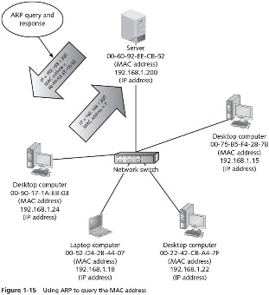
Physical Addresses and the Address Resolution Protocol (2 of 2)

Slide 59
Implementing TCP/IP in Windows Server 2016
Implementing TCP/IP involves two tasks:
Verifying it is enabled
Configuring it
Enabling TCP/IP
Activity 1-6: Verifying TCP/IP and the NIC are Enabled
Configuring TCP/IP
Activity 1-7: Configuring TCP/IP for Static Addressing

Slide 60
Automated Address Configuration (1 of 2)
Automatic Private IP Addressing (APIPA)
Used to automatically configure the TCP/IP settings for a computer without using a DHCP server
Computer automatically assigns itself an IP address from the reserved range of 169.254.0.1 to 169.254.255.254 and a subnet mask of 255.255.0.0
Appropriate for small organizations that have only one network segment and do not need to access another network or the Internet
Automatic configuration can be disabled through the Windows Server 2016 Registry
Registry is a database used to store information about the configuration, program setup, devices, drivers, and other data important to the setup of Windows OSs

Slide 61
Automated Address Configuration (2 of 2)
Dynamic Addressing Through a DHCP Server
Common for medium-sized and large networks
You must first install and configure a DHCP server on the network
In addition to assigning the IP address, the DHCP server can also assign the subnet mask, default gateway, DNS server, and other IP settings
Using a DHCP server can save you a great deal of administrative effort

Slide 62
Chapter Summary (1 of 2)
The Windows Server 2016 main platforms include Essentials Edition, Standard Edition, and Datacenter Edition
Windows Server 2016 also offers specific-purpose platforms that include Windows Server 2016 Multipoint Premium Server, Windows Storage Server 2016, and Windows Hyper-V Server 2016
Windows Server 2016 includes many vital features for security, networking, clustering, virtualization, cloud computing, reliability, database handling, and multitasking and multithreading
The two types of networking models used by Windows Server 2016 are peer-to-peer networks and server-based networks
Peer-to-peer networking is intended for small networks

Slide 63
Chapter Summary (2 of 2)
TCP/IP is the default protocol installed with Windows Server 2016 and is an industry-standard suite of protocols and application utilities that enable communication across local and wide area networks
Two versions of IP are IPv4 and IPv6
Every network device must have a unique IP address to ensure network connectivity and the delivery of data
An IPv6 address uses eight 16-bit fields in hexadecimal format separated by colons and includes addressing rules to enable address prefixes
IP addresses can be manually configured using static addressing or automatically configured, using APIPA or dynamic addressing through a DHCP server

