Slide 1
Hands-On Microsoft Windows Server 2016 2nd Edition
Chapter 2
Installing Windows Server 2016

Slide 2
Objectives (1 of 2)
Plan and make the appropriate preparations for installing Windows Server 2016
Understand the different installation methods used and install Windows Server 2016
Set up Windows Server 2016 using Server Manager
Activate Windows Server 2016

Slide 3
Objectives (2 of 2)
Install and configure Windows Deployment Services
Install Windows Server Core
Install service packs
Troubleshoot installation problems
Uninstall Windows Server 2008

Slide 4
Preparing for Installation
Preinstallation tasks:
Identify the hardware requirements and check hardware compatibility
Determine disk partitioning options
Understand the file system
Determine upgrade options
Plan user licensing
Determine domain or workgroup membership
Choose a computer name
Determine whether to install Nano Server, Server Core, or the full GUI version
Identify the server roles to implement
Determine the immediate preparations

Slide 5
Identifying Hardware Requirements and Determining Compatibility (1 of 2)
Most operating systems come with a list of minimum hardware requirements
Always better to exceed the minimum recommendations
By how much will be determined by what role the Windows Server 2016 server will play on the network
In terms of speed
Pay attention to the speed of the CPU and the amount of RAM
A large corporation or university might start with a redundant array of inexpensive disks (RAID)
An array of multiple hard drives designed to extend the life of disk drives and to prevent data loss from a hard disk failure

Slide 6
Identifying Hardware Requirements and Determining Compatibility (2 of 2)
Hardware compatibility testing
The most up-to-date listing of compatible hardware (and software) is the Windows Server Catalog
www.windowsservercatalog.com
Recommended that you select hardware listed on the Windows Server Catalog or labeled with the Certified for Windows Server 2016 logo
Might still be necessary to upgrade the basic input/output system (BIOS)
BIOS is a program on a read-only or flash memory chip that establishes basic communication with components such as the monitor and disk drives

Slide 7
Determining Disk Partitioning Options (1 of 3)
Creating a partition
A process in which a hard disk section or a complete hard disk is prepared for use by an operating system
A disk can be formatted after it is partitioned
Process divides the disk into small sections called tracks and sectors for the storage of files by a particular file system
The Windows Server 2016 installation program will detect how your hard disk is currently partitioned
Allows you to install the operating system on an existing partition or create a new one

Slide 8
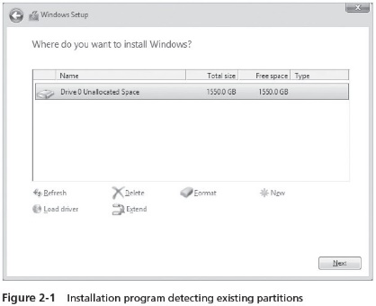
Determining Disk Partitioning Options (2 of 3)

Slide 9
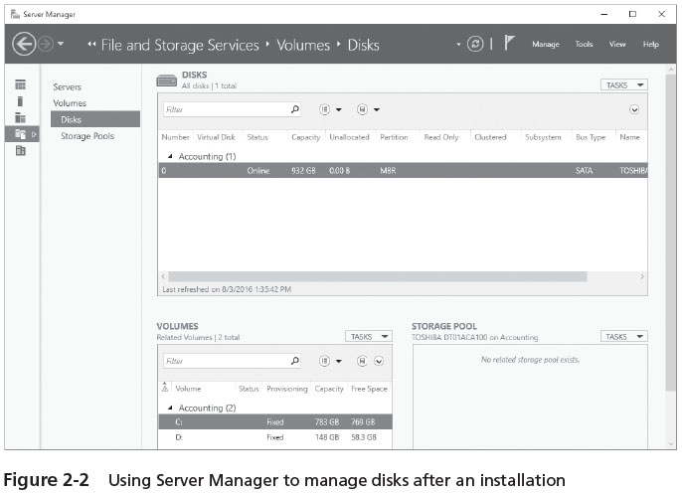
Determining Disk Partitioning Options (3 of 3)
After the installation is complete
You can use Server manager or the Disk Management tool to create additional partitions

Slide 10
Understanding NTFS and ReFS (1 of 3)
New Technology File System (NTFS)
The native Windows Server file system
NTFS features include:
Local security through file and folder permissions
Compression
Disk quotas
Encryption
Indexing
POSIX.1 support
Journaling
Large volume capacity
Hard links
Self-healing
File system cache

Slide 11
Understanding NTFS and ReFS (2 of 3)
Portable operating system interface (POSIX)
A set of standards designed to enable portability of applications from one computer system to another
Journaling by a file system means that it tracks changes to files and keeps a record of these changes in a separate log file
A hard link enables you to create one file and then establish links to that file in other folders
File system cache
An area designated in physical computer memory that is used in Windows OSs to help speed up reading and writing to hard disk

Slide 12
Understanding NTFS and ReFS (3 of 3)
Resilient File System (ReFS)
Microsoft targets ReFS v2 primarily for use with data stores and storage spaces in Hyper-V
At this writing, there are still questions about performance
ReFS can be faster than NTFS in read and write activities, but it is not consistent in different circumstances and types of loads
Disk errors and file system corruption that occur in ReFS can be repaired more quickly than NTFS
ReFS provides more versatility than NTFS

Slide 13
Upgrading to Windows Server 2016
Windows Server 2012 R2 can be upgraded to Windows Server 2016
If upgrading from compatible edition to compatible edition
Example: You can upgrade Windows Server 2012 R2 Standard Edition to Windows Server 2016 Standard or Datacenter Edition
When you upgrade to Windows Server 2016, you use a full version of the new OS and not a special upgrade version sold at a reduced price

Slide 14
Planning User and Device Licensing
Access for a user or device is enabled through a client access licenses (CALs)
One CAL is a license for one client or device to access one or more Windows servers on a network
When Windows Server 2016 Standard or Datacenter Edition is installed in a VM
Users may have one virtual access per CAL
Licensing is also done through processor cores
Available in two-core packs
Standard and Datacenter editions require both CALs and core-based licensing
Essentials and Storage Server 2016 Editions use processor-based licensing
Multipoint Server requires processor-based licensing

Slide 15
Determining Domain or Workgroup Membership
Determine the type of network access for which your computer will be configured
You can specify a domain or workgroup through the Server Manager window
Requirements for adding the computer to a domain:
Provide the DNS name of the domain you want to join
You must have an authorized user account in the domain you want to join
One domain controller and a DNS server must be online before you can join the domain

Slide 16
Choosing a Computer Name
The installation process assigns a randomly generated name for the server computer
Some organizations have a predetermined naming scheme for computers on their network
Microsoft’s recommendations for creating a computer name include the following:
The maximum length is 63 characters
Use shorter names up to 15 characters for easier typing
The computer should have a name that is different from any other computer name on the local network or in the domain
If no DNS server exists on the network, use only standard Internet characters
If a DNS server is present on the network, use standard Internet characters plus additional characters such as $, %, &,* , and others

Slide 17
Determining Whether to Install Nano Server, Server Core, or the Full GUI Version (1 of 2)
Some scenarios for a Nano Server or Server Core installation:
Your organization is medium or large in size and wants to dedicate one server to operate as a DHCP or combined DHCP and DNS server
Your organization offers many shared folders to users for their work and the organization wants to centralize all of the shared folders on one computer
The server contains only centralized databases accessed by users
The server is dedicated to one narrow task
The server is a dedicated web server and you want to give it a small attack surface
The server is used to offer private cloud-based applications to users

Slide 18
Determining Whether to Install Nano Server, Server Core, or the Full GUI Version (2 of 2)
Sample scenarios for installing the full GUI version are:
Your organization is a small or medium-size business and does not plan to dedicate a server for a specific function, such as for DHCP
You prefer to work in a GUI environment
Your organization needs to have GUI-based software on the server
The server administrator is relatively new to Windows Server 2016 and wants to use wizards for guidance
The server is used by small business in which the server administrator and the administrator’s backup person are relatively novice at managing a server

Slide 19
Identifying Server Roles (1 of 8)
Active Directory Certificates Services Role
Offers the ability to establish digital certificates for enhanced security
A digital certificate is a set of unique identification information that is typically put at the end of a file or that is associated with a computer communication
Four services are incorporated into the Active Directory Certificate Services role, see Table below

Slide 20
Identifying Server Roles (2 of 8)
Active Directory Domain Services Role
Central to implementing Active Directory and creating one or more domains
Offers two central services:
Active Directory Domain Controller
Identity Management for UNIX
Can use Microsoft Passport
A new authentication technique that replaces the use of passwords with a two-step authentication process
Active Directory Federation Services Role
Used to manage security tokens and security services on a Windows Server 2016 Web-based network

Slide 21
Identifying Server Roles (3 of 8)
Active Directory Lightweight Directory Services Role
Intended for servers that primarily manage applications for users
Active Directory Rights Management Services Role
Uses security capabilities such as encryption, user authentication, and security certificates to help safeguard information
Device Health Attestation Service Role
Enables the server to assure that each server client meets a predetermined level of security before that client can gain access to server-managed resources
DHCP Server Role
Role in which the server leases IP addresses to network clients

Slide 22
Identifying Server Roles (4 of 8)
DNS Server Role
DNS maintains tables from which this service translates domain and computer names into IP addresses and vice versa
Fax Server Role
Through the Fax Server role, you can manage all fax resources on a network
File and Storage Services Role
Enables users to access and share files through one or more servers
Distribute File System (DFS) – enables folders shared from multiple computers to appear as through they exist in one centralized hierarchy of folders
Host Guardian Service Role
Ensures the “shielding” of VMs, particularly in the cloud
Hyper-V Role
Enables Windows Server 2016 to function as a virtual server

Slide 23
Identifying Server Roles (5 of 8)
Multipoint Services Role
Enables multiple users to share one computer through connecting a keyboard, mouse, and monitor into a USB hub and connecting the USB hub to a USB port on a server
Network Controller Role
Turns a NIC in the server into a central device that can mine the network for information to be used by one or more network management applications
Medium and large organizations will find the Network Controller role valuable to enable centralized management of their networks through automation software

Slide 24
Identifying Server Roles (6 of 8)
Network Policy and Access Services Role
A network is kept secure and healthy by having policies governing who can access it
This role offers services to:
Set up and manage network policy by creating and using a Network Policy Server (NPS)
Configure network policy from a single location rather than having to configure network policy on each network access server
Enable the use of secure wired and wireless authentication protocols so that unauthorized clients cannot access a network or receive an IP address via DHCP
Validate client health certificates to be sure all network client workstations are current on their security patches and other security conditions
Print and Document Services Role
Includes a service to make a Windows Server 2016 server a formal Print Server that manages print jobs and network printers from one place
Another service manages Internet printing, including sharing web-based printers
Line Printer Daemon (LPD) service manages printing activities for UNIX and Linux computers

Slide 25
Identifying Server Roles (7 of 8)
Remote Access Role
Enables clients to access network and server resources from anywhere the Internet is available
Remote Desktop Services Role
Terminal Services were renamed Remote Desktop Services beginning with Windows Server 2008 R2
Clients can use VM and session-based desktops to access and run applications on a server
Volume Activation Services Role
Can be used by business, government, and other organizations that purchase software in bulk for many clients

Slide 26
Identifying Server Roles (8 of 8)
Web Server (IIS) Role
Enables Windows Server 2016 to provide an ever-expanding range of Web services
Turns Windows Server 2016 into a full-featured web server
Windows Deployment Service Role
Enables an organization to purchase multiple computers without operating systems and then install Windows Server 2016 on all of the computers
Windows Server Essentials Experience Role
Offers automated features that Standard and Datacenter Edition server administrators may want to use
Windows Server Update Services Role
Provides a way to automate updating one, some, or all Windows servers and Windows clients on your network

Slide 27
Making Immediate Preparations
Immediate preparations include:
If you are upgrading, back up the files before starting
Ensure that all important hardware are preinstalled
Disconnect or remove removable storage devices
Disconnect any connection for communications with an (UPS)
Have on hand USB thumb drives or DVDs or other media with drivers for new peripherals
Use the test software disc or USB thumb drive that comes with the server to verify that the CPU, memory, and disk drives are working properly
If you are installing Windows Server 2016 into a VM, ensure there is adequate memory and disk storage on the parent virtual server hardware to support the installation

Slide 28
Overview of Windows Server 2016 Installation Methods
The primary installation methods are as follows:
DVD or USB thumb drive installation
Upgrade from Windows Server 2012 or Server 2012 R2
Installation for a virtual server using Hyper-V
Windows Deployment Services

Slide 29
DVD or USB Thumb Drive Installation
To start the installation from DVD:
Make sure the computer’s BIOS is set to boot first from the optical drive
Insert the Windows Server 2016 installation DVD
Power off the computer
Turn on the computer, and if necessary, press the key combination to boot from the CD/DVD drive
Follow the instructions for installing Windows Server 2016

Slide 30
Upgrading from Windows Server 2012/R2
The general steps to begin an upgrade are as follows:
Make sure the computer’s BIOS is set to boot first from the optical drive
Insert the Windows Server 2016 installation DVD
Power off the computer
Turn on the computer, and if necessary, press the key combination to boot from the optical drive
Follow the instructions for installing Windows Server 2016
When you reach Step 11 in Activity 2-4, select Upgrade: Install Windows and keep files, settings, and applications
Follow the remaining steps to complete the installation

Slide 31
Installation for a Virtual Server Using Hyper-V (1 of 2)
The actual installation steps of Windows Server 2016 as a virtual server are nearly the same as those for a DVD installation
But first you need to go through the steps to set up a virtual server (see Pages 70-71)

Slide 32
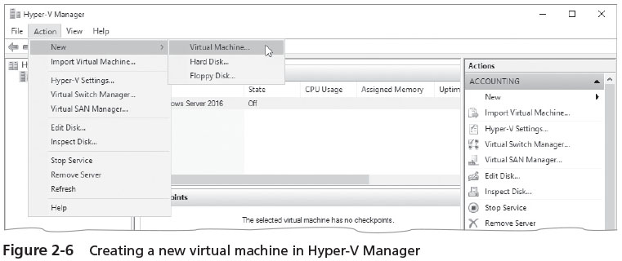
Installation for a Virtual Server Using Hyper-V (2 of 2)

Slide 33
Windows Deployment Services
The WDS role is designed to enable the installation of Windows operating systems on multiple computers
New to WDS in Windows Server 2016 is the ability to use Windows PowerShell cmdlets
Also WDS in Server 2016 adds driver provisioning to support more manufacturer’s drivers
When you use WDS, it’s not necessary to stay at the computer during the operating system installation
An installation DVD is not necessary
The installation files are sent over a network from the Windows Server 2016 Windows Deployment Services server
However, you do need to have licenses for all of the operating systems you install through WDS

Slide 34
Performing a DVD-Based Installation
Complete Activity 2-4: Installing Windows Server 2016 from DVD
Time Required: Approximately 30–60 minutes (depending on the speed of your computer)
Objective: Install Windows Server 2016 from DVD

Slide 35
Using Server Manager for the Initial Setup
Use Server Manager to begin configuring the server through tasks such as:
Providing Computer Information
Configuring the time zone
Configuring IP addressing information
Configuring server services and monitoring those services
Installing and managing server roles and program features
You don’t need to complete all of the tasks at this time
But you should complete some preliminary tasks right away
Many server administrators check for the following:
Remote management is enabled
Windows Firewall is working or they disable it to set up other firewall software
Windows Update is configured to ensure latest updates are obtained

Slide 36
Server Activation (1 of 2)
After Windows Server 2016 is installed
Necessary to activate the copy of the operating system
You need to activate your copy of Windows Server 2016 before the short activation period expires
Or else many functions of the operating system are disabled
Windows Server 2016 can be activated through the Internet using Server Manager

Slide 37
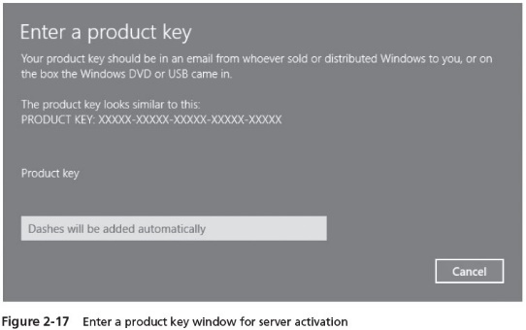
Server Activation (2 of 2)

Slide 38
Using Windows Deployment Services
Benefits
Installs Windows Server from Server 2003 through Server 2016
Installs Windows desktop systems from Windows Vista to Windows 10
Enhances performance
Provides updated boot format
Uses image-based installation techniques
Can utilize multicasting for network efficiency
Offers a redesigned presentation for choosing which operating system to install
Supports cmdlets and scripting in Windows PowerShell, which is new with Windows Server 2012 R2 and Server 2016
WDS operates in Preboot Execution Environment (PXE)

Slide 39
Installing and Configuring Windows Deployment Services
Requirements
A DNS server already configured on the network
A DHCP server already configured on the network
Active Directory Domain Services already installed on a network server and the WDS server is part of the domain managed by Active Directory
NTFS as the file system on the Windows Deployment Services server
You can install the Windows Deployment Services role from Server Manager
Activity 2-6 will step you through this

Slide 40
Elements for an Unattended Installation (1 of 2)
To set up for an unattended installation, it is necessary to do the following:
Create the unattended answer file, in XML format
Configure Windows Deployment Services to enable an unattended installation
The answer file is created using Windows System Image Manager (Windows SIM)
A tool included with the Windows Assessment and Deployment Kit (ADK)
When you create the answer file using Windows SIM, you will likely need to set up several configuration passes

Slide 41
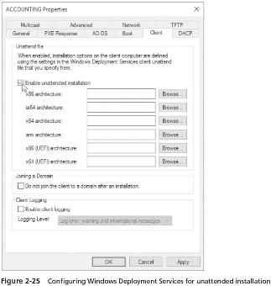
Elements for an Unattended Installation (2 of 2)

Slide 42
Installing Windows Server Core
The steps for installing Windows Server Core are nearly identical to the steps for a full installation
Until you reach the end of the process when you need to log on to the newly installed system
You can implement all or portions of the server roles listed in the earlier section titled “Identifying Server Roles”
For some of these roles, not all role services can be installed as in the full installation of Windows Server 2016
This is in keeping with the design concept of having a smaller attack surface to discourage attackers and malicious software
To access PowerShell, type powershell at the command prompt in the Server Core command-line
At the command line, enter help to view a listing of commands

Slide 43
Installing and Managing Service Packs
Service packs are designed to correct things such as security issues
As well as problems affecting stability, performance, or the operation of features included with the operating system
Guidelines when installing the latest service packs
Download the latest service pack from Microsoft’s download site
Review the documentation that comes with the service pack
Perform a full backup before you do the service pack installation
If the server is already available to clients, schedule when the service pack will be installed
Once the service pack is installed, document any problems that occurred and how you fixed them for future reference

Slide 44
Troubleshooting Installation Problems
Keep the following points in mind to avoid problems:
Ensure that the hardware has the Certified for Windows Server 2008 sticker or is in the Windows Server Catalog of Tested Products
Test all hardware before installing the operating system
Run the computer manufacturer’s diagnostics before installing the operating system
Run a comprehensive test of the hard disk to ensure it is functioning properly

Slide 45
Removing Windows Server 2016
Removing Windows Server 2016 is a relatively straightforward process
And requires you to format the partition on which it has been installed
If you are installing another operating system
You are usually given an opportunity to format the hard drive for that operating system
You can also use the FDISK and FORMAT utilities
Another option is to use the FORMAT or DISKPART utilities from the Command Prompt screen

Slide 46
Chapter Summary (1 of 2)
Before you install Windows Server 2016, complete the preinstallation tasks to help ensure the best result
Windows Server 2016 has many server-based roles, from housing Active Directory functions to offering DNS or DHCP services to providing file and print services
Windows Server 2016 can be installed using any of several methods, which include DVD installation, upgrading from Windows Server 2012/R2, using Hyper-V for a virtual server, and WDS
After Windows Server 2016 is installed, you can perform basic configuration activities using Server Manager

Slide 47
Chapter Summary (2 of 2)
So that you can retain full use of Windows Server 2016, plan to activate the operating system immediately
If your organization is planning to install multiple servers or many Windows 10 computers, you can use Windows Deployment Services to save time and effort
An alternative to installing the GUI version of Windows Server 2016 is to install Server Core
Service packs should be installed to fix any known problems with the OS
If you run into installation problems, try the troubleshooting suggestions in Table 2-4
To remove Windows Server 2016, use the installation of another operating system to overwrite the Windows Server 2016 installation or use tools such as FDISK, FORMAT, and DISKPART

