Slide 1
Hands-On Microsoft Windows Server 2016 2nd Edition
Chapter 3
Configuring the Windows Server 2016 Environment

Slide 2
Objectives (1 of 2)
Use Server Manager to manage a server
Install and remove server roles
Use the Best Practices Analyzer on server roles
Configure server hardware
Use System File Checker and Sigverif to verify system files

Slide 3
Objectives (2 of 2)
Configure the operating system, tune performance, and configure environment variables
Understand and configure the Registry
Use Windows PowerShell

Slide 4
Using Server Manager (1 of 6)
Server Manager
Consolidates administrative functions to make a server easier to manage
Server Manager typically has two main panels
See Figures 3-1 through 3-5

Slide 5
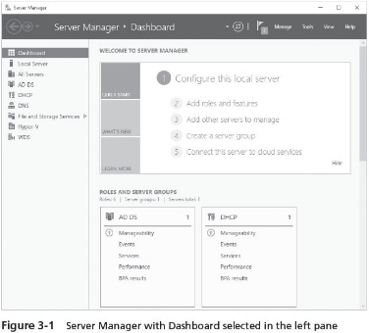
Using Server Manager (2 of 6)

Slide 6
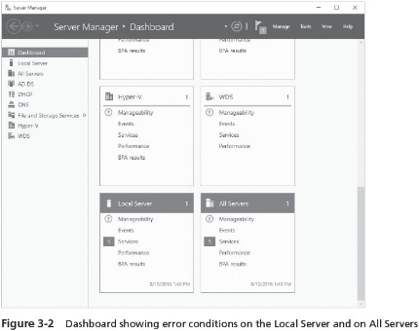
Using Server Manager (3 of 6)

Slide 7
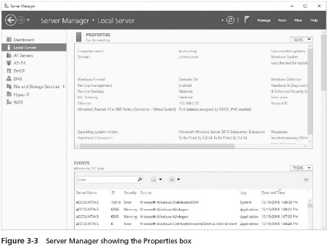
Using Server Manager (4 of 6)

Slide 8
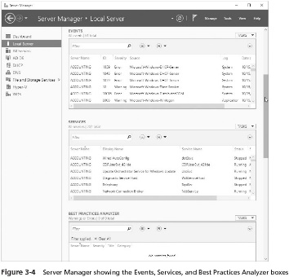
Using Server Manager (5 of 6)

Slide 9
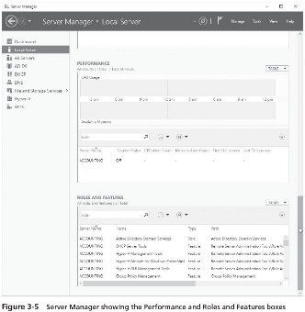
Using Server Manager (6 of 6)

Slide 10
Installing and Removing Server Roles
For most rolls you install
There are different role services you can choose to include or omit
Two common roles for a Windows Server 2016 server
File and Storage Services role
Focuses on sharing files from the server or using the server to coordinate and simplify file sharing through Distributed File System (DFS)
Print and Document Services role
Used to manage network printing services and it can offer one or more network printers connected to the network through the server itself

Slide 11
Using the Best Practices Analyzer (BPA) for Server Roles (1 of 3)
Once you’ve installed a role and set it up
It is important to determine that you have followed the best practices for the establishment of the role
You can run the BPA to determine if one or more roles are installed and configured to follow the guidelines recommended by Microsoft
When problems are found, the analysis of each role yields a report that shows three levels of severity:
Information
Warning
Error

Slide 12
Using the Best Practices Analyzer (BPA) for Server Roles (2 of 3)
The guidelines the BPA uses for analysis are:
Configuration
Predeployment
Postdeployment
Performance
BPA Prerequisites
General steps for running BPA:
Open Server Manager
Click Local Server in the left pane
In the right pane, scroll to Best Practices Analyzer
Click the down arrow for TASKS
Click Start BPA Scan and wait for the scan to complete
Read the results for the scan

Slide 13
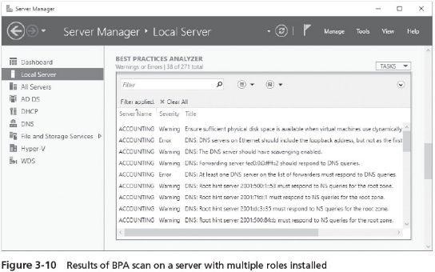
Using the Best Practices Analyzer (BPA) for Server Roles (3 of 3)

Slide 14
Configuring Server Hardware Devices
Hardware devices can include the following:
Disk drives
Disk controllers
Network adapters
Optical drives
Keyboard
Pointing devices
Monitor

Slide 15
Plug and Play
Plug and Play (PnP)
The ability to automatically detect and configure newly installed hardware devices
For this capability to work, PnP must be:
Built into the device
Enabled in the target computer’s BIOS
Built into the computer operating system kernel
PnP eliminates hours of time that server administrators and computer users once spent installing and configuring hardware
In some cases
Once the device is installed you might need to configure its properties and settings

Slide 16
Using Control Panel and the Devices and Printers Utility (1 of 6)
The Devices and Printers utility is used for the following tasks:
Invoke the operating system to use PnP to detect new hardware
Install new non-PnP hardware and hardware drivers
Troubleshoot problems you might be having with existing hardware
The Devices and Printers utility is started from Control Panel
Windows Server 2016 provides two Control Panel view options: Control Panel Home with Category View and Control Panel with Classic View

Slide 17
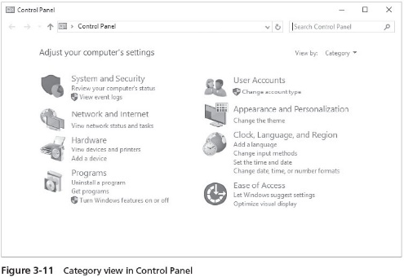
Using Control Panel and the Devices and Printers Utility (2 of 6)

Slide 18
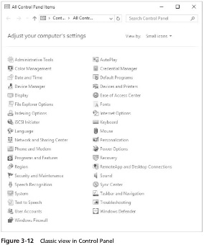
Using Control Panel and the Devices and Printers Utility (3 of 6)

Slide 19
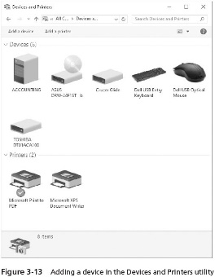
Using Control Panel and the Devices and Printers Utility (4 of 6)

Slide 20
Using Control Panel and the Devices and Printers Utility (5 of 6)
Device Manager
Used to check for a resource conflict and to examine other properties associated with a device
Provides a view of all hardware currently installed on your computer
Can also be used to:
Verify if hardware installed is working properly
Update device drivers
Disable a device
Uninstall a device
Configure the settings for a device

Slide 21
Using Control Panel and the Devices and Printers Utility (6 of 6)
Driver signing
When a driver is verified, a unique digital signature is incorporated into it
When Windows Server 2016 determines that a device driver is not signed, it gives you a warning
Device drivers that are unsigned cannot be loaded in x64 versions of Windows Server 2016

Slide 22
Using the System File Checker
Use the System File Checker
To scan system files for integrity
You can run this utility to:
Scan all system files to verify integrity
Scan and replace files as needed
Scan only certain files
The System File Checker can be manually run from the Command Prompt window or Windows PowerShell window

Slide 23
Using Sigverif to Verify System and Critical Files
Sigverif verifies system and critical files to determine if they have a signature
Only scans files and does not overwrite inappropriate files, enabling you to use the tool while users are logged on
After the scan is complete, the results are written to a log file, called sigverif.txt
If the tool finds a file without a signature that you believe needs to be replaced
You can replace the file when users are off the system

Slide 24
Configuring the Operating System
After the operating system has been installed
It can be configured to optimize performance and meet very specific requirements
Using tools included with Windows Server 2016 you can configure elements of the OS such as:
Performance options
Environment variables
Startup and recovery options
Power options
Protocols

Slide 25
Configuring Performance Options (1 of 2)
You can configure basic areas of performance including:
Processor scheduling and Data Execution Prevention
Virtual memory
File caching and flushing
Configuring Processor Scheduling and Data Execution Prevention
Processor scheduling
Allows you to configure how processor resources are allocated to programs
Data Execution Prevention (DEP)
Monitors how programs use memory to ensure they are not causing memory problems

Slide 26
Configuring Performance Options (2 of 2)
Configuring virtual memory
Virtual memory - Disk storage used to expand the capacity of the physical RAM installed in the computer
Virtual memory works through a technique called paging
Whereby blocks of information, called pages, are moved from RAM into virtual memory on disk
The area of disk that is allocated for this purpose is called the paging file
Tips for placement of the paging file:
Server performance is better if the paging file is not placed on the boot partition
If there are multiple disks, performance can be improved by placing a paging file on each disk
In a mirrored set or volume, place the paging file on the main disk
Do not place the paging file on a stripe set, striped volume, stripe set with parity, or RAID-5 volume

Slide 27
Configuring File Caching
File caching is turned on by default
Uses an area of RAM already established for file caching
Is controlled by the cache manager in Windows OSs
Flushing
After data is written to disk, the RAM used for that cached data is freed
When file caching is off
Server can seem slower to users
In most cases, server performance is better and disk operations are safer when file caching and flushing are turned on

Slide 28
Configuring Environment Variables
Environment variables
Used to tell the operating system where to find certain programs and how to allocate memory to programs, and to control different programs
System environment variables
Defined by the operating system and apply to any user logged onto the computer
User environment variables
Can be defined on a per-user basis, such as specifying the path where application files are stored
Keep the following in mind:
System environment variables are always set first
User environment variables are set next, overriding any conflicting system environment variables

Slide 29
Configuring Startup and Recovery
You can configure the following system startup options:
Which operating system to boot by default, if more than one operating system is installed
How long to display a list of operating systems from which to boot
How long to display a list of recovery options, if the computer needs to go into recovery mode after a system failure
In the event of a system failure, you can configure these options:
Writing information to the system log (hard configured so you cannot change this)
Whether to start automatically after a system failure
How and where to write debugging information

Slide 30
Configuring Power Options
The Power Options that you can set are as follows:
Select a power plan
Choose what the power button does
Create a power plan
Choose when to turn off the display
Three power plans are already created: balanced, power saver, and high performance
Choosing what the power button does give you three options:
Shut down
Do nothing
Hibernate
The option to create a power plan enables you to customize a power plan

Slide 31
Installing a Protocol
You might need to add other protocols to customize the server for your network
Hyper-V Extensible Virtual Switch Protocol
Used when the Hyper-V role is installed in Windows Server 2016
Enables the use of a software virtual switch between the main operating system and the operating systems on virtual partitions
Reduces the overhead in network communications when Hyper-V is installed
Reliable Multicast Protocol
Used for multimedia transmissions
Runs on top of IP and simplifies multicast communications
Because multicasting can be done even without routers to direct network traffic

Slide 32
Understanding the Windows Server 2016 Registry (1 of 3)
Windows Server 2016 Registry
A very complex database containing all information the operating system needs about the entire server
The Registry is the coordinating center for a specific server
Data contained in the Registry include:
Information about all hardware components
Information about Windows Server 2016 services that are installed
Data about user profiles and Windows Server 2016 group policies
Data on the last current and last known setup used to boot the computer
Configuration information about all software in use
Software licensing information
Server Manager and Control Panel parameter configurations

Slide 33
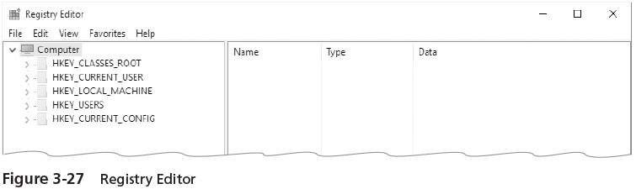
Understanding the Windows Server 2016 Registry (2 of 3)
The Registry Editor is launched from the Start button Run or Command prompt option as regedit
The same command can be used to start the Registry Editor in Windows PowerShell

Slide 34
Understanding the Windows Server 2016 Registry (3 of 3)
Precautions when working with the Registry:
Establish a specific group of administrators who have privileges to open and modify the Registry
Only make changes to the Registry as a last resort
Regularly back up the Registry as part of backing up the Windows Server 2016 Windows folder
Never copy the Registry from one Windows-based system over the Registry of a different system

Slide 35
Registry Contents (1 of 2)
The Registry is hierarchical in structure
Made up of keys, subkeys, and entries
Registry key
A category or division of information within the Registry
Registry subkeys
A single key may contain one or more lower-level keys
Registry entry
A data parameter associated with a software or hardware characteristic under a key (or subkey)
Root key (subkey)
A primary or highest level category of data contained in the Registry

Slide 36
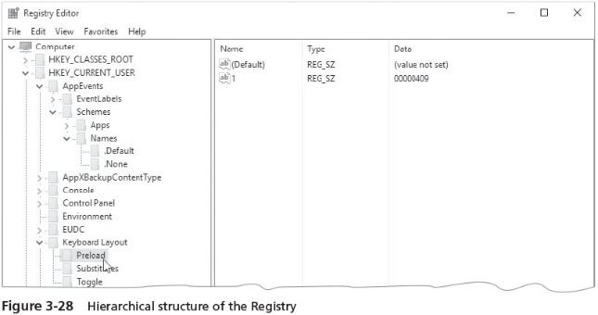
Registry Contents (2 of 2)

Slide 37
HKEY_LOCAL_MACHINE (1 of 2)
HKEY_LOCAL_ MACHINE root key
Contains information on every hardware component in the server
Includes information about what drivers are loaded and their version levels, what IRQ lines are used, setup configurations, the BIOS version, and more
A few subkeys are stored as a set, called hives, because they hold related information

Slide 38
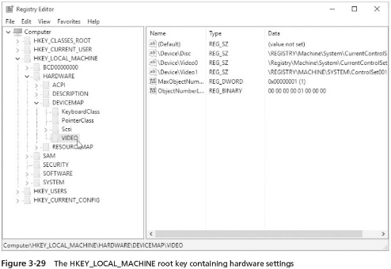
HKEY_LOCAL_MACHINE (2 of 2)

Slide 39
HKEY_CURRENT_USER
HKEY_CURRENT_USER key
Contains information about the desktop setup for the account presently signed in to the server console
HKEY_USERS key
Contains profile settings for all users who have logged onto the server

Slide 40
HKEY_USERS
HKEY_USERS root key
Contains profile information for each user who has logged onto the computer
Each profile is listed under this root key
Within each user profile is information identical to that viewed within the HKEY_CURRENT_USER root key
The profile used when you are signed in is one of the profiles stored under HKEY_USERS

Slide 41
HKEY_CLASSES_ROOT
HKEY_CLASSES_ROOT key
Holds data to associate file extensions with programs
Associations exist for executable files, text files, graphics files, Clipboard files, audio files, and many more
These associations are used as defaults for all users who log on to Windows Server 2016

Slide 42
HKEY_CURRENT_CONFIG
HKEY_CURRENT_CONFIG root key
Has information about the current hardware profile
Holds information about the monitor type, keyboard, mouse, and other hardware characteristics for the current profile

Slide 43
Backing Up the Registry
Before working on the Registry
It is important to have a backup of its contents
An easy way to create a backup
Set a restore point
If Registry is damaged after you work on it
You can go back to the restore point you created just before working on the Registry
Create a restore point
Using the Checkpoint-Computer cmdlet in PowerShell

Slide 44
Windows PowerShell (1 of 4)
Windows PowerShell is a command-line interface or shell
A shell is a customized environment for executing commands and scripts
Script
A file of commands that is run when you run the script
cmdlets
Specialized commands for completing common tasks in PowerShell

Slide 45
Windows PowerShell (2 of 4)
Windows PowerShell is a command-line interface or shell
A shell is a customized environment for executing commands and scripts
Script
A file of commands that is run when you run the script
cmdlets
Specialized commands for completing common tasks in PowerShell

Slide 46
Windows PowerShell (3 of 4)
Some of the tasks you can complete using Windows PowerShell include the following:
Manage files and folders
Manage network tasks
Manage fixed and removable storage
Configure printing services
Manage software applications and updates
Manage Remote Desktop Services
Manage server services and features
Manage web server services
Work with the Registry

Slide 47
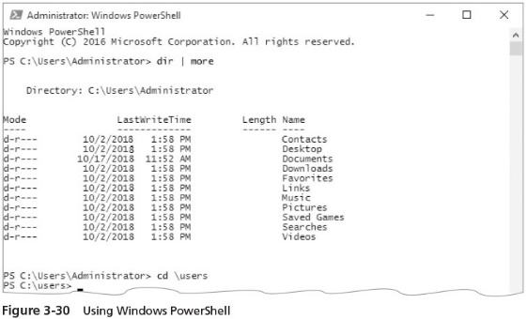
Windows PowerShell (4 of 4)

Slide 48
Chapter Summary (1 of 2)
Server Manager is tool offered in Windows Server 2016 that helps centralize server management tasks
After server roles are installed, you can use the Best Practices Analyzer (BPA) to ensure one or more roles are optimally configured and running
The Devices and Printers utility in Control Panel with the Add a device option enables the installation of hardware devices not properly detected by PnP
Device Manager is a tool you can access from Control Panel or the Computer Management tool to manage hardware
The System File Checker and Sigverif are tools for verifying system files
After Windows Server 2016 is installed, you can tune performance by configuring processor scheduling and Data Execution Prevention (DEP) use, virtual memory, and file caching and flushing

Slide 49
Chapter Summary (2 of 2)
Environment variables are important to configure because they help the OS to find specific programs, help programs to properly allocate memory, and help to control specific programs
To protect your system from complications due to power problems, configure startup and recovery options as well as power options
Knowing how to install a protocol is a skill that is similar to knowing how to change a flat tire; don’t need it often but it is important to know
The Registry is a database that is at the foundation of Windows Server 2016
Windows PowerShell is a command-line tool that enables a system administrator to manage a server using commands, cmdlets, and scripts

