Slide 1
Hands-On Microsoft Windows Server 2016 2nd Edition
Chapter 5
Configuring, Managing, and Troubleshooting Resource Access

Slide 2
Objectives
Set up security for folders and files
Configure shared folders and shared folder security
Troubleshoot security conflicts
Implement work folders
Install and set up the Distributed File System
Configure disk quotas

Slide 3
Managing Folder and File Security
Creating accounts and groups are the initial steps for sharing resources
The next steps are to create access control lists (ACLs) to secure these objects and then to set them up for sharing
Discretionary ACL (DACL)
An ACL that is configured by a server administrator or owner of an object
System control ACL (SACL)
Contains information used to audit the access to an object
DACL and SACL controls for folders and files:
Attributes
Permissions
Auditing
Ownership

Slide 4
Configuring Folder and File Attributes (1 of 8)
Attributes are stored as header information with each folder and file
Along with other characteristics including volume label, designation as a subfolder, date of creation, and time of creation
Two basic attributes remain in NTFS that are still compatible with FAT
Read-only and hidden
On the General tab in an NTFS folder’s or file’s properties dialog box
NTFS offers advanced or extended attributes
Accessed by clicking the General tab’s Advanced button
The advanced attributes are archive, index, compress, and encrypt

Slide 5
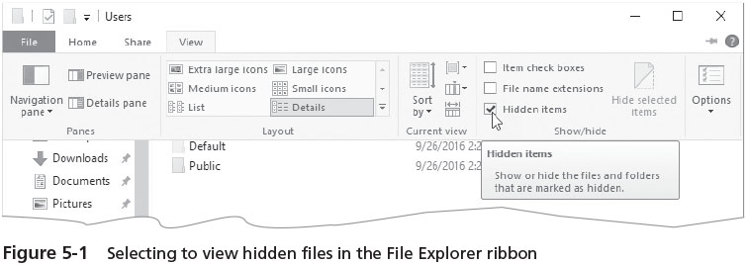
Configuring Folder and File Attributes (2 of 8)

Slide 6
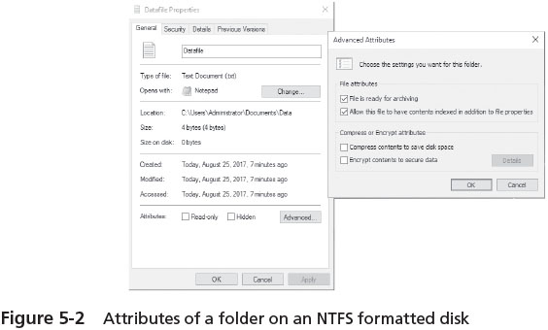
Configuring Folder and File Attributes (3 of 8)

Slide 7
Configuring Folder and File Attributes (4 of 8)
Archive attribute
Indicates that the folder or file needs to be backed up because it is new or changed
File server backup systems can be set to detect files with the archive attribute to ensure those files are backed up
Index attribute vs. Windows Search Service
The NTFS index attribute is used to index the folder and file contents so that file properties can be quickly searched in Windows Server 2016 through the Indexing Service
Windows Server 2016 offers a newer, faster search service called the Windows Search Service
To use the Windows Search Service, you must install the File and Storage Services role via Server Manager

Slide 8
Configuring Folder and File Attributes (5 of 8)
Compress attribute
A folder and its contents can be stored on the disk in compressed format
Compression saves space and you can work on compressed files in the same way as on uncompressed files
Compressed files increase CPU overhead to open the files and to copy them
Best practices for using the compress attribute:
Busy servers that experience high-volume write or execute operations are poor candidates for the use of compression
Servers that are rarely busy or that primary have read traffic are acceptable candidates
Files that are rarely accessed or that are archived on the server can be candidates
User home folders on a server typically have high levels of read and write activity and generally should not be compressed

Slide 9
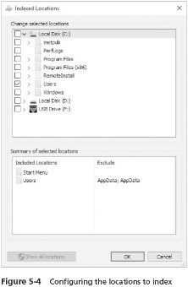
Configuring Folder and File Attributes (6 of 8)

Slide 10
Configuring Folder and File Attributes (7 of 8)
Encrypt attribute
Protects folders and files so that only the user who encrypts the folder or file is able to read it
An encrypted folder or file uses the Microsoft Encrypting File System (EFS)
Which sets up a unique, private encryption key associated with the user account that encrypted the folder or file
EFS uses both symmetric and asymmetric encryption technique
When you move an encrypted file to another folder on the same computer, that file remains encrypted, even if you rename it

Slide 11
Configuring Folder and File Attributes (8 of 8)
Best practices for using EFS:
Move files for encryption into specifically designated folders flagged for encryption
It is safer for an application to work on a file in an encrypted folder rather than to work on a file that is individually encrypted
Workstation users and server administrators should consider encrypting the My Document or Documents folders on their systems
Users and server administrators should frequently export certificates and private keys to portable media and store the media in a secure place

Slide 12
Configuring Folder and File Permissions (1 of 4)
Permissions
Control access to an object, such as a folder or file
When you configure a folder so that a domain local group has access to only read the contents of that folder
You are configuring permissions
At the same time, you are configuring that folder’s discretionary access control list (DACL) of security descriptors

Slide 13
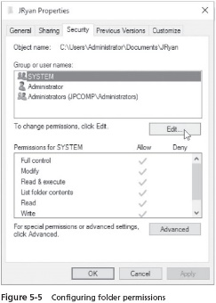
Configuring Folder and File Permissions (2 of 4)

Slide 14
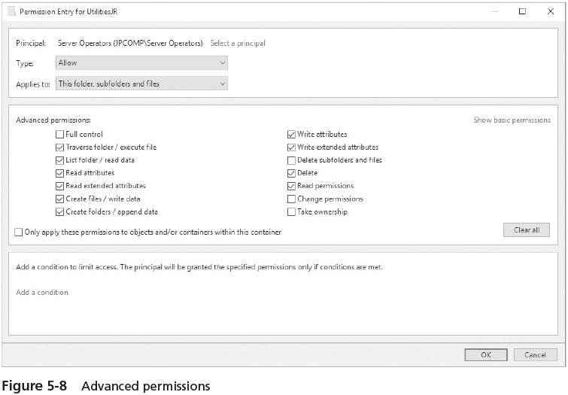
Configuring Folder and File Permissions (3 of 4)
If you need to customize permissions
You have the option to set up special permissions for a particular group or user

Slide 15
Configuring Folder and File Permissions (4 of 4)
Microsoft provides best practice guidelines for setting permissions:
Protect the \Windows folder that contains OS files on Windows Server 2016 servers and its subfolders from general users through allowing limited access
Protect server utility folders with access permissions only for Administrators, Server Operators, and Backup Operators groups
Protect software application folders with Read & execute and Write to enable users to run applications and write temporary files
Create publicly used folders to have Modify access
Provide users Full control of their own home folders
Remove unnecessary access groups from confidential folders
Use Deny sparingly

Slide 16
Configuring Folder and File Auditing
Auditing
Enables you to track activity on a folder or file
Windows Server 2016 NTFS folders and files
Enable you to audit a combination of any or all of the activities listed as advanced permissions in Table 5-2

Slide 17
Configuring Folder and File Ownership (1 of 2)
With permissions and auditing set up, you might want to verify the ownership of a folder
Folders are first owned by the account that creates them
Folder owners have the ability to change permissions for the folders they create
Ownership can be transferred only by having the Take ownership advanced permission
Or Full control permission (which includes Take ownership)

Slide 18
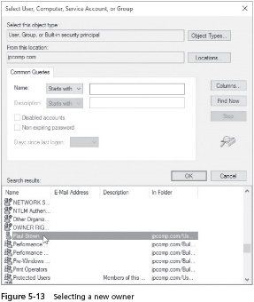
Configuring Folder and File Ownership (2 of 2)

Slide 19
Configuring Shared Folders and Shared Folder Permissions
A folder can be set up as a shared folder for users to access over the network
Configuring a shared folder includes features so that the person configuring a share is more aware of security options
Sharing a folder or file consists of first enabling sharing

Slide 20
Enabling Sharing (1 of 2)
First step for sharing a folder or file over the network
Is to make sure folder/file and printer sharing is turned on
Network discovery can be turned on
Network discovery is the ability to view other network computers and devices
You only need to do this once
But it is necessary for users to be able to access the server’s shared file/folder and printer resources

Slide 21
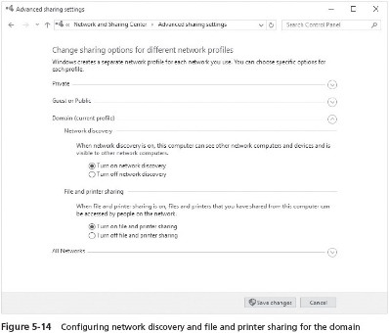
Enabling Sharing (2 of 2)

Slide 22
Configuring Folder/File Sharing Through the Folder/File Properties (1 of 4)
Share permissions for folder or file
Can be set by configuring sharing using the File Sharing window and a folder’s or file’s Sharing tab in its Properties dialog box
When you configure sharing using the advanced sharing options
The share permissions also include Full control and Change
Configured using the Advanced Sharing button on the Sharing tab of Properties
Share permissions:
Read
Write
Change or Contribute
Custom
Full control
Owner

Slide 23
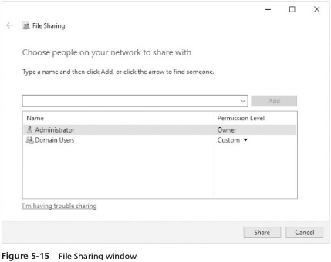
Configuring Folder/File Sharing Through the Folder/File Properties (2 of 4)

Slide 24
Configuring Folder/File Sharing Through the Folder/File Properties (3 of 4)
You can cache a folder to make the contents of a shared folder available offline
Any offline files that have been modified can be synchronized with the network versions of the files
A folder can be cached in three ways:
Only the files and programs that users specify will be available offline
No files or programs from the shared folder are available offline
All files and programs that users open from the shared folder are automatically available offline
Access-based enumeration
Permits the user to view only folders and files for which they have permissions
Besides hiding a shared folder using the $ sign, you can enable access-based enumeration

Slide 25
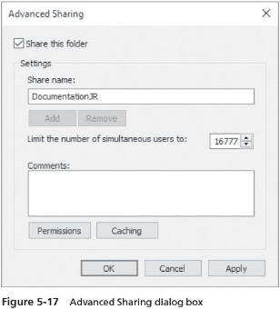
Configuring Folder/File Sharing Through the Folder/File Properties (4 of 4)

Slide 26
Configuring Sharing Through Server Manager
Server Manager
Another way to configure folder and file permissions and share permissions
Offers an interface for managing permissions and shares from one tool
There are more easily accessed options for share management
Server Message Block (SMB) protocol
Enables an OS to offer shared files, folders, printers, serial ports, and other port communications on a network
Network File System (NFS) protocol
Used for file and folder sharing on UNIX and Linux systems
When installed on a Windows system share, enables it to be accessed by UNIX and Linux computers
File Server Resource Manager role service
Allows you to set folder quotas

Slide 27
Publishing a Shared Folder in Active Directory
To publish an object
Means to make it available for users to access when they view Active Directory contents
Makes it easier to find when a user searches for that object
Active Directory search capabilities are automatically built into all modern Windows OSs, including Windows 10 and Server 2016
When you publish an object, you can publish it to be shared for domain-wide access or to be shared and managed through an organizational unit (OU)

Slide 28
Troubleshooting a Security Conflict (1 of 2)
Windows Server 2016 offers the Effective Access tab in the properties of a folder or file
As a tool to help troubleshoot permissions conflicts
Using the Effective Access tab, you can view the effective permissions assigned to a user or group
The calculation will take into account group membership as well as permission inheritance
Take into account what happens when a folder or files in a folder are copied or moved

Slide 29
Troubleshooting a Security Conflict (2 of 2)
When a file or folder is created, copied, or moved, the file and folder permissions can be affected in the following ways:
A newly created file inherits the permissions already set up in a folder
A file that is copied from one folder to another on the same volume inherits the permissions of the folder to which it is copied
A file or folder that is moved from one folder to another on the same volume takes with it the permissions it had in the original folder
A file or folder that is moved or copied to a folder on a different volume inherits the permissions of the folder to which it is moved or copied
A file or folder that is moved or copied from an NTFS volume to a folder in a FAT or FAT32 volume is not protected by NTFS permissions
But it does inherit share permissions if they are assigned to the FAT/FAT32 folder
A file or folder that is moved or copied from a FAT volume to a folder in an NTFS volume inherits the permissions already assigned in the NTFS folder

Slide 30
Using Work Folders (1 of 3)
Work Folders
Employed so that users can access and synchronize folders used in work environments through employing all types of devices, mobile and stationary, such as:
Tablet PCs
Laptops
Stationary PCs
Designed to accommodate the bring-your-own-device (BYOD) environment
User folders are stored on a server in a master folder called a sync share
Folders and files can be automatically synchronized between the user’s mobile or stationary device and the contents in the sync share folder

Slide 31
Using Work Folders (2 of 3)
To accommodate BYOD, work folders
Enable a business to centralize storage of work documents while maintaining control of access and use of these documents
Security is another advantage
Work folders are subject to NTFS permissions and share permissions
A Group Policy can be set up on the server to ensure that mobile and stationary devices must use screen locking with a password and must encrypt files
At this writing, work folders are supported in:
Windows 10, Windows 8.1, Windows RT 8.1, Windows 7 and 8

Slide 32
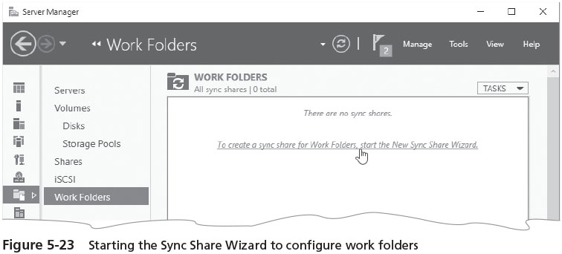
Using Work Folders (3 of 3)
To use work folders
Install the Work Folders role service in the File and Storage Services role
Configure Work Folders in Server Manager
General steps for setting up Work Folders are outlined on page 227 of the text

Slide 33
Implementing a Distributed File System (1 of 2)
Distributed File System (DFS)
Enables you to simplify access to the shared folders on a network by setting up folders to appear as though they are accessed from only one place
DFS also makes managing folder access easier for server administrators
After the DFS role is installed
DFS is configured using the DFS Management tool started from Server Manager
If DFS is used in a domain, then shared folder contents can be replicated to one or more DCs or member servers

Slide 34
Implementing a Distributed File System (2 of 2)
DFS advantages:
Shared folders can be set up so that they appear in one hierarchy of folders
Enabling users to save time when searching for information
NTFS access permissions fully apply to DFS on NTFS-formatted volumes
Fault tolerance is an option by replicating shared folders on multiple servers
Access to shared folders can be distributed across many servers (load balancing)
Access is improved to resources for Web-based Internet and intranet sites
Vital shared folders on multiple computers can be backed up from one set of master folders
DFS reduces the number of calls to server administrators asking where to find a particular resource

Slide 35
DFS Replication
Another advantage of DFS in a domain is that folders can be replicated automatically or manually through DFS Replication
A role service you can install within the File and Storage Service role
When you install DFS functionality, plan to install DFS Replication
Shared folders in DFS are copied to each designated target computer, which yields two significant advantages:
Important information is not lost when a disk drive on one server fails
Users always have access to shared folders even in the event of a disk failure
DFS and DFS Replication can be administered through GUI tools or through PowerShell cmdlets

Slide 36
DFS Models
Stand-alone DFS model
No Active Directory implementation is available to help manage the shared folders
This model provides only a single or flat level share
Domain-based DFS model
Takes full advantage of Active Directory and is available only to servers and workstations that are members of a domain
Enables a deep, root-based, hierarchical arrangement of shared folders that is published in Active Directory
DFS shared folders in the domain-based model are replicated for fault tolerance and load balancing
Stand-along DFS model does not implement these features

Slide 37
DFS Topology
DFS topology
The hierarchical structure of DFS in the domain-based model
Namespace root
A main container (top-level folder) in Active Directory that holds links to shared folders that can be accessed from the root
Namespace server
The server that maintains the namespace root
After the namespace root is created, it is populated by shared folders for users to access
Folders are established in a level hierarchy and appear to be in one server location
Replication group
A set of shared folders that is replicated or copied to one or more servers in a domain

Slide 38
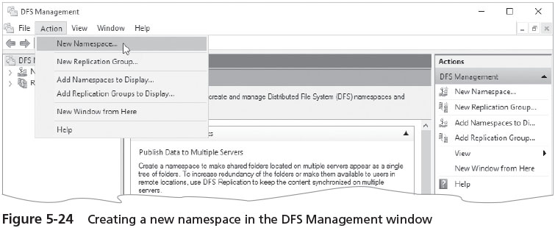
Installing DFS
DFS is installed as a service within the File Services role
File and Storage Services role is installed by default in Windows Server 2016
The elements needed for a domain-based DFS system with namespaces and DFS replication are not automatically installed
Use Server Manager to install DFS namespace and DFS Replication

Slide 39
Managing a Domain-Based Namespace Root System (1of 7)
After the namespace is set up, several tasks are involved in managing the namespace root:
Creating a folder in a namespace
Delegating management
Tuning a namespace
Deleting a namespace root
Using DFS replication

Slide 40
Managing a Domain-Based Namespace Root System (2 of 7)
Creating a folder in a namespace
A folder is simply a shared folder that you add to (or link to) the namespace root
Folder target
A path in the Universal Naming Convention (UNC) format, such as to a shared folder or to a different DFS path
Universal Naming Convention (UNC)
A naming convention that designates network servers, computers, and shared resources
Clients who access the namespace can see a list of folder targets ordered in a hierarchy

Slide 41
Managing a Domain-Based Namespace Root System (3 of 7)
Delegating Management
You can delegate management of a DFS namespace so that the day-to-day activities can be managed by an assistant or by another person who oversees the management of DFS shared folders
Delegating management simply involves right-clicking the namespace and clicking Delegate Management Permissions
Even if you are the main person managing DFS shared folders, it is a good idea to have a backup person

Slide 42
Managing a Domain-Based Namespace Root System (4 of 7)
Tuning a Namespace
After you configure a DFS namespace, you can tune it to match the needs of your organization
Tuning options:
Configure the order for referrals
Configure cache duration for a namespace
Configure cache duration for a folder
Configure namespace polling
Configure folder targets as enabled or disabled

Slide 43
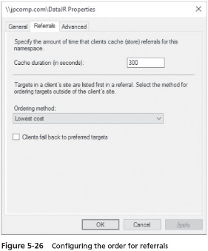
Managing a Domain-Based Namespace Root System (5 of 7)

Slide 44
Managing a Domain-Based Namespace Root System (6 of 7)
Deleting a namespace root
You can delete the namespace root via the DFS Management tool by clicking the namespace root and clicking Delete
Using DFS Replication
To configure replication, you first must have defined two or more folder targets
You need to decide which server is to be the primary group member
The primary group member should be the server containing shared folders and files that are most current

Slide 45
Managing a Domain-Based Namespace Root System (7 of 7)
Recent improvements to DFS replication include:
New Windows PowerShell cmdlets for managing replication tasks
New resources for rebuilding corrupted databases
Improved ability to automatically recover after a power failure

Slide 46
Configuring Disk Quotas
Disk quotas advantages:
Preventing users from filling the disk capacity
Encouraging users to help manage disk space
Tracking disk capacity needs on a per-user basis for future planning
Providing server administrators with information about when users are nearing or have reached their quota limits
A way to manage quotas and to directly configure quota templates is to use the File Server Resource Manager administrative tool
Can be started from Server Manager, from the Windows Administrative Tools folder via the Start button or as an MMC snap-in

Slide 47
Chapter Summary (1 of 2)
Windows Server 2016 uses discretionary access control lists for managing access to resources
NTFS uses folder and file attributes for one level of security
When you use the encrypt attribute, this employs the Microsoft Encrypting File System to protect files and folders
Permissions provide another level of security for files and folders
Advanced permissions provide the option to further customize security at a more granular level than basic permissions
Folder and file auditing enable you to track who has accessed resources

Slide 48
Chapter Summary (2 of 2)
Folder and file owners have Full control permissions, including the ability to change permissions
Folders can be shared for users to access over a network, and shared folder security is configured through share permissions
File can be shared over the network using SMB for Windows-based computers and UNIX or Linux computers that run Samba
Use the Effective Permissions capability to troubleshoot a security conflict
Users who need access to folders/files when they are not connected to the network can have access by making resource available offline
The Distributed File System (DFS) enables you to set up shared folders
Use disk quotas to manage the resources put on a server disk volume

