Slide 1
Hands-On Microsoft Windows Server 2016 2nd Edition
Chapter 6
Configuring Windows Server 2016 Printing

Slide 2
Objectives (1 of 2)
Understand how Windows Server 2016 printing works on a network and on the Internet
Understand and apply the Print and Document Services role
Use the XPS Print Path
Use the Print Management tool to configure network printing resources
Install local and shared printers

Slide 3
Objectives (2 of 2)
Configure printer properties
Configure a network or Internet printer
Manage print jobs
Troubleshoot common printing problems

Slide 4
An Overview of Windows Server 2016 Printing
Network printing process components
Local print device
Network print device
Print client
Print server
Print job
Printer driver
Spooling
Frees the server CPU to handle other processing requests in addition to print requests

Slide 5
How Network Printing Works
Printing process steps
Application at the client generates a print file
Application communicates with the Windows graphics device interface (GDI)
When the GDI is finished, the print file is formatted with control codes
The remote print provider at the client makes a remote procedure call to the network print server
The network print server uses four processes to receive and process a print file: router, print provider, print processor, and print monitor
The Server service calls its router, the Print Spooler service
While the file is spooled, the print provider works with the print processor to ensure that the file is formatted to use the right data type
The print monitor pulls it from the spooler’s disk storage and sends it off to the printer

Slide 6
How Internet Printing Works (1 of 2)
When a Windows client wants to process a print job through the Internet
The client must have Internet Printing Client installed
Internet Printing Client should be installed in Windows Server 2016
So client and server can communicate using a common protocol
Windows Server 2016 can be configured to act as a web-based print server by having the following elements:
Internet Printing Client
Print and Document Services role with the Internet Printing role service installed
Web Server role (IIS; Internet Information Services)

Slide 7
How Internet Printing Works (2 of 2)
The print process on the client is nearly the same as for network printing with a couple of exceptions:
The browser sends the print file to the GDI (instead of client application)
Remote print provider at the client makes a remote procedure call to IIS on the Windows 2016 server
The remote procedure call is made through TCP/IP-based HTTP, which transports another protocol, called the Internet Printing Protocol (IPP)
IPP
Is facilitated through the Internet Printing Client on the client requesting the print job and the Windows Server 2016 server
IPP encapsulates the remote procedure call and print process information and is transported in HTTP

Slide 8
The Print and Document Services Role (1 of 2)
Print and Document Services role
Enables you to set up Windows Server 2016 as a print server to coordinate and manage network and Internet printing functions
Advantage of the role:
You can configure a Group Policy for standardized management of printer resources
Print Management Tool enables you to:
Manage shared printers
Track printing events through a log you can view using Event Viewer

Slide 9
The Print and Document Services Role (2 of 2)
Role services available within the Print and Document Services role:
Printer Server – turns the server into a print server and installs the Print Management tool
Distributed Scan Server – enables Windows Server 2016 to receive scanned documents from network scanners and deliver them to designated server clients
Internet Printing – creates a website through IIS for Internet printing, managing print jobs, and for connecting to shared printers using IPP through Internet Printing Client
LPD Service – Line Printer Daemon (LPD) enables UNIX and Linux computers to print to shared printers managed through Windows Server 2016

Slide 10
Using the XPS Print Path (1 of 2)
XML Paper Specification (XPS)
An advanced way of printing documents for multiple purposes, including viewing electronic pages and printing pages in a polished format
XPS is a concept similar to using PDF files
The XPS print path in Windows Server 2016 is offered as an alternative to the GDI print path
Used by conventional documents

Slide 11
Using the XPS Print Path (2 of 2)
XPS enhancements
Customized print path for documents using XPS
Advanced color support for sophisticated color printers
Faster performance for printouts generated by .NET Framework applications
Full WYSIWYG (What You See Is What You Get)
The XPS drive path uses the XPSDrv Driver Model
This driver can print to an XPS-enabled printer or a file
Windows Server 2016 has XPS services built into the Print and Document Services role

Slide 12
The Devices and Printers Utility (1 of 2)
Windows Server 2016 Devices and Printers utility
A tool you can use to configure printing resources
Enables you to set up a printer directly connected to a server, set up a network printer, and set up a printer through Bluetooth
The Devices and Printers utility is started from Control Panel
An alternate way to set up and manage printers is to use the Print Management Tool

Slide 13
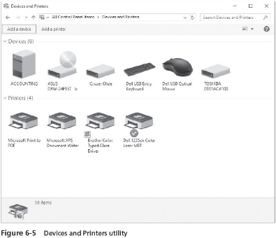
The Devices and Printers Utility (2 of 2)

Slide 14
Using the Print Management Tool (1 of 2)
The Print Management tool
Also available as an MMC snap-in
Centralizes local and shared printer control in one place
Enables printer administrators and operators to manage the print functions of some or all of the shared printers on a network
Using the Print Management tool, you can:
Install and configure local and network printers
Configure printer properties, sharing, and security
You can open this tool from:
The Server Manager Tools menu
The MMC
The Start button by clicking the Windows Administrative Tools folder and Print Management

Slide 15
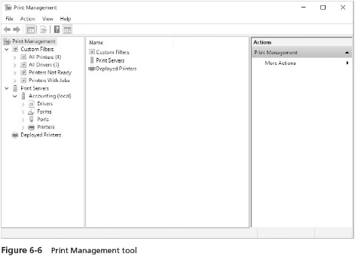
Using the Print Management Tool (2 of 2)

Slide 16
Configuring the Print Server Properties
Using the Print Management tool you can:
Set up the forms to use
Configure print spooler properties
Configure security to apply to all printers managed by the print server
View installed printer driver information for all printers
Update a specific printer driver
Accomplish other tasks
Activity 6-4 enables you to see how to configure the print server properties

Slide 17
Installing Local and Shared Printers (1 of 3)
In Windows Server 2016, you can configure a printer that is attached to the server computer as a local printer
And then enable it as a shared printer
You can also configure a network printer as a shared printer managed through a Windows Server 2016 print server
The steps for installing a local printer depend on the type of printer you are adding
If a printer is not automatically detected through Plug and Play, you can use the Network Printer Installation Wizard to install it
Activity 6-5 shows you how to install a printer using the Network Printer Installation Wizard

Slide 18
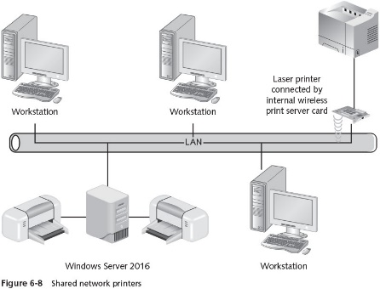
Installing Local and Shared Printers (2 of 3)

Slide 19
Installing Local and Shared Printers (3 of 3)
When you add a shared printer, consider the following guidelines when choosing a share name:
Compose names that are easily understood and spelled by those who will use the printer
Include a room number, floor, or workstation name to identify where the printer is located
Include descriptive information about the printer, such as type, manufacturer, or model
After you install a printer on a network to be shared
Make sure that network printer sharing is turned on

Slide 20
Configuring Printer Properties
Printer properties are accessible from the Print Management tool by right-clicking a printer and clicking Properties
You can manage the following functions associated with a printer from the tabs in the Properties dialog box:
General printer information
Printer sharing
Printer port setup
Printer availability and advanced spooling options
Security
Device settings
Special considerations of a specific printer

Slide 21
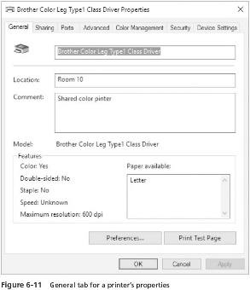
General Printer Specifications

Slide 22
Sharing Printers (1 of 2)
The Sharing tab is used to enable or disable a printer for sharing
As well as to specify the name of the share
If you enable sharing, provide a name for the shared printer
And check List in the directory to publish the printer through Active Directory
The Additional Drivers button on a printer’s properties Sharing tab is used to add new types of clients
Windows Server 2016 enables use of Point and Print with the v4 driver model
This means Windows Server 2016 print server does not have to distribute specific drivers to clients updated with v4 printer drivers

Slide 23
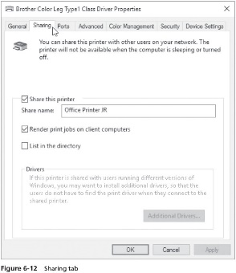
Sharing Printers (2 of 2)

Slide 24
Port Specifications (1 of 4)
The Ports tab has options to:
Specify which server port, such as LPT1 or COM1, is used for the printer
Set up bidirectional printing and printer pooling
Bidirectional printing
Used with printers that have bidirectional capability
A bidirectional printer can engage in two-way communications with the print server and with software applications
Printer pooling
Involves configuring two or more identical printers connected to one print server
All of the printers in a pool must be identical so that they use the same printer driver and handle print files in the same way

Slide 25
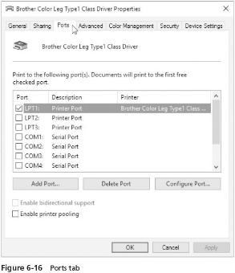
Port Specifications (2 of 4)

Slide 26
Port Specifications (3 of 4)
The Add Port button enables you to add a new port
The default options are Local Port or Standard TCP/IP Port
The Delete Port button is used to remove a port option from the list of ports
The Configure Port button is used to tune the configuration parameters that are appropriate to the type of port

Slide 27
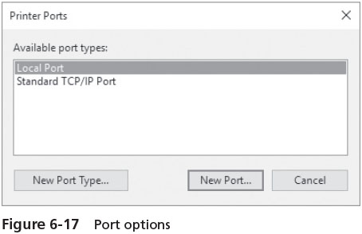
Port Specifications (4 of 4)

Slide 28
Printer Scheduling and Advanced Options (1 of 5)
The Advanced tab allows you to:
Have a printer available at all times
Limit the time to a range of hours
You can set the priority higher to give a particular printer or printer pool priority
Over other printers attached to the server
Printer scheduling can be useful when there is one print device and two printer objects (shares) for that printer

Slide 29
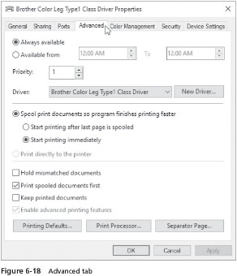
Printer Scheduling and Advanced Options (2 of 5)

Slide 30
Printer Scheduling and Advanced Options (3 of 5)
The Advanced tab provides the option to use spooled printing or to bypass the spooler
Works best to spool print jobs so they are printed on a first-come, first-served basis and enable background printing so the CPU can work on other tasks
Also helps ensure that jobs are printed together
Other advanced options include:
Hold mismatched documents
Print spooled documents first
Keep printed documents
Enable advanced printing features

Slide 31
Printer Scheduling and Advanced Options (4 of 5)
The Printing Defaults button enables you to specify default settings for print jobs
Unless they are overridden by control codes in the print file
Use the Print Processor button to specify one of the print processors and data types
The data type is the way in which information is formatted in a print file
RAW
RAW (FF appended)
RAW (FF auto)
NT EMF
TEXT
XPS2GDI

Slide 32
Printer Scheduling and Advanced Options (5 of 5_
The Separator Page button is used to place a blank page at the beginning of each printed document
Windows Server 2016 has four separator page files
Pcl.sep
Pscript.sep
Sysprint.sep
Sysprtj.sep

Slide 33
Configuring Security (1 of 4)
To configure security for a printer, you must have Manage printers permissions for that printer
Use the Security tab to set up printer share permissions
Once a printer is shared, the default permissions are as follows:
Everyone group-Print
ALL APPLICATION PACKAGES-Print and Manage documents
CREATOR OWNER-Manage documents
Administrator account-Print, Manage this printer, and Manage documents
Administrators, Server Operators, Print Operators groups-Print, Manage this printer, and Manage documents

Slide 34
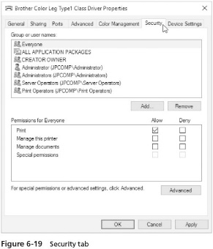
Configuring Security (2 of 4)

Slide 35
Configuring Security (3 of 4)
Use the Advanced button on the Security tab to:
Set up special printer permissions for a specific group or user
Add or remove a group or user for security access
Set up printer auditing
Take ownership of a printer
View the effective permissions for a user or group
Advanced or special access permissions enable you to fine-tune shared printer permissions
Any user account or group can be set up for auditing, by clicking the Auditing tab and the Add button
Before you set up printer auditing, make sure that there is a Group Policy or default domain security policy that enables object auditing on the basis of successful and failed activity attempts

Slide 36
Configuring Security (4 of 4)
For a shared printer you can track successful or failed attempts to:
Print jobs
Manage printers
Manage documents
Read printer share permissions
Change printer share permissions
Take ownership of the printer

Slide 37
Configuring Device Settings (1 of 2)
The Device Settings tab
Enables you to specify printer settings that are specific to the printer you have installed such as:
Printer trays, memory, paper size, fonts, duplexing, and installable options
Printer memory is usually automatically detected in bidirectional printers
Make sure the memory reported in the device settings matches the memory installed in the printer
This enables the Windows Server 2016 print server to offload more work to the printer, improving the speed at which print jobs are completed as well as server performance

Slide 38
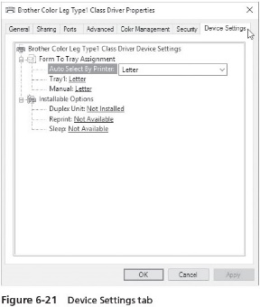
Configuring Device Settings (2 of 2)

Slide 39
Configuring a Nonlocal Printer or an Internet Printer (1 of 2)
You can connect to a network printer by using the Network Printer Installation Wizard
Follow the steps outlined on pages 271-272 in the text
When the remote printer is installed on a domain controller
You can change the properties of the shared printer you just installed
Even though you are not logged on to its host computer
You can manage the remote printer’s properties from the Print Management tool

Slide 40
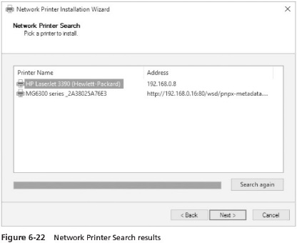
Configuring a Nonlocal Printer or an Internet Printer (2 of 2)

Slide 41
Managing Print Jobs
Users with Print permissions can:
Send print jobs to the printer
Pause, resume, and restart their own print jobs
Cancel their own print jobs
Print Operators, Server Operators, and other groups having Manage documents permissions can:
Send print jobs to the printer
Pause, resume, and restart any user’s print jobs
Cancel any user’s print jobs
To manage printed documents as administrator
Use the Print Management tool

Slide 42
Controlling the Status of Printing (1 of 2)
In Windows Server 2016, printer control and setup information for a particular printer is associated with that printer’s properties and the printer’s print queue
Sometimes you need to pause a printer to fix a problem
You can pause printing to that printer in two way:
Right-click the printer in the middle pane of the Print Management tool and click Pause Printing
Open the printer’s print queue window, click Printer, and click Pause Printing option so that there is a check mark beside it
You will need to resume printing again before print jobs can continue printing

Slide 43
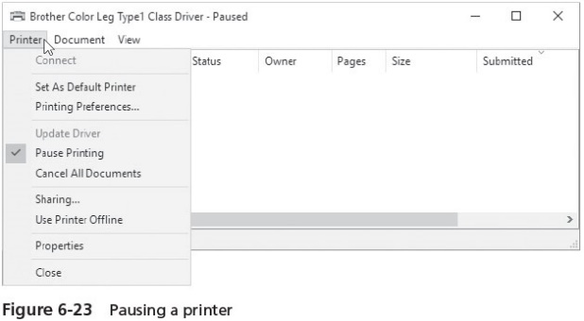
Controlling the Status of Printing (2 of 2)

Slide 44
Controlling Specific Print Jobs (1 of 3)
You can pause, resume, restart, or view the properties of one or more documents
In the print queue of a printer
Print queue
Like a stack of print jobs, with the first job submitted at the top of the stack and the last job submitted at the bottom
And all of the jobs waiting to be sent from the spooler to the printer

Slide 45
Controlling Specific Print Jobs (2 of 3)
In Windows Server 2016, to pause a print job, open the print queue window for the printer
The resulting window shows a list of jobs to be printed
Click the document you want to pause, click the Document menu, and then click Pause
The print job will stop printing until you highlight the document and click Resume or Restart on the Document menu
Jobs print in the order they are received, unless the administrator changes their priority

Slide 46
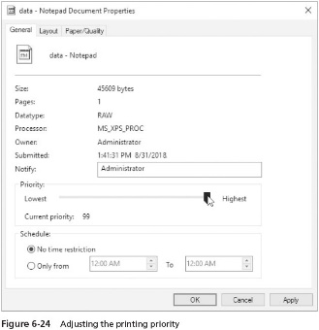
Controlling Specific Print Jobs (3 of 3)

Slide 47
Troubleshooting Common Printing Problems
Use the Print Management tool to quickly check the status of a printer to see if it is offline or paused
A typical printing problem can occur when the Windows Server 2016 Print Spooler service experiences a temporary difficulty, gets out of synchronization, or hangs
To stop and restart the Print Spooler service:
Open Server Manager, click Tools, and click Services
Scroll to find the Print Spooler service and then double-click this service
Check the status to determine if the Print Spooler service is running and that it is set to start automatically
Because the Print Spooler service is dependent on the RPC service, check to make sure that the Remote Procedure Call service is also started and set to start automatically
Close the Service window

Slide 48
Chapter Summary (1 of 2)
Windows Server 2016 printing uses the graphics device interface (GDI) to integrate print file information with the printer driver
Internet printing enables users to print files through an Internet connection using HTTP and Internet Printing Protocol (IPP)
Windows Server 2016 can be a full-featured printer server through the use of the Print and Document Services role
Windows Server 2016 supports using XML Paper Specification (XPS) for polished print documents
The Devices and Printers utility is one way to set up local and Network printing
The Windows Server 2016 Print Management tool is popular among server administrators for managing print server resources

Slide 49
Chapter Summary (2 of 2)
The properties of an installed printer enable you to configure printer sharing, printer port setup, scheduling, security, and specialized device settings
Through the Network Printer Installation Wizard, you can install a local, network, or Internet printer
Printers are configured with permissions to control who can use or manage specific printers
Managing a printer and its printer queue involves actions such as pausing and resuming printing and setting the default printer
Printer problems can occur at any time

