Slide 1
Hands-On Microsoft Windows Server 2016 2nd Edition
Chapter 7
Configuring and Managing Data Storage

Slide 2
Objectives
Understand storage options for Windows Server 2016
Use the Disk Management tool to configure and manage storage
Explain and configure RAID disk storage fault tolerance
Use Storage Spaces for disk storage and fault tolerance
Understand Multipath I/O
Back up and recover disks, folders, and files

Slide 3
Windows Server 2016 Storage Options
Windows Server 2016 supports two essential disk storage types:
Basic disk - One that uses traditional disk management techniques and contains primary partitions, extended partitions, and logical drives
Dynamic disk - One that does not use traditional partitioning
Dynamic disk architecture provides more flexibility than basic disks
So there is virtually no restriction on the number of volumes that can be on one disk

Slide 4
Basic Disks (1 of 7)
Partitioning
A process that allocates a group of tracks and sectors to be used by a particular file system, such as NTFS
Formatting
A process that creates a table containing file and folder information for a specific file system in a partition
Volume
A logical designation of disk storage that is created out of one or more physical disks
Is partitioned and formatted with one file system

Slide 5
Basic Disks (2 of 7)
Basic disks recognize primary and extended partitions
Basic disks also can be configured for any of three RAID levels:
Disk striping (RAID level 0)
Disk mirroring (RAID level 1)
Disk striping with parity (RAID level 5)
RAID stands for redundant array of inexpensive (or independent) disks
A set of standards for lengthening disk life and preventing data loss
Disk striping
The ability to spread data over multiple disks or volumes
Disk mirroring
The practice of creating a mirror image of all data on an original disk, so that the data is fully copied or mirrored to a backup disk

Slide 6
Basic Disks (3 of 7)
MBR and GPT support
When a drive is partitioned, a Master Boot Record (MBR) and a partition table are created
At the beginning track and sectors on the disk
The MBR is located in the first sector and track of the hard disk
Has startup information about partitions and how to access the disk
The partition table contains information about each partition created
Globally Unique Identifier (GUID) Partition Table or GPT
A newer way to partition disks, without imposing the same type of limits on the number of partitions as with MBR
GPT is one element of the Unified Extensible Firmware Interface (UEFI) approach
UEFI is an alternative to using BIOS firmware
GPT disks store partition information in each partition using main and backup tables

Slide 7
Basic Disks (4 of 7)
Instead of storing partition information in an MBR and a partition table, GPT disks store partition information using main and backup tables
Each partition is identified by a different GUID or reference number
In Windows Server 2016 systems:
A GPT partition can theoretically be up to 18 exabytes
A GPT disk can hold up to 128 partitions
You can convert an MBR disk to GPT and vice versa
Follow steps outlined on pages 287-288 to convert an MBR disk to GPT

Slide 8
Basic Disks (5 of 7)
Primary and extended partitions on MBR disks
A primary partition is one from which you can boot an operating system
At least one primary partition must be marked as active
Only one primary partition can be active at a given time
The active partition is the partition where your computer will look for the hardware-specific files to start the operating system
An extended partition is created from space that is not yet partitioned
The purpose of an extended partition is to enable you to exceed the four-partition limit of a basic disk
Only one extended partition can exist on a single basic disk
A computer with multiple partitions boots from the partition that is designated as the active partition
Must also be the system partition

Slide 9
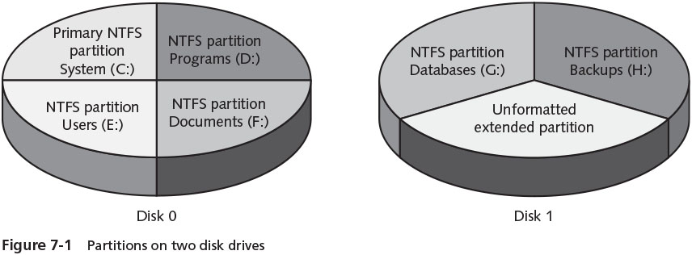
Basic Disks (6 of 7)

Slide 10
Basic Disks (7 of 7)
Volume and Stripe Sets
Volume set
Consists of two or more partitions that are combined to look like one volume with a single drive letter
Stripe set
Two or more disks that are combined like a volume set, but that are striped for RAID level 0 or RAID level 5
Windows Server 2016 provides backward compatibility with basic disk volume and stripe sets that have previously been created through legacy Windows Server systems
However, you should plan to convert basic disks to dynamic disks in order to implement any new multidisk volumes

Slide 11
Dynamic Disks (1 of 6)
A dynamic disk does not use traditional partitioning
Makes it possible to set up a large number of volumes on one disk
Provides the ability to extend volumes onto additional physical disks
The number of disks that can be incorporated into one spanned volume is limited to 32
Dynamic disks support RAID levels 0, 1, and 5
Plan to convert basic disks to dynamic disks after you install Windows Server 2016
On dynamic disks
The volume that contains the \Windows folder of system files is called the boot volume
The volume that contains the files used to boot the computer is called the system volume

Slide 12
Dynamic Disks (2 of 6)
Simple volume
A portion of a disk or an entire disk that is set up as a dynamic disk
Can be extended onto multiple sections of the same disk
Does not provide fault tolerance because it cannot be set up for any RAID level
Spanned volume
Stored on 2 to 32 dynamic disks that are treated as one volume
As you add new disks, the spanned volume can be extended to include each disk
Advantage: the ability to more easily manage several small disk drives or to maximize the use of scattered pockets of disk space across several disks

Slide 13
Dynamic Disks (3 of 6)
Striped volumes
Often referred to as RAID-0
Extend the life of hard disk drives by spreading data equally over two or more drives
Another advantage: increases disk performance
In Windows Server 2016, striping requires at least two disks and can be performed over as many as 32
Useful for volumes that store large databases or for data replication from one volume to another
Data can be lost when one or more disks in the striped volume fail because the system has no automated way to rebuild data

Slide 14
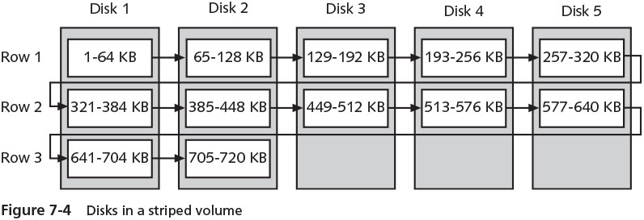
Dynamic Disks (4 of 6)

Slide 15
Dynamic Disks (5 of 6)
Shrinking a volume
Windows Server 2016 comes with the ability to shrink a basic or dynamic disk volume
Shrinking a volume enables you to create a new partition when one is needed and you don’t have extra disks
When you shrink a volume, Windows Server 2016 starts from the end of that volume
Works its way back through contiguous space to create unallocated disk space
You can specify the amount of space to recover

Slide 16
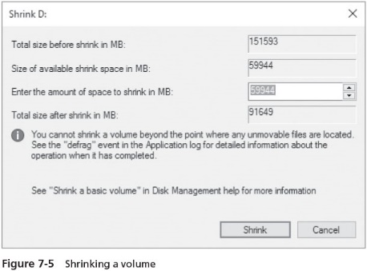
Dynamic Disks (6 of 6)

Slide 17
Disk Management
Disk Management tool
Provides a central location for viewing disk information and performing tasks such as creating and deleting partitions and volumes
Different tasks you can perform using the Disk Management tool:
Creating a partition and simple volume
Converting to dynamic disks
Mounting a drive

Slide 18
Creating a Partition and Simple Volume
Partitions operate as separate storage units on a hard disk
The most basic way to create a partition is to take unallocated disk space
Use the New Simple Volume Wizard to create a simple volume
You can also delete a partition using the Disk Management tool
Once a partition is formatted, it is called a volume and can be assigned a drive letter
To format a partition that is not already formatted
Open the Disk Management tool, right-click the partition to be formatted, click Format
Activity 7-2 shows you how to create a simple volume

Slide 19
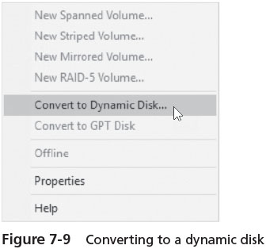
Converting a Partitioned Basic Disk to a Dynamic Disk
Activity 7-3 takes you through the steps to convert a simple basic disk to a dynamic disk

Slide 20
Mounting a Drive
Windows Server 2016 enables you to mount a drive as an alternative to giving it a drive letter
Mounted drive
One that appears as a folder and is accessed through a path like any other folder
You can mount a basic or dynamic disk drive, a CD/DVD drive, or a removable drive
Once a drive is mounted
Other drives can be added to the same folder to appear as one drive
Home directory or home folder
A server folder that is associated with a user’s account and that is a designated workspace for the user to store files

Slide 21
Managing Disks (1 of 3)
Windows Server 2016 includes several tools that can be used to diagnose disk problems and maintain disk performance:
Disk Optimizer, Disk Check, and chkdsk
Using Disk Optimizer
When you save a file to a disk, Windows Server 2016 saves the file to the first area of available space
The file might not be saved to a contiguous area of free space
The disk gradually becomes fragmented
The process of defragmenting
Locates fragmented folders and files and moves them to a location on the physical disk so they are in contiguous order
Activity 7-5 gives you practice using the Disk Optimizer

Slide 22
Managing Disks (2 of 3)
Using Disk Check
The Disk Check tool allows you to scan your disk for bad sectors and file system errors
This tool is meant for use when no users need to access the files on the disk you want to check
Because the disk is made unavailable during the scan for problems
Activity 7-6 show you how to use Disk Check

Slide 23
Managing Disks (3 of 3)
Using chkdsk
You can also check your disk for errors by running the chkdsk utility from the PowerShell or Command Prompt window
In NTFS, chkdsk checks files, folders, indexes, security descriptors, user files, sectors, and disk allocation units
When chkdsk finds lost allocation units or chains
It prompts you with the Yes or No question: Convert lost chains to files?
Answer Yes to the question so you can save the lost information to files (labeled Filexxx.chk)
Spot Verifier
A service that is triggered whenever the OS receives a report of a bad disk area
It records the disk location in an event log
Run chkdsk /spotfix to fix the bad area

Slide 24
Introduction to Fault Tolerance
Fault tolerance
The ability of a system to gracefully recover from hardware or software failure
Windows Server 2016 provides a level of fault tolerance through software-level RAID
With fault tolerance, data is written to more than one drive
In the event one drive fails, data can still be accessed from one of the remaining drives

Slide 25
RAID Volumes (1 of 5)
RAID is a set of standards for lengthening disk life, preventing data loss, and enabling relatively uninterrupted access to data
RAID level 0
Striping with no other redundancy features (such as no parity or mirroring)
RAID level 1
Disk duplexing is the same as disk mirroring, with the exception that it places the backup disk on a different controller or adapter than is used by the main disk
RAID level 2
Uses an array of disks whereby the data is striped across all disks in the array
RAID level 3
Uses disk striping and stores error-correcting information, but the information is only written to one disk in the array

Slide 26
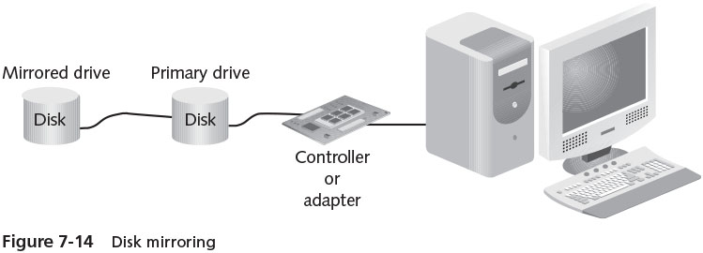
RAID Volumes (2 of 5)

Slide 27
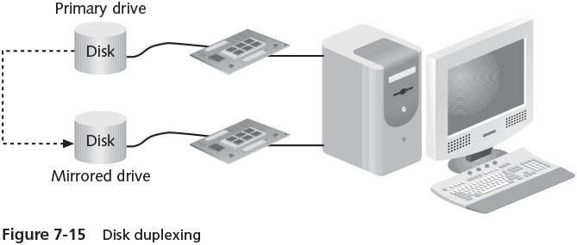
RAID Volumes (3 of 5)

Slide 28
RAID Volumes (4 of 5)
RAID level 4
Stripes data and stores error-correcting information on all drives with an added feature of performing checksum verification
RAID level 5
Combines the best features of RAID, including striping, error correction, and checksum verification
Windows Server 2016 supports RAID levels 0, 1, and 5 for disk fault tolerance
RAID level 0 is not recommended in many situations because it does not really provide fault tolerance

Slide 29
RAID Volumes (5 of 5)
When you decide upon using RAID 1 or RAID 5, consider the following:
The boot and system files can be placed on RAID level 1, but not on RAID level 5
RAID level 1 uses two hard disks and RAID level 5 uses from 3 to 32
RAID level 1 is more expensive to implement than RAID level 5
RAID level 5 requires more memory than RAID level 1
Depending on the disk controller, in Windows Server 2016 disk read access is faster in RAID level 1 and RAID level 5 than is write access

Slide 30
Using a Striped Volume (RAID-0)
Reasons for using a RAID level 0 or a striped volume in Windows Server 2016 are to:
Reduce the wear on multiple disk drives by equally spreading the load
Increase disk performance compared with other methods for configuring dynamic disk volumes
To create a striped volume, right-click the unallocated space for the volume and click New Striped Volume
Only dynamic disks can be striped volumes

Slide 31
Using a Mirrored Volume (RAID-1)
Disk mirroring involves creating a shadow copy of data on a backup disk
Only dynamic disks can be set up as a mirrored volume in Windows Server 2016
One of the most guaranteed forms of disk fault tolerance
Disk read performance is the same as reading data from any single disk drive
A mirrored volume is well suited for situations in which data is mission-critical and must not be lost under any circumstances
Such as customer files at a bank
A mirrored volume is created through the Disk Management tool

Slide 32
Using a RAID-5 Volume (1 of 3)
Fault tolerance is better for a RAID-5 volume
Than for a simple striped volume
A RAID-5 volume requires a minimum of three disk drives
Parity information is distributed on each disk
If one disk fails, the information on that disk can be reconstructed
The parity used by Microsoft is Boolean (true/false, one/zero) logic

Slide 33
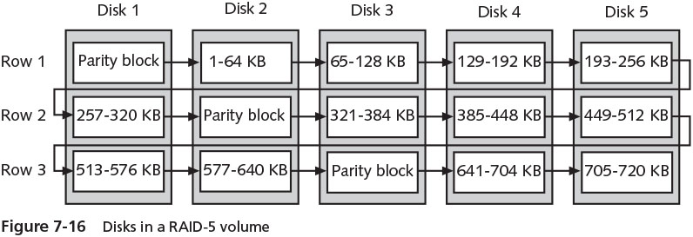
Using a RAID-5 Volume (2 of 3)

Slide 34
Using a RAID-5 Volume (3 of 3)
The performance is not as fast as with a striped volume
Takes longer to write the data and calculate the parity block for each row
Accessing data through disk reads is as fast as a striped volume
A RAID-5 volume is particularly useful in a client/server system that uses a separate database for queries and creating reports
Use the Disk Management tool to create a RAID-5 volume

Slide 35
Software RAID vs. Hardware RAID
Software RAID implements fault tolerance through the server’s operating system
Hardware RAID is implemented through the server hardware
Independent of the operating system
Advantages of hardware RAID over software RAID:
Faster read and write response
The ability to place boot and system files on different RAID levels
The ability to ‘‘hot-swap’’ a failed disk
More setup options to retrieve damaged data

Slide 36
Storage Spaces (1 of 3)
Storage Spaces
Enables you to form groupings of physical disks and free disk space to manage together as individual virtual disks
Each grouping is a storage pool
That gathers together physical disks to appear to an application or a user as one virtual disk
Physical disks that can be combined and used within a storage pool:
Serial Advanced Technology Attachment (SATA)
Solid state drive (SSD)
Non-volatile Memory Express (NVMe)
Universal Serial Bus
Small Computer System Interface (SCSI)

Slide 37
Storage Spaces (2 of 3)
Physical disks that can be combined and used within a storage pool (cont’d)
Internet SCSI (iSCSI)
Serial Attached SCSI (SAS)
A virtual disk formed out of a storage pool can be one of three resiliency types:
Simple – similar to RAID level 0
Mirror – similar to RAID level 1
Parity – similar to RAID level 5
Advantages of Storage Spaces:
When there is a failure in a mirror or parity resiliency type, the system can automatically repair the disk failure by using a hot space placed in the pool or by implementing unused space on physical disk in the pool
When a disk fails in a storage pool, there is no noticeable delay in performance

Slide 38
Storage Spaces (3 of 3)
Tiered storage places
Two tiers can be established: slow and fast
The slow tier consists of SATA drives intended for high capacity storage
The fast tier consists of SSD drives that offer faster performance than SATA and intended to hold data that is frequently accessed
Within a storage pool, you can decide how to allocate disk space using one of the following provisioning methods:
thin
fixed
A new storage pool is created through Server Manager
Steps are outlined on page 309 of the text

Slide 39
Storage Spaces Direct (1 of 2)
Storage Spaces Direct
Software-defined storage intended to make storage more versatile through making it easier to add storage as needed, to access storage, and to use new storage capabilities
Software-defined storage (SDS)
Refers to managing data storage with software that is independent of actual storage hardware
Storage Spaces Direct uses Server Message Block version 3 (SMBv3)
The same protocol that Windows OSs use natively for sharing folders and files on a network
Storage spaces are targeted for use with virtual machines operating through Hyper-V and for clustered VMs

Slide 40
Storage Spaces Direct (2 of 2)
At this writing, one cluster can have up to 240 disks and up to 12 nodes within Storage Spaces Direct
There are two ways to deploy Storage Spaces Direct:
Hyper-converged – Hyper-V clustered servers and their storage are on the same hardware
Disaggregated – the Hyper-V clusters of servers and the Storage Spaces Direct storage components exist on different hardware

Slide 41
Multipath Input/Output (1 of 3)
Multipath I/O
Provides a means to establish multiple paths between a server and its disk storage
The first step in this process is to create the multiple paths between the storage and the server or servers
For a SAN, creating multiple paths might involve establishing two or more network paths through two or more network switches to the SAN
The next step is to install Multipath I/O
A feature installed through Server Manager using the Add Roles and Features Wizard

Slide 42
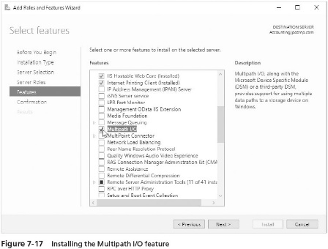
Multipath Input/Output (2 of 3)

Slide 43
Multipath Input/Output (3 of 3)
When you install Multipath I/O, you also install DSM
Device Specific Module (DSM)
Compatible with the following disk storage array controller technologies:
Asymmetric logical unit access (ALUA)
Active/Active controller model
Configuration models:
Dynamic Least Queue Depth
Failback
Failover
Round Robin
Round Robin with a subset of paths
Weighted Path

Slide 44
Disk Backup
One of the best ways to make sure you do not lose valuable information on a hard disk is to fully back up information on a regular basis
These backups can be performed from a server on the network
Performing backups from a backup device installed on the server has several advantages:
No extra load is produced on the network
Perform backups on a multiple-server network
Provides more assurance that key OS files/settings, including the Registry, is backed up
The advantages of performing a network backup
Backup jobs can be stored on a single backup media
One administrator can be responsible for backing up multiple servers
The main disadvantage
The increase in network traffic

Slide 45
Windows Server Backup (1 of 2)
Windows Server Backup tool offers the ability to back up all server files or files that have changed
Features in Windows Server 2016:
It offers both full and incremental backups
Has more backup options, including using the Volume Shadow Copy Service (VSS)
Offers reliable data restoration
Provides information about disk space
Offers the wbadmin command-line tool
Has full support to back up to optical media

Slide 46
Windows Server Backup (2 of 2)
Considerations for using Windows Server Backup tool:
Tool only backs up NTFS volumes
Tool does not back up to tape
Cannot restore backups made from pre-Windows Server 2008 OSs that use Ntbackup.exe, such as archived financial records
You can download Ntbackup.exe from Microsoft’s website and run it in Windows Server 2016 to restore files from backups made from pre-Windows Server 2008 server systems
The first step in using Windows Server Backup is to install it as a feature, as shown in Activity 7-8

Slide 47
Backup Options
Full backup
A backup of an entire system, including all system files, programs, and data files
Changes each file’s archive attribute to show that it has been backed up
Incremental backup
Only backs up files that are new or that have been updated
Backs up only files that have the archive attribute marked
Custom backup
Enables you to configure backups differently for each volume
Such as a file-by-file backup so that you back up only a specific drive, folder, or subfolder

Slide 48
Scheduling Backups 1 of 2)
Windows Server Backup includes a scheduling capability
Can have the server automatically start backups after regular work hours or at a specific time of day
The general steps that illustrate how to create and schedule a backup
Are outlined on page 316 of the text

Slide 49
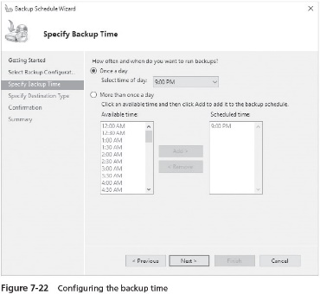
Scheduling Backups (2 of 2)

Slide 50
Configuring Backup Performance
Configuring the backup performance options enables you to specify the speed of the backup and whether to perform a full backup or incremental backup
The default is to always perform full backups
To save time on your backups, you might prefer to use incremental backups or a combination of full and incremental
Activity 7-10 shows you how to configure backup performance

Slide 51
Performing a Recovery (1 of 3)
The Windows Server Backup tool enables you to recover any of the following:
Files
Folders
Volumes
Applications and application data
The backup catalog (of information in the backup)
The operating system (to the same computer or to another computer using identical hardware)

Slide 52
Performing a Recovery (2 of 3)
Before you start, determine the following information:
Date of the backup from which to recover
Type of recovery, such as files and folders or applications
What to recover
Where to recover, such as in the original location or another location
Use the Windows Server Backup tool to perform a recovery of data

Slide 53
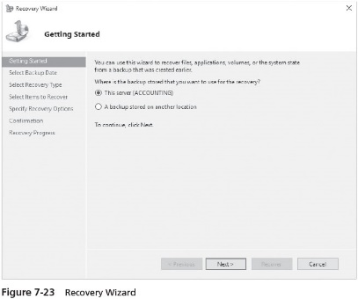
Performing a Recovery (3 of 3)

Slide 54
Chapter Summary (1 of 3)
Windows Server 2016 uses basic and dynamic disks
Dynamic disks can be configured as simple, spanned, striped, mirrored, and RAID-5 volumes
If you need to recover space from a basic or dynamic disk, you can shrink the disk
The Disk Management tool enables you to create basic and dynamic disks
For optimum disk performance, plan to set up a schedule to regularly defragment disks on a server
Use the Disk Check and chkdsk tools to find and repair disk problems
RAID provides fault tolerance for hard disks

Slide 55
Chapter Summary (2 of 3)
RAID level 0 is disk striping
With disk mirroring or duplexing (RAID level 1), the same data is written to a partition on each of the two disks included in the mirror
With RAID level 5, data is written across a minimum of three disks
Storage Spaces enables you to create storage pools containing different types of storage technologies, such as combining SATA and SSD storage in the same pool
Three RAID-like resiliency types are offered through Storage Spaces: simple, mirror, and parity
New to Windows Server 2016, Storage Spaces Direct makes it even easier to add and access storage spaces and is especially targeted for virtual machines

Slide 56
Chapter Summary (3 of 3)
Multipath I/O extends your options for creating fault tolerance for storage through using redundant paths
Windows Server Backup offers features to schedule backups, perform full or incremental backups, and recover data from backups

