Slide 1
Hands-On Microsoft Windows Server 2016 2nd Edition
Chapter 8
Managing Windows Server 2016 Network Services

Slide 2
Objectives
Install, configure, and troubleshoot DNS
Create a DNS implementation plan
Install, configure, and troubleshoot DHCP
Install the IP Address Management tool
Configure NIC teaming
Install, configure, and troubleshoot Microsoft Internet Information Services

Slide 3
Implementing Microsoft DNS
Domain Name System (DNS)
A TCP/IP application protocol that enables a DNS server to resolve (translate):
Domain and computer names to IP addresses
IP addresses to domain and computer names
DNS servers provide the DNS namespace for an enterprise
One of the requirements for using Active Directory on a Windows Server 2016 network is to have a DNS server on the network
Windows Server 2016 DNS is the most compatible with Active Directory
Non-Microsoft servers can be used but they must be compatible with Active Directory

Slide 4
Installing DNS Services (1 of 2)
DNS is installed as a server role in Windows Server 2016
After you install DNS
You’ll need to configure elements in DNS such as zones (described in next sections)
For optimal results, develop a DNS implementation plan before you set up DNS in a production environment
Activity 8-1 will step you through installing DNS

Slide 5
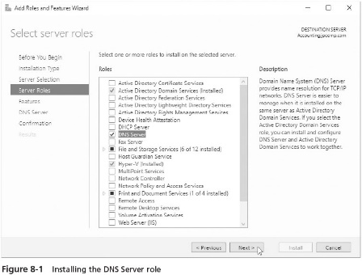
Installing DNS Services (2 of 2)

Slide 6
DNS Zones (1 of 3)
DNS name resolution is enabled through the use of tables of information
That link computer names and IP addresses
The tables are associated with partitions in a DNS server that are called zones
Contain resource records
Each zone houses tables of different types of resource records
Called zone file or zone database
Forward lookup zone
The zone that links computer names to IP addresses
Holds host name records called address records

Slide 7
DNS Zones (2 of 3)
In IP version 4, a host record is called a host address (A) resource record
An IPv6 record is called an IPv6 host address (AAAA) resource record
When you install DNS on a domain controller (DC) in a domain
A forward lookup zone is automatically created for the domain with the DNS server’s address record already entered
You must enter the records of other hosts or configure DHCP to automatically update the DNS forward lookup zone each time it leases an IP address
A DNS server can have several forward lookup zones
There should be at least one for the parent domain

Slide 8
DNS Zones (3 of 3)
Reverse lookup zone
Holds the pointer (PTR) resource record, which contains the IP address-to-host name
Not used as commonly as the forward lookup zone
Because reverse lookup zones are used less often
It is not automatically configured when DNS is installed
Activity 8-2 shows you how to create a reverse lookup zone
Activity 8-3 steps you through creating a Host Address A Resource Record

Slide 9
Using the DNS Dynamic Update Protocol (1 of 2)
Microsoft DNS is also called Dynamic DNS (DDNS)
A modern form of DNS that enables client computers and DHCP servers to automatically register IP addresses
DNS dynamic update protocol
Enables information in a DNS server to be automatically updated in coordination with DHCP
After configuring DNS
Always make sure that it is configured to sue the DNS dynamic update protocol
Saves administrators time because they no longer have to manually register each new workstation or each time a new IP lease is issued
Activity 8-4 shows you how to verify the DNS dynamic update configuration

Slide 10
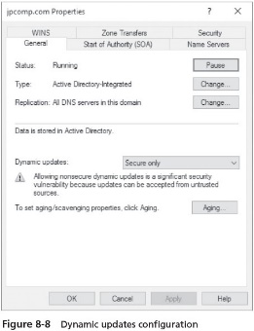
Using the DNS Dynamic Update Protocol (2 of 2)

Slide 11
DNS Replication (1 of 2)
Primary DNS server
The DNS server that is the main administrative server for a zone and thus is also the authoritative server for that zone
Secondary DNS server
Backup DNS server for a primary DNS server
Contains a read-only copy of the primary DNS server’s zone database, but is not used for administration (is not authoritative)
Obtains that copy through a zone transfer over the network

Slide 12
DNS Replication (2 of 2)
Vital services performed by secondary DNS servers:
To make sure that there is a copy of the primary DNS server’s data
To enable DNS load balancing among a primary DNS server and its secondary servers
To reduce congestion in one part of the network
If you use Active Directory and have two or more DCs
Plan to set up Microsoft DNS services on at least two of the DCs
The multimaster replication model enables you to replicate DNS information on each DC
Advantage of replicating DNS information
If one DC that hosts DNS services fails, another DC is available to provide uninterrupted DNS services

Slide 13
Stub Zone
Stub zone has only the bare necessities for DNS functions, which are copies of the following:
SOA record zone
Name server (NS) records to identify authoritative servers
A record for name servers that are authoritative
One common use for a stub zone is to help quickly resolve computer names between two different namespaces
By enabling clients in one namespace to instantly find an authoritative server in a different namespace
The steps for creating a stub zone are similar to those used to create a primary or secondary zone

Slide 14
Additional DNS Server Roles (1 of 4)
It is common to designate one DNS server to forward name resolution requests to a specific remote DNS server
DNS forwarding can be set up that if the DNS server that receives the forwarded request cannot resolve the name
The server that originally forwarded the request attempts to resolve it
Called nonexclusive forwarding
Windows Server 2016 supports the use of root hints
A resource record to enable a DNS server to quickly find an authoritative DNS server in a zone that is not on the DNS server
Used in particular to find an authoritative DNS server on the Internet

Slide 15
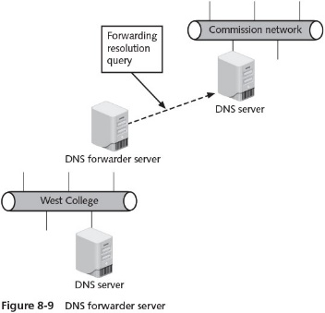
Additional DNS Server Roles (2 of 4)

Slide 16
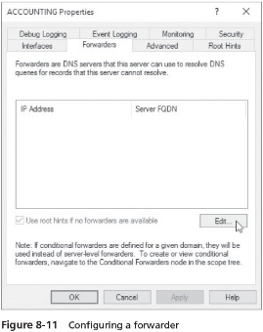
Additional DNS Server Roles (3 of 4)

Slide 17
Additional DNS Server Roles (4 of 4)
A DNS server can function as a caching server
A caching server is used to provide fast queries because the results of each query are stored in RAM
A DNS server without zones is a server that is caching-only
A caching-only DNS server queries a primary or secondary DNS server and caches the results to provide a fast response for the next identical query
Used to reduce the number of secondary server and reduce extra network traffic
One limitation of using caching servers is that it takes time for each one to build up a comprehensive set of resolved names to IP addresses
Sometimes it is necessary to flush the DNS server cache
Steps for clearing the cache on are page 341 of the text

Slide 18
Using DNS to Balance Application Access
In DNS round robin
Resource records are created for two or more servers that have different IP addresses but are associated with the same host name
An effective way to help spread the load for frequently used applications that have their own data sets
Through DNS round robin
Access is evenly distributed among all servers associated with the same host name
No single server is loaded down with all users while other servers sit idle
The general steps to configure DNS round robin and netmask ordering are found on pages 342-344

Slide 19
Creating a DNS Implementation Plan (1 of 2)
Best practice recommendations
Implement Windows Server 2016 DNS servers instead of other versions of DNS, and use Active Directory
The resource records and zones that can be set up for IPv4 can also be set up for IPv6
Consider using namespaces to represent natural organizational boundaries
Make sure the DNS servers on a private network are well secured in terms of Windows Server 2016 security options
Plan to locate a DNS server across most site links
Create two or more DNS servers to take advantage of the load balancing, the multimaster relationships, and the fault tolerance
Designate one DNS server as a forwarder to reduce traffic
The number of DNS servers that you set up can be related to your analysis of an organization

Slide 20
Creating a DNS Implementation Plan (2 of 2)
Best practice recommendations (cont’d)
If a branch location with a read-only domain controller (RODC) needs local DNS services because there are many users, make the RODC a secondary DNS server and not a primary DNS server
If you have multiple servers used for one application use round robin to distribute the load

Slide 21
DNS Enhancement in Windows Server 2016
DNS group policies for:
Filtering malicious IP addresses and redirecting malicious clients to a dead end rather than to the computer they want to reach
Redirecting clients to specific data sources or servers according to the time of day
Managing client access to account for high traffic situations
Directing clients to the best source for a specific application
The ability for DNS to work with client computers that have more than one NIC
New PowerShell cmdlets for configuring DNS

Slide 22
Troubleshooting DNS
Steps to take to troubleshoot DNS problems:
Restart the DNS Server and the DNS Client services
Check for the most recent log errors relating to DNS
Activity 8-5 shows you how to restart the DNS Server and Client services
Activity 8-6 shows you how to check for DNS errors in the log information kept by Windows Server 2016

Slide 23
Implementing Microsoft DHCP (1 of 2)
Dynamic Host Configuration Protocol (DHCP)
Enables a Windows Server 2016 server with DHCP services to detect the presence of a new workstation
Assigns an IP address to that workstation
The DHCP server has a pre-assigned range of IP addresses that it can give to a new client
Range of contiguous addresses is called the scope
A Windows Server 2016 server can be configured in the role of a DHCP server using Microsoft DHCP services
The DHCP server automatically updates the DNS server at the time it assigns an IP address
Using dynamic DNS updates can significantly save time in creating DNS lookup zone records

Slide 24
Implementing Microsoft DHCP (2 of 2)
A Microsoft DHCP server can also:
Reserve an IP address for a specific computer
Update all computers on a network for a particular change in DHCP settings
Provide DHCP services to multiple subnetworks
Exclude certain IP addresses from a scope
You can configure DHCP failover for redundancy
Consists of configuring two DHCP servers to lease IP addresses using the same subnet or scope
DHCP data is replicated between the two servers so that if one goes down, clients can still use the remaining live DHCP server
When you configure two DHCP servers for failover
You can also configure to use load-balancing

Slide 25
Configuring a DHCP Server (1 of 2)
After DHCP is installed, set up one or more scopes of contiguous address ranges and activate each scope
Configuring a scope includes the following:
Obtain the range of addresses to be used
Determine the subnet mask for the range of addresses
Decide on a name for the scope, such as naming it to reflect the name of a department or division in your organization
Decide how long to lease IP addresses
Determine whether to exclude specific addresses

Slide 26
Configuring a DHCP Server (2 of 2)
Next, authorize the DHCP server
The process of authorizing the server is a security precaution to make sure IP addresses are only assigned by DHCP servers that are managed by network and server administrators
Astep that is not required, but that saves time in managing DNS, is to configure the DHCP server and its clients to automatically update DNS records
Activity 8-8 shows you how to configure a DHCP scope
Activity 8-9 shows how to verify that a DHCP server is configured to automatically register IP addresses with a DNS server

Slide 27
Lease Times
Set the duration of a DHCP lease on the basis of the type of connection
Microsoft recommends the following:
If you have a small network with no routers, a lease of 8 days or less is appropriate
On a network with one or more routers, a larger number of clients, and client computer that generally stay put, set leases to expire after a longer period (16-24 days)
On a network that has a large percentage of mobile devices, set leases to expire after the duration of the communication session (8-24 hours)
Consider 1-8 hours for high turnover of mobile users, such as a library, doctor’s office, or coffee shop

Slide 28
DHCPv6 Support
Windows Server 2016 and Windows 10 both enable a network to use Dynamic Host Configuration Protocol for IPv6 (DHCPv6)
For networks that are using IPv6
The Microsoft implementation of DHCPv6 supports:
Stateful autoconfiguration – the computer or network device using IPv6 contacts a DHCP server for a leased address
Stateless autoconfiguration – the computer or network device assigns its own IPv6 address, which is constructed from the MAC address of its NIC
Stateless autoconfiguration of an IPv6 address does not require a DHCP server
But it is included in the DHCPv6 standard for compliance with IPv6 capabilities

Slide 29
Troubleshooting DHCP
When you set up a DHCP server, some problems may occur, such as:
The server stopping or not working
Creating extra network traffic
Not automatically registering with DNS server
Table 8-4 on page 357 presents several typical problems and their resolutions

Slide 30
IP Address Management
IP Address Management (IPAM)
A set of tools available in Windows Server 2016 to consolidate IP address management in one place
Enables you to plan, configure, and manage IP addressing on your network
Monitors DHCP scopes so that you know when a scope needs to be increased
Also offers a central location for opening the DNS and DHCP tools
IPAM limitations
Does not work properly on a computer that is a DC
Discovery of DHCP servers on a network is turned off when IPAM is installed on a DHCP server
IPAM must be installed on a non-DC server that is a member of an existing domain
IPAM does not link up with DHCP services built into network devices

Slide 31
Redundancy Through NIC Teaming (1 of 3)
NIC teaming
Congregated NICs operate as one logical connection
Benefits of NIC teaming
Distributes the load (for NIC load balancing) among the teamed NICs to provide users faster access to the server
Users still have access to the server even when one NIC fails
NIC teaming combines bandwidth for faster access
Three NIC teaming configurations:
Static teaming
Switch-independent teaming
Link Aggregation Control Protocol (LACP)

Slide 32
Redundancy Through NIC Teaming (2 of 3)
When you configure NIC teaming, you have three load-balancing methods from which to choose:
Hyper-V Port
Address hash
Dynamic
The general steps for configuring a NIC team are found on page 359

Slide 33
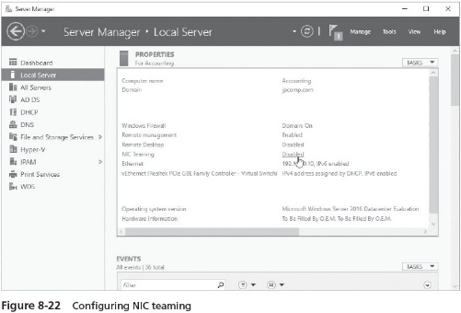
Redundancy Through NIC Teaming (3 of 3)

Slide 34
Implementing Microsoft Internet Information Services (1 of 2)
Microsoft Internet Information Services (IIS)
Software included with Windows Server 2016 that enables you to offer a complete Web site
Internet Server Application Programming Interface (ISAPI)
A group of DLL (dynamic link library) files that are applications and filters
Built-in to IIS, which makes IIS services fast and can be integrated with other programs
Web Server (IIS) role services
World Wide Web service
File Transfer Protocol (FTP) service
Simple Mail Transfer Protocol (SMTP) service

Slide 35
Implementing Microsoft Internet Information Services (2 of 2)
Windows Server 2016 is a good candidate for a Web server for several reasons
Windows Server 2016’s privileged-mode architecture and fault-tolerance capabilities
Windows Server 2016 is compatible with small and large databases
Users can log in to a database through the IIS Open Database Connectivity (ODBC) drivers
IIS is compatible with Microsoft Point-to-Point Encryption (MPPE) security, IP Security (IPsec), and the Secure Sockets Layer (SSL) encryption technique
IIS in Windows Server 2016 is broken into modules or features
So that you can install only the features you need
Presents a smaller attack surface and makes IIS more efficient
You can install IIS and most features in Windows Server Core and Nano Server
As well as in the full version of Server 2016

Slide 36
Installing a Web Server
Installing and using IIS on the Internet requires the following:
Windows Server 2016 installed on the computer to host IIS
TCP/IP installed on the IIS host
Access to an Internet service provider (ISP)
Sufficient disk space for IIS and for website files
A method for resolving IP addresses to computer or domain names, such as DNS
Activity 8-11 shows you how to install IIS

Slide 37
Web Server Best Practices
Best practices for your Web Server installation:
Set the firewall on your network or server to block unneeded applications and to close unused TCP and UDP communication ports
Place the web server in a demilitarized zone
Use only those applications and services that are necessary on the web server
Keep current with security patches to Windows Server 2016, IIS, and the applications on the web server
Keep logs of all user activity and regularly monitor those logs
Consider installing traps to help identify attacks when they occur
Install and regularly use scanning, malware, and intrusion detection software

Slide 38
Internet Information Services (IIS) Manager (1 of 2)
Through this tool, you can do the following:
Connect to a web server on your computer or remotely connect to a web server, an application, or site
Have connections to multiple web servers, applications, and sites
Manage a web server
Manage ASP.NET
Manage authorization for users and for specific web server roles
Manage web server logging
Compress web server files
Manage code modules and worker processes
Manage server certificates
Troubleshoot a web server

Slide 39
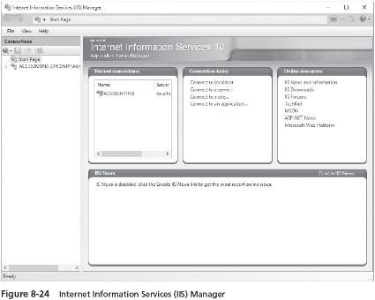
Internet Information Services (IIS) Manager (2 of 2)

Slide 40
Creating a Virtual Directory (1 of 3)
Virtual directory
A physical folder or a redirection to a Uniform Resource Locator (URL) that points to a folder
So that it can be accessed over the Internet, an intranet, or VPN
The reason for creating a virtual directory is to provide a shortcut path to specific IIS server content
When you set up a virtual directory, you give it an alias
A name to identify it to a Web browse
The URL format for access a file in a virtual directory entails providing:
\\Server name\Virtual directory alias\filename

Slide 41
Creating a Virtual Directory (2 of 3)
When you create a virtual directory, you can choose the permissions you want to apply
The same as permissions for a regular NTFS folder and files in the folder
After a virtual directory is created, you can modify its properties in IIS Manager
You can set up the virtual directory to be shared
So that users who need access to add contents to the directory can do this over the network

Slide 42
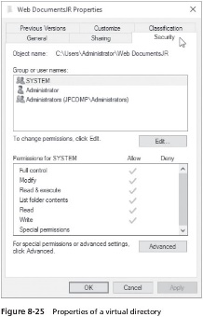
Creating a Virtual Directory (3 of 3)

Slide 43
Managing and Configuring an IIS Web Server (1 of 2)
The Internet Information Services Manager tool enables you to manage IIS components including the following:
Application pools
Sites
SMTP e-mail
Certificates
Application pools enable you to group similar Web applications into pools or groups for management
Sites is a folder used to manage multiple Web sites from one administrative Web server

Slide 44
Managing and Configuring an IIS Web Server (2 of 2)
The SMTP E-mail Page feature is used to manage Internet e-mail via e-mail programs
Takes advantage of the application programming interface, system.net.mail
Through the certificates feature, you can configure and monitor certificate security that is used with other Web sites
A website can be configured in many ways
Table 8-8 on page 368 lists many of the features you can configure through icons displayed in the middle pane of the IIS Manager

Slide 45
Troubleshooting a Web Server
Occasionally a Web server can experience problems, such as users not being able to connect to the server
Table 8-9 lists possible problems and their solutions

Slide 46
Chapter Summary (1 of 2)
DNS is used to resolve domain and computer names to IP addresses and vice versa
Before you install DNS, ensure that the server to house this role has a static address
After you install DNS as a server role, the next step is to configure forward and reverse lookup zones, as well as DNS resource records
When you configure Dynamic DNS, you enable automated IP address registration in a coordinated way with a DHCP server
Plan to set up two or more DNS servers on most networks
DHCP dynamically leases IP addresses to client computers
Configuring DHCP involves configuring scopes that are IP address ranges from which addresses are leased to clients

Slide 47
Chapter Summary (2 of 2)
Windows Server 2016 DHCP server supports both IPv4 and IPv6
IPAM is a set of tools you can use for IP address management
NIC teaming enables you to aggregate multiple NICs in a server to appear as one logical connection
To create a Windows Server 2016 Web server, install the Web Server (IIS) role to implement Internet Information Services
Create IIS virtual directories to enable multiple users to publish information on a Web site
Use standard NTFS and share permissions to protect virtual directories
After you install a Web server, configure it to customize features

