Slide 1
Hands-On Microsoft Windows Server 2016 2nd Edition
Chapter 9
Configuring Remote Access Services

Slide 2
Objectives
Understand Windows Server 2016 remote access services
Implement and manage a virtual private network
Configure a VPN server
Implement a DirectAccess server
Troubleshoot virtual private network and DirectAccess remote access installations
Install and configure Remote Desktop Services

Slide 3
Introduction to Remote Access
Remote Access Services (RAS) role
Enables remote access through three means: virtual private networking, DirectAccess, and Web Application Proxy
Virtual private network (VPN)
Like a tunnel through a larger network that is restricted to designated member clients only
DirectAccess
Establishes two “tunnels” for connecting to a Direct Access server used in remote access
Transparent to users and always on
Web Application Proxy
Publishing applications so that users external to an organization can access those applications on the organization’s servers

Slide 4
Implementing a Virtual Private Network (1 of 3)
VPNs can use an Internet connection or an internal network connection as a transport medium to establish a connection with a VPN server
A VPN uses LAN protocols as well as tunneling protocols
To encapsulate the data as it is sent across a public network such as the Internet
Benefit of using a VPN
Users can connect to a local ISP and connect through the ISP to the local network
VPN is used to ensure that any data sent across a public network, such as the Internet, is secure
VPN creates an encrypted tunnel between the client and the RAS server

Slide 5
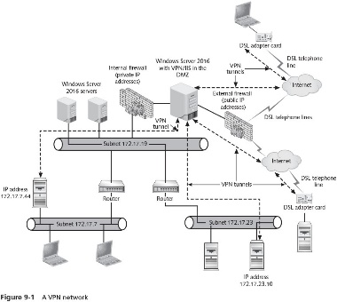
Implementing a Virtual Private Network (2 of 3)

Slide 6
Implementing a Virtual Private Network (3 of 3)
A VPN server uses two or more NICs for communication
One NIC is used to connect to the private network inside the organization that uses private IP addressing
The other NIC connects to the external public network
To create this tunnel, the client first connects to the Internet by establishing a connection using a remote access protocol
Once connected to the Internet, the client establishes a second connection with the VPN server
The client and the VPN server agree on how the data will be encapsulated and encrypted across the virtual tunnel

Slide 7
Using Remote Access Protocols (1 of 4)
Remote access protocol carries the network packets over a wide area network (WAN) link
Encapsulates a packet, such as an IP datagram, so that it can be transmitted from a point at one end of a WAN to another point
IP is the most commonly used transport protocol
Several remote access protocols are used by Windows Server 2016 and its remote clients
An early basic remote access protocol in use is PPP

Slide 8
Using Remote Access Protocols (2 of 4)
Point-to-Point Protocol (PPP)
Used in legacy remote communications involving modems
Enables the authentication of connections and encryptions for the network communications, but is not considered to be as secure as more modern options
Can automatically negotiate communications with several network communication layers at once
When you implement a Windows Server 2016 VPN server, one of three remote access tunneling protocols is used:
Point-to-Point Tunneling Protocol
Layer Two Tunneling Protocol
Secure Socket Tunneling Protocol

Slide 9
Using Remote Access Protocols (3 of 4)
Point-to-Point Tunneling Protocol (PPTP)
Offers PPP-based authentication techniques
Encrypts data carried by PPTP through using Microsoft Point-to-Point Encryption (MPPE)
Layer Two Tunneling Protocol (L2TP)
Works similarly to PPTP
Uses Layer Two Forwarding that enables forwarding on the basis of MAC addressing
Uses IP Security (IPsec) for additional authentication and for data encryption
IPsec is a set of IP-based secure communications and encryption standards created through IETF

Slide 10
Using Remote Access Protocols (4 of 4)
Secure Socket Tunneling Protocol (SSTP)
Employs PPP authentication techniques
Encapsulates the data packet in the Hypertext Transfer Protocol (HTTP) used through Web communications
Additionally uses a Secure Sockets Layer (SSL) channel for secure communications
SSL is a data encryption technique employed between a server and a client
SSL has now evolved into Transport Layer Security (TLS)
Viewed as more secure than PPTP or L2TP

Slide 11
Configuring a VPN Server
General steps:
Install the Network Policy and Access Services role
Configure a Microsoft Windows Server 2016 server as a network’s VPN server, including configuring the right protocols to provide VPN access to clients
Configure a VPN server as a DHCP Relay Agent for TCP/IP communications
Configure the VPN server properties
Configure a remote access policy for security
Activity 9-1 shows you how to install the Network Policy and Access Services and Remote Access roles
Activity 9-2 takes you through the initial setup of a VPN server

Slide 12
Configuring the Server’s Firewall
The VPN server must be able to send communications through the network
An early configuration step is to make sure its communications can go through a firewall set up at the server
If you are using Windows Firewall on your server
TCP and UDP ports used by VPN are unblocked by default when you configure a VPN server
However, it is important to make certain they are unblocked
You learn how to check in Activity 9-3

Slide 13
Configuring a DHCP Relay Agent (1 of 2)
DHCP Relay Agent
Broadcasts IP configuration information between the DHCP server on a network and the client acquiring an address
You can configure the VPN server as a DHCP Relay Agent
Using the Routing and Remote Access tool
In basic terms:
The client contacts the VPN server to make a connection
The VPN server, as a DHCP relay agent, contacts the DHCP server for an IP address for the client
The DHCP server notifies the VPN server of the IP address
The VPN server relays this IP address assignment to the client

Slide 14
Configuring a DHCP Relay Agent (2 of 2)
Activity 9-4 shows you how to set up a DHCP relay agent
Activity 9-5 instructs you on how to configure the DHCP relay agent hop count

Slide 15
Configuring VPN Properties (1 of 2)
After the VPN server is set up, you can further configure it from the Routing and Remote Access tool
By right-clicking the VPN server in the tree and clicking Properties

Slide 16
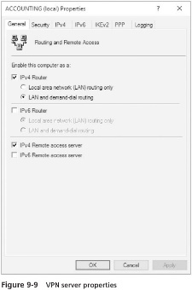
Configuring VPN Properties (2 of 2)

Slide 17
Configuring VPN Security (1 of 4)
You can set up VPN security through a remote access policy
Greatly reduces administrative overhead and offers more flexibility and control for authorizing connection attempts
Elements of a Remote Access Policy
Access permission
Conditions
Constraints
Settings

Slide 18
Configuring VPN Security (2 of 4)
First step in evaluating access is to determine if access permission is enabled at the VPN server
Default permission for this policy is set to Deny access
Change the default permission to Grant access in the default remote access policy
The conditions of a remote access policy are a set of attributes that are compared with the attributes of the connection attempt
If the connection attempt matches the conditions of a remote access policy, the constraints are evaluated
Settings in the remote access policy are then examined
Settings include elements such as IP filters, encryption, IP settings, and others

Slide 19
Configuring VPN Security (3 of 4)
Establishing a Remote Access Policy
You can use the Routing and Remote Access tool to create and configure a remote access policy
To create a new remote access policy, click to activate and then right-click the Remote Access Logging & Policies folder in the tree under the VPN server
Click Launch NPS to launch the Network Policy Server tool
Activity 9-6 shows you how to configure a remote access policy

Slide 20
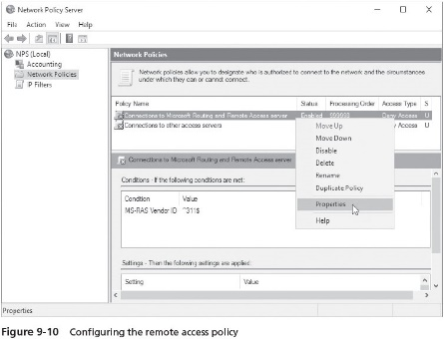
Configuring VPN Security (4 of 4)

Slide 21
Monitoring VPN Users
After you have configured the VPN server and placed it in production
You should periodically monitor the users who are connected
Use the Routing and Remote Access tool to monitor connected users
With the tool open:
Expand the elements under the server name in the left pant
Click Remote Access Clients in the left pane
The right pane shows the users who are connected
If you want to disconnect a user, right-click the user and click Disconnect

Slide 22
Implementing DirectAccess (1 of 4)
DirectAccess is built on using IPv6
And connecting clients through the Internet
Advantage:
The user connection is available as soon as the user turns on the computer
No need to sign in or enter a password
After the client OS boots, the computer sets up an infrastructure tunnel to the organization’s domain
As well as to access DNS and DHCP servers
Client’s computer can also be managed from the domain

Slide 23
Implementing DirectAccess (2 of 4)
To use DirectAccess, the server must have:
IPv6 enabled at the server and clients
Applications that are IPv6 aware
Use of digital certificates that are either self-signed certificates or are managed through implementing a PKI to assign digital certificates
A security group containing the accounts of participating computers
Client computers running Windows 7 or above
Client computer that use Windows Firewall with the domain and public profiles configured to be on

Slide 24
Implementing DirectAccess (3 of 4)
DirectAccess is installed using the Routing and Remote Access tool
If you have not previously installed a VPN server
Open the Routing and Remote Access tool, right-click the server name in the tree, and click Configure and Enable Routing and Remote Access
If you have previously installed a VPN
You can enable and install DirectAccess to work alongside VPN by using the Enable DirectAccess Wizard
Activity 9-7 steps you through enabling DirectAccess after a VPN has been installed

Slide 25
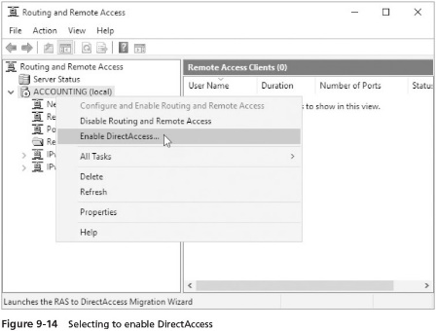
Implementing DirectAccess (4 of 4)

Slide 26
Troubleshooting VPN and DirectAccess Installations
Troubleshooting a VPN or DirectAccess server communications problem can be divided into hardware and software troubleshooting tips

Slide 27
Hardware Solutions
Use Device Manager to make sure network adapters and WAN adapters are working properly
Also use Device Manager to make sure that an adapter has no resource conflicts
For an external DSL adapter or a combined DSL adapter and router
Make sure the device is properly configured and connected
Check its monitor lights for problems
Call your ISP to determine if problems are present on the ISP’s WAN

Slide 28
Software Solutions (1 of 2)
Use the Services tool or Server Manager to make sure the following services are started:
IP Helper, Remote Access Connection Manager, IKE and AuthIP IPsec Keying Modules, Routing and Remote Access, Netlogon, Remote Access Management service, Base Filtering Engine, Windows Firewall, and Secure Socket Tunneling Protocol Service
Ensure that the Windows Firewall is set up to allow remote access
Make sure that the VPN/DirectAccess server is enabled
Check the remote access policy to be sure that access permission is granted
Be certain that the VPN/DirectAccess server is started
In the Routing and Remote Access tool, check the network interface

Slide 29
Software Solutions (2 of 2)
Make sure that the IP parameters are correctly configured to provide an address pool for either a VPN/DirectAccess server
Check to be sure the remote access policy is consistent with the users’ access needs
Open the Remote Access Management Console and click Dashboard in the left pane
If only certain clients but not all are having connection problems, try these solutions:
Make sure the clients are using the same communications protocol as the server
If you manage access to a VPN/DirectAccess server by using security groups, make sure that each user account or computer account that needs access is in the appropriate group

Slide 30
Connecting Through Remote Desktop Services (1 of 6)
Remote Desktop Services (RDS) server
Enables clients to run sessions-based desktops, virtual desktops, and software applications on Windows Server 2016 instead of at the client
Using session-based desktops
The client accesses an RDS server to run applications on that server during a connection session
Virtual desktops
Are used in association with accessing virtual machines on a virtual server through Hyper-V
Multiple virtual desktops can be in a pool of desktops for different purposes

Slide 31
Connecting Through Remote Desktop Services (2 of 6)
Windows Server 2016 Remote Desktop Services are used for three broad purposes:
To run applications on a server instead of the client
To support thin clients
To centralize program access
Thin clients
Downsized PCs that have minimal Windows-based OSs that access a Windows Server 2016 server so that most CPU-intensive operations are performed on the server
Generally used to save money and reduce training and support requirements
Also used for portable field or handheld remote devices

Slide 32
Connecting Through Remote Desktop Services (3 of 6)
Centralize control of how programs are used
Highly-classified or sensitive documents can be stored and modified only on the server
Server can be configured to provide a high level of security
RDS not only supports thin clients, but also other types of OSs including:
Windows 10
Windows Server 2016
UNIX and UNIX-based X-terminals
Linux
Mac OS
Table operating systems

Slide 33
Connecting Through Remote Desktop Services (4 of 6)
Four main components enable remote desktop server connectivity:
Windows Server 2016 multiuser Remote Desktop Services
Remote desktop services client
Remote Desktop Protocol (RDP)
Remote Desktop Services administration tools
See Table 9-6 for a description of these components

Slide 34
Connecting Through Remote Desktop Services (5 of 6)
When you install RDS, you can install different role services:
Remote Desktop Session Host
Remote Desktop Web Access
Remote Desktop Virtualization Host
Remote Desktop Licensing
Remote Desktop Gateway
Remote Desktop Connection Broker
See Table 9-7 for a description of these services

Slide 35
Connecting Through Remote Desktop Services (6 of 6)
An RDS server employs RemoteApp
A feature that enables a client to run an application without loading a remote desktop on the client computer
The program appears to be just another program in a window running on the local computer
A RemoteApp program is started by clients in the following ways:
From an icon on the client’s desktop
From the client’s Start menu
As a link on a website via Remote Desktop Web Access
As an .rdp (remote desktop protocol) file

Slide 36
Installing Remote Desktop Services (1 of 4)
When you install the Remote Desktop Services role, you also need to install the RDS Licensing role service
To manage the number of terminal server user licenses you have obtained from Microsoft
The RDS Licensing role server can be installed when you install the Remote Desktop Services role
Licenses can be purchased either per user account or by client device
When you install the RDS role, you implement Network Level Authentication (NLA)
NLA enables authentication to take place before the RDS connection is established
Designed to eliminate man-in-the-middle attacks

Slide 37
Installing Remote Desktop Services (2 of 4)
Another element to consider before you install the RDS role is who will be allowed to access the RDS server
Create groups of user accounts in advance so that you can add these groups during the installation
If operating in an Active Directory environment
Consider creating a domain local group, such as RDS Users
Next, create different global groups of users, such as a global group for each department that will access the RDS server
Add the appropriate user accounts for each department’s global group
Finally, add the global groups to the single domain local group

Slide 38
Installing Remote Desktop Services (3 of 4)
Activity 9-8 shows you how to install the Remote Desktop Service role

Slide 39
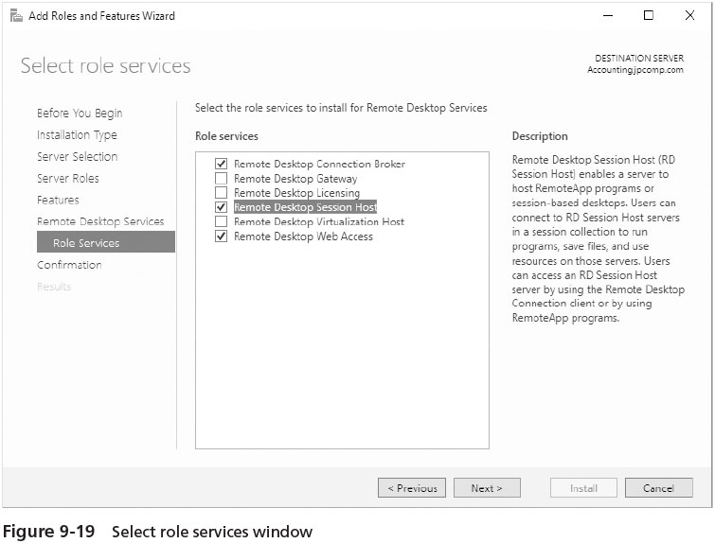
Installing Remote Desktop Services (4 of 4)

Slide 40
Configuring Remote Desktop Services
After you have installed the RDS role and associated role services
Use Server Manager to complete a basic configuration as in Activity 9-9

Slide 41
Accessing an RDS Server from a Client
Remote Desktop Services client computers can sign in using the Remote Desktop Connection (RDC) client
The RDC client is already installed in Windows Vista through Windows 10 and in Windows Server 2016
The general steps to start RDC client in Windows 10 or Windows Server 2016 are as follows:
Click Start and click the Windows Accessories folder
Click Remote Desktop Connection
Enter the name of the computer to access and click Connect
Provide the username and password and click OK

Slide 42
Publishing Applications for RemoteApp on an RDS Server
After you configure an RDS server
You can create a collection of RemoteApp programs that are published
The first step is to create a collection
Next, you select RemoteApps appplications on the server to include in the collection
As in Activity 9-10

Slide 43
Chapter Summary (1 of 2)
Windows Server 2016 offers Remote Access Services to enable users to have remote access to a server
Remote Access Services includes virtual private network (VPN) and DirectAccess services that can be installed individually or together on a server
Remote access protocols include PPP, PPTP, L2TP, and SSTP
Use Server Manager to install the Network Policy and Access Services and the Remote Access roles in Windows Server 2016
Use Server Manager to initially configure a VPN
After a VPN is installed, it should be configured to be a DHCP Relay Agent
A VPN has many properties that can be configured

Slide 44
Chapter Summary (2 of 2)
Plan to configure a remote access policy to govern how a VPN server is accessed
DirectAccess is another remote access service that can be configured with VPN or stand-alone
Many troubleshooting strategies can be used if your VPN or DirectAccess remote access server is having problems
Use Server Manager to install the Remote Desktop Services role and to configure the role after it is installed

