Slide 1
Hands-On Microsoft Windows Server 2016 2nd Edition
Chapter 10
Securing Windows Server 2016

Slide 2
Objectives (1 of 2)
Understand how Windows Server 2016 uses Group Policies
Understand and configure security policies
Implement Active Directory Rights Management Services
Manage security using the Security Templates and Security Configuration and Analysis snap-ins
Configure security policies for client computers

Slide 3
Objectives (2 of 2)
Use the cipher command for encryption
Use BitLocker Drive Encryption
Configure Network Address Translation
Configure Windows Firewall
Use Windows Defender

Slide 4
An Overview of Security Features in Windows Server 2016 (1 of 4)
Windows Server 2016 was created to emphasize security
Reduced attack surface of the kernel through Server Core and Nano Server
Expanded and evolving Group Policies
Windows Firewall
Windows Defender
Security Templates and Security Configuration and Analysis tools
User Account Control
BitLocker Drive Encryption

Slide 5
An Overview of Security Features in Windows Server 2016 (2 of 4)
Server Core or Nano Server can be a good solution for a server that handles critical network operations such as DNS and DHCP
Also can be a good solution for a Web or other server in the demilitarized zone of a network
They also can offer better performance and lead to fewer problems
Demilitarized zone (DMZ)
A portion of a network that is between two networks, such as between a private network and the Internet
Computers in the DMZ have fewer security defenses via routers and firewalls
Group policy is a way to bring consistent security and other management to Windows Server 2016
And to clients connecting to a server

Slide 6
An Overview of Security Features in Windows Server 2016 (3 of 4)
In Windows Firewall and IPsec
Settings are merged for consistency
Windows Defender
Software that scans for viruses, spyware, and malware
Windows Server 2016 is the first Windows Server OS to include Windows Defender
Security Templates and Security Configuration and Analysis tools
Enable you to configure server-wide security

Slide 7
An Overview of Security Features in Windows Server 2016 (4 of 4)
User Account Control (UAC)
Designed to keep the user running in the standard user mode as a way to:
More fully insulate the kernel
Keep operating system and desktop files stabilized
Another element of UAC is the Administrator Approval Mode
Prevents malware or an intruder from acquiring control through a back door without the administrator knowing
BitLocker Drive Encryption
Prevents an intruder from bypassing ACL file and folder protections

Slide 8
Introduction to Group Policy (1 of 2)
Group policy in Windows Server 2016
Enables you to standardize the working environment of clients and servers by setting policies in Active Director
Defining characteristics of Group Policy:
Group Policy can be set for a site, domain, OU, or local computer
Group Policy cannot be set for non-OU folder containers
Group Policy settings are stored in Group Policy Objects
GPOs can be local and nonlocal
Group Policy can be set up to affect user accounts and computers
When Group Policy is updated, old policies are removed or updated for all clients

Slide 9
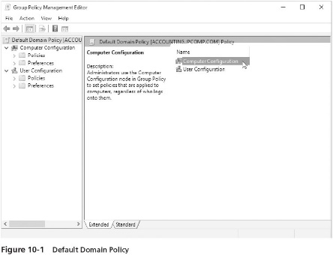
Introduction to Group Policy (2 of 2)

Slide 10
Securing Windows Server 2016 Using Security Policies
Security policies are a subset of individual policies
Within a larger group policy for a site, domain, OU, or local computer
Security policies include:
Account Policies
Audit Policy
User Rights
Security Options
IP Security Policies
Activity 10-1 shows you how to use the Group Policy Management tool

Slide 11
Establishing Account Policies (1 of 9)
Account policies
Security measures set up in a Group Policy that applies to all accounts or to all accounts in a container when Active Directory is installed
The account policy options that you can configure affect three main areas:
Password security
Account lockout
Kerberos security
Password security
One option is to set a password expiration period, requiring users to change passwords at regular intervals
Some organizations require that all passwords have a minimum length

Slide 12
Establishing Account Policies (2 of 9)
Specific password security options:
Enforce password history
Maximum password age
Minimum password age
Minimum password length
Passwords must meet complexity requirements
Store password using reversible encryption
Activity 10-2 shows you how to configure password security in the default domain security policy

Slide 13
Establishing Account Policies (3 of 9)
Account Lockout
The operating system can employ account lockout to bar access to an account (including the true account owner) after a number of unsuccessful tries
The lockout can be set to release after a specified period of time
Or by intervention from the server administrator
A common policy is to have lockout go into effect after five to 10 unsuccessful logon attempts
Administrator can set lockout to release after a designated time
Account lockout parameters
Account lockout duration
Account lockout threshold
Reset account lockout count after

Slide 14
Establishing Account Policies (4 of 9)
Activity 10-3 shows you how to configure account lockout policy in the default domain security policy

Slide 15
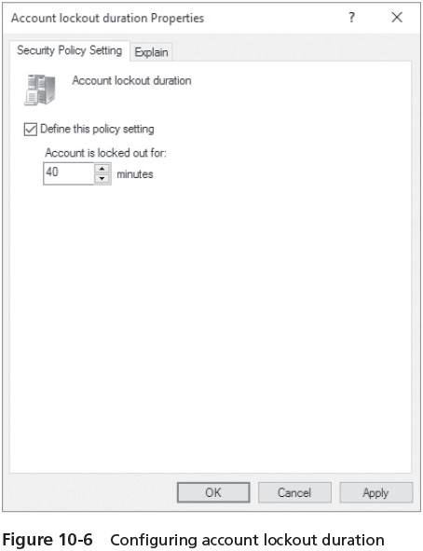
Establishing Account Policies (5 of 9)

Slide 16
Establishing Account Policies (6 of 9)
Kerberos security
Involves the use of tickets that are exchanged between the client who requests logon and network services access and the server or Active Directory that grants access
When Active Directory is used, each DC is a key distribution center
Once a user is authenticated, the Kerberos ticket-granting service grants a permanent ticket (called a service ticket) to that computer
A service ticket is good for the duration of the logon session
Enhancements on Windows Server 2016 and Windows 10
The use of Advanced Encryption Standard (AES) encryption
When Active Directory is installed, the account policies enable Kerberos
When Active Directory is not installed, the default authentication is through Windows NT LAN Manager version 2 (NTLMv2)

Slide 17
Establishing Account Policies (7 of 9)
Options available for configuring Kerberos:
Enforce user logon restrictions
Maximum lifetime for service ticket
Maximum lifetime for user ticket
Maximum lifetime for user ticket renewal
Maximum tolerance for computer clock synchronization

Slide 18
Establishing Account Policies (8 of 9)
Activity 10-4 steps you through configuring Kerberos in the default domain security policy

Slide 19
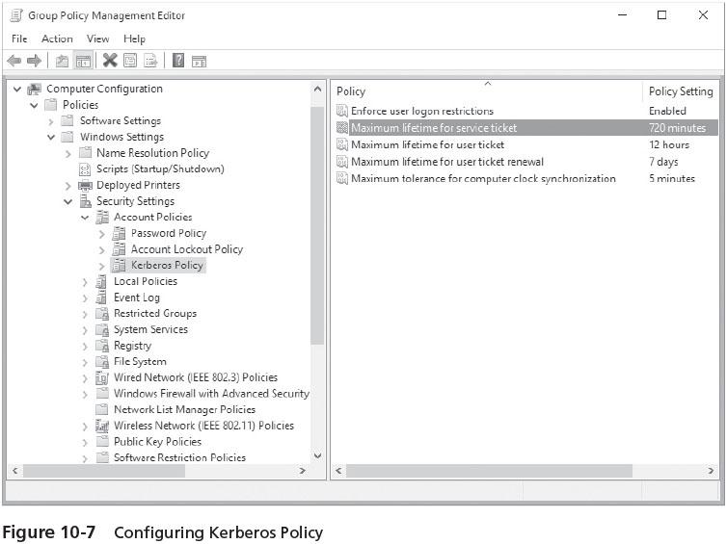
Establishing Account Policies (9 of 9)

Slide 20
Establishing Audit Policies (1 of 3)
Examples of events that an organization can audit are as follows:
Account logon (and logoff) events
Account management
Directory service access
Logon (and logoff) events at the local computer
Object access
Policy change
Privilege use
Process tracking
System events

Slide 21
Establishing Audit Policies (2 of 3)
Activity 10-5 shows you how to configure an audit policy

Slide 22
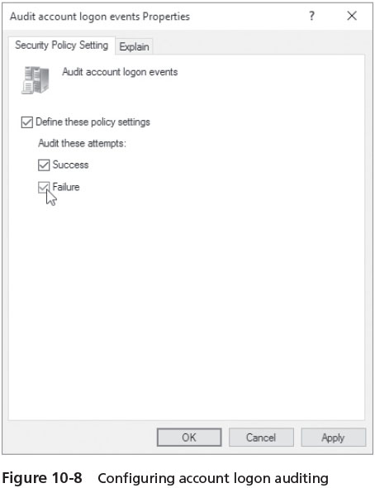
Establishing Audit Policies (3 of 3)

Slide 23
Configuring User Rights (1 of 5)
User rights enable an account or group to perform predefined tasks
The most basic right is the ability to access a server
More advanced rights give privileges to create accounts and manage server functions
Two general categories of rights:
Privileges – generally relate to the ability to manage server or Active Directory functions
Logon rights – are related to how accounts, computers, and services are accessed

Slide 24
Configuring User Rights (2 of 5)
Some examples of privileges include the following:
Add workstations to domain
Back up files and directories
Change the system time
Create permanent shared objects
Generate security audits
Load and unload device drivers
Perform volume maintenance tasks
Shut down the system

Slide 25
Configuring User Rights (3 of 5)
Examples of logon rights are as follows:
Access this computer from the network
Allow logon locally
Allow logon through Remote Desktop Services
Deny access to this computer from the network
Deny logon as a service
Deny logon locally
Deny logon through Remote Desktop Services

Slide 26
Configuring User Rights (4 of 5)
Activity 10-6 shows you how to configure user rights

Slide 27
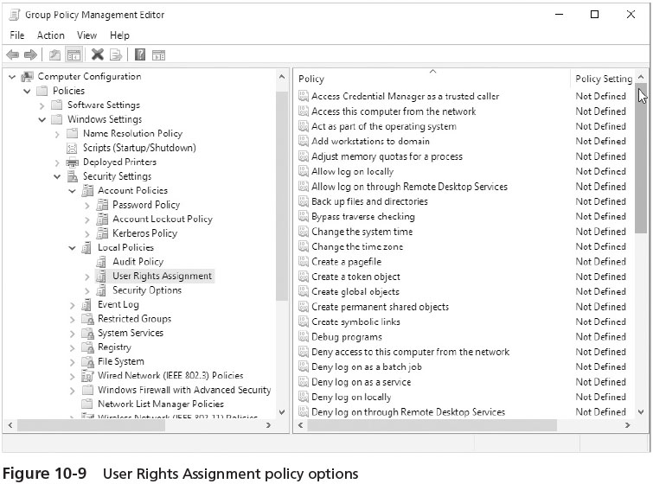
Configuring User Rights (5 of 5)

Slide 28
Configuring Security Options (1 of 4)
There are many specialized security options that are divided into the following categories:
Accounts
Audit
DCOM
Devices
Domain controller
Interactive logon
Microsoft network client
Network access
Network security

Slide 29
Configuring Security Options (2 of 4)
There are many specialized security options that are divided into the following categories (cont’d):
Recovery console
Shutdown
System cryptography
System objects
System settings
User Account Control

Slide 30
Configuring Security Options (3 of 4)
Activity 10-7 allows you to examine Security Options and then configure an option

Slide 31
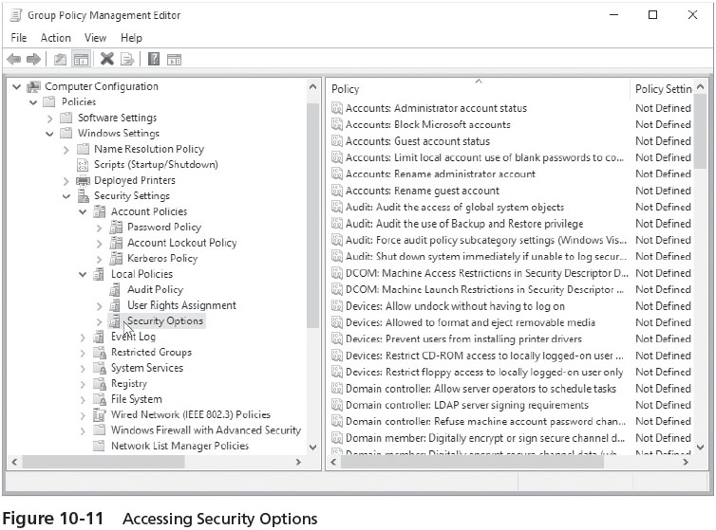
Configuring Security Options (4 of 4)

Slide 32
Using IP Security Policies (1 of 4)
Windows Server 2016 supports the implementation of IP security (IPsec)
When an IPsec communication begins between two computers
The computers first exchange certificates to authenticate the receiver and sender
Next, data is encrypted at the NIC of the sending computer as it is formatted into an IP packet
IPsec can provide security for all TCP/IP-based application and communications protocols
Including FTP and HTTP, which are used in Internet transmissions

Slide 33
Using IP Security Policies (2 of 4)
A computer that is configured to use IPsec communication can function in any of three roles:
Client (Respond Only)
Secure Server (Require Security)
Server (Request Security)
IPsec security policies can be established through the Default Domain Policy
IPsec security policies can also be configured through the IP Security Policy Management MMC snap-in

Slide 34
Using IP Security Policies (3 of 4)
Activity 10-8 steps you through how to configure IPsec Group Policy elements

Slide 35
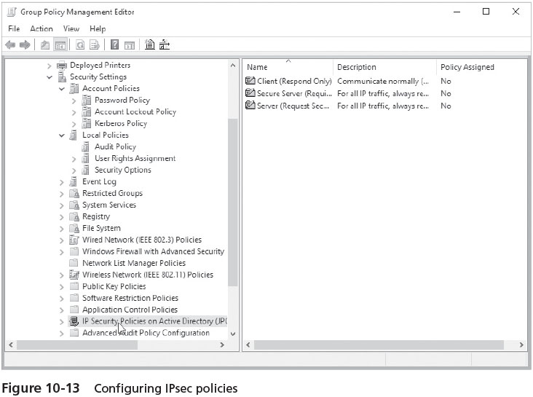
Using IP Security Policies (4 of 4)

Slide 36
Active Directory Rights Management Services (1 of 2)
Active Directory Rights Management Services (AD RMS)
A server role to complement the client applications that can take advantage of Rights Management Services safeguards
Rights Management Services (RMS)
Security rights developed by Microsoft to provide security for documents, spreadsheets, e-mail, and other types of files created by applications
Uses security capabilities such as encryption, user authentication, and security certificates to help safeguard information
RMS works by implementing rights that manage who can read, modify, copy, save, print, forward, and manipulate a document, spreadsheet, email, web document, and other types of files
Rights are given to user accounts and groups

Slide 37
Active Directory Rights Management Services (2 of 2)
General steps used in RMS security
A user creates a Word document, for example
In the process of protecting the document with RMS, Word encrypts the document using an AES key and an additional RSA key
The AD RMS server issues an identity license to the client who can access the document
Client shows the AD RMS server its license to access the document
The AD RMS server authenticates the client and determines the level of access

Slide 38
Managing Security Using the Security Templates and Security and Configuration Analysis Snap-Ins (1 of 3)
This snap-in enables you to set up security to govern the following:
Account policies
Local policies
Event log tracking policies
Group restrictions
Service access security
Registry security
File system security

Slide 39
Managing Security Using the Security Templates and Security and Configuration Analysis Snap-Ins (2 of 3)
Activity 10-9 shows you how to use the Security Templates snap-in
Activity 10-10 shows you how to use the Security Configuration and Analysis snap-in

Slide 40
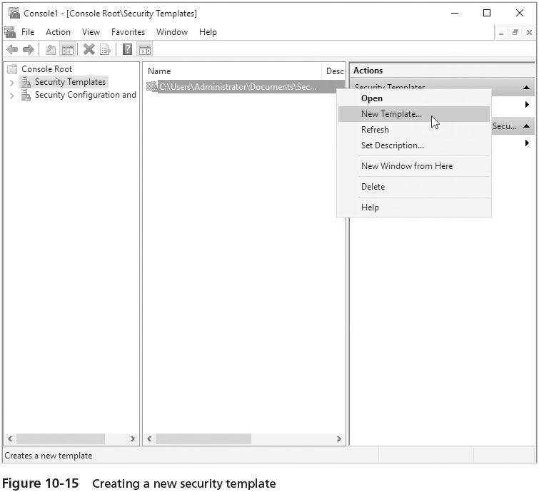
Managing Security Using the Security Templates and Security and Configuration Analysis Snap-Ins (3 of 3)

Slide 41
Configuring Client Security Using Policies in Windows Server 2016
Customizing settings used by clients offers several advantages:
Enhanced security
Providing a consistent working environment in an organization
The settings are customized by configuring policies on the Windows Server 2016 servers that the clients access
When the client signs in to the server or the network, the policies are applied to the client

Slide 42
Manually Configuring Policies for Clients (1 of 2)
You can manually configure one or more policies that apply to clients by using:
The Group Policy Management tool
or the Group Policy Object Editor snap-in
In either tool, you customize the desktop settings for client computers by using the Administrative Templates Policy object
Under User Configuration and Policies in a Group Policy Object

Slide 43
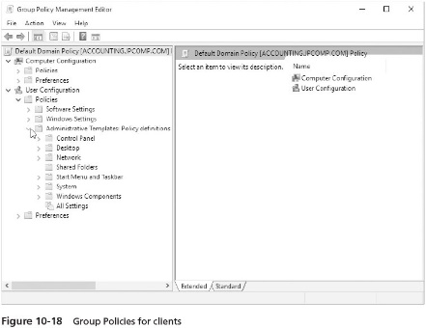
Manually Configuring Policies for Clients (2 of 2)

Slide 44
Publishing and Assigning Software (1 of 3)
Publishing applications (or software)
Involves setting up software through a group policy so that the application is available for users to install from a central application distribution server
Such as through the Programs and Features capability via the user’s desktop
Assigning applications
An application is automatically represented on the user’s desktop
Is initially really a link to the central application distribution server
When the application is assigned to the computer, the application is automatically installed the next time the user boots or signs in to the computer

Slide 45
Publishing and Assigning Software (2 of 3)
Activity 10-12 shows you where to set up software installation in a Group Policy

Slide 46
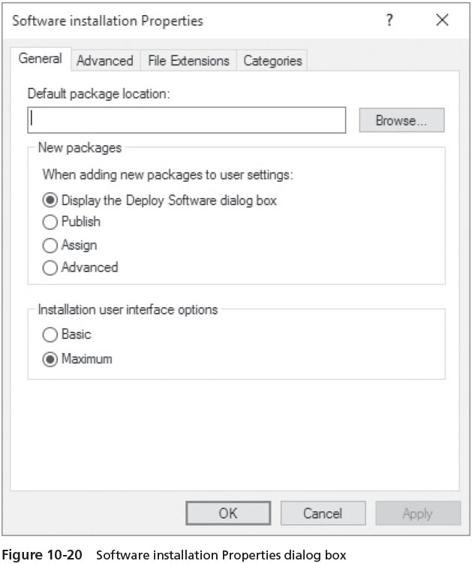
Publishing and Assigning Software (3 of 3)

Slide 47
Resultant Set of Policy
Resultant Set of Policy (RSoP)
Used to make the implementation and troubleshooting of group policies much simpler for an administrator
Can query the existing policies that are in place and then provide reports and the results of policy changes
RSoP supports two modes:
Planning – generates a report and provides the results of proposed policy changes
Logging – generates a report based on the current policies in place and provides the resulting policy settings
Activity 10-13 shows you how to use the Resultant Set of Policy tool

Slide 48
User the cipher Command
When you deploy NTFS you can use the Encrypt attribute to protect folders and files
Enabling only the user who encrypts the folder or file to read it
An encrypted folder or file uses Microsoft’s Encrypting File System (EFS)
Configuring a unique private encryption key that is associated with the user account that encrypted the folder or file
You can set the Encrypt attribute on a folder or file through working with that folder’s or file’s properties
Another option that you learn in this section is to use the cipher command from the Windows PowerShell or Command Prompt window
Table 10-2 on page 454 describes some common cipher command-line parameters

Slide 49
Using BitLocker Drive Encryption (1 of 2)
BitLocker Drive Encryption
An effective tool for protecting data on hard drives, including removable hard drives connected through a USB port
Also supports EFI-based computers as well as computers using BIOS
Uses Trusted Platform Module for one approach to security
Trusted Platform Module (TPM)
A security specification for a hardware device that can be used to secure information on a different hardware device, such as a hard drive
When used to protect a hard drive
TPM verifies that the computer to which the hard drive is connected has authority to access that hard drive
If a hard drive is stolen, it cannot be accessed by another computer

Slide 50
Using BitLocker Drive Encryption (2 of 2)
If a computer is not equipped with a TPM chip
BitLocker Drive Encryption can be used with a USB flash drive that contains a personal identification number (PIN)
BitLocker Drive Encryption encrypts the entire drive
Including the OS, programs, and data files
BitLocker can check to ensure files have not been tampered with or accessed by any sources that do not have the proper physical-device key
If it detects unauthorized access, it locks the files on the drive
Activity 10-15 shows you how to set up BitLocker Drive Encryption

Slide 51
Configuring NAT (1 of 2)
Network Address Translation (NAT) serves two important functions:
Enables an organization to automatically assign its own IP addresses on an internal network
Without having to set up many globally unique addresses for use over external networks
Protects computers on an internal network so that computers on external networks cannot identify their true IP addresses on the internal network
NAT uses a pool of private addresses for its internal network
Because the internal addresses are not viewed by the outside world
There is no need to have a large pool of IP addresses that can also be used over an external network

Slide 52
Configuring NAT (2 of 2)
Only one or a very small pool of globally unique IP addresses are needed for outside communications
NAT is also a good security technique because internal IP addresses are concealed from the outside world
In a typical installation,
NAT acts like a firewall so that the outside world (external networks) sees only one address
When you install the Remote Access role and then use the Getting Started Wizard
You can configure to setup NAT
Activity 10-16 shows you how to add NAT as a role service in the Remote Access Services role

Slide 53
Windows Firewall (1 of 2)
Windows Firewall offers the following advantages:
Protects incoming and outgoing communications
Merges firewall filters with IPsec settings to avoid settings conflicts
Includes the Windows Firewall with Advanced Security MMC snap-in
Has firewall exceptions or rules for several kinds of managed objects
After enabling Windows Firewall, your next step should be configuring exceptions and advanced features
Exceptions are programs that you choose to allow through the firewall in both directions
When considered as a group, the exceptions are a set of rules

Slide 54
Windows Firewall (2 of 2)
Exceptions can be configured for the following:
TCP and UDP ports
All or only specified ports
IPv4 and IPv6
All or only specified network interfaces
Services by providing the path to the service
You can configure basic exceptions and advanced features from Control Panel or Server Manager
Specific inbound and outbound communications can be configured from the Windows Firewall with Advanced Settings MMC snap-in
Activity 10-17 shows you how to configure Windows Firewall from Control Panel

Slide 55
Windows Defender
Windows Defender
A security program that comes with Windows Server 2016 that protects against malware, viruses, spyware, and other threats
Windows Server 2016 is the first Windows Server system that includes Windows Defender
Can be downloaded to operate in Windows Server 2008/R2 and 2012/R2
Windows Defender
Regularly scans for malware and has the option to run a manual scan
Updates are sent automatically (if Windows Update allows automatic updates to Windows Defender)
Activity 10-18 shows you how to use the Windows Defender GUI

Slide 56
Chapter Summary (1 of 3)
Windows Server 2016 has many important security features
Group policy offers a way to standardize security across a domain, OU, site, or local server
Configure account policies to include security features such as password security, account lockout, and Kerberos authentication
Use audit policies to track how resources are accessed, such as folders, files, or user accounts
User rights policies enable you to create specific security controls
Security options are specialized policies
Configure IPsec security policy for strong client authentication

Slide 57
Chapter Summary (2 of 3)
Implement Active Directory Rights Management Services for application-level security
Use the Security Templates and Security Configuration and Analysis snap-ins to configure consistent security policies for an Active Directory container
For better control over the activities of clients, configure security policies on the local server or in the domain that applies to clients
Use Resultant Set of Policy to plan and troubleshoot Group Policy
The cipher command is a valuable tool for implementing the Encrypting File System from the Command Prompt window
BitLocker Drive Encryption is a security measure for protecting entire hard drives

Slide 58
Chapter Summary (3 of 3)
Network Address Translation is used to disguise IP addresses on an internal network from the outside world
Windows Firewall can be configured to allow traffic exceptions and to manage incoming and outgoing traffic
Windows Defender is included with Windows Server 2016 to protect against malware, viruses, spyware, and other threats

