Slide 1
Hands-On Microsoft Windows Server 2016 2nd Edition
Chapter 11
Server and Network Monitoring

Slide 2
Objectives (1 of 2)
Understand the importance of server monitoring
Use Resource Monitor
Monitor server services and solve problems with services
Use Task Manager for server monitoring
Configure and use Performance Monitor

Slide 3
Objectives (2 of 2)
Set up and use Data Collector Sets for performance and diagnostic information
Implement the SNMP service for network management

Slide 4
Introduction to Server Monitoring (1 of 2)
Server monitoring is performed for several reasons
To establish a baseline of performance so problems can be more easily identified when they occur
To prevent problems before they occur and to diagnose existing problems
Benchmarks or baselines
Provide a basis for comparing data collected during problem situations with data showing normal performance conditions

Slide 5
Introduction to Server Monitoring (2 of 2)
Sample benchmarks that you might establish include the following:
Test benchmarks of disk, CPU, memory, and network response before releasing a new operating system, server hardware, or a complex application to users
Slow, typical, and heavy usage of disk, CPU, memory, and other server resources for each server
Slow, typical, and heavy usage of the combined network and server resources
Growth of use of network and server resources at specific intervals, such as every six months to a year

Slide 6
Using Resource Monitor (1 of 3)
Resource Monitor provides a real-time snapshot for monitoring the following resources:
CPU
Memory
Disk
Network
This tool is very useful for a first quick analysis of a problem
Processes or services running on a server are displayed according to the four main categories above

Slide 7
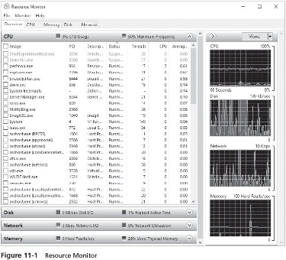
Using Resource Monitor (2 of 3)

Slide 8
Using Resource Monitor (3 of 3)
Processor(s) in a server can be a bottleneck for several reasons:
The processor does not have enough processing speed
One or more applications are inefficient or poorly programmed
Memory bottlenecks can be caused by insufficient memory or inefficient programs
Hard disk bottlenecks affect the overall server performance
Resource Monitor shows disk I/O and the highest active time
Network performance is a possible bottleneck
Problems to look for include a problem with a server NIC or a network that is saturated with traffic
Activity 11-1 shows you how to use Resource Monitor for an initial server assessment

Slide 9
Monitoring Server Services
Servers are always running a number of services
Table 11-1 on page 475 presents a sampling of some of the services typically in use in Windows Server 2016

Slide 10
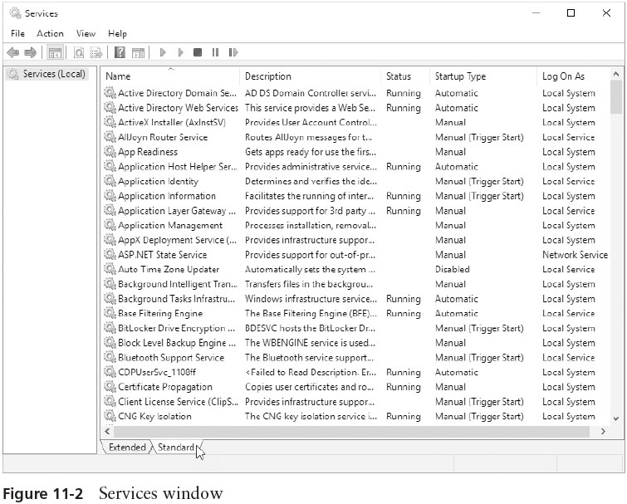
Accessing Server Services
You can access server services through Server Manager or the Computer Management tool

Slide 11
Solving a Problem with a Service (1 of 2)
When you experience a problem on a server that is associated with a service
Check the status of the service to make sure that it is started or set to start automatically
You can start, stop, pause, resume, or restart a service
By right-clicking it and clicking any of these options
You can check dependencies by double-clicking a service and clicking the Dependencies tab
Pausing a service takes it offline to be used only by Administrators or Server Operators

Slide 12
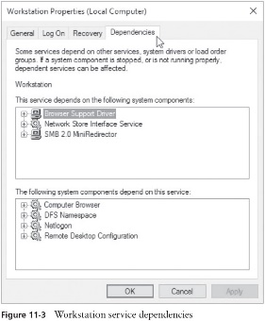
Solving a Problem with a Service (2 of 2)

Slide 13
Using Task Manager
Windows Server 2016 includes the Task Manager tool
Can be used to monitor applications and processes running on a server

Slide 14
Monitoring Applications (1 of 3)
You can use Task Manager to view applications running on the server
By pressing CTRL+ALT+DEL while logged on as Administrator or as a member of the Administrators group
The Processes tab shows:
All the software applications, background processes, and Windows processes running from the server console

Slide 15
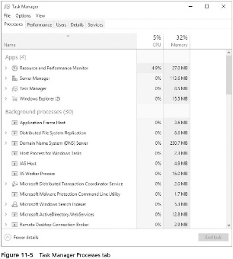
Monitoring Applications (2 of 3)

Slide 16
Monitoring Applications (3 of 3)
If you right-click an application, several active options appear in a shortcut menu, as follows:
Expand
Restart
End task
Resource values
Create dump file
Go to details
Open file location
Search online
Properties

Slide 17
Monitoring Processes (1 of 2)
The Details tab lists the processes in use by all running applications
If you need to stop a process, simply highlight it and click End task
The Details tab also shows information about each started process

Slide 18
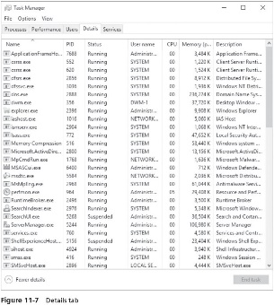
Monitoring Processes (2 of 2)

Slide 19
Setting Priorities (1 of 2)
Using the Details tab within Task Manager
You can increase the priority of a process (or processes) in the list so that it has more CPU priority than what is set as its default
Base priority class
The priority at which a process runs is set in the program code of the application
If the base priority class is not set by the program, a normal (average) priority is set by the system

Slide 20
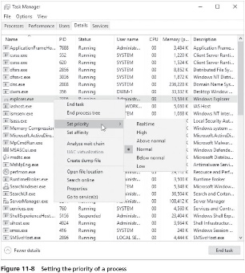
Setting Priorities (2 of 2)

Slide 21
Monitoring Services (1 of 2)
The Services tab in Task Manager shows the services that are started, stopped, or paused
If you want to manage services using more management options
Use Server Manager or the Computer Management tool

Slide 22
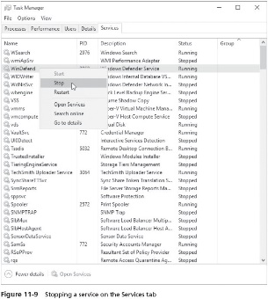
Monitoring Services (2 of 2)

Slide 23
Monitoring Real-Time Performance (1 of 6)
The Performance tab shows vital CPU and memory performance information
Through graphs and performance statistics
Handle
A resource, such as a file, used by a program and having its own identification so the program is able to access it
Threads
Blocks of code within a program
Committed memory
The number of bytes a process has designated for use and that are promised by the OS to a designated portion of the page file

Slide 24
Monitoring Real-Time Performance (2 of 6)
Paged pool
Represents data that can be stored in the paging file and so can be paged in and out of the virtual memory
Non-paged pool
Hold the OS kernel and device drivers that cannot be paged out
These processes are always kept in physical memory or RAM to assure faster, uninterrupted service
Page fault
Occurs whenever memory pages are called by a program or process from the paging file on disk

Slide 25
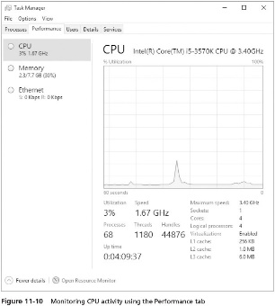
Monitoring Real-Time Performance (3 of 6)

Slide 26
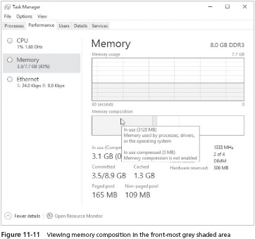
Monitoring Real-Time Performance (4 of 6)

Slide 27
Monitoring Real-Time Performance (5 of 6)
Network performance information shows real-time send and receive throughput on the network
Network performance data can be a quick diagnostic tool
Not only to determine if the network is busy but also to ensure that the NIC is connected and working
This information can be valuable if you suspect there is a problem with a NIC in the server
Can also be an initial warning that something is causing prolonged high network utilization

Slide 28
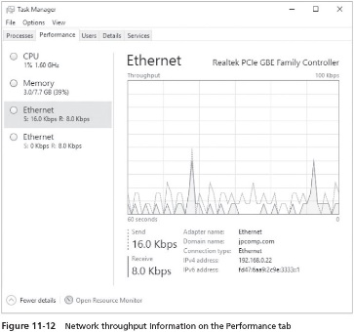
Monitoring Real-Time Performance (6 of 6)

Slide 29
Monitoring Users (1of 2)
The Users tab provides a list of the users currently signed in
You can sign out a user by clicking that user and clicking the Disconnect button
Ensures that any open files are closed before the user is signed out
To view programs in use and the amount of CPU or memory occupied by an individual program
Right-click a user and click Expand

Slide 30
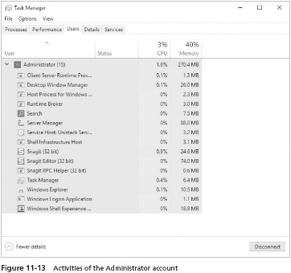
Monitoring Users (2 of 2)

Slide 31
Using Performance Monitor
Performance Monitor
Can be used to monitor components such as hard disks, memory, the processor, a network interface, a started process, and the paging file

Slide 32
Capturing Data Using Performance Monitor (1 of 6)
Performance Monitor can be opened from:
Server Manager
The Windows Administrative Tools folder through the Start button
An MMC snap-in
The default view is in the line mode, showing a grid that you use for graphing activities on the server
Counter
An indicator of a quantity of the object that can be measured in some unit, such as percentage, rate per second, or peak value, depending on what is appropriate to the object
Example: % Processor Time counter measures the percentage of processor time that is in use by nonidle processes

Slide 33
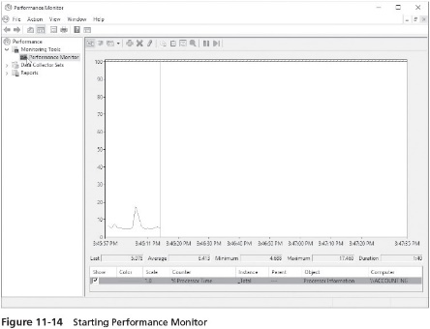
Capturing Data Using Performance Monitor (2 of 6)

Slide 34
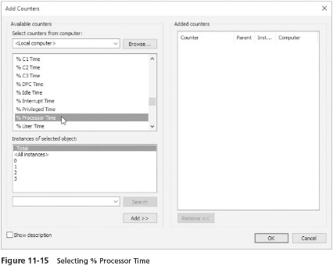
Capturing Data Using Performance Monitor (3 of 6)

Slide 35
Capturing Data Using Performance Monitor (4 of 6)
Sometimes instances are associated with a counter
An instance exists when there are different elements to monitor
Such as individual processes when you use the Process object
You can monitor one or more objects at a time
As a way to get a better understanding of how particular objects interact
You can use three view modes when monitoring objects:
Line – a running line chart of the object that shows distinct peaks and valleys
Histogram bar – a running bar chart that shows each object as a bar in a different color
Report – provides numbers on a screen, which you can capture to put in a report

Slide 36
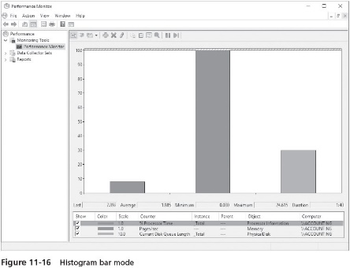
Capturing Data Using Performance Monitor (5 of 6)

Slide 37
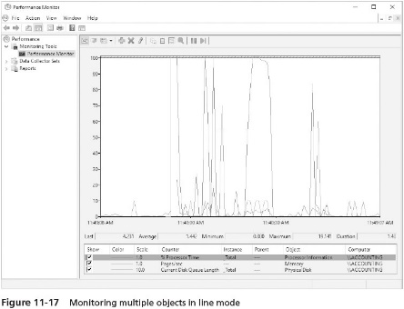
Capturing Data Using Performance Monitor (6 of 6)

Slide 38
Monitoring System Components
When monitoring the performance of a server, four objects are often used:
Processor
Memory
Physical disk
Network interface
Activities 11-5 and 11-6 enable you to explore how to use Performance Monitor and how to troubleshoot processor difficulties
In Activity 11-7, you’ll learn how to enable Performance Monitor to track disk activity through activating the Disk Performance Statistic Driver

Slide 39
Using Data Collector Sets (1 of 3)
Data Collector Sets tool
Another vehicle that is used to monitor performance and to consolidate performance information
Data collector set is a collection of diagnostic and performance information in the form of a report or log
There are three basic types of data collection tools and formats:
Performance counters and performance counter reports
Traces and trace reports
System configuration data

Slide 40
Using Data Collector Sets (2 of 3)
Performance counter report
Tracks information using objects, counters, and instances
A trace monitors particular events
Trace report contains only those instances when the events occur
Data collector sets can be created in several ways
One way is to use a predefined data collector set
Using a predefined data collector set helps to take the guesswork out of what to monitor
The Data Collector Sets tool also enables you to start a wizard and select a template to use for creating a data collector set

Slide 41
Using Data Collector Sets (3 of 3)
Each data collector set consists of properties that you can configure as follows:
General
Directory
Security
Schedule
Stop Condition
Task

Slide 42
Using a Wizard and a Template to Create a Data Collector Set
Templates that can be deployed from the Create new Data Collector Set Wizard:
Active Directory Diagnostics
Basic
System Diagnostics
System Performance
WDAC Diagnostics
The Create new Data Collector Set Wizard steps you through deploying one of these templates
To start the wizard, right-click the User Defined folder under Data Collector Sets in the Performance Monitor tool
Point to New and click Data Collector Set

Slide 43
Returning to a Report and the Importance of Network Data (1 of 2)
After you create a report, you can go back to it by finding that report
Under Reports in the tree within the Reliability and Performance Monitor tool
Monitoring the network is one of the monitoring tasks you should set out to do early on
Provides a way to determine baselines
And later, to compare baseline data with current system performance statistics to locate a problem source

Slide 44
Returning to a Report and the Importance of Network Data (2 of 2)
Plan to gather data such as the following:
Network Interface performance counter
IPv4 and IPv6 performance counters
TCPv4 and TCPv6 performance counters
Begin gathering benchmarks so that you have an understanding of what network activity is typical
Also gather benchmarks on typical network error levels
So you know at what point an increase in network errors signals a problem
Activity 11-9 shows you how to go back to view a report you have already created

Slide 45
Using a Predefined Data Collector Set
Performance Monitor has several predefined data collector sets
That you can run at anytime without first creating them through the Create new Data Collector Set Wizard
For diagnosing system and network problems
The predefined System Diagnostics data collector set is valuable
Activity 11-10 enables you to use the System Diagnostics data collector set

Slide 46
Implementing the SNMP Service (1 of 3)
Simple Network Management Protocol (SNMP)
Used for network management on TCP/IP-based networks
Provides administrators with a way of centrally managing workstations, servers, hubs, and routers from a central computer running management software
SNMP can be used for the following:
Configuring network devices
Monitoring the performance of a network
Locating network problems
Monitoring network usage

Slide 47
Implementing the SNMP Service (2 of 3)
SNMP provides network management services through agents and management systems
SNMP management system
A computer running management software
Sends and requests information from an SNMP agent
SNMP agent
Any computer or network device running SNMP agent software
Responds to the management system’s request for information

Slide 48
Implementing the SNMP Service (3 of 3)
Microsoft operating systems and components compatible with SNMP:
All versions of Windows Server OSs from Windows 2000 Server to Windows Server 2016
All versions of Windows workstation OSs from Windows 2000 to Windows 10
WINS servers
DHCP servers
Web (IIS) servers
Microsoft Remote Access servers
At this writing, Windows Server 2016 does not come with a full-fledged SNMP network management system application
The Windows Management Instrumentation (WMI) Software Development Kit (SDK) enables SNMP applications to access SNMP data
Activity 11-11 shows you how to install SNMP

Slide 49
Chapter Summary (1 of 2)
Server monitoring enables you to establish benchmarks or baselines to help identify areas that need improvement and to identify problem areas
Resource Monitor is a tool you can use to gain an initial picture of how CPU, memory, disk, and network resources are employed and to use as a springboard to troubleshooting server problems
A server has many services running at the same time
Task Manager enables you to monitor applications, processes, services, system performance, network performance, and logged-on users
Performance Monitor uses objects such as the processor or memory for monitoring

Slide 50
Chapter Summary (2 of 2)
A data collector set is a tool associated with Performance Monitor that enables you to collect data about a server or network and compile the data into a report
Windows Server 2016 offers the SNMP service, which you can choose to install

