Slide 1
Hands-On Microsoft Windows Server 2016 2nd Edition
Chapter 12
Managing System Reliability and Availability

Slide 2
Objectives
Understand general problem-solving strategies
Resolve boot problems
Use and configure Event Viewer
Troubleshoot network connectivity
Remotely administer one or more servers

Slide 3
General Problem-Solving Strategies
The best approach to solving server and network problems is to develop effective troubleshooting strategies
Four general strategies are:
Understanding how a server and the network interact
Training your users to help you solve problems
Solving problems step by step
Tracking problems and solutions

Slide 4
Understanding How Servers and the Network Interact (1 of 3)
Many server and network administrators create a diagram of the entire network or diagrams of different portions of a network
And then update the diagrams each time an aspect of the network changes

Slide 5
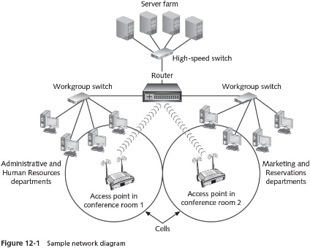
Understanding How Servers and the Network Interact (2 of 3)

Slide 6
Understanding How Servers and the Network Interact (3 of 3)
A network diagram should include the following elements:
Servers (and any mainframes/supercomputers)
Workstations and network printers (unless the network is too large to include these)
Wireless network devices
Cabled network devices
Telecommunications links
Wireless and cabled links
Remote links
Building locations

Slide 7
Training Users to Help
Train network users to be your partners in reporting problems
For example, they should:
Save their work at the first sign of a problem
Record information about a problem as the problem is occurring
Report any protocol information, such as error messages about a protocol or an address
Quickly report a problem by telephone, or by voice mail if you cannot be reached immediately
Avoid sending e-mail about urgent problems

Slide 8
Solving Problems Step-by-Step (1 of 2)
Step-by-step techniques to solve server and network problems:
Get as much information as possible about the problem
Record the error message at the time it appears or when a user reports it to you
Determine if anyone else is experiencing the problem
Check the Windows Server 2016 event logs for signs of a problem
Use Performance Monitor, Data Collector Sets, Task Manager, Server Manager, and the Computer Management tool to help you troubleshoot problems
Check for power interruptions
Take the information you have gathered and define the problem

Slide 9
Solving Problems Step-by-Step (2 of 2)
Step-by-step techniques to solve server and network problems (cont’d):
Determine possible solutions for the problem
Consider the best or most likely solutions, which may be simple ones
Determine how the solution will affect users
After your solution is implemented, continue monitoring the server to ensure there are no further problems

Slide 10
Tracking Problems and Solutions
Keep a log of all network problems and their solution
Help desk system
Application software designed to maintain information on computer systems, user questions, problem solutions, and other information that members of the organization can reference
The advantage of tracking problems is that you soon accumulate a wealth of information on solutions
Log of problems can also be used as a teaching tool and reference for computer support staff
It is also good practice to keep a change log
A record of changes made to a server’s hardware and software
Provides a reference for troubleshooting if problems arise later

Slide 11
Resolving Boot Problems
Some of the common causes of boot failures include:
Disk failure on the drive or drives containing the system and boot files
A corrupted partition table
A corrupted boot file
A corrupted master boot record
A disk read error
In most cases, the first step is to power off the computer and try rebooting it

Slide 12
Troubleshooting by Using Safe Mode (1 of 2)
If a simple reboot does not fix the problem
Try using the advanced options for booting, which is accessed by pressing F8 as soon as the computer boots
Safe Mode
Boots the server using the most generic default settings and only those services needed to boot a basic configuration
After you boot into Safe Mode, you have the opportunity to further troubleshoot the problem

Slide 13
Troubleshooting by Using Safe Mode (2 of 2)
To access the Advanced Boot Options menu:
Reboot the computer
Press F8 as soon as the computer boots
Select the option you want to use, such as Safe Mode, and press Enter
If you use Safe Mode, but are unable to troubleshoot the problem, or a failed driver message is displayed during the boot process
Use the Enable Boot Logging option so that you can create a log that you can later check for problems
The Safe Mode with Command Prompt option is particularly useful when you can solve a problem by executing a command
Such as running chkdsk to repair damaged files

Slide 14
Troubleshooting by Using the Repair Your Computer Option or Installation DVD (1 of 3)
In Windows Server 2016
You can access repair options when you select Repair Your Computer from the Advanced Boot Options menu
Or when you boot from an installation DVD and select the option to Repair your computer
Options available when you select Repair Your Computer:
Continue
Use another operating system
Troubleshoot
Turn off your PC
When you boot from the installation DVD and select Repair your computer you see the options:
Continue, Troubleshoot, and Turn off your PC

Slide 15
Troubleshooting by Using the Repair Your Computer Option or Installation DVD (2 of 3)
When you select Troubleshoot
You can select from the options: System Image Recovery or Command Prompt
System Image Recovery
An option that requires that you have previously taken an image
Used for a full restore of all the files on a server using a complete image of all folders and files
An all or none type of restore
Cannot restore selected folders or files
System state data
Includes the operating system plus extra components and information that reflect the currently configured state of the server
When you back up the system state data, you also are backing up the system protected files

Slide 16
Troubleshooting by Using the Repair Your Computer Option or Installation DVD (3 of 3)
Using the Command Prompt
When you select to use the Command Prompt option
You can repair a disk problem or copy a critical file back to the server
You can use it to copy off the server important files you have not yet backed up
Can be vital when you cannot boot into your server
You can execute many commands from the command prompt
Table 12-2 shows many sample command prompt commands
In Activity 12-3, you learn how to access the command prompt from the Windows Server 2016 installation DVD

Slide 17
General Tips for Fixing Boot Problems
Using the Safe Mode, the Windows Server 2016 installation DVD, and other techniques
Tables 12-3 and 12-4 provide tips for fixing boot problems and responding to Stop messages
Stop message
An error message displayed when the server experiences a serious problem and then stops functioning

Slide 18
Using and Configuring Event Viewer (1 of 5)
Event Viewer
Houses the event logs that record information about all types of server events, in the form of errors, warnings, and informational events
Windows Server 2016 event logs are divided into three general categories:
Windows logs, applications and services logs, and Microsoft logs

Slide 19
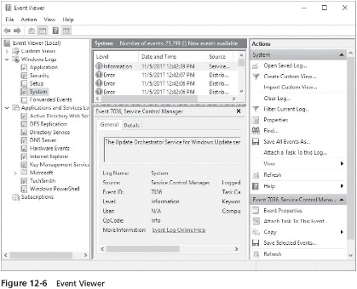
Using and Configuring Event Viewer (2 of 5)

Slide 20
Using and Configuring Event Viewer (3 of 5)
Windows generates logs for reporting general operating system and software application events:
Application log
Security log
Setup log
System log
Forwarded events lot
Admin logs
Designed to help give the system administrator information about a specific problem and its causes and may suggest how to solve the problem

Slide 21
Using and Configuring Event Viewer (4 of 5)
Operational log
Tracks occurrences of specific operations, such as when a disk drive is added
Applications and services logs available in Event Viewer depend in part on which roles and features are installed
A sampling of these logs include:
Active Directory Web Services log
DFS Replication log
Directory Service log
DNS Server log
Hardware Events
Internet Explorer
Key Management Service
Windows PowerShell

Slide 22
Using and Configuring Event Viewer (5 of 5)
Analytic logs
Relate to how programs are operating and are typically used by application or system programmers
Debug logs
Used by application developers to help trace problems in programs so they can fix program code or program structures
Several elements are related to working with event logs:
Viewing log events
Creating filters
Maintaining event logs

Slide 23
Viewing Log Events (1 of 4)
Log events are displayed in Event Viewer with an icon that indicates the seriousness of the event
Each log displays descriptive information about individual events, including the following provided in the system log:
Description of the event
Name of the log in which the event is recorded
Source of the event
Event ID
Level of the event—information, warning, error
User associated with the event, if any
OpCode of the event

Slide 24
Viewing Log Events (2 of 4)
Each log displays descriptive information about individual events, including the following provided in the system log (cont’d):
Link for more information
Date and time the event was logged
Task category of the event
Keywords associated with the event
Name of the computer on which the event occurred
Event Viewer can be opened from Server Manager, the Windows Administrative Tools folder from the Start button, as an MMC snap-in, from the Computer Management tool, and by right-clicking Start and clicking Event Viewer

Slide 25
Viewing Log Events (3 of 4)
To view the contents of a log, click that log in the tree under Event Viewer
To view the detailed information about an event, double-click the event
The event logs are a good source of information to help you troubleshoot a software or hardware problem

Slide 26
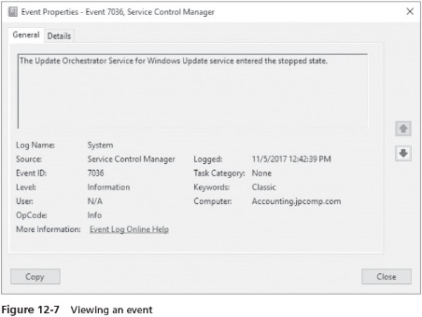
Viewing Log Events (4 of 4)

Slide 27
Using the Event Viewer Filter Option
All of the event logs in Event Viewer have a filter option to help you quickly locate a problem
The events can be filtered on the basis of the following criteria:
When the event was logged, such as in the last 7 days
Event level, such as information, warning, error, critical, and verbose
By log, such as the system or security log
By source of the event, such as a particular service or software component
Task category of the event, such as a security change
Keywords, such as Audit Failure and Audit Success
User associated with the event
Computer associated with the event
Date and time ranges

Slide 28
Maintaining Event Logs (1 of 2)
The event logs quickly fill with information
Logs can be maintained using several methods, as follows:
Size each log to prevent it from filling too quickly
Overwrite the oldest events when the log is full
Archive the log when it is full
Clear the log manually (does not overwrite events)
It is recommended that you develop a maintenance schedule
To save the log contents for a designated time period because logs contain valuable information about historical server activity

Slide 29
Maintaining Event Logs (2 of 2)
To tune the event logs, open Event Viewer and right-click each log you want to tune, one at a time
And click Properties
On the General tab, set the log size in the Maximum log size (KB): box
To save a log, right-click the log in the tree, click Save All Events As, enter a name for the log file, and click Save
You can save the log as one of the following kinds of files:
.evtx
.xml
.txt
.csv

Slide 30
Troubleshooting Connectivity
One area that server and network administrators often troubleshoot is TCP/IP connectivity
Both command-line tools and graphical tools are available for troubleshooting Windows Server 2016 connectivity

Slide 31
Command-Line Tools (1 of 4)
Windows server and workstation OSs come with tools you can use to help test network connectivity
Using the Windows PowerShell or the Command Prompt window
Type ipconfig to view a dialog box showing the adapter address (MAC or Ethernet), IP address, subnet mask, and other information for that computer
Can also show when there are multiple network adapters and can show when the media is disconnected
Type ping to poll the presence of another TCP/IP computer
netstat is a quick way to verify that a workstation or server has established a successful TCP/IP connection
netstat -e provides a quick indication of the number of transmission errors and discarded packets detected at that computer’s NIC

Slide 32
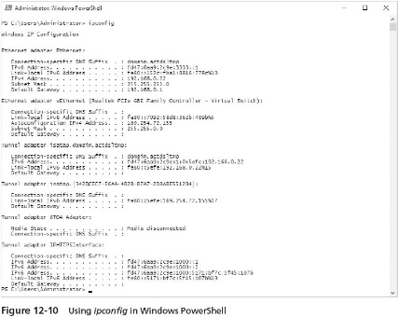
Command-Line Tools (2 of 4)

Slide 33
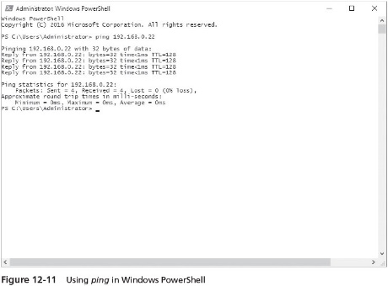
Command-Line Tools (3 of 4)

Slide 34
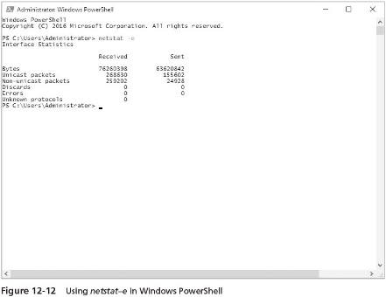
Command-Line Tools (4 of 4)

Slide 35
Graphical Tools (1 of 2)
You can use a GUI (graphical user interface) tool for diagnosing and repairing network problems
The Network Connections window
Use to disable and then enable network connections
Doing so resets the NIC and the TCP/IP connectivity to make sure you have a clean connection
You can also use the Network Connection window to diagnose a network problem

Slide 36
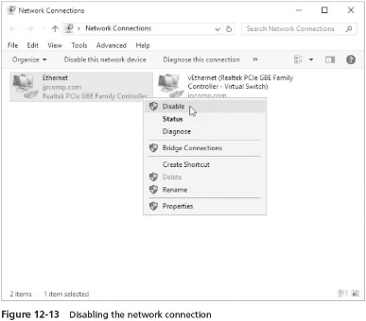
Graphical Tools (2 of 2)

Slide 37
Using the System Configuration Tool (1 of 2)
Some server administrators like using the system configuration tool, msconfig
To help troubleshoot a problems
Start msconfig
By typing this command in the Windows PowerShell or Command Prompt windows
The System Configuration window has five tabs:
General
Boot
Services
Startup
Tools

Slide 38
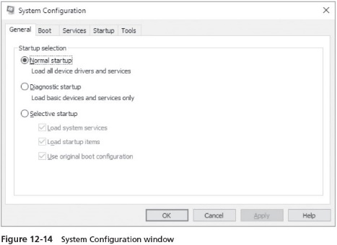
Using the System Configuration Tool (2 of 2)

Slide 39
Remotely Administering a Server (1 of 3)
It is useful for server administrators to be able to remotely access a server in order to solve a problem
Use the Remote Desktop client to remotely access and manage the server
Such as through a VPN server or Internet connection
You can configure Remote Desktop using Server Manager
Or the System applet in Control Panel to access the System Properties dialog box
Click Allow remote connections to this computer and Allow connections only from computers running Remote Desktop with Network-Level Administration

Slide 40
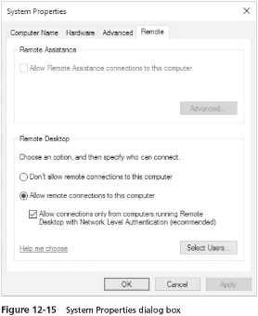
Remotely Administering a Server (2 of 3)

Slide 41
Remotely Administering a Server (3 of 3)
Configure a strong password for the account from which you perform administration
Microsoft defines the following characteristics of a strong password:
Contains seven or more characters (eight or more is better)
Does not reflect qualities about you that others might guess
Is not a word that could be found in a dictionary
Is changed at regular intervals without repeating a previously used password
Contains a combination of upper- and lowercase characters, numbers, and symbols

Slide 42
Remote Server Administration Tools (1 of 5)
Remote Server Administration Tools (RSAT)
Enable you to manage multiple servers from one Windows Server 2016 server
The Remote Server Administration Tools are offered through Server Manager
Role Administration Tools
A subset of the Remote Server Administration Tools automatically installed, but only for managing Active Directory DS, Active Directory LDS, and DNS Server
You can install more role management tools through Server Manager
The Remote Server Administration Tools enable you to manage roles and features that are installed on a server

Slide 43
Remote Server Administration Tools (2 of 5)
The Remote Server Administration Tools enable you to manage roles and features that are installed on a server
This includes the following role-based management tools:
Active Directory Certificate Services Tools
Active Directory Domain Services Tools
Active Directory Lightweight Directory Services Tools
Active Directory Rights Management Services Tools
DHCP Server Tools
DNS Server Tools
FAX Server Tools
File Services Tools
Hyper-V Management Tools
Network Controller Management Tools

Slide 44
Remote Server Administration Tools (3 of 5)
Role-based management tools (cont’d):
Network Policy and Access Services Tools
Print and Document Services Tools
Remote Access Management Tools
Remote Desktop Services Tools
Volume Activation Tools
Windows Deployment Services Tools
Windows Server Host Guardian Service Tools

Slide 45
Remote Server Administration Tools (4 of 5)
Remote Server Administration Tools also include the following tool sets, when the Feature Administration Tools subset is installed:
BitLocker Drive Encryption Tools
BITS Server Extensions Tools
Failover Clustering Tools
IP Address Management (IPAM) Client
Network Load Balancing Tools
Shielded VM Tools
SMTP Server Tools
Storage Replica Management Tools
WINS Server Tools

Slide 46
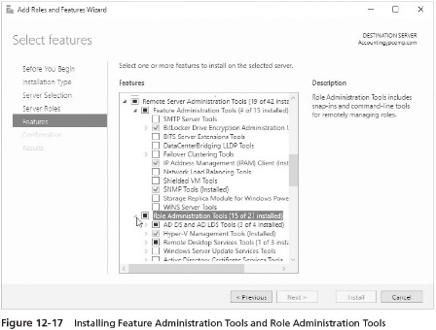
Remote Server Administration Tools (5 of 5)

Slide 47
Chapter Summary (1 of 2)
Before problems occur, develop a problem-solving strategy
Windows Server 2016 gives you the Advanced Boot Options menu for times when you have boot problems
The Repair Your Computer option on the Advanced Boot Options menu or using the same option from the Windows Server 2016 installation DVD offers tools to recover a system, or work with a system that won’t boot
Regularly perform a full backup, which includes system state data, so that you can fully recover a system that has failed
Event Viewer is a storehouse of logs from which you can monitor a system and diagnose problems

Slide 48
Chapter Summary (2 of 2)
Regularly use Event Viewer to monitor the contents of logs
Windows Server 2016 contains command-line and graphical tools for troubleshooting network connectivity problems
Windows Server offers Remote Server Administration Tools that enable you to manage a server remotely
You can use the Remote Desktop client capability to remotely manage a Windows Server 2016 server

