Slide 1

Hands on Gradle
Mushfekur Rahman
Associate Software Engineer
Therap BD Ltd.

Slide 2
Outline
Intro to build systems
Java build system evolution
Intro to Gradle
Gradle basics
Building Java project with Gradle
Build web app with Gradle
Building android app with Gradle
Tips & Tricks

Slide 3
Why Build Systems?
Your may need to share your code
You may grow old and forget stuff
IDEs change frequently
Makes life easier
Automate product development lifecycle
Validate
Compile
Test
Packaging (jar, war, ear, aar, apk…)
Deploy and/or Publish

Slide 4
What Are The Options?
Ant
Maven
Gradle

Slide 5
Ant
Stands for Another Neat Tool
Evolved from *NIX based build utility make
Pros
Task based build lifecycle
Concise build flow
Cons
Heavy XML (less maintainable)
Hard to reuse

Slide 6
Maven
Goal based system
Pros
Standard Project Structure
Project signature
Dependency Management
Release and distribution management
Cons
Loads of XML
Hard to implement custom behavior

Slide 7
Drum roll… Gradle!
General purpose Java build tool
Based on Groovy DSL (Domain Specific Language)
Founder – Hans Dockter
Maintained by Gradleware
Free and open source (published under Apache License 2.0)

Slide 8
Why Gradle?
Combines best of both worlds
Task based build flow (remember Ant??)
Robust dependency management (Maven)
Convention over configuration
Flexible, scalable, extensible
Plugins
Easy multi-project building
Awesome documentation

Slide 9

Who uses Gradle?

Slide 10
Gradle Basics
Installation
Make sure you have Java on your machine
Download (http://www.gradle.org/downloads)
Copy (/usr/local or C:\Users\Public\)
Add to system PATH (.bashrc, .bash_profile, environment variable)
… and voila!

Slide 11
Gradle Basics
Tasks
Fundamental unit of build activity
Tasks are Objects
Every task is a subclass of DefaultTask (like java.lang.Object)
task hello << {
println ‘hello’
}

Slide 12
Gradle Basics (cont.)
Properties of DefaultTask
doFirst
doLast
hello.doFirst {
println ‘before hello’
}
hello.doLast {
println ‘after hello’
}

Slide 13
Gradle Basics (cont.)
Task Dependency
Links two tasks
Used to create build lifecycle DAG
task hi(dependsOn: ‘hello’) << {
println ‘hi’
}

Slide 14
Gradle Basics (cont.)
Plugins
Collection of tasks
Reusable piece of build script
Example
jar
war
android

Slide 15
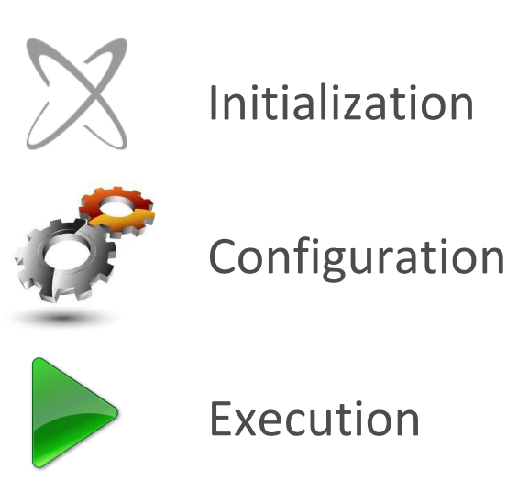
Gradle Basics (cont.)
Build lifecycle
Initialization
Initializes scope of a build
Identifies project environment
e.g. single or multi-module
Creates project instance
Configuration
Configures project objects
Execution
Determines subset of tasks
Runs the build

Slide 16
Gradle Basics (cont.)
Build scripts
build.gradle
settings.gradle
gradle.properties (optional)

Slide 17
*Hopefully* Your First Gradle Build
The Simplest Java Project (hello-gradle)
Project layout
Hello-gradle/
build.gradle
src/
main/
java/
resources/

Slide 18
Hello Gradle!
‘java’ plugin
http://www.gradle.org/docs/current/userguide/java_plugin.html
Tasks
Configure source set
Dependency management

Slide 19
SourceSet Configuration
A logical group of Java source codes and resources
Can be used to modify conventional project layout
sourceSets {
main {
java {
}
resources {
}
}
}

Slide 20
Dependency Management
One of the most critical part of a build system
Inherits from maven
Dependency scopes
Compile
Test
Runtime
Provided
System
<scope> <group_id>:<artifact_id>:<version>
dependencies {
compile ‘org.hibernate:hibernate-validator:5.1.1’
}

Slide 21
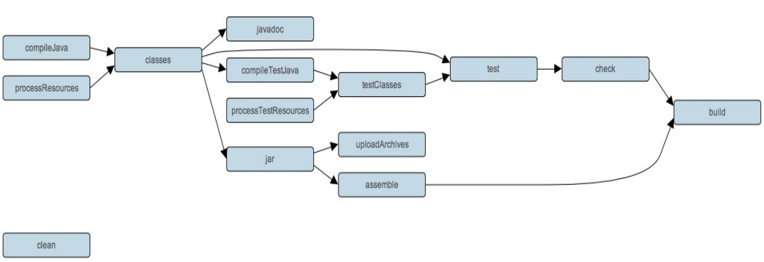
Java Plugin: Under The Hood

Slide 22
Building Web Apps
Let’s make a currency converter - BDT to USD
Project layout
Hello-gradle/
build.gradle
src/
main/
java/
resources/
webapp/
WEB-INF/
<style scripts>/

Slide 23
Building Web Apps
‘war’ plugin
Deploying our app
‘jetty’ plugin
gradle jettyRunWar

Slide 24
Building Android Apps
Currency converter for android
New android build system
http://tools.android.com/tech-docs/new-build-system/
Project layout
currency-converter/
settings.gradle
app/
src/
main/
java/
res/
AndroidManifest.xml
build.gradle

Slide 25
Building Android Apps (cont.)
‘android’ plugin
http://tools.android.com/tech-docs/new-build-system/user-guide
Tasks
Packaging options

Slide 26
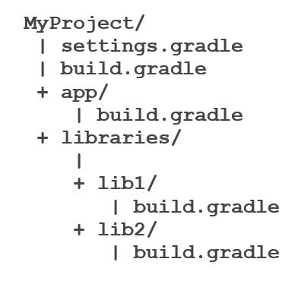
Building Library Projects
Project layout

Slide 27
Gradle Wrapper
How can I manage Gradle’s version?
What if I don’t have gradle installed on my machine?

Slide 28
Tips
Configuring build environment
gradle.properties
Try to get used to Terminal or command prompt
Pre-build library projects
Use from local repository
Saves time (time is money)

Slide 29
References
Official User Guide
http://www.gradle.org/docs/current/userguide/userguide.html
New android build system (Google IO 2013)
https://www.youtube.com/watch?v=LCJAgPkpmR0

Slide 30
Happy Building!

