Slide 1

Say ‘No’ to Sexual Harassment
Team 404:Name not Found
Abdullah Al Mamun
Phone No: 01717374611 Email Address: oronno@therapservices.net
Sharafat Ibn Mollah Mosharraf
Phone No: 01755529174 Email Address: sharafat@therapservices.net
Anindita Islam
Phone No: 01912063317 Email Address: anindita@therapservices.net
A N M Bazlur Rahman
Phone No: 01671865012 Email Address: bazlur@therapservices.net
Mushfekur Rahman
Phone No: 01622179659 Email Address: mushfekur@therapservices.net

Slide 2
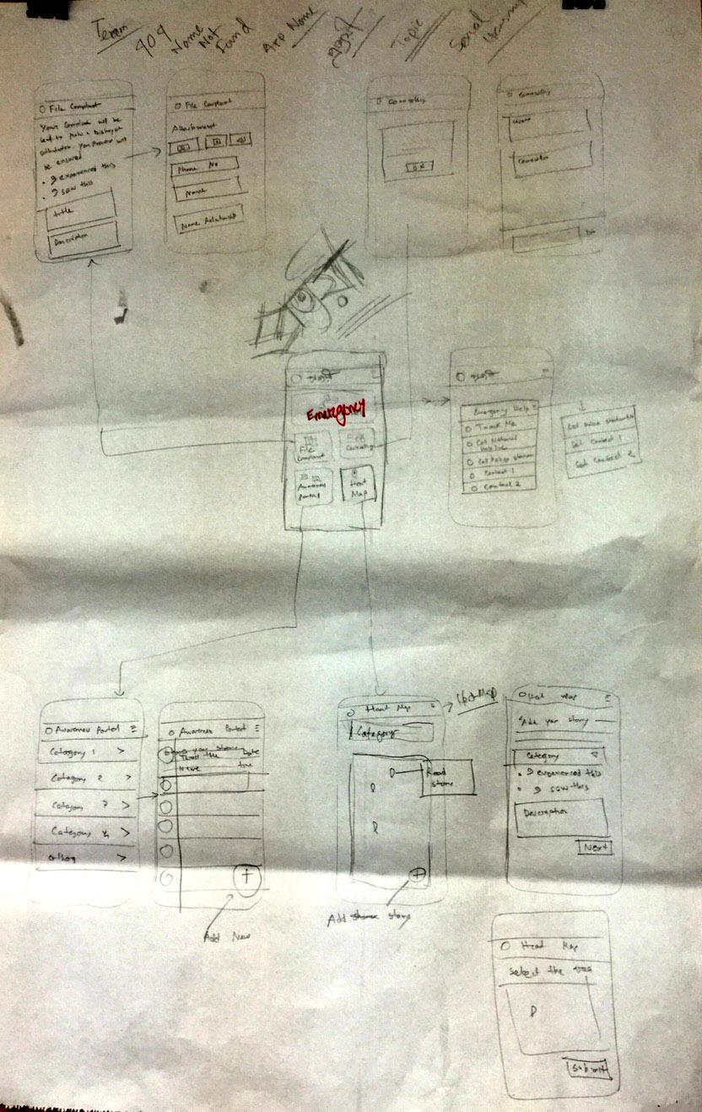
Prototype
Features:
Emergency Help
File Complaint
Counseling
Awareness Portal
Heat Map

Slide 3
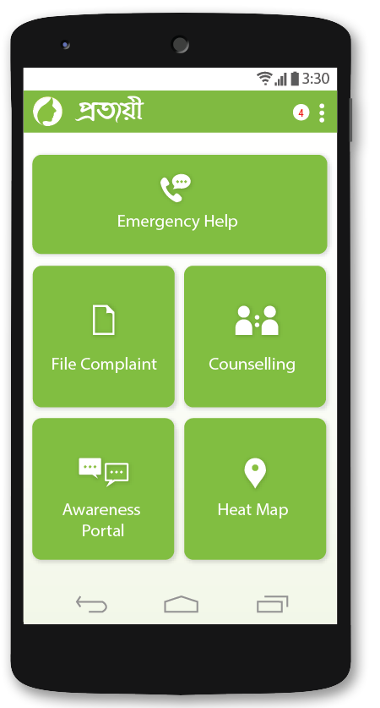
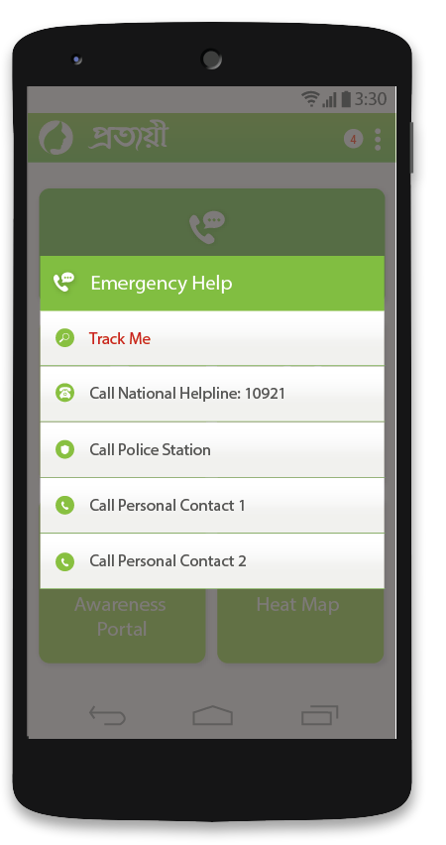
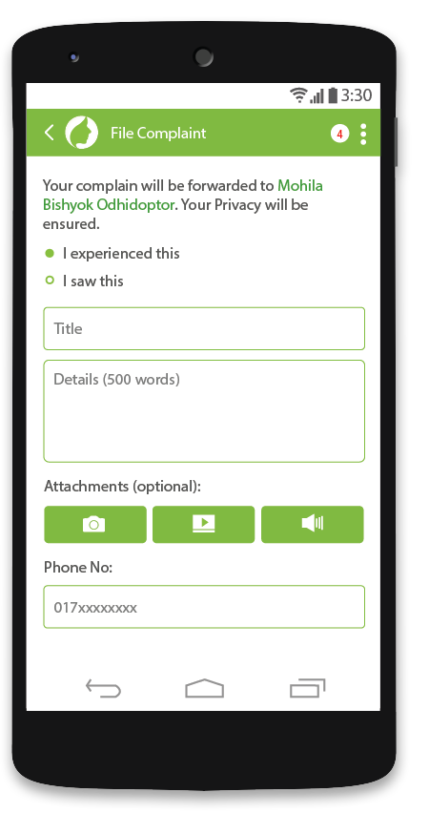
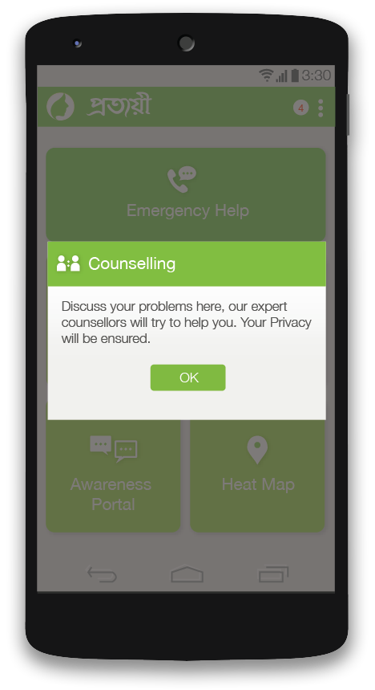
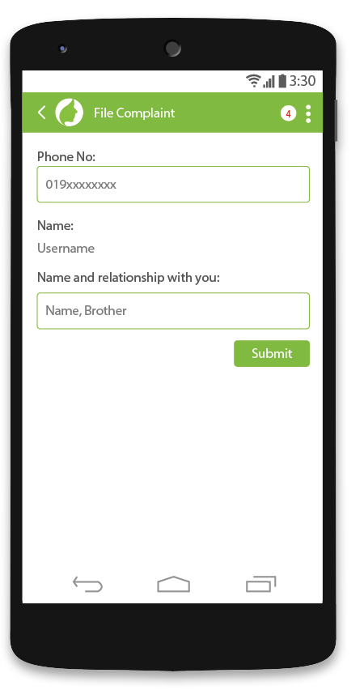
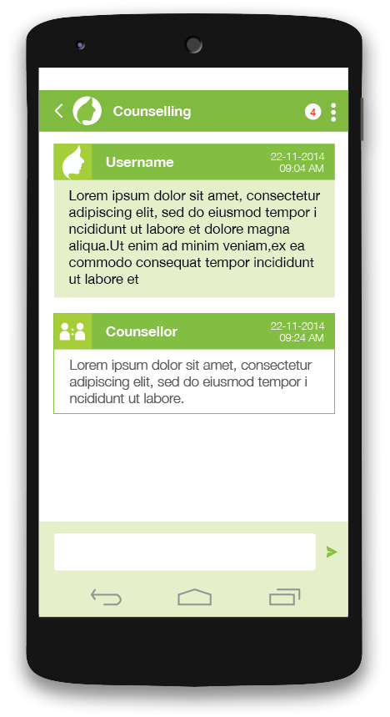
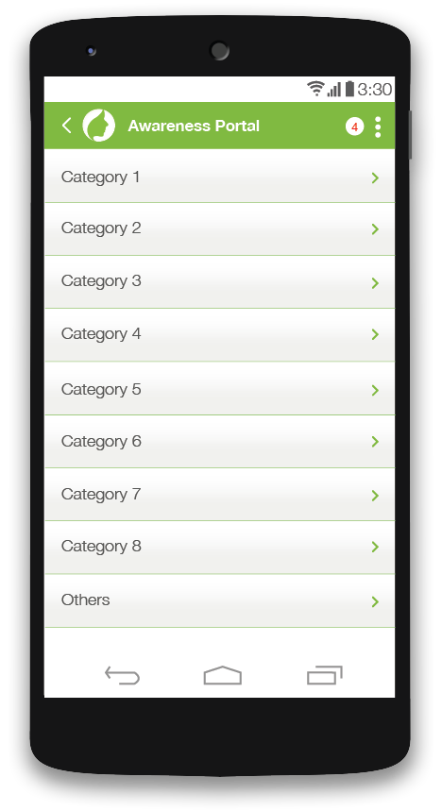
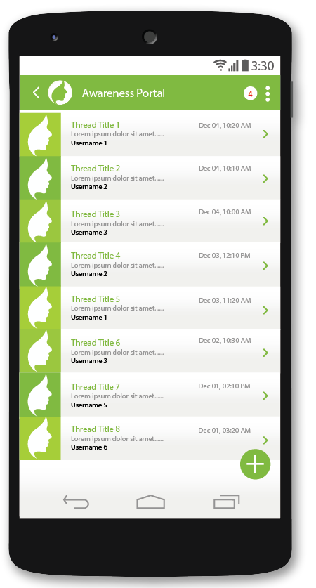
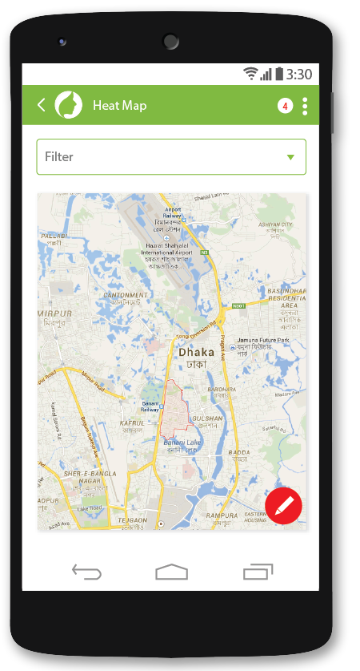
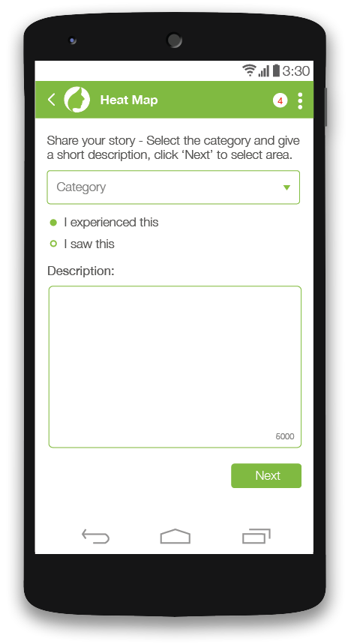
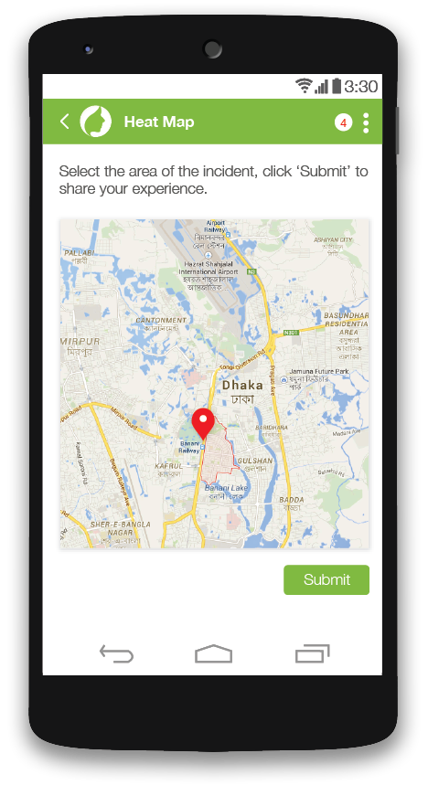

Slide 4
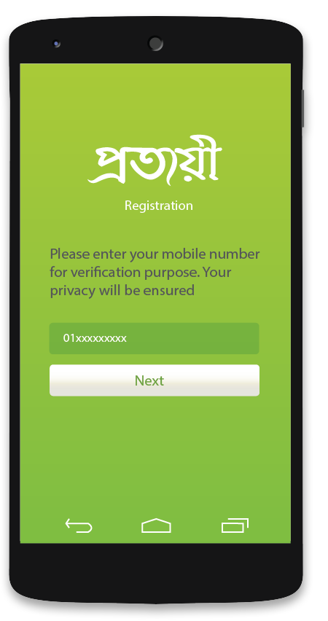

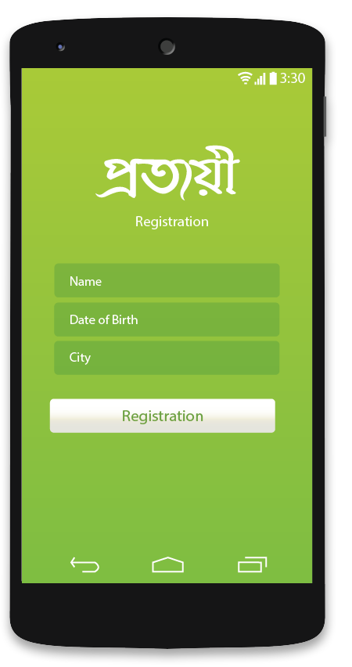

Registration and Verification

Slide 5
Features
Emergency Help
File Complaint
Counseling
Awareness Portal
Heat Map

Slide 6
Emergency Help
Tracking
Call National Helpline 10921
Call Nearby Police Station
2 Personal Contacts

Slide 7
File Complaint
Experience/saw
Title
Details
Attachments
Phone Number
Name
Name and Relationship (If others)

Slide 8
Counselling
Policy
User sends
Counsellor Replies

Slide 9
Awareness Portal
Categories
Other Categories
Read Thread
Reply to Thread
Write New Thread

Slide 10
Heat Map
Select category
Experienced/ Saw
Description
Select Area of Incident
Submit

