Slide 1
Lab 8, CS 112
Recursion
Review and Practice Examples

Slide 2
Recursion - Review
Way of programming in which a function calls itself until a condition is met:
Two parts:
Base case/ termination condition:
Define when to terminate the recursion
Recursive case:
Define the recursion function
If a problem can be broken down into multiple identical subproblems, and the result of the base case is a known constant value, you can use recursion to solve it.

Slide 3
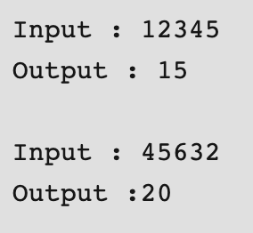
Practice 1 (Ungraded)
Given a number, compute the sum of its digits using recursion:
def sumDigit( n ):
if n == 0:
return 0
return (n % 10 + sumDigit(int(n/10)))
Copy/Paste the above code and try it out

Slide 4
Practice 2 (Ungraded)
Print a given string in reverse using recursion:
Input: "programming"
Output:
g
n
i
m
m
a
r
g
o
r
p
def print_reverse(str):
if len(str) == 0:
return
r = str[0]
print_reverse(str[1:])
print(r)
Copy/Paste the above code and try it out

Slide 5
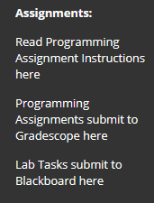
Lab Task 8
Name your file according to the format: gmuID_2XX_Lab8.py
Your gmuID is your netID not your G-number!
2XX means your lab section number.
Submit to the Lab 8 folder in the main
Blackboard course shell.

