Slide 1

The Development of Infrared Sensors and Its Application
COURSE INSTRUCTOR: MS. AJMIRI SABRINA KHAN
SEMESTER: SPRING 2021
MOHAMMED TOHA (1930615) Mushfiqur Alam Bhuiyan (2020301)

Slide 2
Introduction
Since the primary source of infrared radiation is heat or thermal radiation, any object which has a temperature radiates in the infrared radiation. And through this groundbreaking discovery scientist built such technology which can assist us in our day-to-day life. Infrared technology addresses a wide variety of wireless applications. The main areas are sensing and remote controls. In the electromagnetic spectrum, the infrared portion is divided into three regions: near infrared region, mid infrared region and far infrared region. Based on the range different types of IR sensors are made. An infrared (IR) sensor is an electronic device that measures and detects infrared radiation in its surrounding environment.

Slide 3
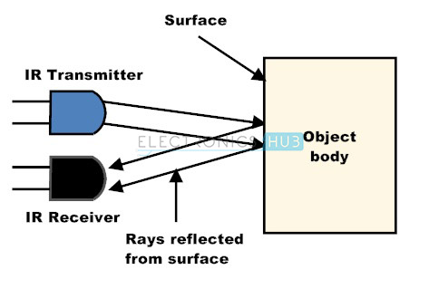
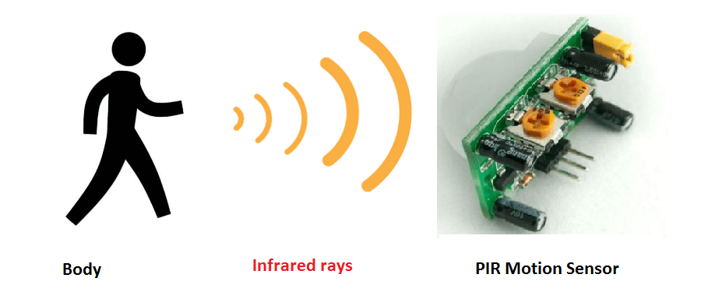
Different Types of IR Sensors
There are mainly two types of IR sensors:-
Active IR sensor:
Passive IR sensor:
This type of sensors emit IR radiation which is later detected by a receiver.
This type of Sensors can only detect IR radiation.

Slide 4
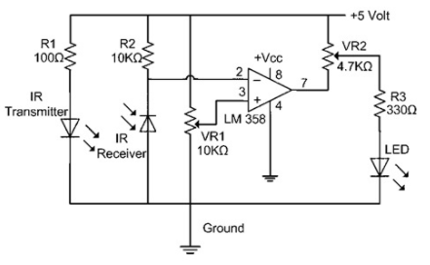
Circuit Analysis
In this project, the transmitter section includes an IR sensor, which transmits continuous IR rays to be received by an IR receiver module. An IR output terminal of the receiver varies depending upon its receiving of IR rays. Since this variation cannot be analyzed as such, therefore this output can be fed to a comparator circuit. Here an operational amplifier (op-amp) of LM 339 is used as a comparator circuit.

Slide 5
Development of IR sensors
A great British astronomer Sir William Herschel discovered infrared radiation and named it calorific rays in the 18th Century.
Lead sulfide, thermocouples and bolometers were the first infrared detectors Thermocouples – thermoelectric temperature measurement device Bolometers – device to measure the power of radiant energy
HgCdTe was used as the semiconductor for IR Sensors and is currently being used.

Slide 6
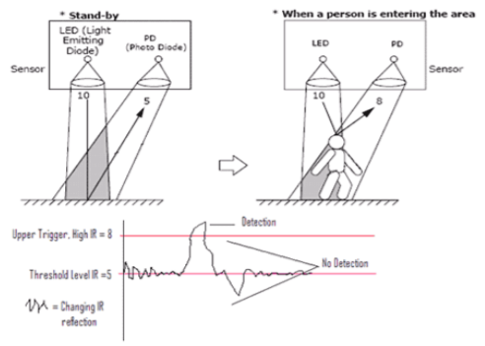
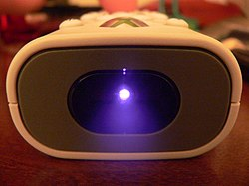
Application of IR Sensors
Burglar Alarm
IR remote control
One of the most widely used sensor application. This is an example of a direct incidence method which works like an item counter where IR sensor is used.
Its safe to say that almost all video and audio equipment can be used using IR sensor. This image down below is one of the examples of active IR sensor.

Slide 7
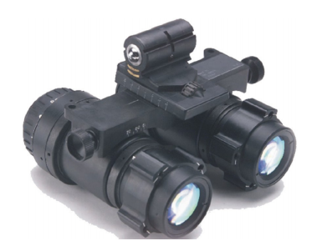
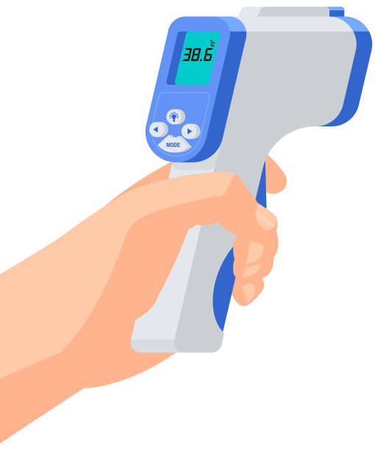
IR Goggles
Where there is no visible light, IR goggles can be used to create a colored image from the heat radiation emitted by other objects. It is mainly used for military applications.
IR Thermometer
The most common device which we come across these days. This thermometer uses the basic fundamentals of passive infrared sensors.

Slide 8
Conclusion

