Slide 1
Employee salary PREDICTION
CAPSTONE PROJECT
Presented By:
1. Kumari Mushkan – ICEAS – Dept. of AI & ML

Slide 2
OUTLINE
Problem Statement
System Development Approach
Algorithm & Deployment
Result
Conclusion
Future Scope
References

Slide 3
Problem Statement
Predict whether an employee earns >50K or ≤50K based on demographic and work features like age, education, job role, hours/week, etc. This problem helps organizations estimate salary classes for new hires. The dataset used is the UCI Adult Income Dataset. The goal is to build a classification model to assist HR & analytics teams.

Slide 4
System Approach
The system was developed using Python and deployed via Streamlit to create an interactive web application. It follows a full machine learning pipeline — from data preprocessing to training multiple classification models and deploying the best one.
System Requirements
Hardware: Basic system with 4GB+ RAM
Software:
Python 3.8+
VS Code or Jupyter Notebook
Streamlit for UI deployment

Slide 5
System Approach
Libraries Required
pandas - data loading & manipulation
numpy - numerical computations
scikit-learn - model building & evaluation
Streamlit - interactive frontend app
matplotlib / seaborn - data visualization

Slide 6
System Approach
Models Used
The following classification models were implemented and compared:
Logistic Regression – A linear model used for binary classification
Random Forest Classifier – An ensemble model that uses multiple decision trees
K-Nearest Neighbors (KNN) – A distance-based model that classifies based on nearest data points
Support Vector Machine (SVM) – A model that finds the optimal boundary between classes
Gradient Boosting Classifier – An advanced boosting model that combines weak learners sequentially for high accuracy

Slide 7
Algorithm & Deployment
Data Collection:
Loaded the UCI Adult Income dataset (adult.csv) for salary prediction analysis.
Data Cleaning & Preprocessing:
Replaced missing values (?) with "Others"
Removed irrelevant job categories like "Never-worked" and "Without-pay"
Encoded categorical variables using LabelEncoder/OneHotEncoder

Slide 8
Algorithm & Deployment
Exploratory Data Analysis (EDA):
Viewed distributions using value_counts()
Detected outliers using box plots
Checked correlations and feature relationships
Model Selection:
Trained and compared 5 ML models:
Logistic Regression
Random Forest
KNN
SVM
Gradient Boosting

Slide 9
Algorithm & Deployment
Model Training:
Split data into train/test sets
Trained models using scikit-learn
Evaluated using accuracy and performance metrics
Streamlit App Development:
Built an interactive web app using Streamlit
Added input forms and CSV file upload option
Displayed prediction results dynamically
Deployment:
Ran app locally using streamlit run app.py

Slide 10
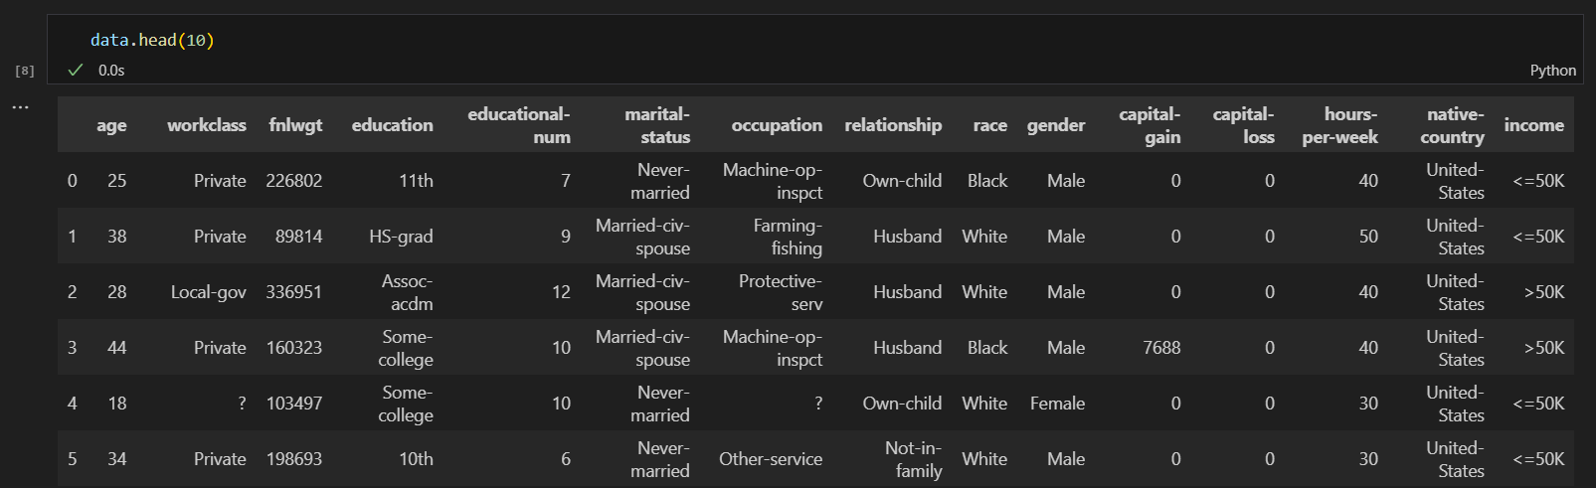
Result
GitHub Repository Link: https://github.com/mushkan24/Employee_Salary_Prediction

Slide 11
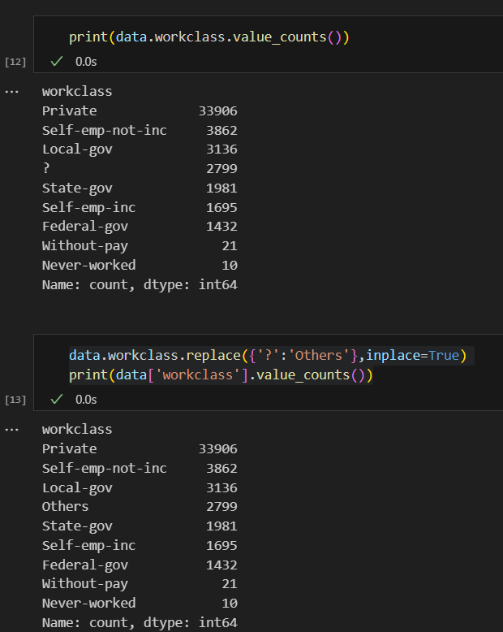
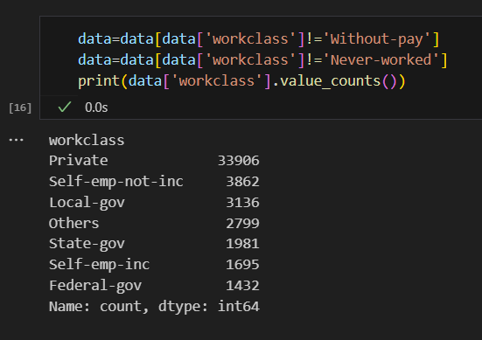
Result

Slide 12
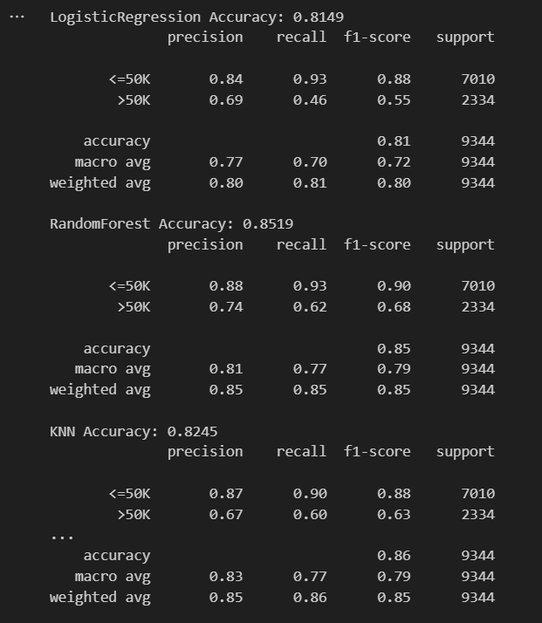
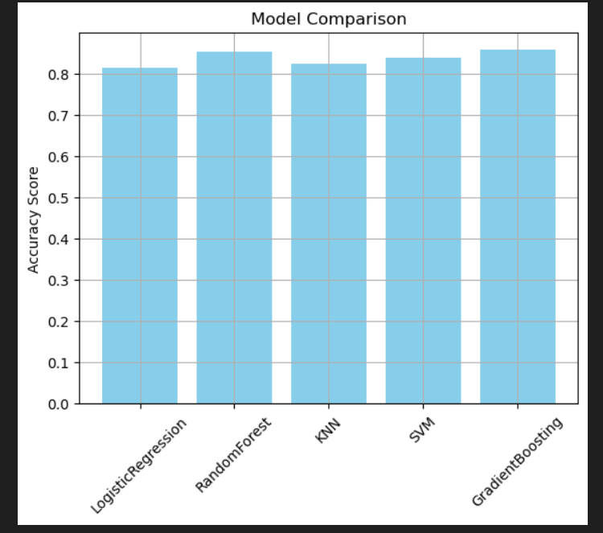
Result

Slide 13
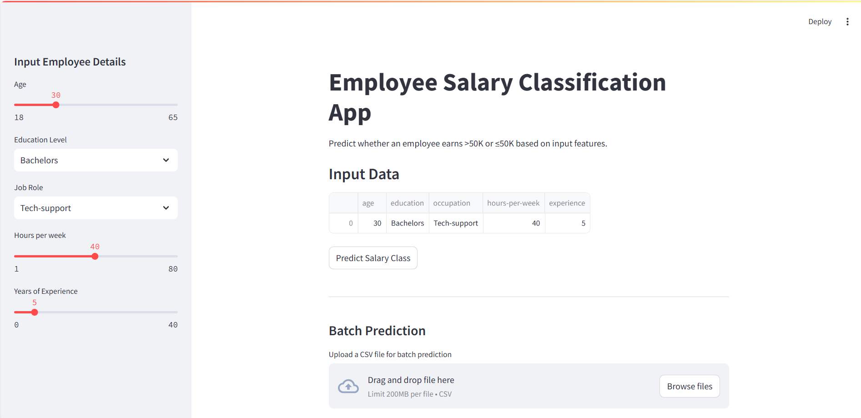
Result

Slide 14
Conclusion
This project successfully predicts whether an individual earns more than ₹50K using machine learning models trained on demographic and employment data.
Gradient Boosting and Random Forest delivered the highest accuracy. Data cleaning and feature encoding played a key role in model performance.
The Streamlit app made the system user-friendly and interactive. Challenges included handling missing values, encoding categorical features, and integrating the model into a web interface.
Future improvements can involve hyperparameter tuning, model explainability tools, and deploying the app to the cloud.

Slide 15
Future scope
Deploy the Streamlit app on Streamlit Cloud or Heroku for wider access
Integrate advanced ensemble models like XGBoost or LightGBM for improved accuracy
Implement model explainability using SHAP or LIME to understand predictions
Add real-time data input via API or user-uploaded files
Build a dashboard to visualize predictions and insights
Expand the system to handle multi-class salary brackets
Include a user authentication system for secure access

Slide 16
References
UCI Machine Learning Repository – Adult Income Dataset
Scikit-learn Documentation – https://scikit-learn.org/stable/
Streamlit Documentation – https://docs.streamlit.io/
IBM SkillsBuild – Project Learning Materials
Stack Overflow – For resolving code-related errors

Slide 17
THANK YOU

