Slide 1
HUMAN AGE, EMOTION, GENDER RECOGNITION
Group Members-
Shubham Pawar
Aditya Sable
Atharva Vaidya
Project Guide-
Prof. Archana Kotangale

Slide 2
INTRODUCTION
A face emotion recognition system comprises of two step process i.e. face detection (bounded face) in image followed by emotion detection on the detected bounded face.
The following technique is used for respective mentioned tasks in face recognition system.
Haar feature-based cascade classifers : It detects frontal face in an image well.

Slide 3
ABSTRACT
Emotions play a very significant role in conveying what we think.
Research has shown that almost 90% of our communication can be non-verbal.
The overall body language coupled with emotions could help to effectively recognize the thought process. Hence recognizing emotions becomes a vital task.
There a seven types of emotions namely, happy, sad, anger, smile, neutral,disgust and fear. To effectively identify these would help to decipher the thinking. Hence the importance and need of recognising emotions is growing rapidly.
Machine Learning and Artificial intelligence has enabled us to recognize emotions.
Understanding contextual emotion has widespread consequences for society and business. In the public sphere, governmental organizations could make good use of the ability to detect emotions.

Slide 4
PROBLEM STATEMENT
To build an emotion,age and gender recognition system in which when system detects user’s face it will be able to effectively classify user’s characteristics.

Slide 5
OBJECTIVES
To be able to recognize human emotions, age, gender effectively.
To be able to distinguish between the different characteristics.
To focus on optimizing the resources.

Slide 6
OBJECTIVES
To be able to recognize human emotions, age, gender effectively.
To be able to distinguish between the different characteristics.
In particular cases to be able to predict the future action of the individual.
To focus on optimizing the resources.

Slide 7
SCOPE
In this project, we introduce an approach to classify emotion, gender and age from images of human faces.
The thoughts of humans are effectively conveyed through emotions which are often uncertain and situation dependent.
Automatic detection can help to recognise human behaviour in real time and avert unwanted events.
This project is a continuation of previous year’s project which was specifically regarding emotion recognition.
The project is based on real time analysis and we hope to complete it by the end of the year.

Slide 8
LITERATURE SURVEY
Image are the most direct and most natural channels that people acquire information. If achievements in these two fields are applied on robots that can great improve the intelligence of the machine.
In practice, in image recognition we will encounter the feature selection problem. Common image features are composed of color feature,texture feature, shape feature, spatial relations characteristics. Sometimes in order to acquire a better final result, these characteristics also be integrated appropriately.
CNN is a specially designed multi-layer perceptron to identify two-dimension shapes.

Slide 9
LITERATURE SURVEY(CONT.)
Therefore dimensional information retained in waveform points is effectively utilized by CNN.
CNN model due to its characteristics of adaptive feature extraction.
References
https://ieeexplore.ieee.org/document/7985780
https://ieeexplore.ieee.org/document/7550778

Slide 10
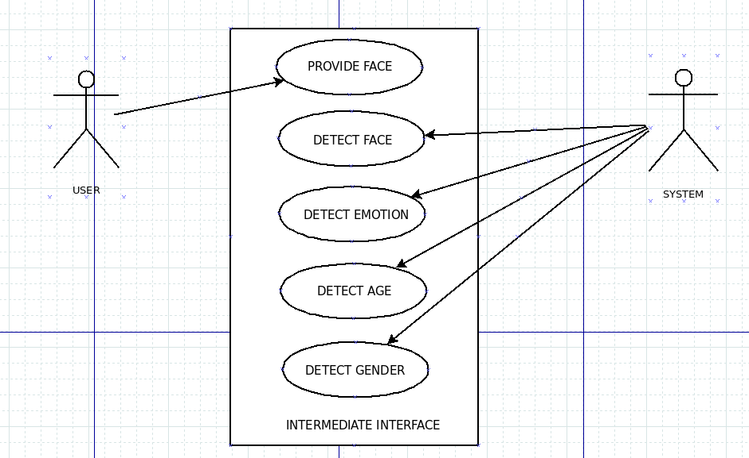
Use Case Diagram

Slide 11
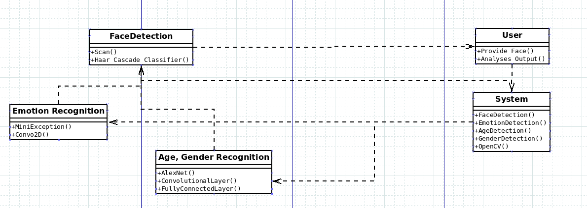
Class Diagram

Slide 12
TECHNOLOGY STACK
Tensorflow
Google collab
Python flask

Slide 13
APPLICATIONS
• Health Care: It would help to decide when patients need medicine or to help out physicians determine who to see first.
• Automobile Industry: In their pursuit to build more smart car features, it makes sense for car manufacturers to use ML to help them understand the human emotions. Using facial emotion detection smart cars can alert the driver when he is feeling drowsy.
•Video Game Testing: Video games are designed with a specific target audience in mind and aim to evoke a particular behavior and set of emotions from the users.
• Security: It could be used for detecting malicious behaviour which show distinct facial charateristics.

Slide 14
THANK YOU!

