Slide 1
The Battle of the Neighbourhoods
Melbourne

Slide 2
introduction
When people move to a new city, there are a lot a of obstacles and difficulties in their ways. One of the main challenges is to find a suitable neighbourhood. Each neighbourhood is suitable for some groups of people according to their preferences and financial ability. In this project, I would suggest a neighbourhood to a user by asking them five multiple choice questions and how much they can afford to pay for housing.

Slide 3
Where the data from ?
Foursquare location data: Foursquare is a local search-and-discovery service. it features a developer API that lets third-party applications make use of Foursquare’s location data. I use this API to search and find out about different venues and their categories of each neighbourhood.
Melbourne Housing Snapshot: I download this dataset from Kaggle.com to understand the price of houses in Melbourne. This dataset contains a lot of features but I only use the ‘price’ to normalize housing price and location of the house.

Slide 4
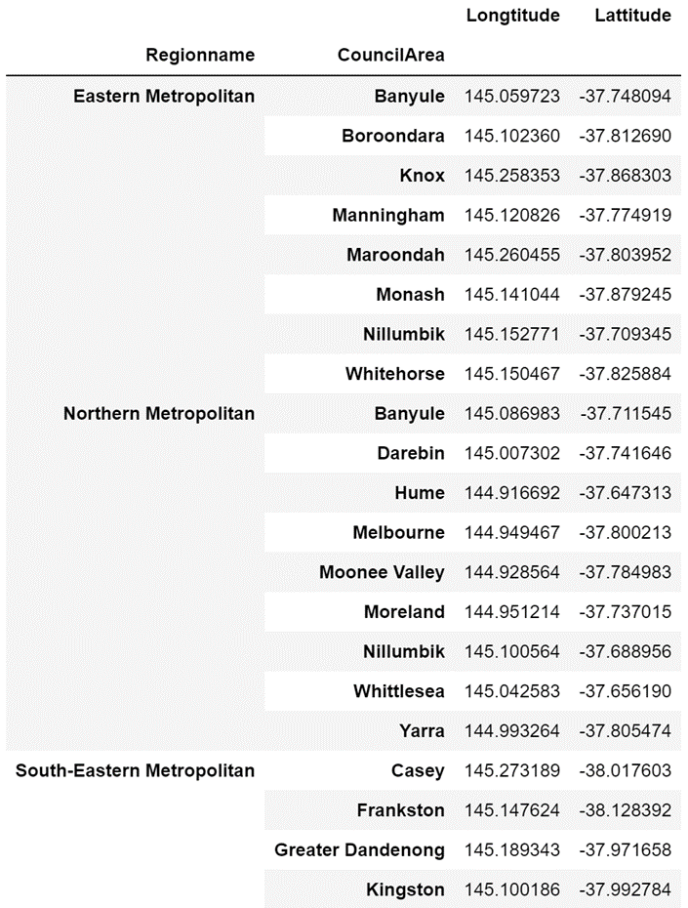
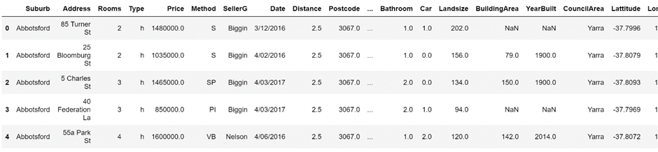
Dataset after cleaning

Slide 5
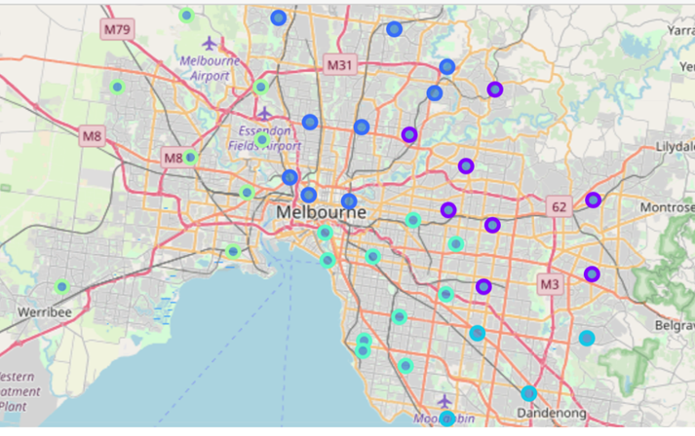
Neighbourhoods visualisation
Different Colour Represents Different Regions

Slide 6
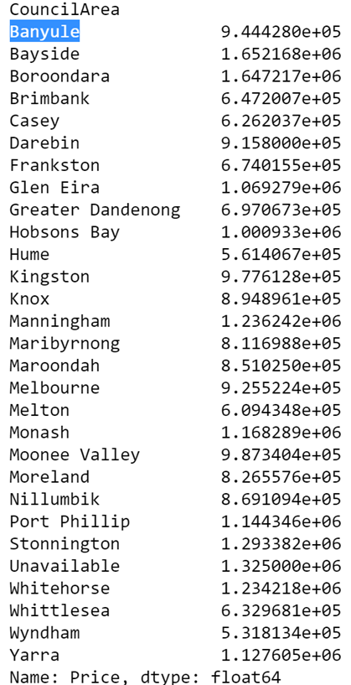
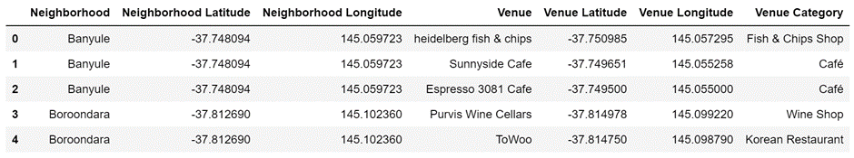
Mean housing price & venues in neighbourhoods

Slide 7
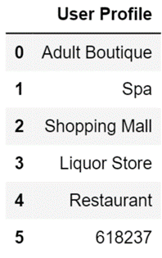
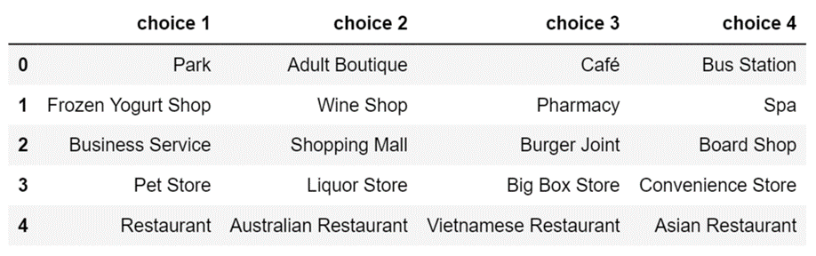
content-based recommendation system – example result

Slide 8
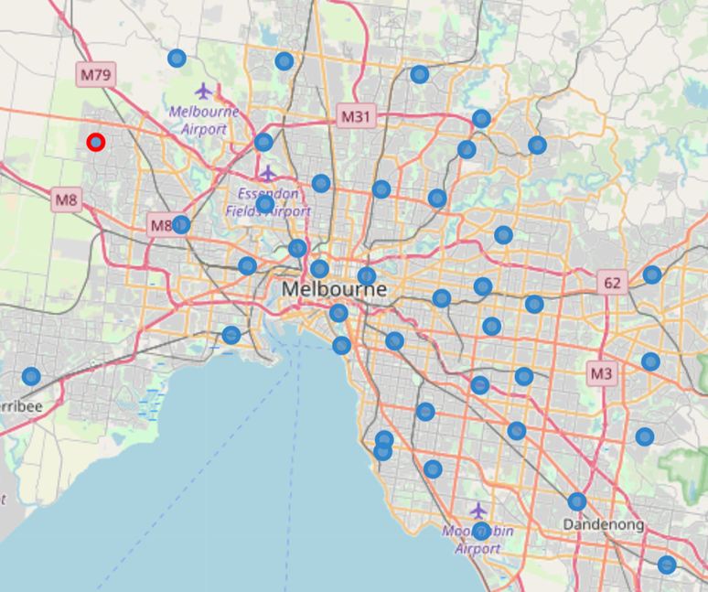
The best neighbourhood – MELTON

Slide 9
RECOMMENDATION
This project can be further improved by engaging more features like rent price, distance from point that user can choose, rate of crime, etc.
We can also take rural areas into consideration, to make the results more well-rounded, and fit different users’ requirements.
This project can be adapted to other cities as well. For example, use Paris’s data instead for people who plan to move to Paris.

Slide 10
THANKS ☺

