Slide 1

Python
Working with Databases

Slide 2
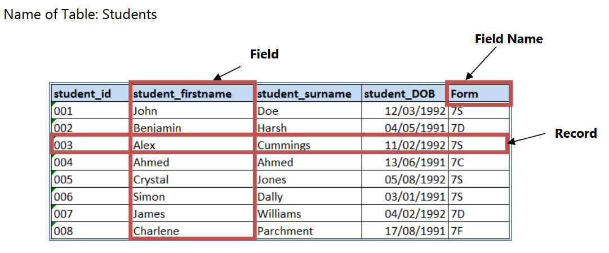
Database Basics

Slide 3
SQL
Commands and Pseudocode examples

Slide 4

Structured Query Language (SQL)
We will discuss the following statements available in SQL:
CREATE TABLE – this will create a table in a database
SELECT – display data that is in a table in a database
UPDATE – change data in a table in a database
DELETE – remove data from a table in a database
INSERT INTO – insert new data into a table in a database

Slide 5
The CREATE TABLE Statement
We first use the CREATE TABLE statement to create the table that we will be using as a running example.
Syntax:
CREATE TABLE <table_name>
(
<field_name> <data_type>,
<field_name> <data_type>,
<field_name> <data_type>
)
<table_name> is the name of the table to be created in the database.
<field_name> is the name of the column to be created in the table.
<data_type> is the data type of the column

Slide 6
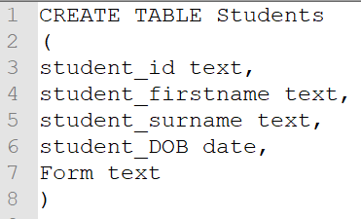
The CREATE TABLE Statement - Example
This will create the following table called "Students" in the database

Slide 7
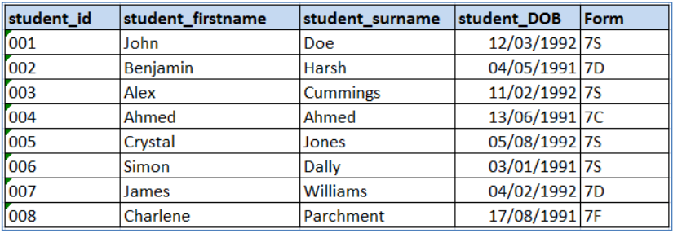
Example Data
For the rest of the SQL section, we will use the following table as our running example.

Slide 8
The SELECT Statement
The SELECT statement is used to display data in a table. We can view all the data, or we can specify a
criterion, in which case only data that meets the criteria will be displayed.
Syntax:
SELECT <field_name> FROM <table_name>
<field_name> is the name of the column to be selected.
<table_name> is the name of the table in the database.

Slide 9
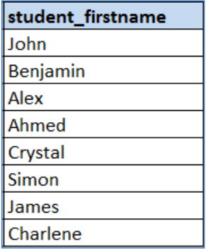
The SELECT Statement - Example 1
Example:
SELECT student_firstname FROM Students
This will produce the following output:

Slide 10
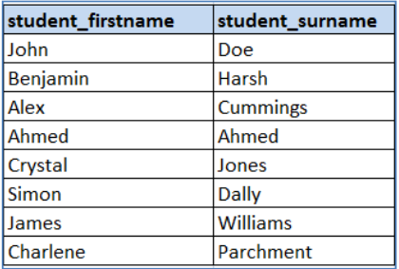
The SELECT Statement - Example 2
Example:
SELECT student_firstname, student_surname FROM Students
This will produce the following output:

Slide 11
The SELECT Statement - Example 3
This select statement would produce the entire table
SELECT student_id, student_firstname, student_surname, student_DOB, Form FROM Students
But this is very inefficient so instead it is quicker to use the wildcard (*)
SELECT * FROM Students

Slide 12
The WHERE Clause
The "Where" clause is used in conjunction with the select statement; this is used to specify a criteria in
the selection.
Syntax:
SELECT <field_name> FROM <table_name>
WHERE <field_name> operator <value>
<field_name> is the name of the column to be selected
<table_name> is the name of the table in the database
operator is an operator such as < or !=
<value> is any legal value that can be stored in the field name selected

Slide 13
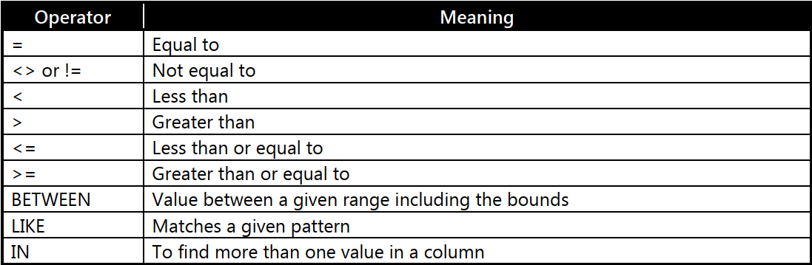
The WHERE Clause - Operators
The operators that you can use are shown in the table below.

Slide 14
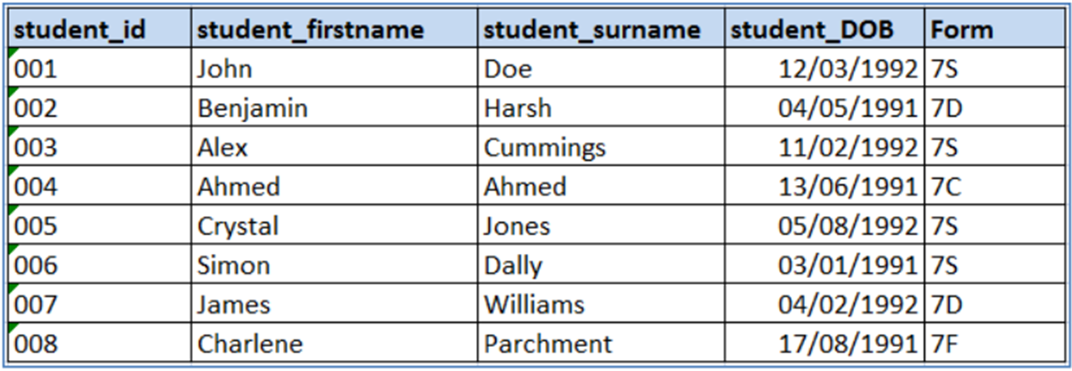
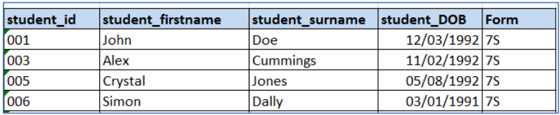
The WHERE Clause - Example
Example:
SELECT * FROM Students
WHERE Form='7S'
This will produce
Notice that '7S' requires single quotation marks as the data type is text.
There is no need for quotation marks if the data type is numeric.

Slide 15
The UPDATE Statement
This statement is used to change records by updating them in a table in a database.
Syntax:
UPDATE <table_name>
SET <column1> = value1, <column2>=value2, ...
WHERE <field_name> = value
<table_name> is the name of the table in the database.
<column1> is the first column to be updated.
<column2> is the second column to be updated.
<field_name> specifies the record to be updated.
Note that the WHERE clause specifies the particular record to be updated.
If this is left blank, then all the records will be updated.

Slide 16
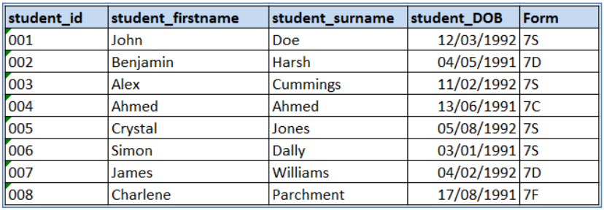
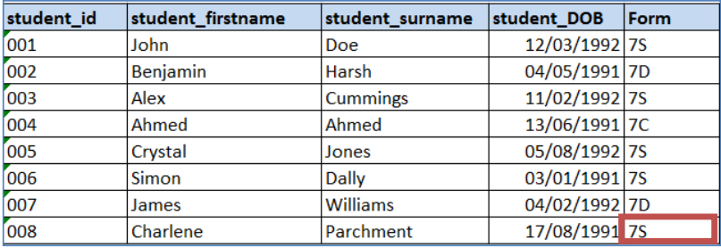
The UPDATE Statement - Example
Before the update:
UPDATE Students SET Form = '7S' WHERE student_firstname='Charlene'
After the update:
Notice that the Charlene is now in form 7S.

Slide 17
The DELETE Statement
This statement is used to remove records from a database.
Syntax:
DELETE FROM <table_name>
WHERE <field_name> = value
<table_name> is the name of the table in the database.
<field_name> = value specifies the record to be deleted.

Slide 18
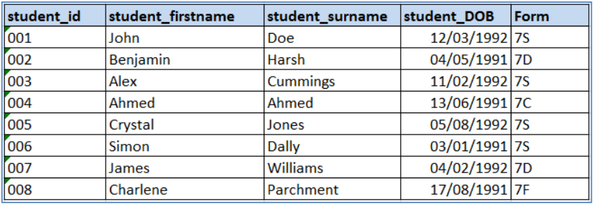
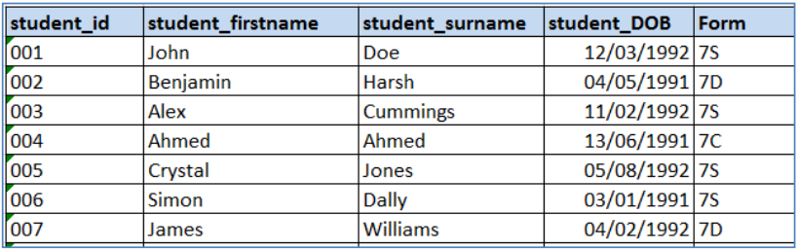
The DELETE Statement - Example
Before the delete statement:
Example
DELETE FROM Students
WHERE student_firstname=’Charlene’
After the delete statement:

Slide 19
The INSERT INTO Statement
The insert into statement is used to insert a new record into a database.
Syntax:
INSERT INTO <table_name> (column1, coulmn2, column3, ...)
VALUES (value1, value2, value3, ...)
<table_name> is the name of the table in the database.
column is the column into which the value should be inserted.
value is the value to be inserted into the matching column.
Note that the column is optional, but SQL will insert the values into consecutive columns if they are omitted. Specifying the column is a good way to insert data into non-consecutive columns.

Slide 20
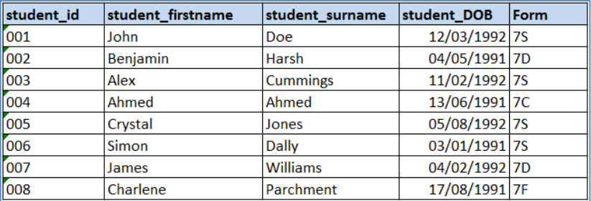
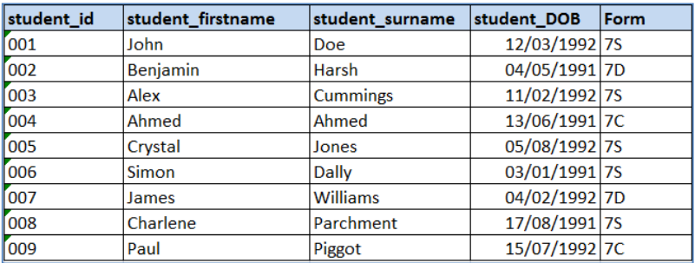
The INSERT INTO Statement
Before the insert into statement:
Example:
INSERT INTO Students
VALUES (‘009’, ‘Paul’, ‘Piggot’, ‘15/07/1992’, ‘7C’)
After the insert into statement:
We could have used the field name to specify the columns where we want the data to be inserted, but in this case we want to insert it into all columns and therefore it is not necessary.

Slide 21
SQL and Python
Using SQLite3

Slide 22


SQLite3 - Import Library
If you wish to use SQL when programming in Python you can import the sqlite3 library.

Slide 23
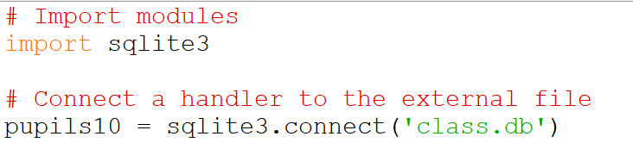
SQLite3 - Connect
Similar to when we connected to files, we need to have a handler in our program that interacts with the physical database saved on our hard disk.
We use the connect() function to do this
The database will be created in the same folder that your Python program is saved.

Slide 24
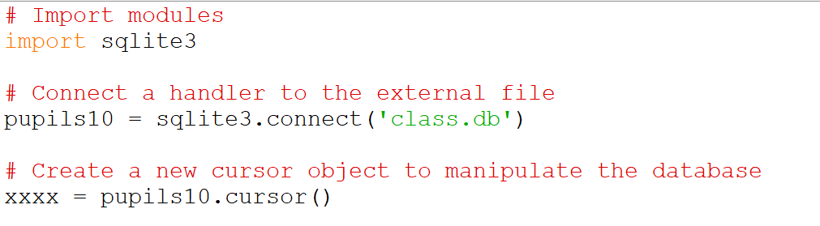
SQLite3 - Create Cursor Object
The cursor object allows us to work with and manipulate databases.
In this case the curser is called xxxx and now that we have a connection to our database and a cursor object, we can execute SQL statements to create our table and insert data into our tables.

Slide 25
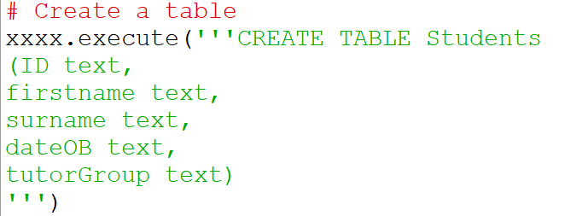
SQLite3 - Create a table
In this example we will create a database of students.

Slide 26
SQLite3 - INSERT INTO statement to populate the table
Next, we use the INSERT INTO statement to insert values into our table.

Slide 27
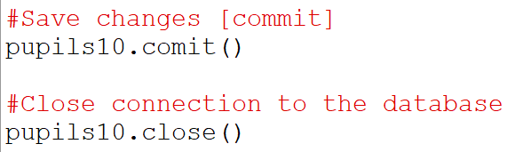
SQLite3 - Commit and Close
We use the commit() statement to save/commit the final transaction and finally close the database.

Slide 28
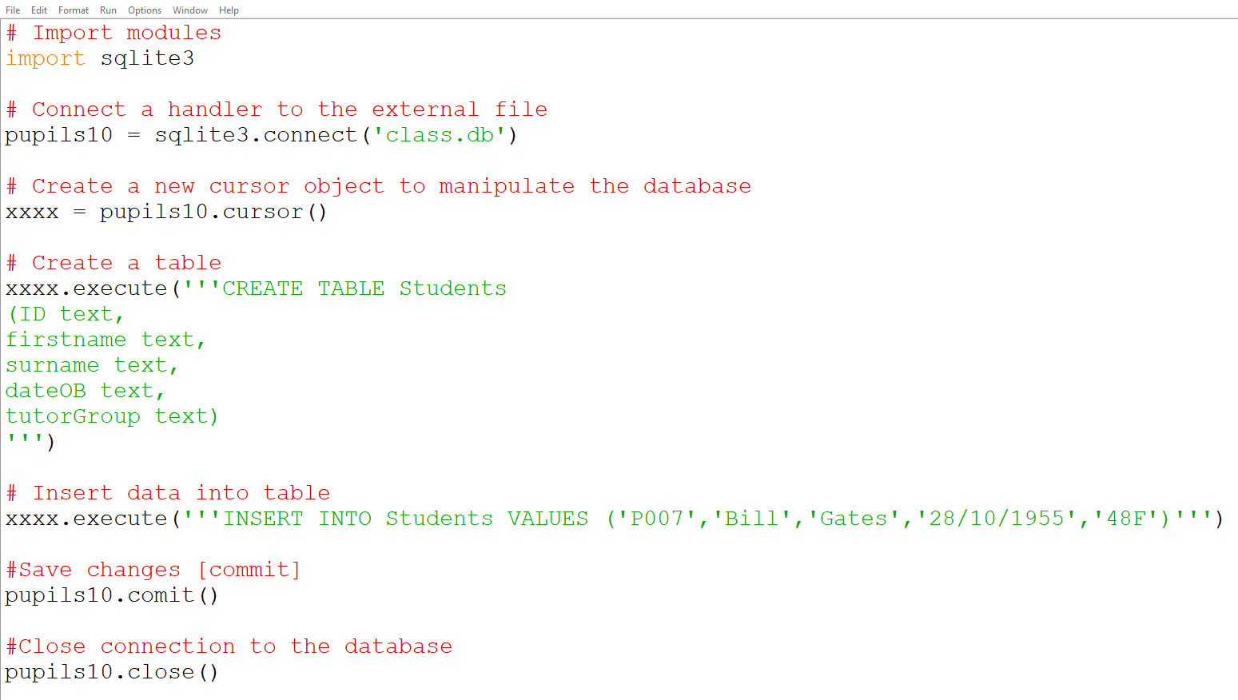
SQLite3 - So Far

Slide 29

SQLite3 - So Far
We can, however, use Python to read the data from this file and print this data to the screen.
http://inloop.github.io/sqlite-viewer/

Slide 30
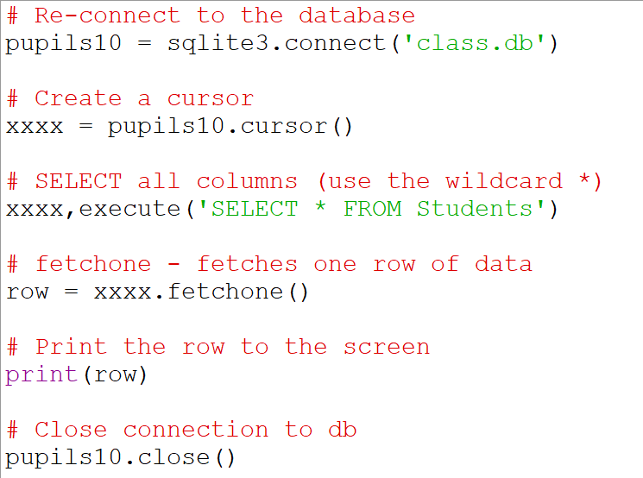
SQLite3 - Using Python

Slide 31
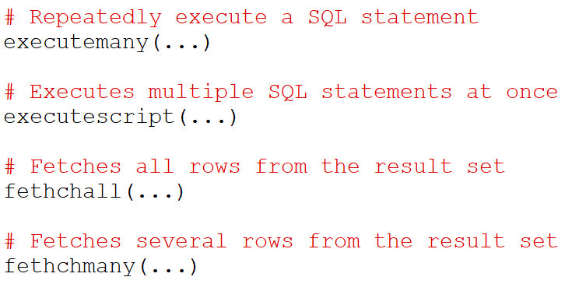
SQLite3 - Using Python
Here are some other functions defined on the object cursor and a description of what they do.

Slide 32
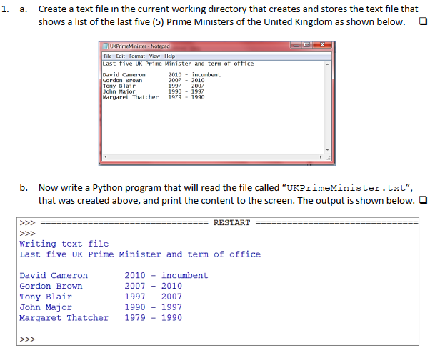
Exercises

