Slide 1

Date started | Date completed
12/03/2019

Slide 2
Analysis

Slide 4
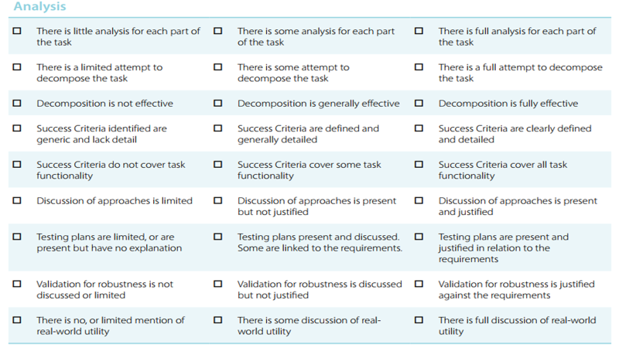

Slide 5
Success Criteria:
x
x
x

Slide 7

Design

Slide 9
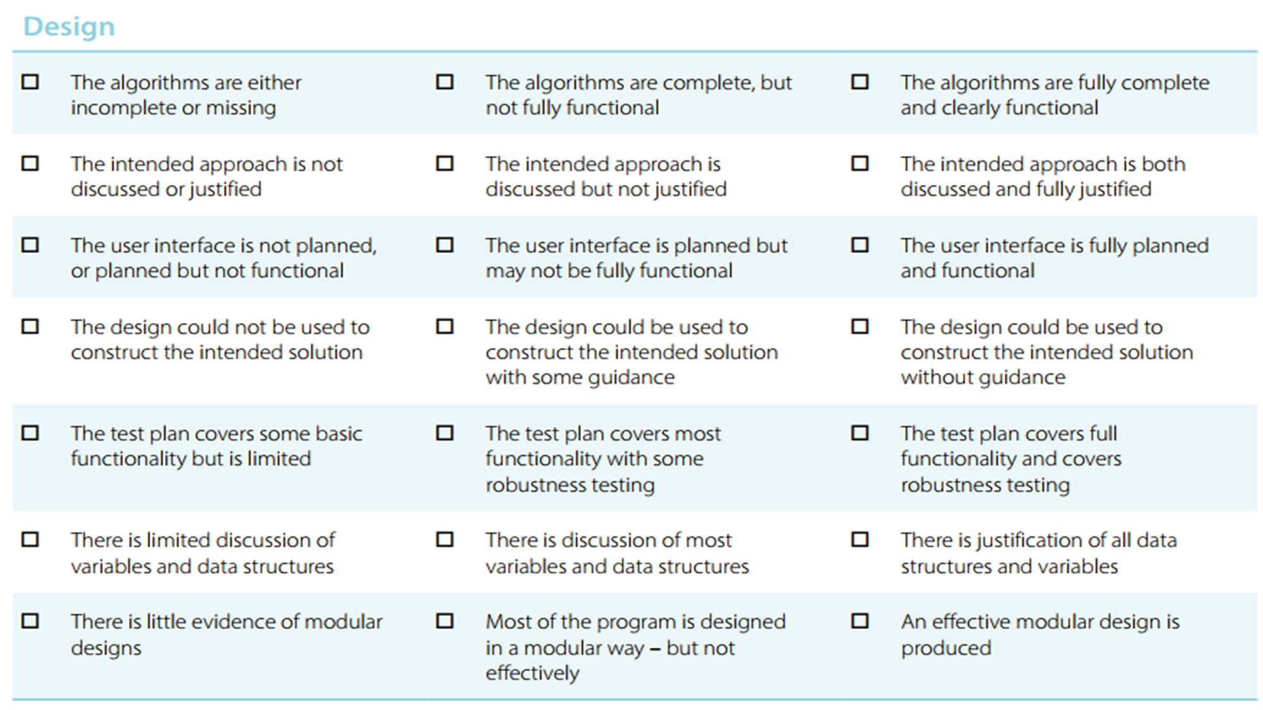

Slide 11
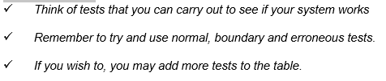
Test design
Test | What am I testing? | What data will I use? | Normal/Boundary/Erroneous? | Expected Result
1
2
3
4

Slide 12

Development

Slide 13
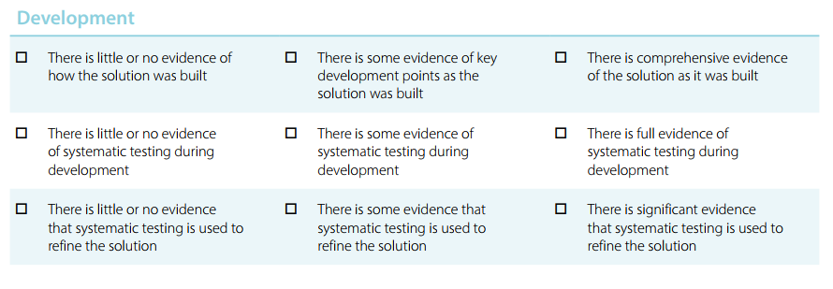

Slide 16
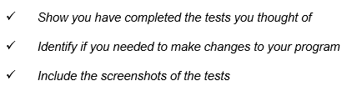
Testing

Slide 17
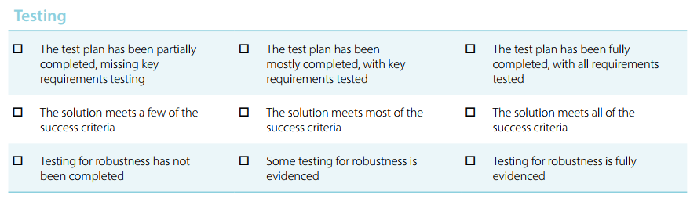

Slide 18
My tests:
Test | What am I testing? | Expected result | Pass/Fail | Do I need to change my program? If so, how?
1
2
3
4
5

Slide 19
Test Evidence

Slide 21
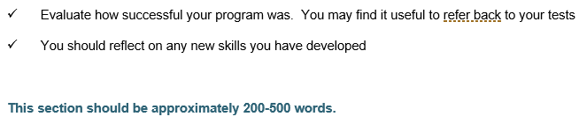
Evaluation

Slide 22
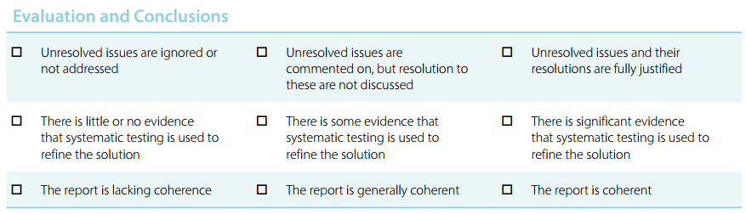

Slide 23
How successful was my program?

Slide 24
What new skills have I developed?

