Slide 1


Are you up for a challenge?

Slide 2
Do you need something on your
CV,
UCAS
or
job application
to help you stand out from the crowd?​

Slide 3

Then look no further...

Slide 4

Young Enterprise
Notes:
Young Enterprise Company Programme is an exciting opportunity for you to create your own student company and discover what life is like in the business world over this academic year.
You’ll work together as a Board of Directors to decide on what your company should sell and what your brand should be. You’ll need to put your creative thinking to the test in order to raise money to get your student business started, explore what it is that your customers really want, decide on a marketing plan, and make sure your business stands out from crowd

Slide 5
This is your chance
to experience what
life is really like in
the business world

Slide 6



We challenge a group of you to...
CREATE A STUDENT
COMPANY

Slide 7
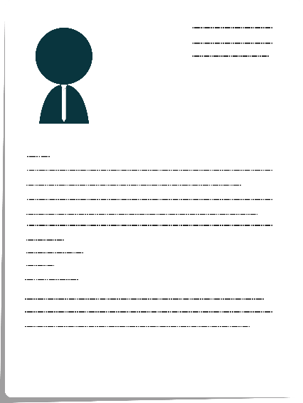
We challenge a group of you to...
EACH TAKE ON
A JOB ROLE

Slide 8
Examples of Job Roles include:
Managing Director (MD)
Secretary and Administrative Director
Finance Director
IT Director (eg. website design)
Sales and Marketing Director
Operations Director
CSR Director
HR Director

Slide 9

We challenge a group of you to...
WORK TOGETHER AS A BOARD OF DIRECTORS

Slide 10

We challenge a group of you to...
ATTEND BOARD MEETINGS

Slide 11

We challenge a group of you to...
DEVELOP YOUR OWN
PRODUCT OR SERVICE

Slide 12

We challenge a group of you to...
PROMOTE AND SELL
TO THE PUBLIC

Slide 13

You will make all of the decisions
What will you sell?

Slide 14
You will make all of the decisions
What should your brand be?

Slide 15
You will make all of the decisions
What do your customers
really want?

Slide 16

You are ultimately responsible for the success...
or failure of your student company

Slide 17

But you won't be on your own...
You will access online guidance and receive support from Business Volunteers and YE representatives

Slide 18
Did we mention that
you get to make
some money?
You can keep
the profits!...
£

Slide 19
Did we mention that
you get to make
some money?
...unless you choose to
set up a Social Enterprise to make a difference to your local community or further afield

Slide 20

Towards the end
of the experience
you can showcase
your student company
to compete for the
title of...
Notes:
As part of your Company Programme journey you’ll also showcase your student company and the skills you’ve developed at the Young Enterprise (YE) Company of the Year Competition.
The Competition starts at a local level with winning companies progressing through a series of ‘competition events at county, regional, and national level.

Slide 21

Winners of the National Company of the Year go on to represent the UK at the European final
Notes:
For the national winners you’ll then have the amazing experience of showcasing your company, your journey and representing your country at the European finals.

Slide 22

So what's the catch?
We can't lie....
it can sometimes
be hard work
…but it's also a lot of fun

Slide 23
Can you think of a
better way to develop
your career, life and employability skills?

Slide 24
Employers, colleges
and universities want these skills!

Slide 25
You need
these skills!

Slide 26
So you may as
well have some fun getting them!

Slide 27
Sign up for the
Young Enterprise Student Company programme today

Slide 28






FIND OUT MORE
WWW.YOUNG-ENTERPRISE.ORG.UK
FIND US

Slide 29
Why Should I Get Involved in YE?
Build your CV/University Application by developing valuable employability skills.
Fantastic co-curricular opportunity and a great school experience.
Make new friends.
Build your character by developing your entrepreneurial, teamwork and leadership skills.
Chance to make money!

Slide 30
If Interested….
Please submit a CV and letter of application by Friday 24th September latest to Mr Hughes at email address: g.hughes1@newhallschool.co.uk or attached application via the firefly task
In your letter it is expected you will detail:
Why you want to be part of YE.
Assurance that you will commit to the programme and be available for meetings 2nd lunch each Monday and Thursday.
The role(s) you wish to apply for.

Slide 31
Videos about YE
Young Enterprise Company Programme – YouTube
Young Enterprise Company Programme UK Final 2016 - YouTube

