Slide 1
Python Functions
Lecture 6

Slide 2
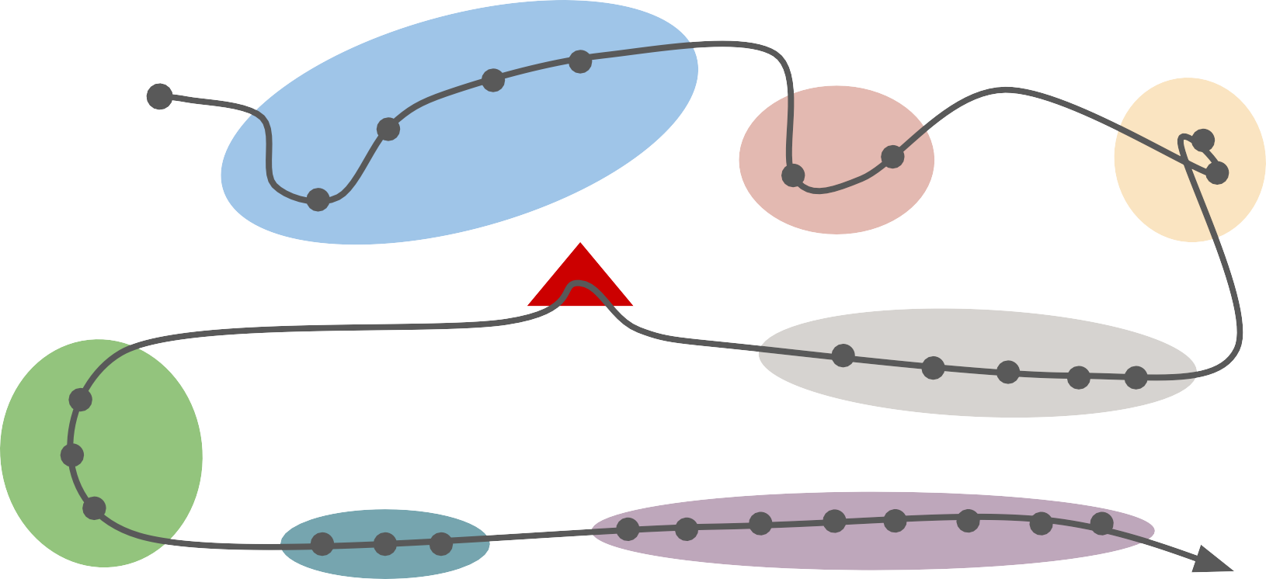
Programming Basics
The Console
Images
Graphics
Data structures
Midterm
Object-Oriented Programming
Everyday Python

Slide 3
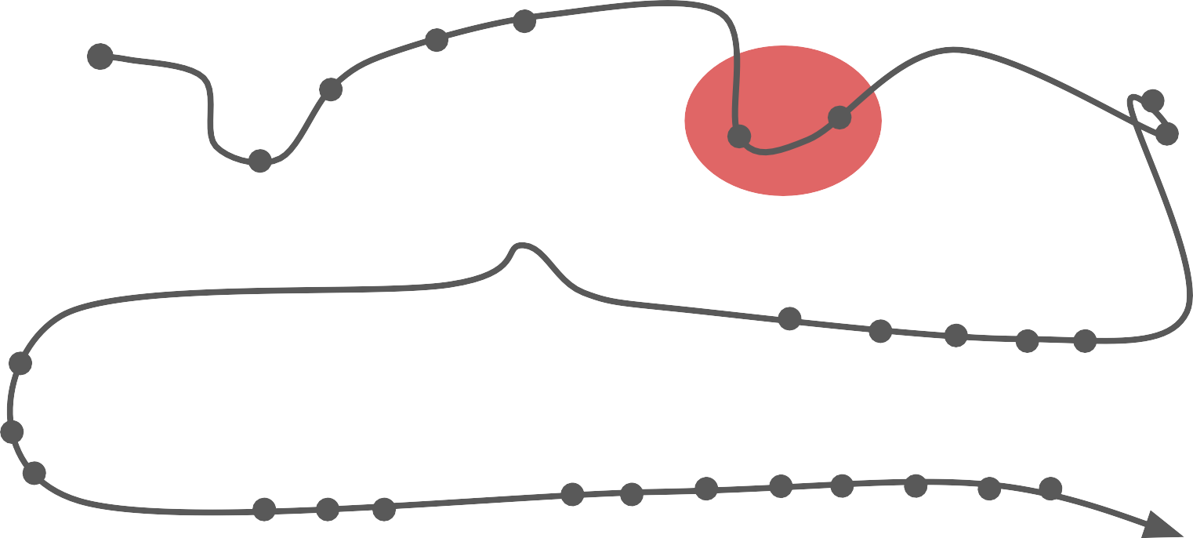

Roadmap
Programming Basics
The Console
Day 1!
Images
Python Functions
Strings and the Console
Graphics
Data structures
Midterm
Object-Oriented Programming
Everyday Python

Slide 4
How do we translate what we know from Karel into regular Python code?
Today’s questions
How can we make our code more flexible by producing different outputs depending on the input?

Slide 5
1. Introduction and Review
Range For Loops
Python Functions
Variable Scope
What’s next?
Today’s topics

Slide 6
Variables

Slide 7

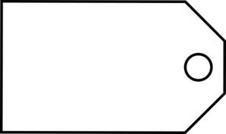
What is a variable?
A variable is a container for storing a data value.
num_flowers = 5
5
num_flowers
variabIe’s name

Slide 8
Terminology summary
Variables have a name and are associated with a value
Variable assignment is the process of associating a value with the name (use the equals sign =)
Retrieval is the process of getting the value associated with the name (use the variable’s name)
This is how you use variables!

Slide 9
Expressions

Slide 10
Recall: expressions
The computer evaluates expressions to a single value
We use operators to combine literals and/or variables into expressions

Slide 11
Arithmetic operators
Operator | Precedence
() | 1
*, /, //, % | 2
+, - | 3
* Multiplication
/ Division
// Integer division
% Modulus (remainder)
+ Addition
- Subtraction

Slide 12
Arithmetic operators
Operator | Precedence
() | 1
*, /, //, % | 2
+, - | 3
* Multiplication
/ Division
// Integer division
% Modulus (remainder)
+
Addition
- Subtraction
Integer division takes the larges integer that is equal to or smaIler than the qvotient

Slide 13
Integer Division Practice!
5 + 1 // 2
9 // 3
8 // 3
-8 // 3
Integer division takes the Iargest integer that is equal to or smaller than the qvotient

Slide 14
Integer Division Practice!
5 + 1 // 2 = 5
9 // 3 = 3
8 // 3 = 2
-8 // 3 = -3
Integer division takes the Iargest integer that is equal to or smaller than the qvotient

Slide 15
How can I repeat a task a finite number of times?

Slide 16
While loop with variables
counter = 0
while counter < 3: do_something() counter += 1

Slide 17
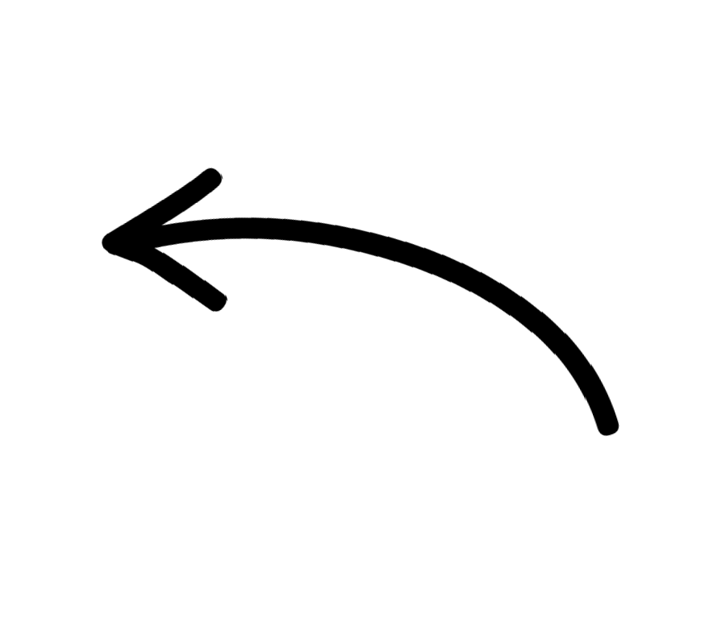
While loop with variables
counter = 0
while counter < 3: do_something() counter += 1
This is the same thing as:
counter = counter + 1

Slide 18
While loop with variables
counter = 0
while counter < 3: do_something() counter += 1
GeneralIy, x += y is the same as:
x = x + y

Slide 19
While loop with variables
counter = 0
while counter < 3: do_something() counter += 1
GeneralIy, x += y is the same as:
x = x + y
You can also do: -=, *=, /=

Slide 20

While loop with variables
counter = 0
^{while counter < 3:} Computer scientists count from 0.
do_something()
counter += 1

Slide 21
While loop with variables
counter = 0
while counter < 3: do_something() counter += 1
0
counter

Slide 22
While loop with variables
counter = 0
while counter < 3: do_something() counter += 1
0
counter

Slide 23
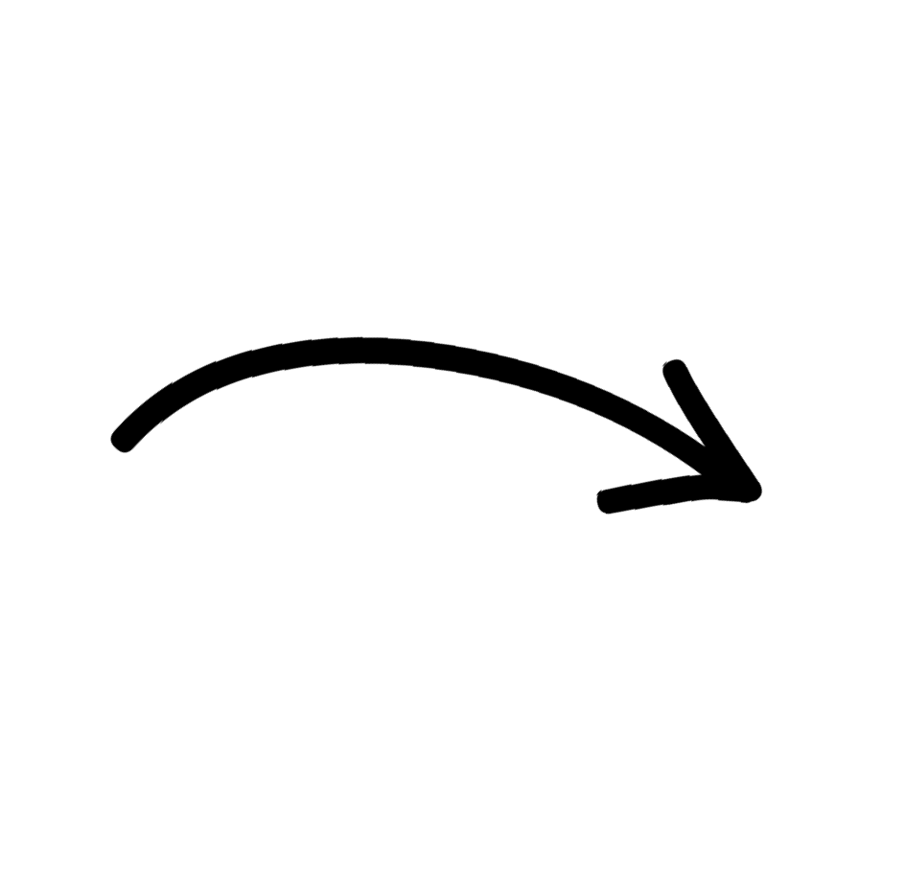
While loop with variables
counter = 0
while counter < 3: _{Trve} do_something() counter += 1
0
counter

Slide 24
While loop with variables
counter = 0
while counter < 3: _{Trve} do_something() counter += 1
1
counter

Slide 25
While loop with variables
counter = 0
while counter < 3: _{Trve} do_something() counter += 1
2
counter

Slide 26
While loop with variables
counter = 0
while counter < 3: do_something() counter += 1
3
counter

Slide 27
While loop with variables
counter = 0
while counter < 3: _{/aIse!} do_something() counter += 1
3
counter

Slide 28
For loops

Slide 29
For loop with range
for i in range(3): do_something()

Slide 30
For loop with range
for i in range(3): do_something()
Deﬁnition
for loop
A way to repeat a block of code a specific number of times

Slide 31

For loop with range
for i in range(3): do_something()
TeIls us we’re going to loop through one by one

Slide 32
For loop with range
for i in range(3): do_something()
A variabIe that helps vs keep 9rack of where we are (index)

Slide 33

For loop with range
for i in range(3): do_something()
Nvmber of iterations

Slide 34
For loop with range
for i in range(3): do_something()
Can be a variable, as long as i9’s an int!

Slide 35
For loop with range
for i in range(3): do_something()
BviIt-in function

Slide 36
Range
range(3) -> iterates through 0,1,2

Slide 37
Range
range(3) | -> | iterates through 0,1,2
range(0, | 3) | -> iterates through 0,1,2

Slide 38
Range
range(3) | -> | iterates through 0,1,2
range(0, | 3) | -> iterates through 0,1,2
range(4, | 7) | -> iterates through 4,5,6

Slide 39
Range
for i in range(end_index):
# assumes 0 is the start index

Slide 40
Range
for i in range(end_index):
# assumes 0 is the start index
for i in range(start_index, end_index): # end_index is not inclusive!
# recall: range(4,7) -> 4,5,6

Slide 41
How can I make my code more flexible?

Slide 42
Python Functions

Slide 43
print(x)
front_is_clear()
turn_right()
math.sqrt(4)
average(x, y)
predict_temperature()

Slide 44

Karel Functions
def turn_right(): turn_left() turn_left() turn_left()

Slide 45
Karel Functions
def move_x_times(): # ????

Slide 46
Karel Functions
def move_x_times(): # ????
How can we make functions more flexible and reusabIe by producing diﬀerent outputs?

Slide 47
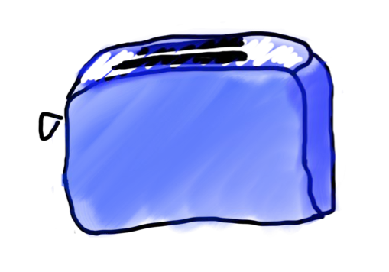
Function Analogy
toaster()
SIide adapted from Chris Piech

Slide 48
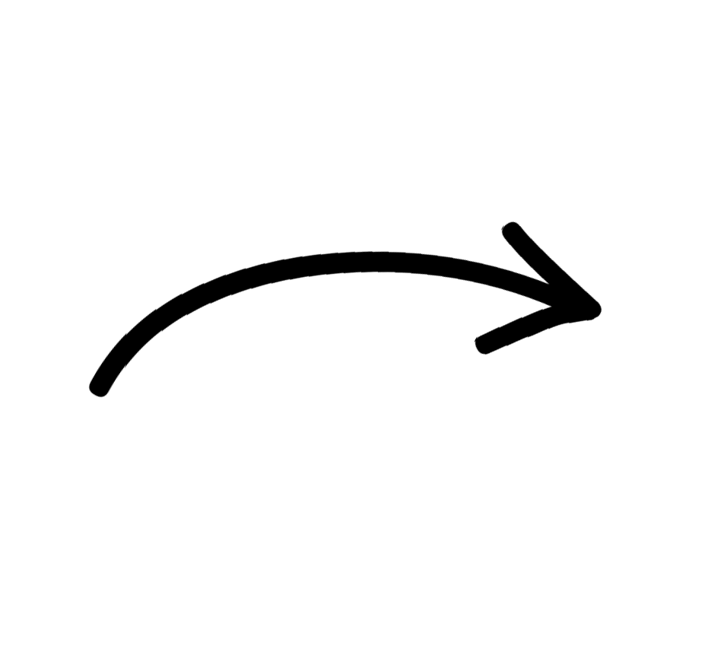
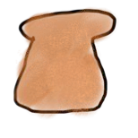
Function Analogy
toaster(bread)
bread
SIide adapted from Chris Piech

Slide 49
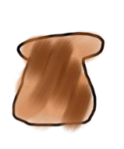
Function Analogy
toaster(bread)
bread
toast
SIide adapted from Chris Piech

Slide 50
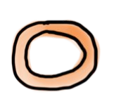
Function Analogy
toaster(bagel)
bagel
SIide adapted from Chris Piech

Slide 51
Function Analogy
toaster(bagel)
bagel
You don’t need a diﬀerent toaster for toasting bagels! Use the same one.
SIide adapted from Chris Piech

Slide 52
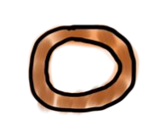
Function Analogy
toaster(bagel)
bagel
toasted bagel
SIide adapted from Chris Piech

Slide 53
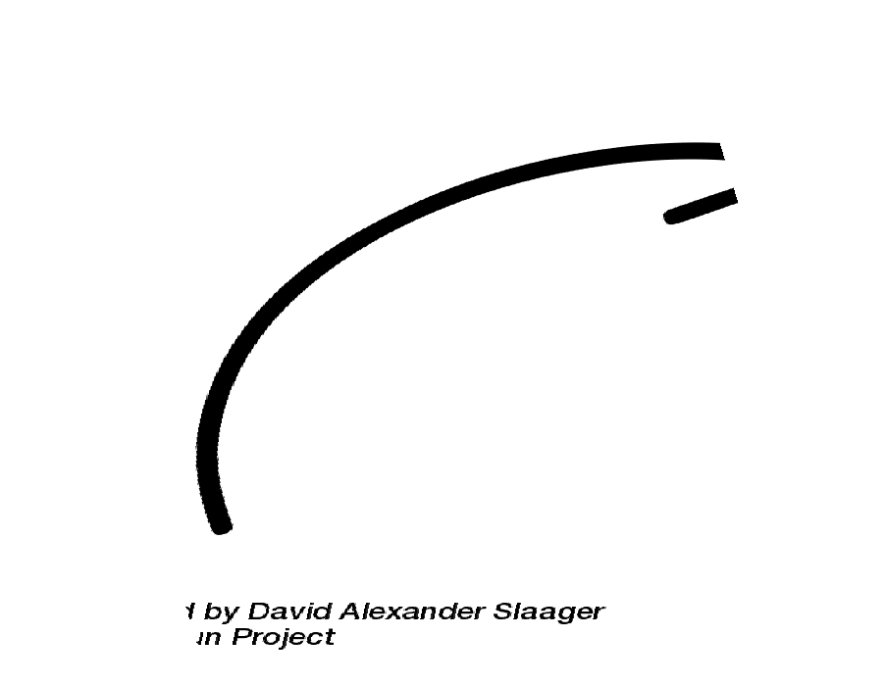
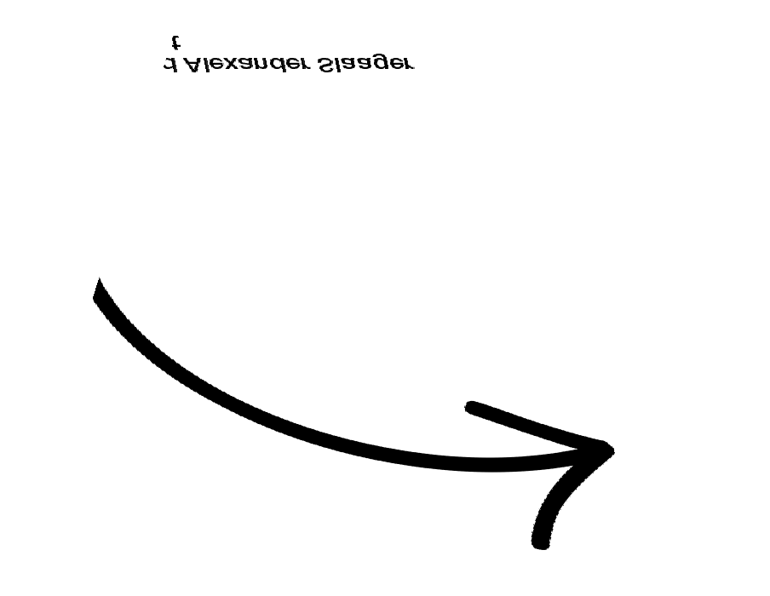
Anatomy of a Function
input
function(input)
output
parameter(s)
/arguments
“return valve”

Slide 54
Anatomy of a Function
def function_name(param1, param2): result = # do something
return result

Slide 55

Anatomy of a Function
def function_name(param1, param2): result = # do something
return result
fvnction deﬁni9ion

Slide 56

Anatomy of a Function
def function_name(param1, param2): result = # do something
return result
name

Slide 57
Anatomy of a Function
def function_name(param1, param2): result = # do something
return result
inpu9 expected

Slide 58
Anatomy of a Function
def function_name(param1, param2): result = # do something
return result
parameters

Slide 59
Anatomy of a Function
def function_name(param1, param2): result = # do something
return result
Deﬁnition
parameter(s) One or more variables that a
function expects as input

Slide 60

Anatomy of a Function
def function_name(param1, param2): result = # do something
return result
outpu9 expected

Slide 61
Anatomy of a Function
def function_name(param1, param2): result = # do something
return result
return valve

Slide 62
Think/Pair/Share:
Find the function definition, function name, parameter(s), and return value.

Slide 63
Anatomy of a Function
Think/Pair/Share:
def main():
mid = average(10.6, 7.2) print(mid)
def average(a, b): sum = a + b return sum / 2
Find the function definition, function name, parameter(s), and return value in average.

Slide 64
Anatomy of a Function
def main():
mid = average(10.6, 7.2) print(mid)
def average(a, b): sum = a + b return sum / 2
fvnction deﬁni9ion

Slide 65

Anatomy of a Function
def main():
mid = average(10.6, 7.2) print(mid)
def average(a, b): _{name}
sum = a + b
return sum / 2

Slide 66
Anatomy of a Function
def main():
mid = average(10.6, 7.2) print(mid)
def average(a, b): sum = a + b return sum / 2
parameters

Slide 67
Anatomy of a Function
def main():
mid = average(10.6, 7.2) print(mid)
def average(a, b): sum = a + b return sum / 2
parameters
return valve

Slide 68
Deﬁnition
Anatomy of a Function
def main():
mid = average(10.6, 7.2) print(mid)
Return value Value that a function hands back to the
“calling” function
def average(a, b): sum = a + b return sum / 2
return valve

Slide 69
Deﬁnition
# Anatomy of a Function
def main():
mid = average(10.6, 7.2)
print(mid)
def average(a, b):
total = a + b
return total / 2
# Call the main function
main()
Return value Value that a function hands back to the
“calling” function
What is the “calling” fvnction?

Slide 70
Anatomy of a Function
def main():
mid = average(10.6, 7.2) print(mid)
def average(a, b): sum = a + b return sum / 2
caller
(calling func9ion)

Slide 71
Anatomy of a Function
def main():
mid = average(10.6, 7.2) print(mid)
caller
(calling func9ion)
def average(a, b): sum = a + b return sum / 2
callee
(called function)

Slide 72
Anatomy of a Function
def main():
mid = average(10.6, 7.2) print(mid)
fvnction “call”
def average(a, b): sum = a + b return sum / 2

Slide 73
Anatomy of a Function
def main():
mid = average(10.6, 7.2) print(mid)
arguments
def average(a, b): sum = a + b return sum / 2

Slide 74
Anatomy of a Function
def main():
mid = average(10.6, 7.2) print(mid)
def average(a, b): sum = a + b return sum / 2
arguments
What’s the diﬀerence be9ween arguments and parame9ers?

Slide 75
Anatomy of a Function
def main():
mid = average(10.6, 7.2) print(mid)
def average(a, b): sum = a + b return sum / 2
parameters are the name of inpu9 values in the function deﬁnition

Slide 76
Anatomy of a Function
def main():
mid = average(10.6, 7.2) print(mid)
def average(a, b): sum = a + b return sum / 2
arguments are the values passed in when function is calIed!

Slide 77

Anatomy of a Function
def main():
mid = average(10.6, 7.2)
print(mid)
Note that we’re s9oring the
returned vaIue in a variable!
def average(a, b): sum = a + b return sum / 2

Slide 78
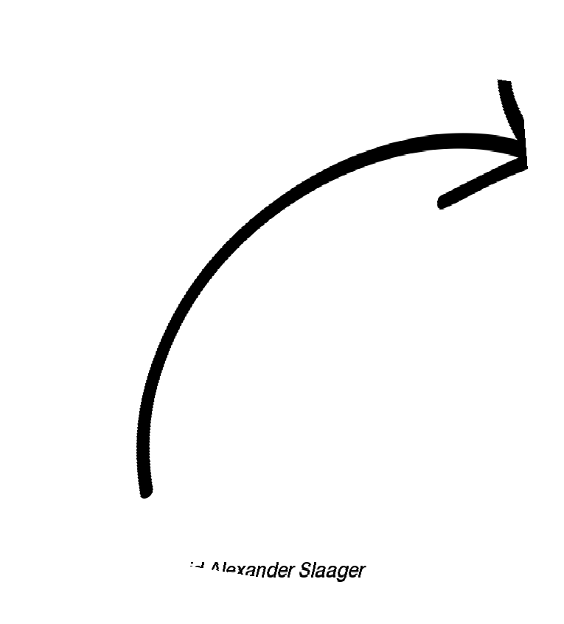
Recall from last lecture:
>>> math.sqrt(4)
2.0
/vnc9ion

Slide 79
Recall from last lecture:
>>> math.sqrt(4)
2.0
Argvment

Slide 80
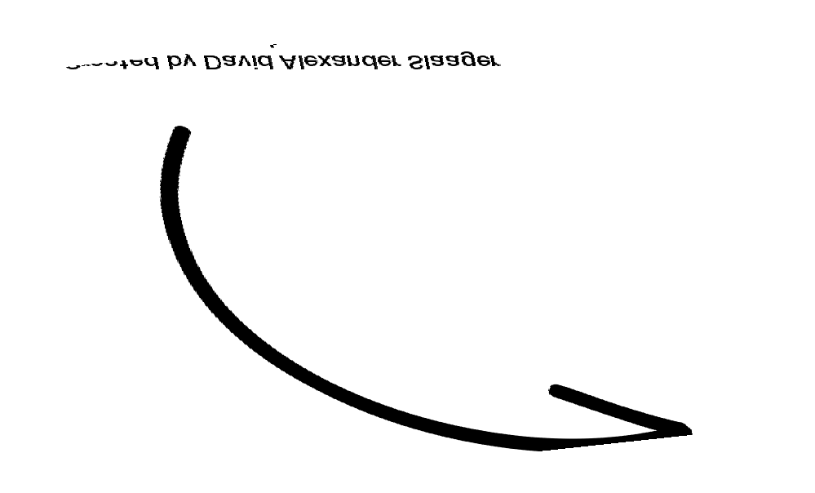
Recall from last lecture:
>>> math.sqrt(4)
2.0
Return valve

Slide 81
Anatomy of a Function
4
math.sqrt(4)
2.0
argument
return valve

Slide 82
Think/Pair/Share:
Write a function that takes in two values and outputs the sum of their squares.

Slide 83
Think/Pair/Share:
Write a function that takes in two values and outputs the sum of their squares. [demo]

Slide 84
Functions as Python Objects
def add(x, y): return x + y
add
function object

Slide 85


Parameters and return values are optional
def turn_right(): turn_left() turn_left() turn_left()
“I’m a function too!”

Slide 86
Parameters and return values are optional
def turn_right(): turn_left()
turn_left() turn_left()

Slide 87
Parameters and return values are optional
def turn_right(): turn_left() turn_left() turn_left()

Slide 88
When am I allowed to use a variable?

Slide 89
Scope

Slide 90
Scope Variable Life Expectancy

Slide 91
Deﬁnition
scope
The parts of a program where you can access a variable

Slide 92

Variable Scope
def main(): function_name() print(y)
def function_name(): x = 2
y = 3
this is the scope where x and y “Iive”

Slide 93
Variable Scope
def main(): function_name() print(y)
def function_name(): x = 2
y = 3

Slide 94
Variable Scope
def main(): function_name() print(y)
def function_name(): x = 2
y = 3

Slide 95
Variable Scope
def main(): function_name() print(y)
2
x
def function_name(): x = 2
y = 3

Slide 96
Variable Scope
def main(): function_name() print(y)
2
x
def function_name(): x = 2
y = 3
3
y

Slide 97
Variable Scope
def main(): function_name() print(y)
def function_name(): x = 2
y = 3

Slide 98
Variable Scope
def main(): function_name() print(y)
NameError
def function_name(): x = 2
y = 3

Slide 99


Variable Scope
def main(): function_name() print(y)
def function_name(): x = 2
y = 3
y is now ovt of scope!

Slide 100
Variable Scope
def main(): function_name() print(y)
def function_name(): x = 2
y = 3
y is now ovt of scope!
Once a function finishes executing, the variables declared inside of it are no longer accessible!

Slide 101
Unless...
def main():
y = function_name() print(y)
def function_name(): x = 2
y = 3 return y

Slide 102
Unless...
def main():
y = function_name() print(y)
def function_name(): x = 2
y = 3 return y

Slide 103
Let’s put it all together!

Slide 104
Receipt program
What subtasks can we break this program into?

Slide 105
Receipt program
What subtasks can we break this program into?
calculating tax
calculating the tip
aggregating tax and tip
[demo]

Slide 106
How do we translate what we know from Karel into regular Python code?
Today’s questions
How can we make our code more flexible by producing different outputs depending on the input?

Slide 107
What’s next?

Slide 108
Tomorrow: making programs interactive!
Strings: representations of text
Interactive programs

Slide 109
Roadmap
Programming Basics
The Console
Day 1!
Images
Python Functions
Strings and the Console
Graphics
Data structures
Midterm
Object-Oriented Programming
Everyday Python
Life after CS106AP!

