Slide 1
Python_ Functions

Slide 2
Features of python
Python is beloved for its versatility, simplicity, and extensive features. Here are some of its key features:
Simple and Readable Syntax: Python emphasizes code readability, making it accessible even for beginners.
Dynamically Typed: No need to declare variable types explicitly; Python determines them during runtime.
Cross-Platform Compatibility: Python runs on various operating systems, such as Windows, macOS, and Linux.
Extensive Libraries and Frameworks: Python comes with a rich standard library and supports countless third-party libraries for web development, data analysis, machine learning, and more.
Object-Oriented and Functional Programming: You can use both paradigms to suit your needs.
Interpreted Language: No need to compile Python programs; you run the code directly, making debugging simpler.
Support for Large Communities: Python has a massive and active user community that offers robust support and tutorials.
Strong Integration Capabilities: Python integrates seamlessly with other languages and tools, including C, C++, Java, and .NET.
Scalability: Python can handle small scripts to enterprise-level applications efficiently.

Slide 3
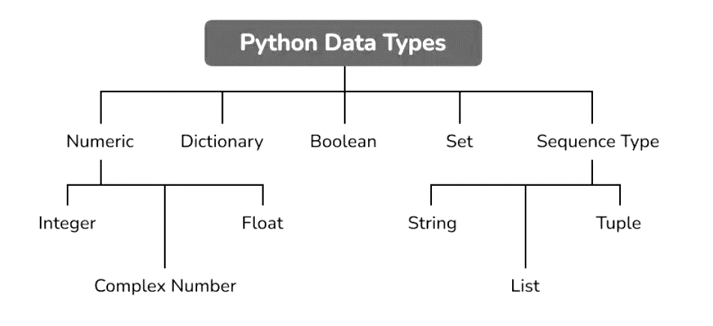

Slide 4
Built-in Data Types
In programming, data type is an important concept.
Variables can store data of different types, and different types can do different things.
Python has the following data types built-in by default, in these categories:
Text Type: | str
Numeric Types: | int, float, complex
Sequence Types: | list, tuple, range
Mapping Type: | dict
Set Types: | set, frozenset
Boolean Type: | bool
Binary Types: | bytes, bytearray, memoryview
None Type: | NoneType

Slide 5
Python functions are reusable blocks of code that perform a specific task. They are useful for organizing code, reducing repetition, and making code more modular and maintainable.
Defining a Function
To define a function in Python, you use the `def` keyword followed by the function name and a list of parameters in parentheses.
def greet(name):
print(f"Hello, {name}!")
greet("John") # Output: Hello, John! Function Arguments
Functions can take arguments, which are values passed to the function when it is called.
def add(a, b):
return a + b
result = add(2, 3)
print(result) # Output: 5
Default Argument Values
You can specify default values for function arguments.
def

Slide 6
def greet(name = "World"):
print(f"Hello, {name}!")
greet() # Output: Hello, World!
greet("John") # Output: Hello, John
Variable Number of Arguments
You can define functions that take a variable number of arguments using the `*args` and `**kwargs` syntax.
def sum_numbers(*numbers):
return sum(numbers)
result = sum_numbers(1, 2, 3, 4, 5)
print(result) # Output: 15
-----------------------------------------------------------------------------------------------------------
def greet(**kwargs):
name = kwargs.get("name", "World")
age = kwargs.get("age", None)
if age:
print(f"Hello, {name}! You are {age} years old.")
else:
print(f"Hello, {name}!")
greet(name="John", age=30) # Output: Hello, John! You are 30 years old.

Slide 7
Return Values
Functions can return values using the `return` statement.
def square(x):
return x ** 2
result = square(4)
print(result) # Output: 16
Lambda Functions
Lambda functions are small, anonymous functions that can be defined inline.
double = lambda x: x * 2
result = double(5)
print(result) # Output: 10
Function Documentation
You can document functions using docstrings.
def greet(name):
Prints a personalized greeting message.
Args:
name (str): The person's name.
Returns:
None
print(f"Hello, {name}!")
help(greet) # Output: prints the docstring

