Slide 1
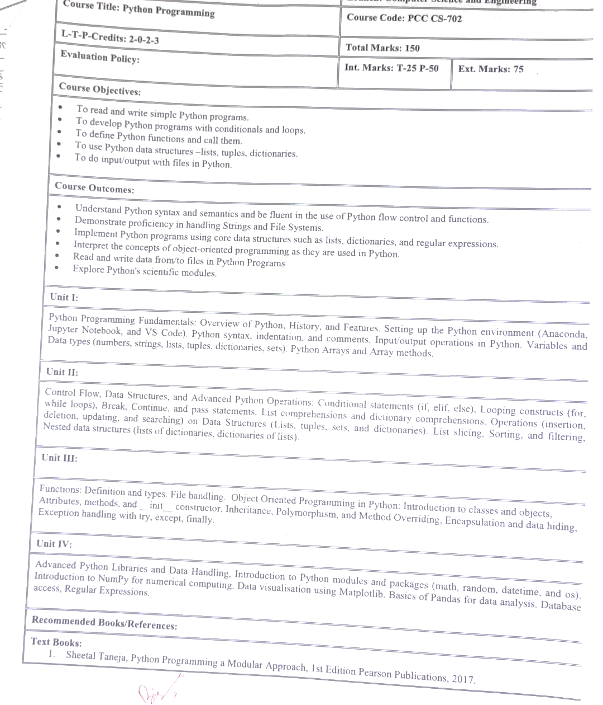

Slide 2
Features of python
Python is beloved for its versatility, simplicity, and extensive features. Here are some of its key features:
Simple and Readable Syntax: Python emphasizes code readability, making it accessible even for beginners.
Dynamically Typed: No need to declare variable types explicitly; Python determines them during runtime.
Cross-Platform Compatibility: Python runs on various operating systems, such as Windows, macOS, and Linux.
Extensive Libraries and Frameworks: Python comes with a rich standard library and supports countless third-party libraries for web development, data analysis, machine learning, and more.
Object-Oriented and Functional Programming: You can use both paradigms to suit your needs.
Interpreted Language: No need to compile Python programs; you run the code directly, making debugging simpler.
Support for Large Communities: Python has a massive and active user community that offers robust support and tutorials.
Strong Integration Capabilities: Python integrates seamlessly with other languages and tools, including C, C++, Java, and .NET.
Scalability: Python can handle small scripts to enterprise-level applications efficiently.

Slide 3
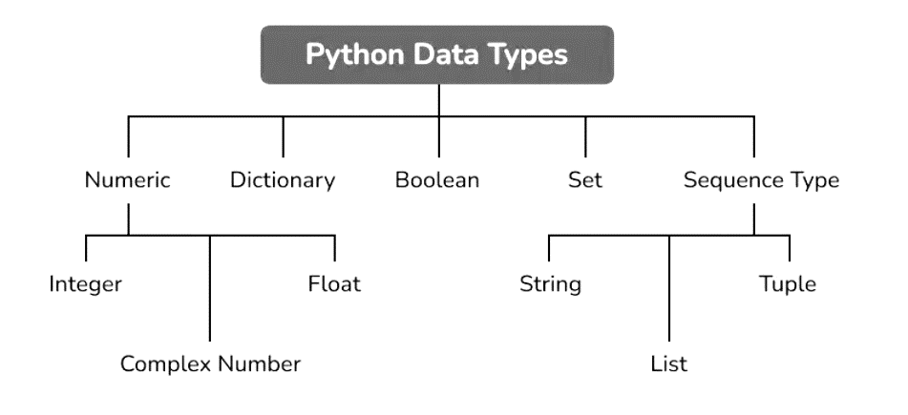

Slide 4
Built-in Data Types
In programming, data type is an important concept.
Variables can store data of different types, and different types can do different things.
Python has the following data types built-in by default, in these categories:
Text Type: | str
Numeric Types: | int, float, complex
Sequence Types: | list, tuple, range
Mapping Type: | dict
Set Types: | set, frozenset
Boolean Type: | bool
Binary Types: | bytes, bytearray, memoryview
None Type: | NoneType

