Slide 1
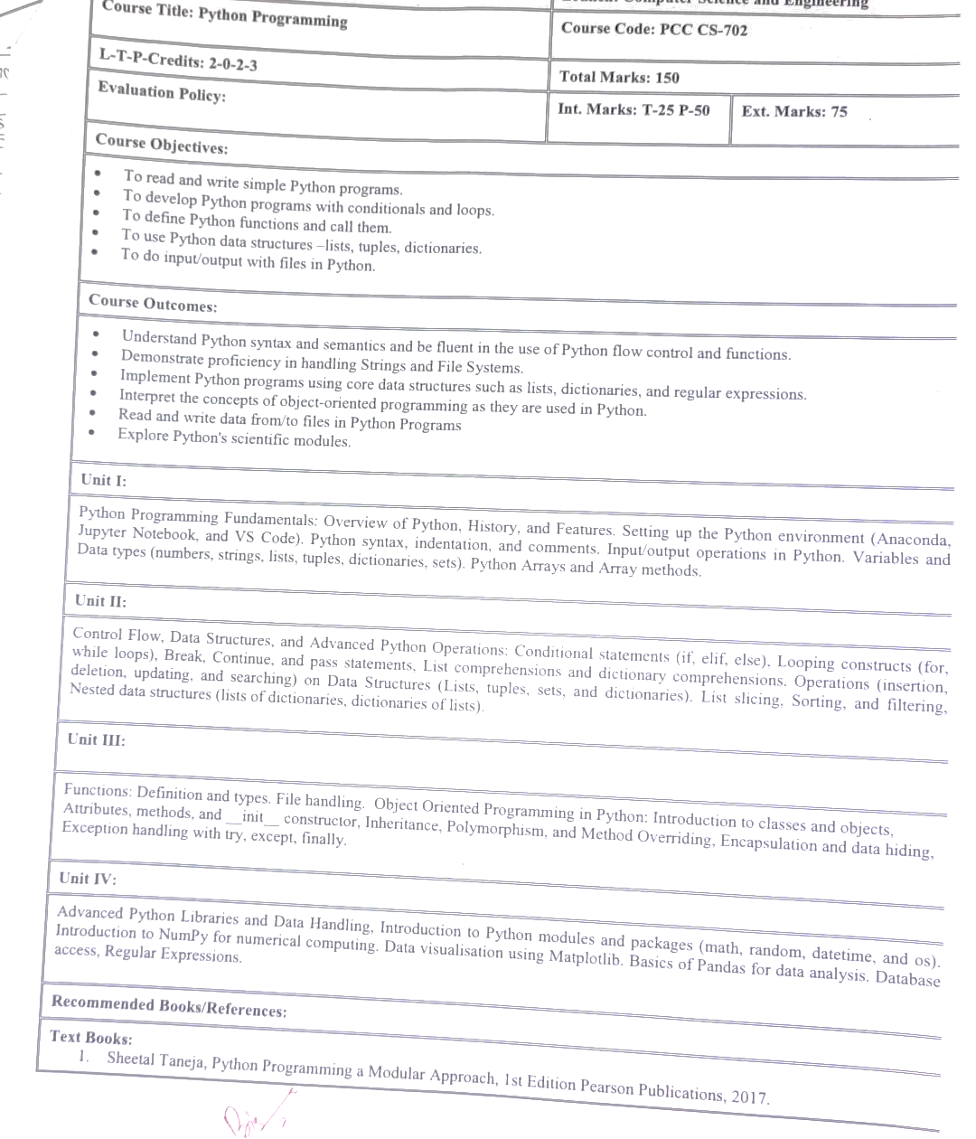

Slide 2
Features of python
Python is beloved for its versatility, simplicity, and extensive features. Here are some of its key features:
Simple and Readable Syntax: Python emphasizes code readability, making it accessible even for beginners.
Dynamically Typed: No need to declare variable types explicitly; Python determines them during runtime.
Cross-Platform Compatibility: Python runs on various operating systems, such as Windows, macOS, and Linux.
Extensive Libraries and Frameworks: Python comes with a rich standard library and supports countless third-party libraries for web development, data analysis, machine learning, and more.
Object-Oriented and Functional Programming: You can use both paradigms to suit your needs.
Interpreted Language: No need to compile Python programs; you run the code directly, making debugging simpler.
Support for Large Communities: Python has a massive and active user community that offers robust support and tutorials.
Strong Integration Capabilities: Python integrates seamlessly with other languages and tools, including C, C++, Java, and .NET.
Scalability: Python can handle small scripts to enterprise-level applications efficiently.

Slide 3
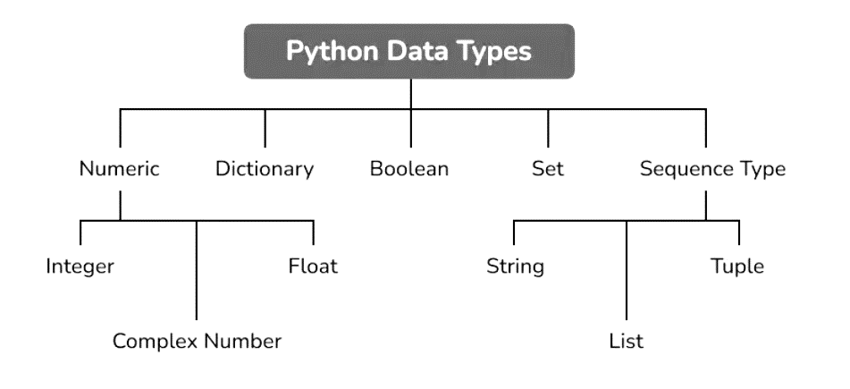

Slide 4
Built-in Data Types
In programming, data type is an important concept.
Variables can store data of different types, and different types can do different things.
Python has the following data types built-in by default, in these categories:
Text Type: | str
Numeric Types: | int, float, complex
Sequence Types: | list, tuple, range
Mapping Type: | dict
Set Types: | set, frozenset
Boolean Type: | bool
Binary Types: | bytes, bytearray, memoryview
None Type: | NoneType

Slide 5
Built-in Data Types
In programming, data type is an important concept.
Variables can store data of different types, and different types can do different things.
Python has the following data types built-in by default, in these categories:
Dictionary
Python provides another composite called a dictionary, which is similar to a list in that it is a collection of objects.
Dictionaries are Python’s implementation of a data structure that is more generally known as an associative array. A dictionary consists of a collection of key-value pairs. Each key-value pair maps the key to its associated value.
You can define a dictionary by enclosing a comma-separated list of key-value pairs in curly braces ({}). A colon (:) separates each key from its associated value: # empty dictionary
my_dict = {}
# dictionary with integer keys
my_dict = {1: 'apple', 2: 'ball'}

Slide 6
Built-in Data Types
In programming, data type is an important concept.
Variables can store data of different types, and different types can do different things.
Python has the following data types built-in by default, in these categories:
# dictionary with mixed keys
my_dict = {'name': 'John', 1: [2, 4, 3]}
# using dict()
my_dict = dict({1:'apple', 2:'ball'})
# from sequence having each item as a pair
my_dict = dict([(1,'apple'), (2,'ball')])

Slide 7
Built-in Data Types
In programming, data type is an important concept.
Variables can store data of different types, and different types can do different things.
Python has the following data types built-in by default, in these categories:
Boolean
Python Boolean type is one of the built-in data types provided by Python, which represents one of the two values i.e. True or False. Generally, it is used to represent the truth values of the expressions. For example, 1==1 is True whereas 2<1 is False. For Example:
a = 10
b = 20
print(a == b)
Output:
False

Slide 8
Built-in Data Types
In programming, data type is an important concept.
Variables can store data of different types, and different types can do different things.
Python has the following data types built-in by default, in these categories:
Set
Set is another data type in Python and it works as mathematical sets. Very much similar to lists and sets are denoted as curly brackets. Set is an unordered collection of data types that is iterable, mutable and has no duplicate elements. For example:
result = set([1, 2, 4, 4, 3, 3, 3, 6, 5])
print(result)
Output:
{1, 2, 3, 4, 5, 6}

Slide 9
Built-in Data Types
In programming, data type is an important concept.
Variables can store data of different types, and different types can do different things.
Python has the following data types built-in by default, in these categories:
Sequences
Sequences are containers with items stored in a deterministic ordering. Each sequence data type comes with its unique capabilities.
There are many types of sequences in Python.
Types of Sequence in Python:
a) Strings:
In python, the string is a sequence of Unicode characters written inside a single or double-quote. Python does not have any char type as in other languages (C, C++), therefore, a single character inside the quotes will be of type str only.

Slide 10
Built-in Data Types
In programming, data type is an important concept.
Variables can store data of different types, and different types can do different things.
Python has the following data types built-in by default, in these categories:
Sequences
Types of Sequence in Python:
a) Strings:
1. To declare an empty string, use str() or it can be defined using empty string inside quotes.
Example of String in Python:
name = "LearnPython"
print(name)
Output:
LearnPython
2. Strings are immutable data types, therefore once declared, we can’t alter the string. Though, we can reassign it to a new string.

Slide 11
Built-in Data Types
In programming, data type is an important concept.
Variables can store data of different types, and different types can do different things.
Python has the following data types built-in by default, in these categories:
Lists:
Lists are a single storage unit to store multiple data items together. It’s a mutable data structure, therefore, once declared, it can still be altered.
A list can hold strings, numbers, lists, tuples, dictionaries, etc.
1. To declare a list, either use list() or square brackets [], containing comma-separated values.
Example of Lists in Python:
list_1 = ["LearnPython ", "Sequences", "Tutorial"] # [all string list]
print(f'List 1: {list_1}')
list_2 = list() # [empty list]
print(f'List 2: {list_2}')
list_3 = [2021, ['hello', 2020], 2.0] # [integer, list, float]
print(f'List 3: {list_3}')
list_4 = [{'language': 'Python'}, (1,2)] # [dictionary, tuple]
print(f'List 4: {list_4}')
Output:
List 1: [‘LearnPython, ‘Sequences’, ‘Tutorial’]
List 2: []
List 3: [2021, [‘hello’, 2020], 2.0]
List 4: [{‘language’: ‘Python’}, (1, 2)]

Slide 12
Built-in Data Types
In programming, data type is an important concept.
Variables can store data of different types, and different types can do different things.
Python has the following data types built-in by default, in these categories:
Tuples:
Just like Lists, Tuples can store multiple data items of different data types. The only difference is that they are immutable and are stored inside the parenthesis ().
To declare a tuple, either use tuple() or parenthesis, containing comma-separated values.
Example of Tuple in Python:
tuple_1 = ("LearnPython ", "Sequences", "Tutorial") # [all string tuple]
print(f'tuple 1: {tuple_1}')
tuple_2 = tuple() # [empty tuple]
print(f'tuple 2: {tuple_2}')
tuple_3 = [2021, ('hello', 2020), 2.0] # [integer, tuple, float]
print(f'tuple 3: {tuple_3}')
tuple_4 = [{'language': 'Python'}, [1,2]] # [dictionary, list]
print(f'tuple 4: {tuple_4}')
Output:
tuple 1: (‘PythonGeeks’, ‘Sequences’, ‘Tutorial’) tuple 2: () tuple 3: [2021, (‘hello’, 2020), 2.0] tuple 4: [{‘language’: ‘Python’}, [1, 2]]

Slide 13
Built-in Data Types
In programming, data type is an important concept.
Variables can store data of different types, and different types can do different things.
Python has the following data types built-in by default, in these categories:
Python constructs
Assignment Statement
Assignment statement serves various purpose and used for creating a variable, initializing a variable or modifying the value of an existing variable.
The operator used for assignment is “=” also known as assignment operator.
Variable placed on the Left Hand Side (L.H.S) of the assignment operator is set with the constant value or value of another variable present on the Right Hand Side (R.H.S) of the assignment operator.
Example 1. Program to explain the assignment statement and initialization.
Consider a variable A whose value is to be initialized with 10 then the syntax would be: A = 10
print (A)
Output:
10

Slide 14
Built-in Data Types
In programming, data type is an important concept.
Variables can store data of different types, and different types can do different things.
Python has the following data types built-in by default, in these categories:
Example 2. Program to explain the assignment statement.
A = 10
B = A
print(B)
Output:
10

Slide 15
Built-in Data Types
In programming, data type is an important concept.
Variables can store data of different types, and different types can do different things.
Python has the following data types built-in by default, in these categories:
Example 3. Program for explaining the working of expressions.
A = 2 + 3
B = A* 5
C = B / A
D = (A+ B) – (C + A)
print(A)
print(B)
print(C)
print(D)
Output:
5
25
5
20

Slide 16
Built-in Data Types
In programming, data type is an important concept.
Variables can store data of different types, and different types can do different things.
Python has the following data types built-in by default, in these categories:
Arithmetic Operator
Operators are applied on the operand to obtain the desired results and there are different types of operators. The arithmetic operators are the most basic operators used for in general calculations or arithmetic operations. The arithmetic operators include +, -, /, *, % (modulus), ** (exponent) etc.
Example 4. Explaining Binary Operators with Program
A = 2 + 2
B = 5 * 2
C = 10 / 2
D = 10 % 2
print(A)
print(B)
print(C)
print(D)
Output:
4
10
5
0

Slide 17
Built-in Data Types
In programming, data type is an important concept.
Variables can store data of different types, and different types can do different things.
Python has the following data types built-in by default, in these categories:
Example 5. Explaining Binary Operators with Program
#Explaining Binary Operators with Program
A = 6+2 # Addition Operator
B = 6-2 # Subtraction Operator
C = 6 * 2 # Multiplication Operator
D = 6/2 # Division Operator
E = 6%2 # Modulus Operator
F = 6**2 # Exponential Operator
print("Sum of 6+2 is: ", A)
print("Subtraction of 6-2 is: ", B)
print("Multiplication of 6*2 is: ", C)
print("Division of 6/2 is: ", D)
print("Modulus of 6%2 is: ", E)
print("Exponential of 6**2 is: ", F)
#End of Program
Output:
Sum of 6+2 is: 8
Subtraction of 6-2 is: 4
Multiplication of 6*2 is: 12
Division of 6/2 is: 3.0
Modulus of 6%2 is: 0
Exponential of 6**2 is: 36

Slide 18
Built-in Data Types
In programming, data type is an important concept.
Variables can store data of different types, and different types can do different things.
Python has the following data types built-in by default, in these categories:
Example 6. Program to calculate the profit of a businessperson.
# Program to calculate the profit of a businessperson.
CP = float (input ("Enter the Cost Price of the Item: "))
SP = float (input ("Enter the Selling Price of the Item: "))
P = SP - CP
print ("Profit earned is: ", P)
#End of Program

Slide 19
Built-in Data Types
In programming, data type is an important concept.
Variables can store data of different types, and different types can do different things.
Python has the following data types built-in by default, in these categories:
Example 7. Program to calculate area of rectangle.
#Program to calculate area of rectangle
length = int(input("Enter the length: "))
width = int(input("Enter the width: "))
area = length * width
print("Area of Rectangle is : ",area)
#End of Program
Output:
Enter the length: 5
Enter the width: 4
Area of Rectangle is: 20

Slide 20
Built-in Data Types
In programming, data type is an important concept.
Variables can store data of different types, and different types can do different things.
Python has the following data types built-in by default, in these categories:
Example 8. Program to explain the functionality of Modulus Operator (%).
#Program to explain the functionality of Modulus Operator (%)
num1 = int(input("Enter the first number : "))
num2 = int(input("Enter the second number : "))
quotient = num1/num2
remainder = num1%num2
# Division operator (/) returns the quotient after dividing num1 by num2
# Modulus operator (%) returns the remainder after dividing num1 by num2
print("Quotient is : ",quotient)
print("Remainder is: ",remainder)
#End of Program
Output:
Enter the first number : 15
Enter the second number : 3
Quotient is : 5.0
Remainder is: 0

Slide 21
Built-in Data Types
In programming, data type is an important concept.
Variables can store data of different types, and different types can do different things.
Python has the following data types built-in by default, in these categories:
Example 9. Program to explain the operator precedence.
#Program to explain the operator precedence.
A = (4+5)/3*2-1
B = 6/3+2*(3+2)
print("Value of A is: ",A)
print("Value of B is: ",B)
#End of Program
Output:
Value of A is: 5.0
Value of B is: 12.0

