Slide 1
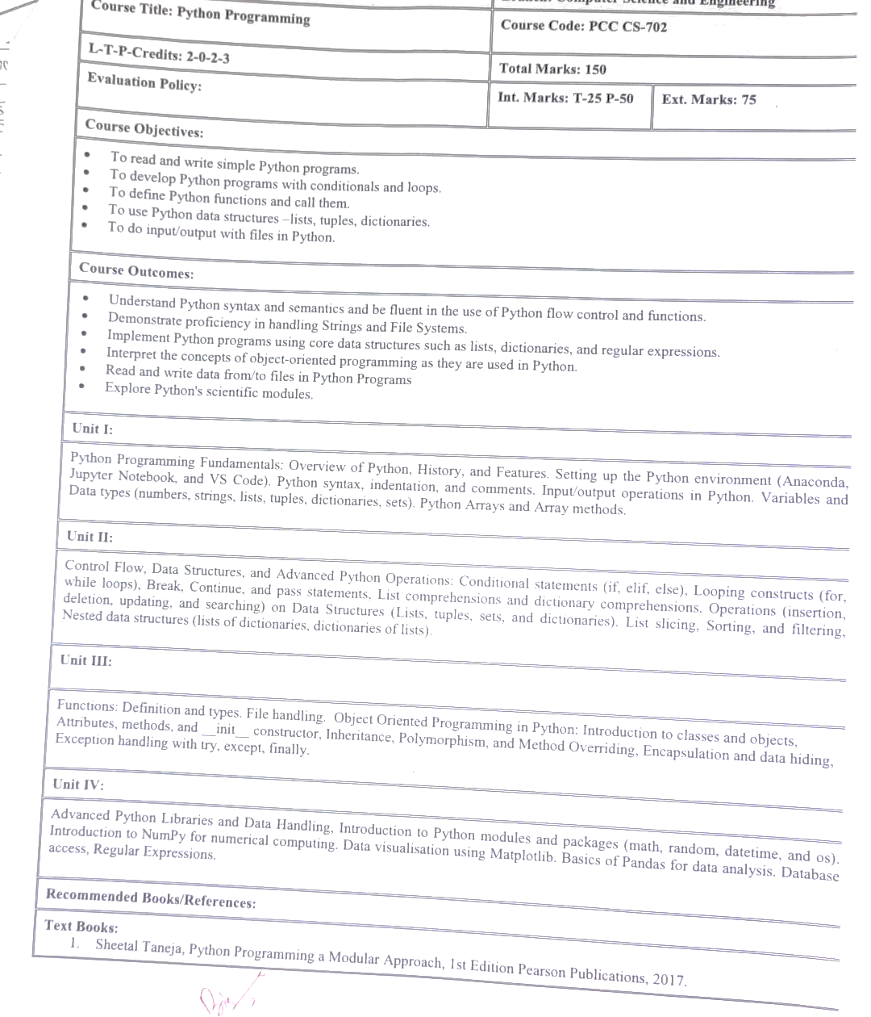

Slide 2
Python is beloved for its versatility, simplicity, and extensive features. Here are some of its key features:
Simple and Readable Syntax: Python emphasizes code readability, making it accessible even for beginners.
Dynamically Typed: No need to declare variable types explicitly; Python determines them during runtime.
Cross-Platform Compatibility: Python runs on various operating systems, such as Windows, macOS, and Linux.
Extensive Libraries and Frameworks: Python comes with a rich standard library and supports countless third-party libraries for web development, data analysis, machine learning, and more.
Object-Oriented and Functional Programming: You can use both paradigms to suit your needs.
Interpreted Language: No need to compile Python programs; you run the code directly, making debugging simpler.
Support for Large Communities: Python has a massive and active user community that offers robust support and tutorials.
Strong Integration Capabilities: Python integrates seamlessly with other languages and tools, including C, C++, Java, and .NET.
Scalability: Python can handle small scripts to enterprise-level applications efficiently.

