Slide 1
Build and Fix Model – Software Engineering
Process Models

Slide 2
Introduction to Process Models
Software process models define how software is developed.
Common models: Waterfall, Agile, Spiral, V-Model, Build and Fix, etc.
Focus today: Build and Fix Model – one of the earliest and simplest models.

Slide 3
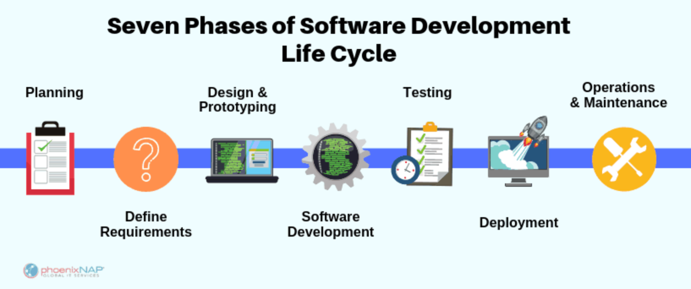
Introduction to Process Models

Slide 4
What is the Build and Fix Model?
A naive software development model.
Software is built without proper specifications or planning.
The product is continuously modified until it satisfies the client.

Slide 5
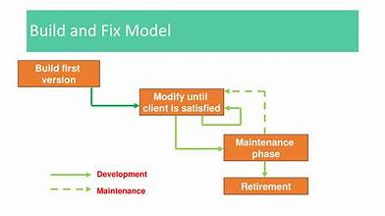
What is the Build and Fix Model?

Slide 6
Stages of Build and Fix Model
1. Build the software: Start coding immediately.
2. Fix the software: Test and correct problems as they arise.
Repeat until client is satisfied.

Slide 7
Diagram: Build and Fix Model
Build
Deliver
Feedback
Fix

Slide 8
Advantages
Very simple to implement.
Useful for small, short-term projects.
No overhead of formal processes or documentation.

Slide 9
Disadvantages
No planning or design.
Poor for large or complex systems.
Difficult to maintain and scale.
High chance of bugs and design flaws.
Lacks proper documentation.

Slide 10
When to Use
Suitable for:
- Small-scale projects.
- Prototypes or throwaway applications.
- One-person or informal development environments.

Slide 11
Comparison with Other Models
Model | Planning | Feedback Loops | Suitable For
Build & Fix | ❌ | ✅ | Small projects
Waterfall | ✅ | ❌ | Structured projects
Agile | ✅ | ✅ | Dynamic teams

Slide 12
Conclusion
Build and Fix is outdated but historically important.
Shows the evolution of structured software engineering.
Better models are now available for reliability and scalability.

Slide 13
Q&A / Thank You
Any questions?
Contact info (if needed)

