Slide 1
UNIT_2
Requirements and Tools- Software requirements

Slide 2
Requirements and Tools- Software requirements
https://www.process.st/requirements-management-tools/

Slide 3
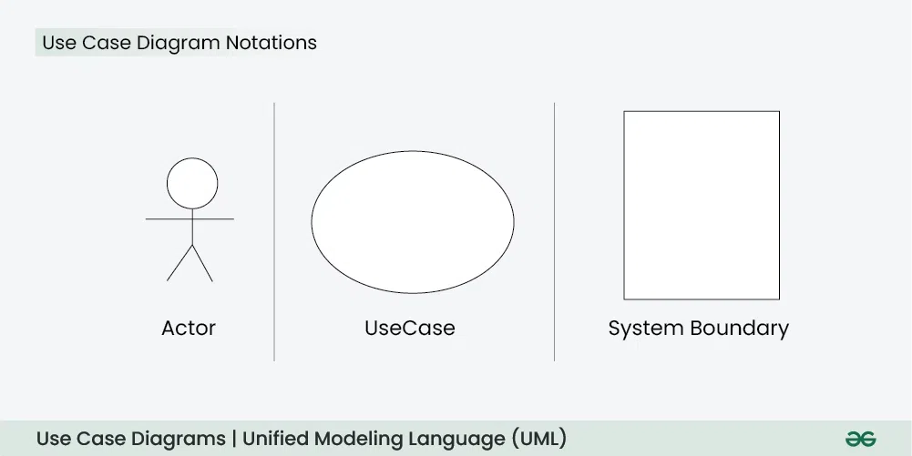
USE Case

Slide 4
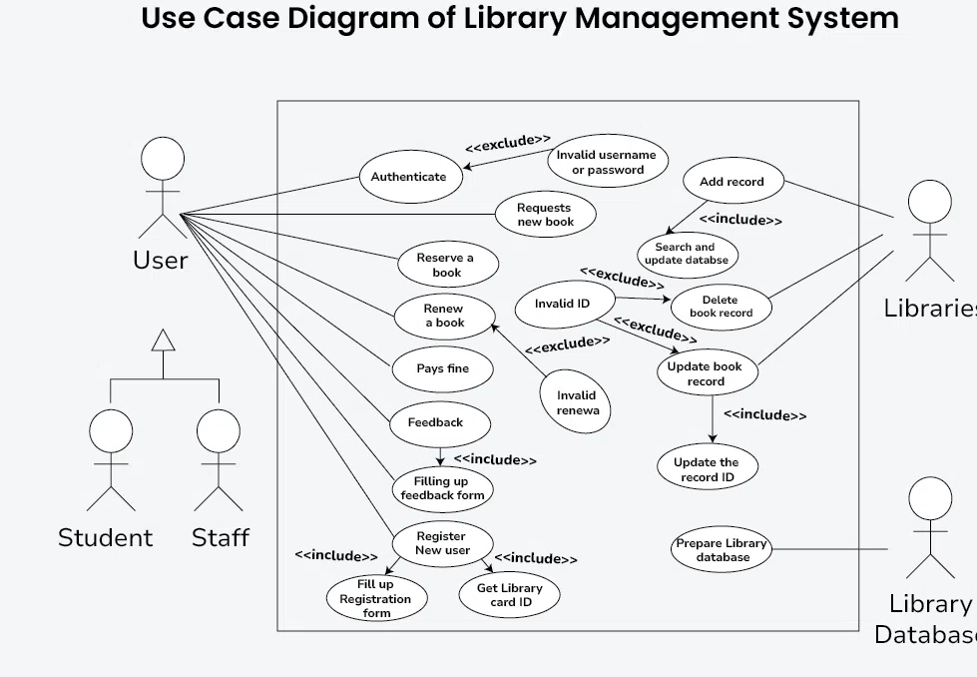

Slide 5
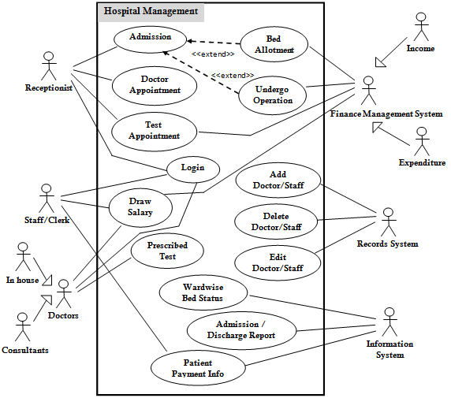

Slide 6
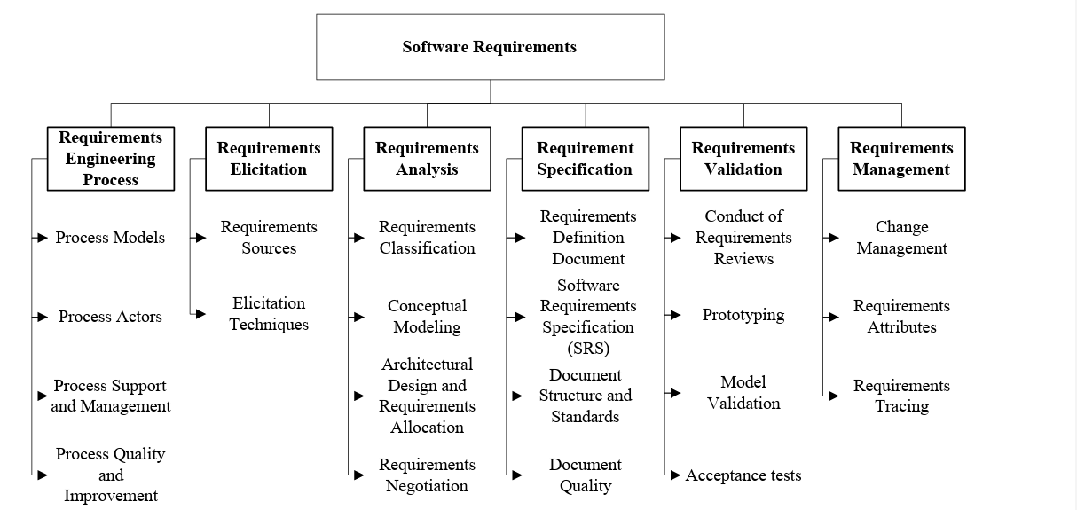

Slide 7
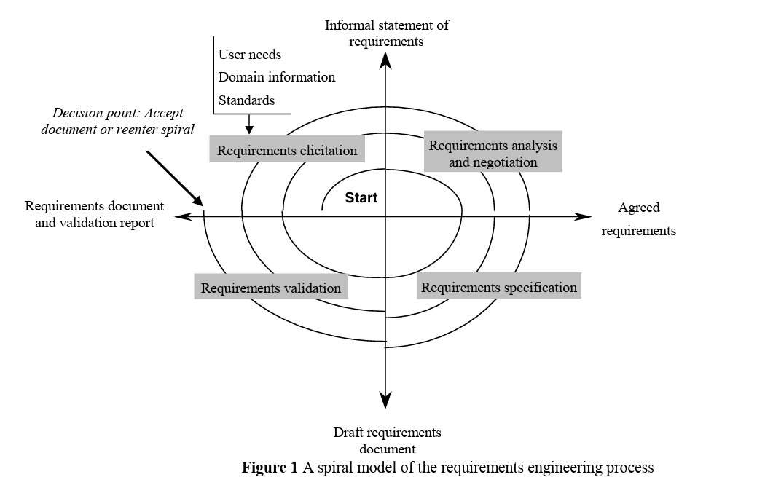

Slide 8
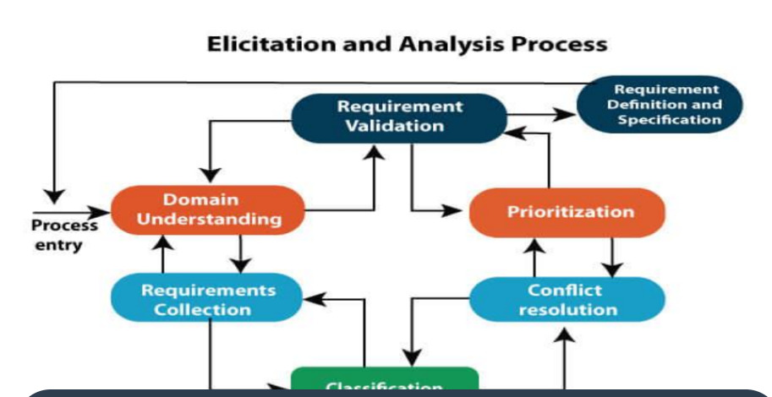
Classification

Slide 9
Feature | Functional Requirements | Non-Functional Requirements
Definition | What the system must do | How the system performs under conditions
Focus | Features & behavior | Performance, usability, security, scalability
Examples | Login, search, booking | Load time, reliability, security, availability

