Slide 1
Software Development Life Cycle (SDLC)
An Overview of SDLC Phases and Models

Slide 2
Introduction to SDLC
Software Development Life Cycle (SDLC) is a process used by software developers to design, develop, and test high-quality software.

Slide 3
Phases of SDLC
1. Planning
2. Requirement Analysis
3. System Design
4. Implementation (Coding)
5. Testing
6. Deployment
7. Maintenance

Slide 4
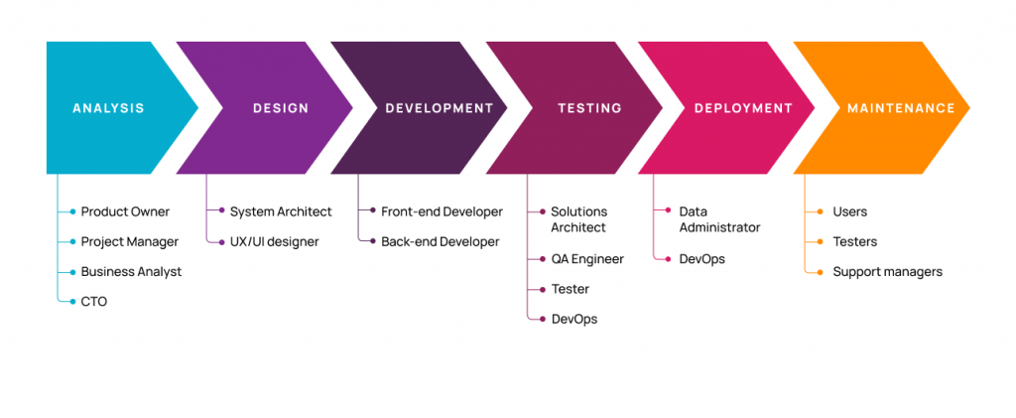
Phases of SDLC

Slide 5
SDLC Models
• Waterfall Model
• Agile Model
• Spiral Model
• V-Model
• Iterative Model

Slide 6
Best Practices in SDLC
• Clear requirement gathering
• Effective communication
• Continuous testing
• Proper documentation
• Regular updates and maintenance

Slide 7
Conclusion
SDLC provides a structured approach to software development, ensuring high-quality and cost-effective solutions.

