Slide 1
Unified Process Model
A Disciplined Approach to Software Development
UML is a standardized modeling language used to visualize, specify, construct, and document the artifacts of a software system. It helps in designing and understanding software architecture and interactions.
Standardized diagrams: Includes class diagrams, sequence diagrams, use case diagrams, etc.
Object-oriented: Based on OO principles like encapsulation, inheritance, and polymorphism.
Not a programming language: But can be used to model systems before coding begins.

Slide 2
Key Features
- Iterative and Incremental Development
- Use-Case Driven
- Architecture-Centric
- Risk-Focused

Slide 3
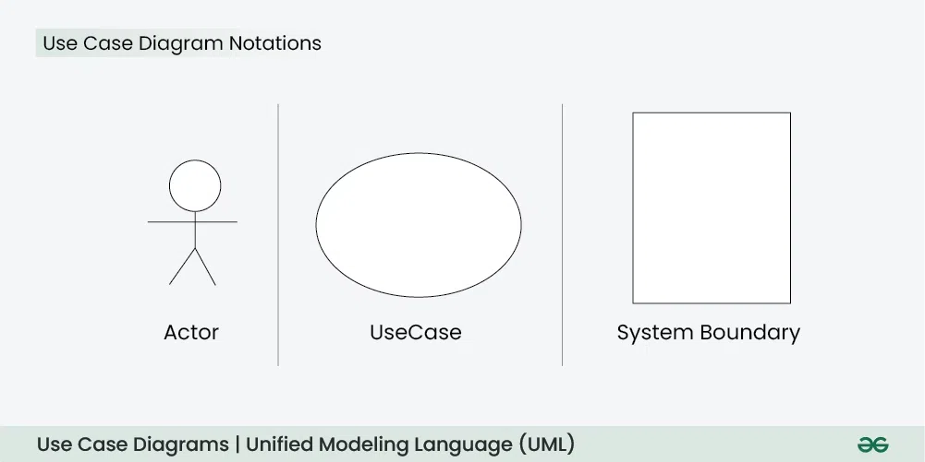
USE Case

Slide 4
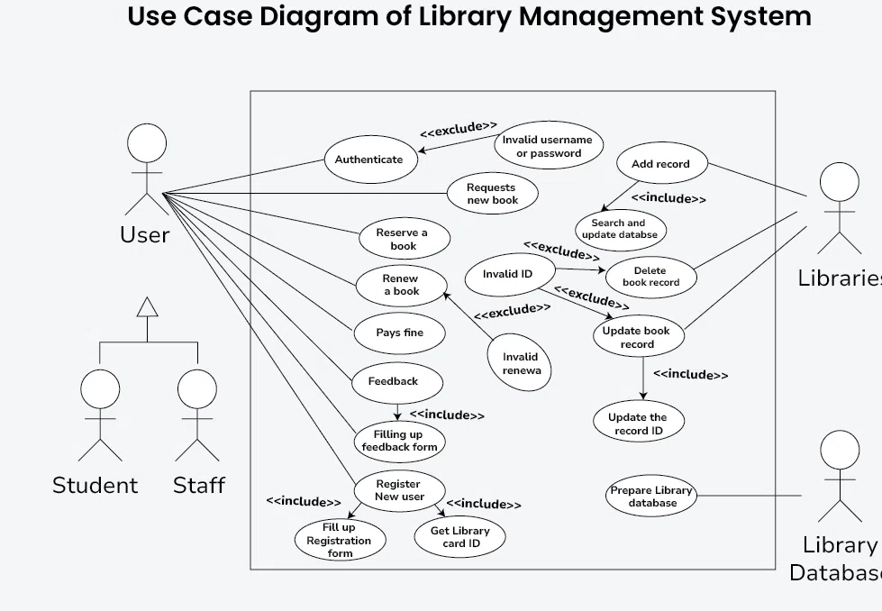

Slide 5
Phases of the Unified Process
- Inception: Define scope and business case.
- Elaboration: Refine architecture and requirements.
- Construction: Build and integrate system components.
- Transition: Deploy the system into production.

Slide 6
Inception Phase
- Establish business case and project scope.
- Define key system functionality.
- Identify stakeholders and risks.
- Output: Vision document, initial project plan.

Slide 7
Elaboration Phase
- Refine and validate architecture and requirements.
- Develop prototypes to address high-risk elements.
- Output: Software architecture document, refined use cases.

Slide 8
Construction Phase
- Build and integrate system components.
- Perform rigorous testing.
- Output: Initial operational version of the system.

Slide 9
Transition Phase
- Deploy the system into production.
- Conduct beta testing and user training.
- Output: Final product, user documentation.

Slide 10
Benefits of the Unified Process
- Accommodates changes in requirements.
- Ensures high-quality software through continuous testing.
- Manages risks early in the lifecycle.
- Encourages stakeholder involvement.

Slide 11
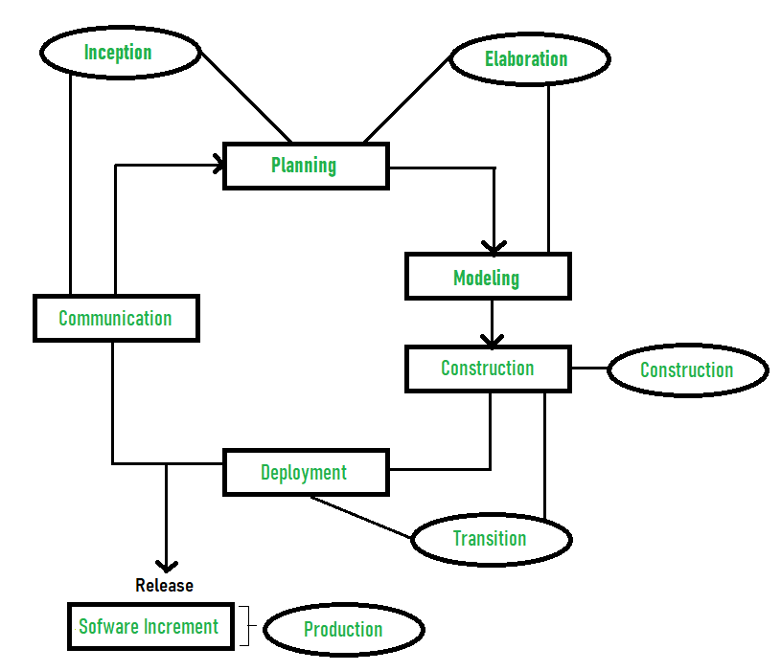

Slide 12
