Slide 1
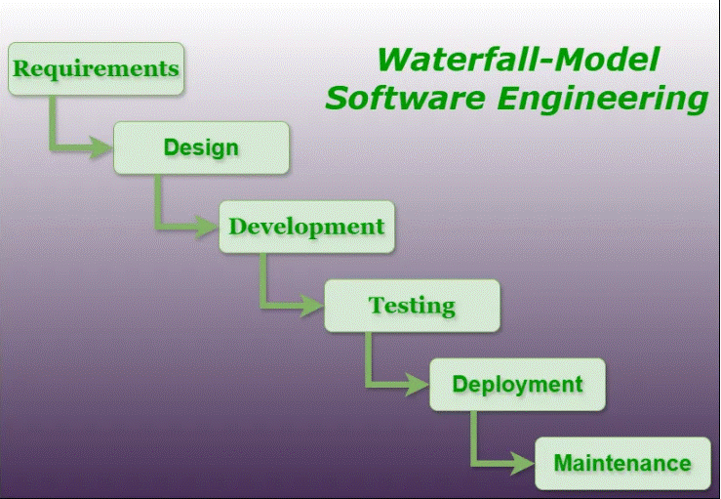
Waterfall Model
A Sequential Approach to Software Development

Slide 2
Key Features
- Linear and Sequential Process
- Documentation-Driven Development
- No Phase Overlap
- Strict Discipline in Execution

Slide 3
Phases of the Waterfall Model
- Requirements Analysis: Gather and document requirements.
- System Design: Plan the architecture and components.
- Implementation: Develop the code.
- Integration and Testing: Combine components and test thoroughly.
- Deployment: Deliver the final product to the client.
- Maintenance: Provide updates and bug fixes.

Slide 4
Advantages
- Simple and Easy to Understand
- Works Well for Small Projects
- Ensures Thorough Documentation
- Easy to Manage with Well-Defined Phases

Slide 5
Disadvantages
- Poor Flexibility for Changes
- Late Delivery of Working Software
- High Risk for Large Projects
- Issues Identified Late in the Lifecycle

Slide 6
When to Use the Waterfall Model
- Projects with Well-Defined Requirements
- Short-Term and Simple Projects
- When Thorough Documentation is Needed
- Low Risk of Requirement Changes

