Slide 1
Suricata Tutorial
FloCon 2016

Slide 2
Agenda
Setup
Introduction to Suricata
Suricata as a SSL monitor
Suricata as a passive DNS probe
Suricata as a flow probe
Suricata as a malware detector

Slide 3
VirtualBox setup
File -> Preferences
Apple: ‘VirtualBox -> Preferences’
Network -> Host Only Network (tab)
Add network vboxnet0

Slide 4
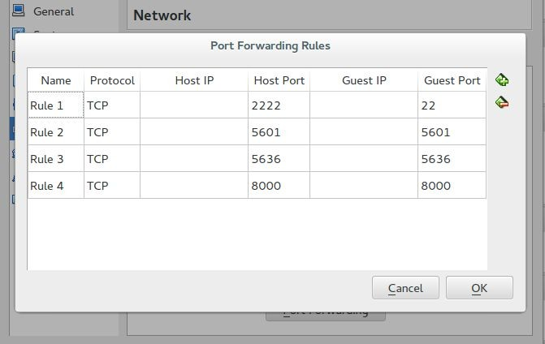
VirtualBox Port Forwards
2222 SSH
5601 Kibana4
5636 Evebox
8000 Scirius

Slide 5
Setup
We have USB keys with OVA files
Please copy to local disk first
Pass on USB key
File -> Import Appliance. Select the OVA file.
Username “suricata”. Password “suricata”
ssh suricata@localhost -p2222

Slide 6

Introduction to Suricata

Slide 7
Who still knows their network?
Increasing complexity
BYOD
IoT
VM's and containers
ICS/SCADA

Slide 8
Suricata is an engine for...
Network Intrusion Detection Network Intrusion Prevention Network Security Monitoring

Slide 9
IDS
Intrusion Detection System
Passive
Out of line
On tap or span port

Slide 10
IPS
Intrusion Prevention System
Active
Inline
Router or bridge

Slide 11
NSM
Network Security Monitoring
Not ‘just’ generating alerts, but also informational events like HTTP requests, TLS transfers, etc
Full Packet Capture (FPC) for being able to dig deep into traffic if necessary
Produces LOTS of data

Slide 12
Suricata Ecosystem
Distributions
SELKS & Amsterdam
SecurityOnion
pfSense & OPNsense
Management tools
Evebox
Scirius
Kibana
Event processing
Mobster
Barnyard2
Logstash

Slide 13
Suricata’s main features
Inspect traffic for known bad using extended Snort language
Lua based scripting for detection
Unified JSON output for easy post-processing
File extraction
Scalable through multi-threading

Slide 14
Technical Features
IPv4/IPv6, defrag, flow tracking
TCP tracking, reassembly
Port independent protocol detection
Stateful HTTP, SMTP, DNS, TLS parsing
File extraction for HTTP, SMTP
Rule language additions: SSH, TLS, file names, type & md5
IP Reputation, GeoIP, IP list support
Lua scripting for extending detection and outputs
(Net)flow like output logging

Slide 15
Suricata and performance
Scalability via multithreading
Almost linear scalability
Around 450-650 Mbps per core
1Gbps
Multicore required
Straight setup
10Gbps
Possible on commodity hardware
Serious tuning needed

Slide 16
Suricata 2.0
Current Stable
Eve, an all JSON alert and event stream
For use with Splunk,Logstash and native JSON log parsers
DNS parser, matcher and logger
“NSM runmode” -> only events, no rules and alerts

Slide 17
Suricata 3.0
In Release Candidate cycle. Due January 27th.
SMTP file extraction and logging
Performance & scalability!
Lua scripting++
Multitenancy
Redis output
Flow logging

Slide 18
Rulesets
2 main sources of IDS rules
Emerging Threats (Proofpoint)
VRT/Talos (Sourcefire/Cisco)
Both have free and paid sets
Emerging Threats is optimized for Suricata

Slide 19
Introduction to SELKS
Ready to use Linux distribution featuring
Suricata 3.0*
Elasticsearch: database
Logstash: data pipeline
Kibana: dashboard and visualization interface
Scirius: suricata ruleset management
Availability
As a Live and Installable ISO
GPLv3

Slide 20
Suricata commandline
General Suricata commands
-v, -h
--build-info
-i eth0
- r <pcap file>
-S <rule file>
-T -> test config & rules
To run command inside running container:
docker exec flocon_suricata_1 suricata -V

Slide 21
Suricata as a TLS monitor

Slide 22
TLS tracking in Suricata
Suricata tracks SSL/TLS sessions
No decryption capabilities
Looking at TLS still valuable
heartbleed
certificate validation

Slide 23
TLS Logging
subject
issuer
fingerprint
server name indication (SNI)
protocol version

Slide 24
SSL Logging Example
{"timestamp":"2016-01-06T11:20:31.431359+0100","flow_id":105716325071680,"
in_iface":"eth0","event_type":"tls","src_ip":"192.168.1.6","src_port":48952,"
dest_ip":"173.194.65.132","dest_port":443,"proto":"TCP","tls":{"subject":"C=US, ST=California, L=Mountain View, O=Google Inc, CN=*.googleusercontent.com", "issuerdn":"C=US, O=Google Inc, CN=Google Internet Authority G2", "fingerprint":" b2:e7:5a:d1:e4:3a:a9:a8:37:f5:13:b0:1a:88:70:a2:60:fe:8a:4a", "sni":"lh3.
googleusercontent.com","version":"TLS 1.2"}}

Slide 25
Replay pcap containing TLS
Download the pcap as suricata user
wget http://home.regit.org/~regit/flocon-tls.pcap
Replay the pcap
sudo tcpreplay -i eth0 flocon-tls.pcap
Wait 90s for completion

Slide 26
Usage in Kibana
Create the following visualization and add them to a dashboard
Pie with TLS version
Bar diagram with Top issuer DNs splitted by server IP
Demonstration
Top SNI timeline with point being unique servers

Slide 27
Using jq
JQ is a command line tool to operate filtering and transformation on JSON
Install it
sudo apt-get install jq
Basic usage is to enhance format
cd flocon/suricata
cat eve.json | jq ‘.’
cat eve.json | jq -c ‘.’
tail -f eve.json | jq -c ‘.’

Slide 28
Using jq
Select only TLS events
cat eve.json | jq 'select(.event_type=="tls")'
Use jq to show only sni and issuerdn
cat flocon/suricata/eve.json | jq '{ sni:.tls.sni, issuerdn:.tls.issuerdn}'
Find self signed certificates
cat eve.json | jq 'select(.event_type=="tls" and .tls.subject==.tls.issuerdn)'

Slide 29
Using TLS detection
keywords to match on issuerdn, subject, fingerprint
combine with protocol detection for TLS on non-std ports
HTTP & other protocols on port 443
Lua
Alert example:
alert tls any any -> $SERVERS any ( tls.issuerdn:!"C=NL, O=Staat der Nederlanden, CN=Staat der Nederlanden Root CA";)

Slide 30
Alerting on self-signed certificates
The rule:
alert tls any any -> any any (msg:"SURICATA TLS Self Signed Certificate"; flow:established; luajit:self- signed-cert.lua; tls.store; sid:999666111; rev:1;)
The script

Slide 31
Exercise: tls lua script (1/2)
Download the ruleset on laptop
http://home.regit.org/~regit/tls-self-signed.tgz
Connect to
http://localhost:8000
Click on “Sources”, then “add source”
Select Archive + Upload
Click “Suricata,” then “ruleset actions”
Select “build” and ”push”

Slide 32
Exercise: tls lua script (2/2)
Activate tls-store in yaml:
sudo vi flocon/config/suricata/suricata.yaml
Switch enabled to yes for tls-store
Restart suricata
docker restart flocon_suricata_1
Replay flocon-tls.pcap
Refresh suricata page of scirius to see alerts
Check that certificate are created
openssl x509 -in flocon/suricata/1452462998.778376-1.pem -text

Slide 33
Suricata as a passive DNS probe

Slide 34
Suricata DNS tracking
Suricata does stateful DNS tracking for UDP and TCP
Stateful in the sense that requests and responses are matched

Slide 35
Suricata DNS Logging
log DNS transactions in EVE
file
syslog
redis
unix socket
lua script(s)
log the data of various record types
A, AAAA
MX, PTR
TXT

Slide 36
Exercise: NXDOMAIN
Lets try to look into NXDOMAIN responses
tcpreplay -M1 -i eth0 pcaps/2015-02-15-traffic-analysis-exercise.pcap
Kibana:
In Discover tab, search “event_type:dns”, then save the search as “DNS events”
In Visualize tab, select Pie Chart. From Saved Search. Select “DNS events”
In Buckets (left) select split slices, Aggregation “terms”, select field “dns.rcode.raw”
Save as “DNS Error”
In Dashboard tab: “Add Visualization” and select “DNS Error”
In Dashboard tab: “Add Visualization”, “Searches” tab, then “DNS Events”

Slide 37
Exercise: DNS types pie graph
Create a pie diagram of the top 10 used DNS types
Hint: use dns.rrtype.raw

Slide 38
Exercise: show DNS names with TTL < 100
Create visualization in Kibana
Hint: search for “dns.ttl:[0 TO 99]”

Slide 39
Suricata as a flow probe

Slide 40
Suricata flow tracking
Suricata keeps ‘flow’ records
bidirectional
uses 5 or 7 tuple depending on VLAN support
used for storing various ‘states’
TCP tracking and reassembly
HTTP parsing
Flow records are updated per packet
Flow records time out

Slide 41
Suricata Flow Output
Two different outputs with similar data
‘flow’
Bidirectional
‘netflow’
Unidirectional
Data contained
IP tuple
Duration and volumetry
Application layer info

Slide 42
Suricata Flow Logging
Flow Hash management is done asynchronously
A flow is timed out after no packets have been seen for it for some time
When a flow is timed out, it can be logged
The logging API allows for logging to:
file
syslog
redis
unix socket
lua script(s)
or any combination of the above

Slide 43
Flow output records
bidirectional
IP protocol, source, destination, source port, destination port
packet count, bytes count
start time stamp (first packet), end time stamp (last packet)
L7 protocol as detected based on traffic content
TCP
flags seen
state at flow end

Slide 44
Flow Logging Example
{"timestamp":"2009-11-11T02:01:04.731888+0100","flow_id":105716325086112,"
event_type":"flow","src_ip":"192.168.2.9","src_port":2432,"dest_ip":"
174.133.12.162","dest_port":80,"proto":"TCP","app_proto":"http","flow":
{"pkts_toserver":26,"pkts_toclient":36,"bytes_toserver":1885,"bytes_toclient": 47934,"start":"2009-11-11T02:01:02.937818+0100","end":"2009-11-11T02:01:
04.731888+0100","age":2,"state":"closed","reason":"shutdown"},"tcp":{"tcp_flags":"
1b","tcp_flags_ts":"1b","tcp_flags_tc":"1b","syn":true,"fin":true,"psh":true,"ack":true," state":"closed"}}

Slide 45
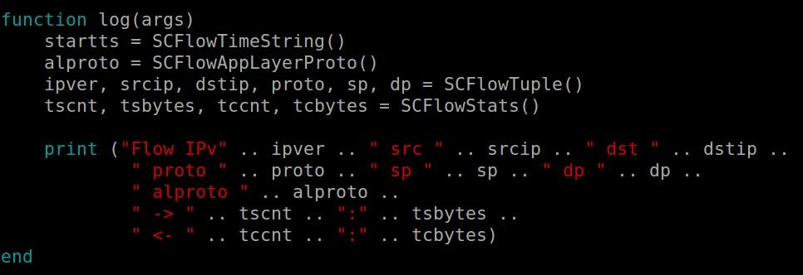
Using Lua scripts for output

Slide 46
Inject traffic in the VM
sudo tcpreplay -M1 -i eth0 pcaps/2015-*
starts a slow replay
tail -f ~/flocon/suricata/eve.json | jq -c ‘select(.event_type==”flow”)’

Slide 47
Kibana visualization
Timeline with flow count
Timeline with mean value of flow duration
Timeline with mean value of flow duration per protocol
Donut with source, proto, destination

Slide 48
Scripting flow events in Python
JSON module is official
Deserialization via a single function
Access to JSON like you access to a dictionary

Slide 49
Scripting JSON: example in Python
import json
with open('eve.json') as f: for line in f:
event = json.loads(line) print event[‘event_type’]

Slide 50
Python scripting
Display events in the classical format
src ip:src port -> dst ip:dst port

Slide 51
Scripting JSON: example in Python
import json
with open('eve.json') as f: for line in f:
event = json.loads(line)
if event['event_type'] == 'flow':
print("%s:%d --> %s:%d" % (event['src_ip'], event['src_port'], event['dest_ip'], event['dest_port']))

Slide 52
Python scripting
Display events in the format
src ip:src port -> dst ip:dst port [pkt_count]

Slide 53
Scripting JSON: example in Python
import json
with open('eve.json') as f: for line in f:
event = json.loads(line)
if event['event_type'] == 'flow':
print("%s:%d --> %s:%d [pkts %d]" % (event['src_ip'], event['src_port'], event['dest_ip'], event['dest_port'], event['flow'] ['pkts_toserver']))

Slide 54
Python scripting
Add application protocol or layer 3 protocol if not available to the display

Slide 55
Scripting JSON: example in Python
with open('/tmp/eve.json') as f:
for line in f:
event = json.loads(line)
if event['event_type'] == 'flow':
if event.has_key('app_proto'): app_proto = event['app_proto']
else:
app_proto = event['proto']
print("%s:%d - %s -> %s:%d [pkts %d]" % (event['src_ip'], event['src_port'], app_proto, event['dest_ip'], event ['dest_port'], event['flow']['pkts_toserver']))

Slide 56
Suricata as a malware detector

Slide 57
Suricata as a malware detector
Rule/signature based detection
More the ‘traditional’ IDS functionality
Emerging Threats ruleset has strong focus malware
landing pages
CnC
Lua detect scripts for infections
https://github.com/EmergingThreats/et-luajit-scripts
“Open” version loaded by default in “Amsterdam”

Slide 58
Start your replay engines
sudo tcpreplay -M1 -i eth0 pcaps/2015-*
starts a slow replay
tail -f ~/flocon/suricata/fast.log
tail -f ~/flocon/suricata/eve.json | jq -c ‘select(.event_type==”alert”)|.alert’

Slide 59
Bonus
cat ~/flocon/suricata/eve.json | jq -c 'select(.alert.signature=="ET POLICY Outdated Windows Flash Version IE")|.payload' -r|base64 -d|grep -i flash
It’s a bit dangerous, so be careful

Slide 60
Short Demo of Evebox
Evebox is a front-end to ElasticSearch with EVE data
To try it, add a port-forwarding rule to VirtualBox for TCP/5636
I’ll give a quick demo
Try yourself at http://localhost:5636

Slide 61
Exercise: show Alerts on map
In visualization, use Tile Map
Use “Geo Coordinates”

Slide 62
Unix socket runmode
A way to analyse fast a huge amount of pcap files
Coming from a honeypot
…
Limitation in pcap reading mode
Detection engine optimisation can take 30 s or more
We need to skip this part
In unix socket mode, suricata
Open a unix socket
wait for pcap file to analyse
output is done in specified directory

Slide 63
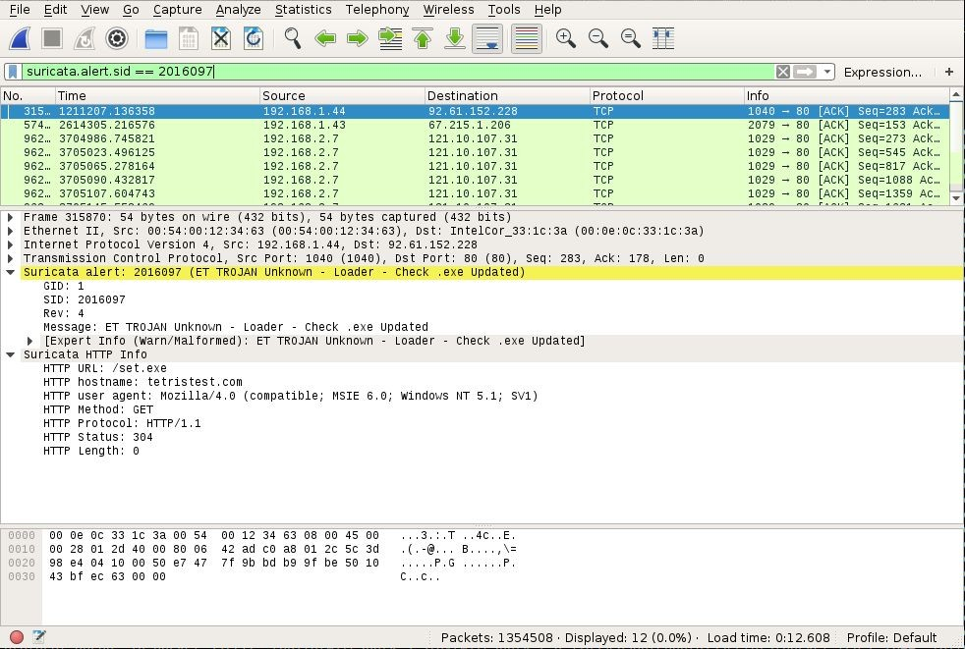
Showing Alerts in Wireshark
Add EVE info to wireshark
Done via suriwire plugin
https://github.com/regit/suriwire

Slide 64

PCAP credit: malware-traffic-analysis.net

